Slide 1
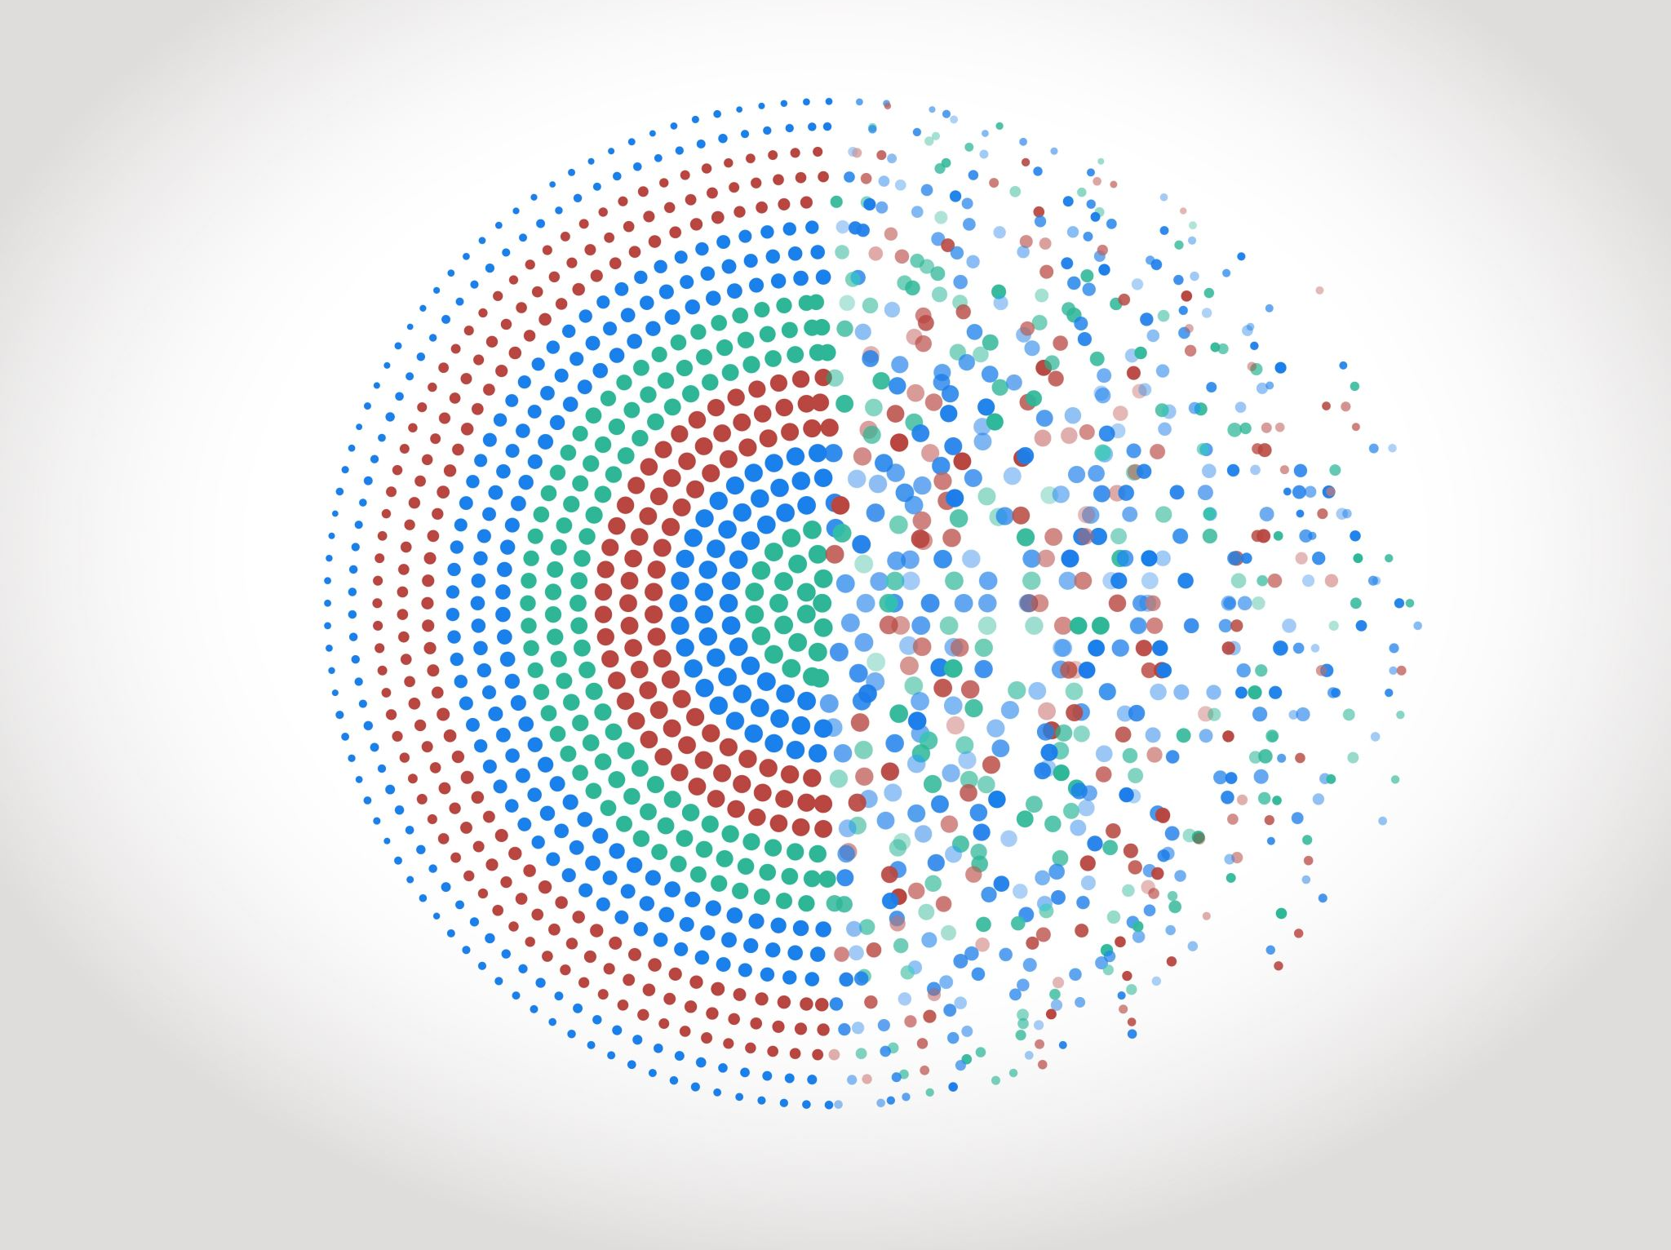
Data Preprocessing
Disleve Kanku

Slide 2
Introduction
Data preprocessing is a crucial step in machine learning.
It involves cleaning, transforming, and organizing data before feeding it to the model.
Proper preprocessing can significantly impact the model's performance.

Slide 3
Data Cleaning
Handling Missing Values
Identified and filled missing data with the median.
Data Types
Ensured the correct data types for features.

Slide 4
Data Transformation
Encoded Categorical Data
Converted categorical variables into numerical form using oneHotencoder.
Feature Scaling
Standardized data.

