Slide 1
Modern Block Ciphers- DES
(based on slides made by Dr. Lawrie Brown)
now look at modern block ciphers
one of the most widely used types of cryptographic algorithms
Provide confidentiality services
We discuss in detail DES (Data Encryption Standard) and AES (Advanced Encryption Standard)
We discuss block cipher design principles
Notes:
Modern block ciphers are widely used to provide encryption of quantities of information, and/or a cryptographic checksum to ensure the contents have not been altered. We continue to use block ciphers because they are comparatively fast, and because we know a fair amount about how to design them. Will use the widely known DES algorithm to illustrate some key block cipher design principles.

Slide 2
Block vs Stream Ciphers
block ciphers process messages in blocks, each of which is then en/decrypted
like a substitution on very big alphabet
  64-bits or more
stream ciphers process messages a bit or byte at a time when en/decrypting
many current ciphers are block ciphers
broader range of applications
Notes:
Block ciphers work a on block / word at a time, which is some number of bits. All of these bits have to be available before the block can be processed. Stream ciphers work on a bit or byte of the message at a time, hence process it as a “stream”. Block ciphers are currently better analysed, and seem to have a broader range of applications, hence focus on them.

Slide 3
Data Encryption Standard (DES)
most widely used block cipher in world
adopted in 1977 by NBS (now NIST)
  as FIPS PUB 46
encrypts 64-bit data using 56-bit key
has widespread use
has been considerable controversy over its security
Notes:
The most widely used private key block cipher, is the Data Encryption Standard (DES). It was adopted in 1977 by the National Bureau of Standards as Federal Information Processing Standard 46 (FIPS PUB 46). DES encrypts data in 64-bit blocks using a 56-bit key. The DES enjoys widespread use. It has also been the subject of much controversy its security.

Slide 4
DES History
in 1973 NIST (then NBS) issued request for proposals for a national cipher standard
IBM already developed Lucifer cipher
  by team led by Feistel in late 60’s
  used 64-bit data blocks with 128-bit key
1974, IBM submits Lucifer
Lucifer is analyzed and redesigned by NSA and others, and becomes DES
1977, the new cryptosystem becomes the federal standard in USA (till Nov. 2001).
Some variants of DES (we’ll discuss them later) still very much in use.
Notes:
In the late 1960s, IBM set up a research project in computer cryptography led by Horst Feistel. The project concluded in 1971 with the development of the LUCIFER algorithm. LUCIFER is a Feistel block cipher that operates on blocks of 64 bits, using a key size of 128 bits.
Because of the promising results produced by the LUCIFER project, IBM embarked on an effort, headed by Walter Tuchman and Carl Meyer, to develop a marketable commercial encryption product that ideally could be implemented on a single chip. It involved not only IBM researchers but also outside consultants and technical advice from NSA. The outcome of this effort was a refined version of LUCIFER that was more resistant to cryptanalysis but that had a reduced key size of 56 bits, to fit on a single chip.
In 1973, the National Bureau of Standards (NBS) issued a request for proposals for a national cipher standard. IBM submitted the modified LUCIFER. It was by far the best algorithm proposed and was adopted in 1977 as the Data Encryption Standard.

Slide 5
DES Design Controversy
although DES standard is public
was considerable controversy over design
  in choice of 56-bit key (vs Lucifer 128-bit)
  and because design criteria were classified
subsequent events and public analysis show in fact design was appropriate
use of DES has flourished
  especially in financial applications
  still standardised for legacy application use
Notes:
Before its adoption as a standard, the proposed DES was subjected to intense & continuing criticism over the size of its key & the classified design criteria.
Recent analysis has shown despite this controversy, that DES is well designed. DES is theoretically broken using Differential or Linear Cryptanalysis but in practise is unlikely to be a problem yet. Also rapid advances in computing speed though have rendered the 56 bit key susceptible to exhaustive key search, as predicted by Diffie & Hellman.
DES has flourished and is widely used, especially in financial applications. It is still standardized for legacy systems, with either AES or triple DES for new applications.

Slide 6
DES Basic Principles
DES is based on the Feistel Structure
Feistel structure: decrypt ciphertext is very similar to encrypt plaintext
Uses the idea of a product cipher – that is a sequence of transformations
The smaller transformations are substitutions and permutations
Notes:
Most symmetric block encryption algorithms in current use are based on a structure referred to as a Feistel block cipher. A block cipher operates on a plaintext block of n bits to produce a ciphertext block of n bits. An arbitrary reversible substitution cipher for a large block size is not practical, however, from an implementation and performance point of view. In general, for an n-bit general substitution block cipher, the size of the key is n x 2^{n}. For a 64-bit block, which is a desirable length to thwart statistical attacks, the key size is 64 x 2⁶⁴ = 2⁷⁰ = 10²¹ bits. In considering these difficulties, Feistel points out that what is needed is an approximation to the ideal block cipher system for large n, built up out of components that are easily realizable.

Slide 7
Claude Shannon and Substitution-Permutation Ciphers
Claude Shannon introduced idea of substitution-permutation (S-P) networks in 1949 paper
form basis of modern block ciphers
S-P nets are based on the two primitive cryptographic operations seen before:
  substitution (S-box)
  permutation (P-box)
provide confusion & diffusion of message & key
Notes:
Claude Shannon’s 1949 paper has the key ideas that led to the development of modern block ciphers. Critically, it was the technique of layering groups of S-boxes separated by a larger P-box to form the S-P network, a complex form of a product cipher. He also introduced the ideas of confusion and diffusion, notionally provided by S-boxes and P-boxes (in conjunction with S-boxes).

Slide 8
Confusion and Diffusion
cipher needs to completely obscure statistical properties of original message
a one-time pad does this
more practically Shannon suggested combining Substitutions & Permutations to obtain:
diffusion – dissipates statistical structure of plaintext over bulk of ciphertext (in particular – one change in the plaintext triggers many changes in the ciphertext)
confusion – makes relationship between ciphertext and key as complex as possible (in particular, each character of the ciphertext depends on many parts of the key)
Notes:
The terms diffusion and confusion were introduced by Claude Shannon to capture the two basic building blocks for any cryptographic system. Every block cipher involves a transformation of a block of plaintext into a block of ciphertext, where the transformation depends on the key. The mechanism of diffusion seeks to make the statistical relationship between the plaintext and ciphertext as complex as possible in order to thwart attempts to deduce the key. Confusion seeks to make the relationship between the statistics of the ciphertext and the value of the encryption key as complex as possible, again to thwart attempts to discover the key.
So successful are diffusion and confusion in capturing the essence of the desired attributes of a block cipher that they have become the cornerstone of modern block cipher design.

Slide 9
Feistel Cipher Structure
Horst Feistel devised the Feistel structure
  based on concept of invertible product cipher
partitions input block into two halves
  process through multiple rounds which
  perform a substitution on left data half
  based on round function of right half & subkey
  then have permutation swapping halves
implements Shannon’s S-P net concept
Notes:
Horst Feistel, working at IBM Thomas J Watson Research Labs devised a suitable invertible cipher structure in early 70's.
One of Feistel's main contributions was the invention of a suitable structure which adapted Shannon's S-P network in an easily inverted structure. It partitions input block into two halves which are processed through multiple rounds which perform a substitution on left data half, based on round function of right half & subkey, and then have permutation swapping halves. Essentially the same h/w or s/w is used for both encryption and decryption, with just a slight change in how the keys are used. One layer of S-boxes and the following P-box are used to form the round function.

Slide 10
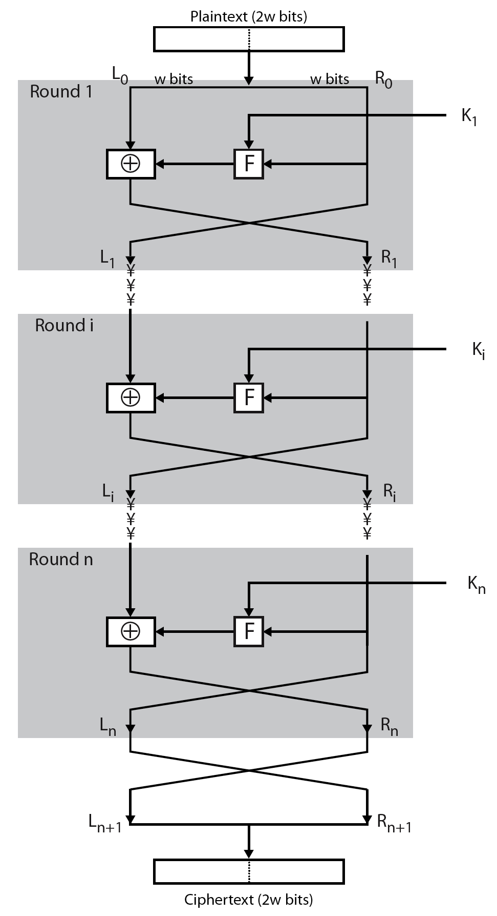
Feistel Cipher Structure
Notes:
Stallings Figure 3.2 illustrates the classical feistel cipher structure, with data split in 2 halves, processed through a number of rounds which perform a substitution on left half using output of round function on right half & key, and a permutation which swaps halves, as listed previously.

Slide 11
Show on board one round of Feistel encryption/decryption

Slide 12
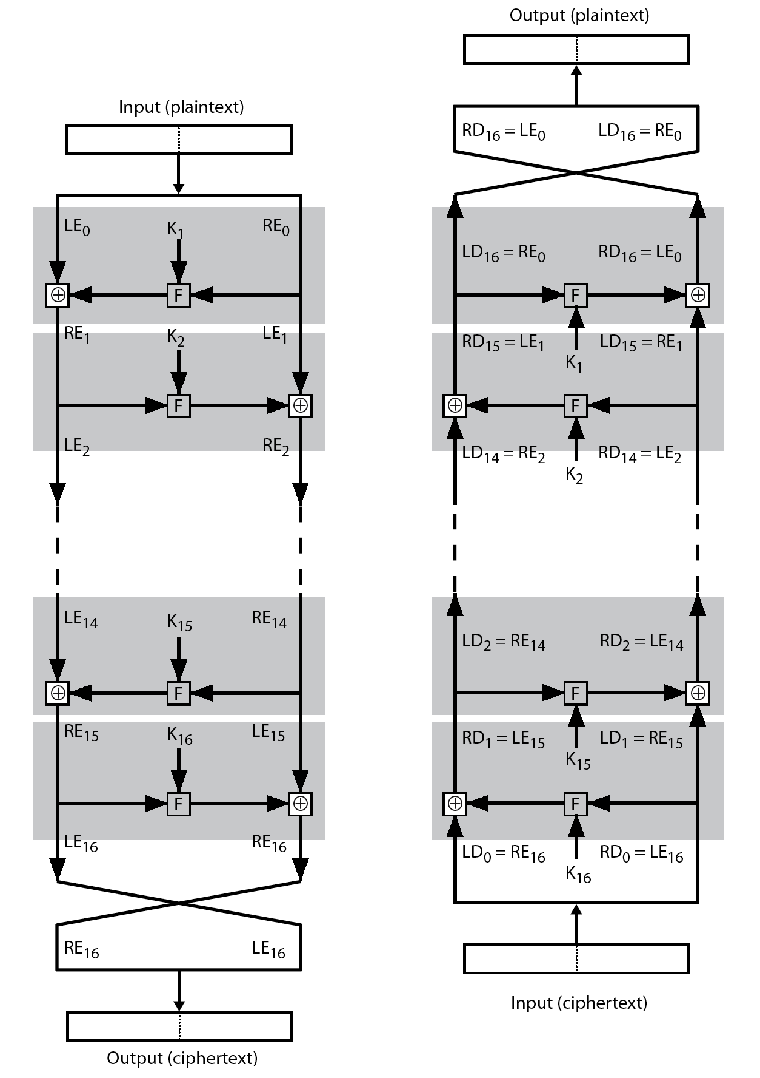
Feistel Cipher Decryption
Notes:
The process of decryption with a Feistel cipher, as shown in Stallings Figure 3.3, is essentially the same as the encryption process. The rule is as follows: Use the ciphertext as input to the algorithm, but use the subkeys Ki in reverse order. That is, use Kn in the first round, Kn–1 in the second round, and so on until K1 is used in the last round. This is a nice feature because it means we need not implement two different algorithms, one for encryption and one for decryption.

Slide 13
Baby DES – show on board
Differential cryptanalysis example – show on board

Slide 14
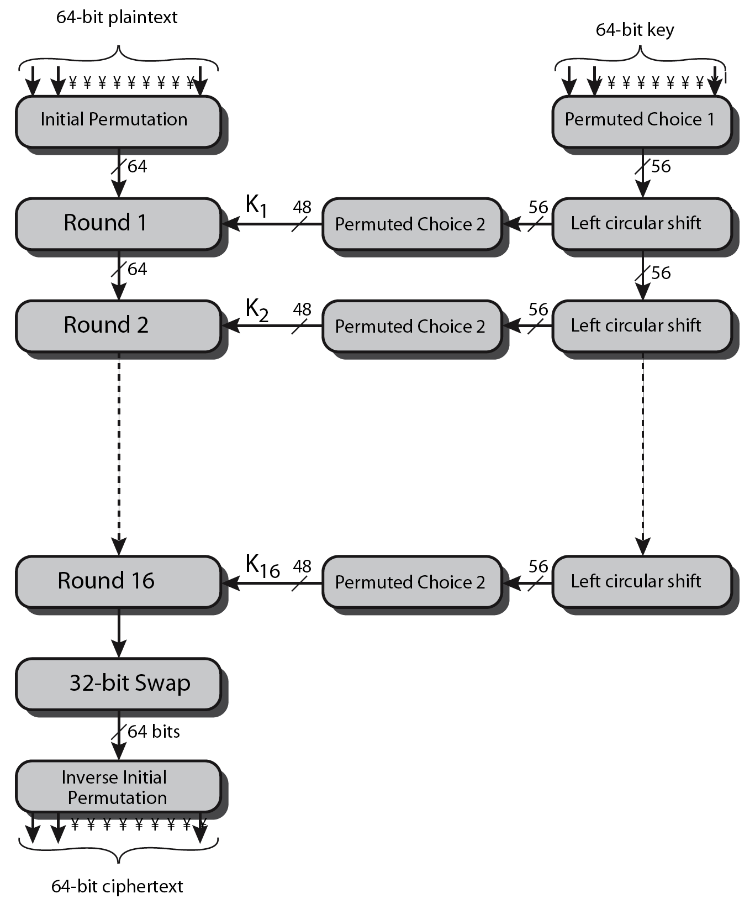
DES Encryption Overview
Notes:
The overall scheme for DES encryption is illustrated in Stallings Figure3.4, which takes as input 64-bits of data and of key.
The left side shows the basic process for enciphering a 64-bit data block which consists of:
- an initial permutation (IP) which shuffles the 64-bit input block
- 16 rounds of a complex key dependent round function involving substitutions & permutations
- a final permutation, being the inverse of IP
The right side shows the handling of the 56-bit key and consists of:
- an initial permutation of the key (PC1) which selects 56-bits out of the 64-bits input, in two 28-bit halves
- 16 stages to generate the 48-bit subkeys using a left circular shift and a permutation of the two 28-bit halves

Slide 15
Initial Permutation IP
first step of the data computation
No crypto value
IP reorders the input data bits
even bits to LH half, odd bits to RH half
quite regular in structure (easy in h/w)
Notes:
The initial permutation and its inverse are defined by tables, as shown in Stallings Tables 3.2a and 3.2b, respectively. The tables are to be interpreted as follows. The input to a table consists of 64 bits numbered left to right from 1 to 64. The 64 entries in the permutation table contain a permutation of the numbers from 1 to 64. Each entry in the permutation table indicates the position of a numbered input bit in the output, which also consists of 64 bits.
Note that the bit numbering for DES reflects IBM mainframe practice, and is the opposite of what we now mostly use - so be careful! Numbers from Bit 1 (leftmost, most significant) to bit 32/48/64 etc (rightmost, least significant).
Note that examples are specified using hexadecimal.
Here a 64-bit plaintext value of “675a6967 5e5a6b5a” (written in left & right halves) after permuting with IP becomes “ffb2194d 004df6fb”.

Slide 16
DES Round Structure
uses two 32-bit L & R halves
as for any Feistel cipher, one round can be described as:
  L_{i} = R_{i–1}
  R_{i} = L_{i–1} ⊕ F(R_{i–1}, K_{i})
F takes 32-bit R half and 48-bit subkey K:
  expand R: 32 → 48-bits using expansion E
  adds to subkey: E(R) XOR K – we get 48 bits which we split into 8 blocks B_1 B_2 B_3 B_4 B_5 B_6 B_7 B_8 of 6 bits each
  We substitute the blocks using the 8 S-boxes S_1, S_2, S_3, S_4, S_5, S_6, S_7 and S_8
  each S-box has 4 rows and 6 columns
  each S- box defines a substitution from 6 bits to 4 bits
  input b_1 b_2 b_3 b_4 b_5 b_6; b_1 b_6 gives the row in the S-box; b_2 b_3 b_4 b_5 gives the column
  example: input B_3 = 001001 → we use S_3;
  row 01 (2nd row in S_3), col 0100 (5th col. In S_3) → in S_3 we find 3, which is 0011 (in binary)
  We get C_1 C_2 C-3 C_4 C_5 C_6 C_7 C_8 – in total 8 * 4 = 32 bits
  finally permutes using 32-bit perm P
Notes:
Detail here the internal structure of the DES round function F, which takes R half & subkey, and processes them through E, add subkey, S & P.
This follows the classic structure for a feistel cipher.
Note that the s-boxes provide the “confusion” of data and key values, whilst the permutation P then spreads this as widely as possible, so each S-box output affects as many S-box inputs in the next round as possible, giving “diffusion”.

Slide 17

DES Round Structure- the f function
Notes:
Stallings Figure 3.6 illustrates the internal structure of the DES round function F. The R input is first expanded to 48 bits by using expansion table E that defines a permutation plus an expansion that involves duplication of 16 of the R bits (Stallings Table 3.2c). The resulting 48 bits are XORed with Ki. This 48-bit result passes through a substitution function comprising 8 S-boxes which each map 6 input bits to 4 output bits, producing a 32-bit output, which is then permuted by permutation P as defined by Stallings Table 3.2d.

Slide 18
Substitution Boxes S
have eight S-boxes which map 6 to 4 bits
each S-box is a 4-by-16 table
  outer bits 1 & 6 (row bits) select one row from 4
  inner bits 2-5 (col bits) select one col from 16
  result is 8 lots of 4 bits, or 32 bits
row selection depends on both data & key
Show the S-boxes from DES-tables
Notes:
The substitution consists of a set of eight S-boxes, each of which accepts 6 bits as input and produces 4 bits as output. These transformations are defined in Stallings Table 3.3, which is interpreted as follows: The first and last bits of the input to box Si form a 2-bit binary number to select one of four substitutions defined by the four rows in the table for Si. The middle four bits select one of the sixteen columns. The decimal value in the cell selected by the row and column is then converted to its 4-bit representation to produce the output. For example, in S1, for input 011001, the row is 01 (row 1) and the column is 1100 (column 12). The value in row 1, column 12 is 9, so the output is 1001.
The example lists 8 6-bit values (ie 18 in hex is 011000 in binary, 09 hex is 001001 binary, 12 hex is 010010 binary, 3d hex is 111101 binary etc), each of which is replaced following the process detailed above using the appropriate S-box. ie
S1(011000) lookup row 00 col 1100 in S1 to get 5
S2(001001) lookup row 01 col 0100 in S2 to get 15 = f in hex
S3(010010) lookup row 00 col 1001 in S3 to get 13 = d in hex
S4(111101) lookup row 11 col 1110 in S4 to get 2 etc

Slide 19
DES Key Schedule
calculation of the subkey K_i used in round i
  Permute the original key using permutation PC1 which selects 56-bits. This will be K_0.
  K_i (i = 1, 2, …, 16) is obtained by running i stages consisting of:
    Split K_(i-1) into the halves C_(i-1) and D_(i-1), each with 28 bits
    Left shifting each half separately either 1 or 2 places depending on the key rotation schedule K
    selecting 48-bits & permuting them by PC2
Notes:
The DES Key Schedule generates the subkeys needed for each data encryption round. The 64-bit key input is first processed by Permuted Choice One (Stallings Table 3.4b). The resulting 56-bit key is then treated as two 28-bit quantities C & D. In each round, these are separately processed throgh a circular left shift (rotation) of 1 or 2bits as shown in Stallings Table 3.4d. These shifted values serve as input to the next round of the key schedule. They also serve as input to Permuted Choice Two (Stallings Table 3.4c), which produces a 48-bit output that serves as input to the round function F.
The 56 bit key size comes from security considerations as we know now. It was big enough so that an exhaustive key search was about as hard as the best direct attack (a form of differential cryptanalysis called a T-attack, known by the IBM & NSA researchers), but no bigger. The extra 8 bits were then used as parity (error detecting) bits, which makes sense given the original design use for hardware communications links. However we hit an incompatibility with simple s/w implementations since the top bit in each byte is 0 (since ASCII only uses 7 bits), but the DES key schedule throws away the bottom bit! A good implementation needs to be cleverer!

Slide 20
DES Decryption
decrypt must unwind steps of data computation
with Feistel design, do encryption steps again using subkeys in reverse order (K16 … K1)
  IP undoes final FP step of encryption
  1st round with K16 undoes 16th encrypt round
  ….
  16th round with K1 undoes 1st encrypt round
  then final IP^(-1) undoes initial permutation IP
  thus recovering original data value
Notes:
As with any Feistel cipher, DES decryption uses the same algorithm as encryption except that the subkeys are used in reverse order SK16 .. SK1.
If you trace through the DES overview diagram can see how each decryption step top to bottom with reversed subkeys, undoes the equivalent encryption step moving from bottom to top.

Slide 21
Avalanche Effect
key desirable property of encryption alg
where a change of one input or key bit results in changing approx half output bits
making attempts to “home-in” by guessing keys impossible
DES exhibits strong avalanche
Notes:
A desirable property of any encryption algorithm is that a small change in either the plaintext or the key should produce a significant change in the ciphertext. In particular, a change in one bit of the plaintext or one bit of the key should produce a change in many bits of the ciphertext. If the change were small, this might provide a way to reduce the size of the plaintext or key space to be searched. DES exhibits a strong avalanche effect, as may be seen in Stallings Table 3.5.

Slide 22
Strength of DES – Analytic Attacks
now have several analytic attacks on DES
these utilise some deep structure of the cipher
  by gathering information about encryptions
  can eventually recover some/all of the sub-key bits
  if necessary then exhaustively search for the rest
generally these are statistical attacks
include
  differential cryptanalysis
  linear cryptanalysis
Notes:
Another concern is the possibility that cryptanalysis is possible by exploiting the characteristics of the DES algorithm. The focus of concern has been on the eight substitution tables, or S-boxes, that are used in each iteration. These techniques utilise some deep structure of the cipher by gathering information about encryptions so that eventually you can recover some/all of the sub-key bits, and then exhaustively search for the rest if necessary. Generally these are statistical attacks which depend on the amount of information gathered for their likelihood of success. Attacks of this form include differential cryptanalysis. linear cryptanalysis, and related key attacks.

Slide 23
DES resistance to diff. attack
Original DES → requires 2^47 encryptions (that’s a lot) = 1mln GB
What if creators of DES did not know about differential cryptanalysis:
Modifications:
  Identity permutation instead of P → 2^19 encryptions = 4MB
  Order of S-boxes →2^38 = 2000 GB
  XOR replaced by addition → 2^31 = 2GB
  S-boxes one position changed → 2^33 = 8GB
  Expansion function E eliminated → 2^26 = 64 MB

Slide 24
Linear Cryptanalysis
another recent development
also a statistical method
must be iterated over rounds, with decreasing probabilities
developed by Matsui et al in early 90's
based on finding linear approximations
can attack DES with 2⁴³ known plaintexts, easier but still in practice infeasible
Notes:
A more recent development is linear cryptanalysis. This attack is based on finding linear approximations to describe the transformations performed in DES. This method can find a DES key given 2^43 known plaintexts, as compared to 2^47 chosen plaintexts for differential cryptanalysis. Although this is a minor improvement, because it may be easier to acquire known plaintext rather than chosen plaintext, it still leaves linear cryptanalysis infeasible as an attack on DES. Again, this attack uses structure not seen before. So far, little work has been done by other groups to validate the linear cryptanalytic approach.

Slide 25
DES Design Criteria
as reported by Coppersmith in [COPP94]
7 criteria for S-boxes provide for
  non-linearity
  T is linear if T(x ⊕ y) = T(x) ⊕ T(y)
  E and P are linear; the only non-linear transformation is the S-box substitution
  resistance to differential cryptanalysis
  good confusion
  Example: if two inputs to an S-box differ in exactly one bit, the outputs must differ in at least two bits.
3 criteria for permutation P provide for
  increased diffusion
Notes:
Although much progress has been made in designing block ciphers that are cryptographically strong, the basic principles have not changed all that much since the work of Feistel and the DES design team in the early 1970s. Some of the criteria used in the design of DES were reported in [COPP94], and focused on the design of the S-boxes and on the P function that distributes the output of the S boxes, as summarized above. See text for further details.

Slide 26
Brute – Force Attack
Key Size (bits) | Number of Alternative Keys | Time required at 1 decryption/µs | Time required at 10⁶ decryptions/µs
32 | 2³² = 4.3 × 10⁹ | 2³¹ µs = 35.8 minutes | 2.15 milliseconds
56 | 2⁵⁶ = 7.2 × 10¹⁶ | 2⁵⁵ µs = 1142 years | 10.01 hours
128 | 2¹²⁸ = 3.4 × 10³⁸ | 2¹²⁷ µs = 5.4 × 10²⁴ years | 5.4 × 10¹⁸ years
168 | 2¹⁶⁸ = 3.7 × 10⁵⁰ | 2¹⁶⁷ µs = 5.9 × 10³⁶ years | 5.9 × 10³⁰ years
26 characters (permutation) | 26! = 4 × 10²⁶ | 2 × 10²⁶ µs = 6.4 × 10¹² years | 6.4 × 10⁶ years

Slide 27
Main weakness of DES – Key Size
56-bit keys: there are 2⁵⁶ = 7.2 x 10¹⁶ possible values
brute force search is hard, but (more and more) feasible
Software (200MHZ Pentium) 2⁴⁴ encryptions per year
1PC: 2000 years, 200 PC’s: 10 years, 6000 PC’s: 3 months
Hardware (FPGA), Cost = $10 000
less than 2 years
Hardware (ASIC), Cost = $250 000
1 key in about 50 hours
for 1 million $: I key in ½ hour
Notes:
Since its adoption as a federal standard, there have been lingering concerns about the level of security provided by DES in two areas: key size and the nature of the algorithm.
With a key length of 56 bits, there are 2^56 possible keys, which is approximately 7.2*10^16 keys. Thus a brute-force attack appeared impractical.
However DES was finally and definitively proved insecure in July 1998, when the Electronic Frontier Foundation (EFF) announced that it had broken a DES encryption using a special-purpose "DES cracker" machine that was built for less than $250,000. The attack took less than three days. The EFF has published a detailed description of the machine, enabling others to build their own cracker [EFF98].
There have been other demonstrated breaks of the DES using both large networks of computers & dedicated h/w, including:
- 1997 on a large network of computers in a few months
- 1998 on dedicated h/w (EFF) in a few days
- 1999 above combined in 22hrs!
It is important to note that there is more to a key-search attack than simply running through all possible keys. Unless known plaintext is provided, the analyst must be able to recognize plaintext as plaintext.
Clearly must now consider alternatives to DES, the most important of which are AES and triple DES.

Slide 28
Concrete brute-force attacks
recent advances have shown that the brute-force attack against DES is possible
in 1997 – Verser – internet program with volunteers –took 97 days
in 1998 - Deep Crack computer developed by Electronic Frontier Foundation – cost $220 000 – avg. time search is 4.5 days
still must be able to recognize plaintext
must now consider alternatives to DES

Slide 29
Recommendations for key length
Intruder | Budget | Secure key length
hacker | tiny | 45
Small company | $400 | 50
Small company | $10000 | 55
 | $300K | 60
Big company | $10M | 70
Intelligence agency | $300M | 75

