Slide 1
UCUG1903_Project
1111

Slide 2
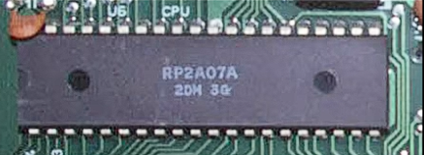
H
Ricoh 2A03

Slide 3
80年代，游戏，声卡，声音demo（图片/音频）
Ricoh 2A03

Slide 4
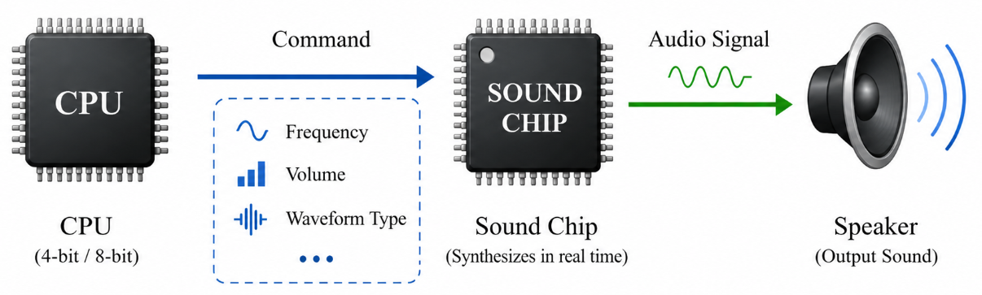
Hardware Constraints of the 1980s
Limited Storage
Storage media had capacities measured in Kilobytes (KB).
Low Processing Power
CPUs were 4-bit or 8-bit.
No hardware multiplier, no complex floating-point math.
Command-Driven

Slide 5
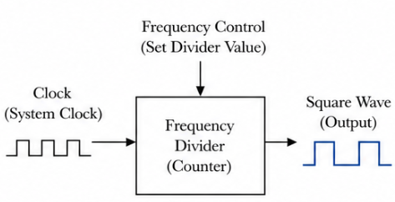
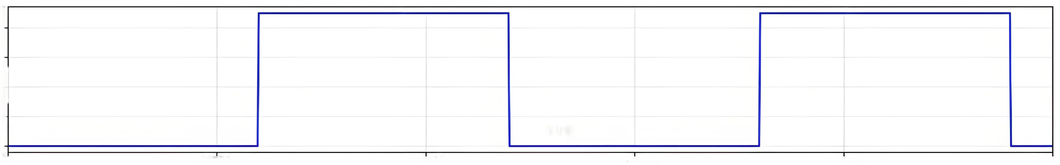
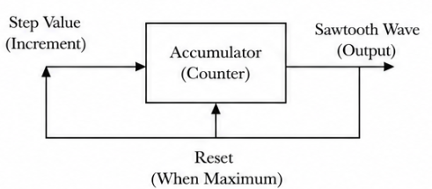
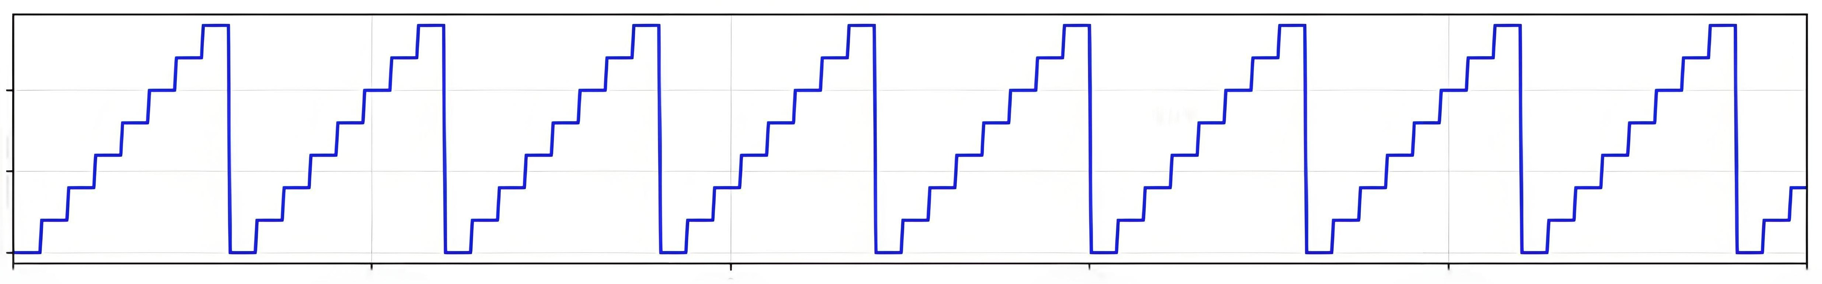
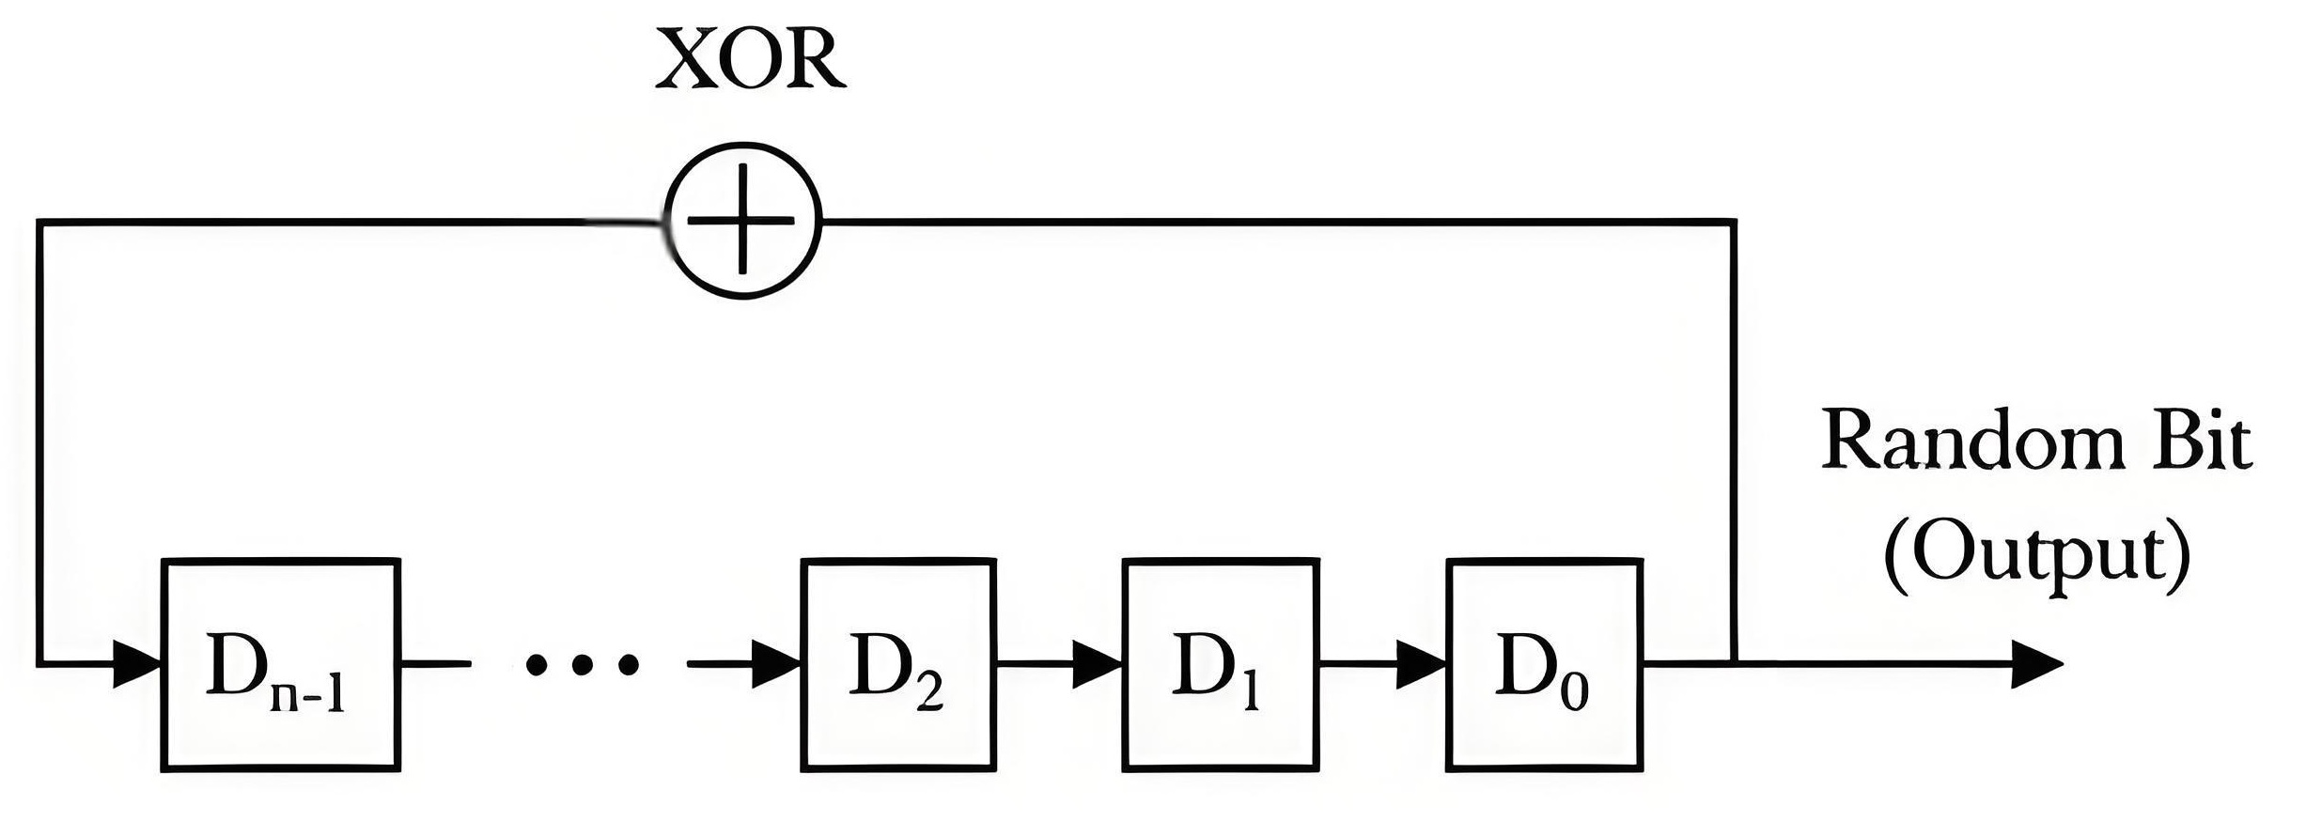
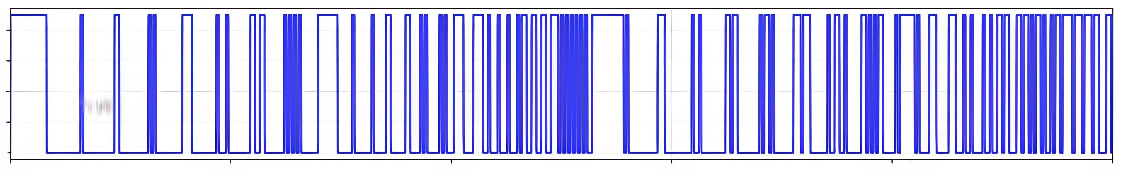
Three Basic Waveforms & Their Generation
Square Wave
Sawtooth Wave
Noise Wave
LFSR

Slide 6
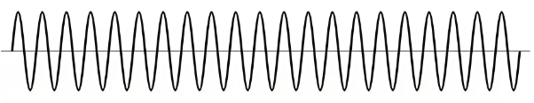
Why Was There No Sine Wave?
Most fundamental waveform in signal processing
Computational Complexity
Require Taylor series expansion / trigonometric function calculations
Hardware Requirement
Need a high‑precision DAC to produce a smooth, continuous curve
Memory Consumption
Using a lookup table (LUT) would consume precious ROM space
But very difficult to generate in the 1980s

Slide 7
How to create a piece of music
Three main attributes of sound
Timbre (Waveform)
Pitch (Frequency)
Loudness (Amplitude)

Slide 8
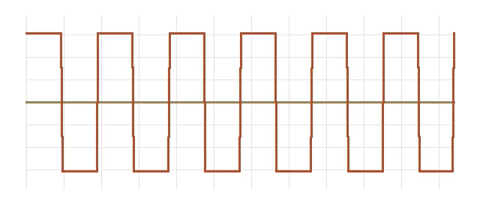
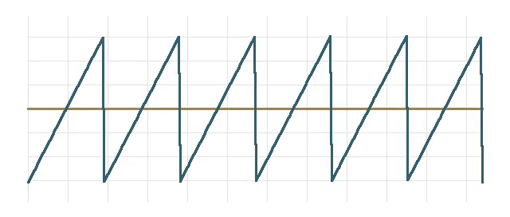
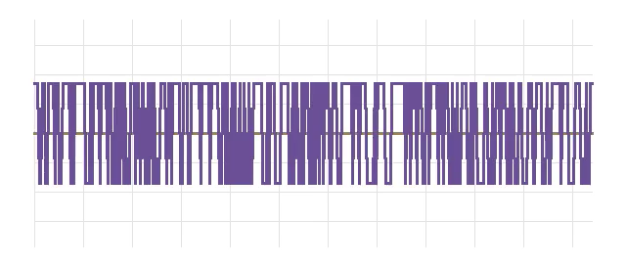
How to create a piece of music
Three main attributes of sound
Timbre (Waveform)
Square Wave
Clear
Lead melodies & harmonies
Sawtooth Wave
Solid & Stable
Bass (低音)
Noise Wave
Punchy (有冲击力)
Drums & Percussion (敲击)

Slide 9
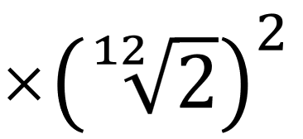
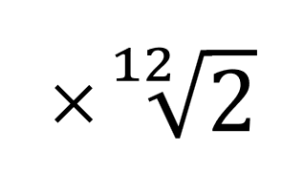
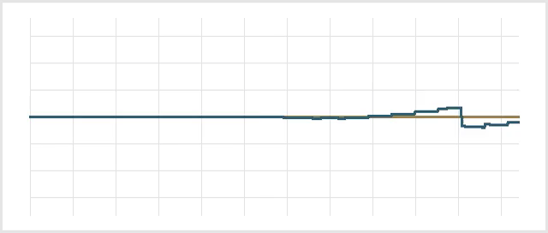
How to create a piece of music
Three main attributes of sound
Pitch (Frequency)
Based on Twelve-Tone Equal Temperament (十二平均律), Each semitone is higher than previous one by a factor of the 12th root of 2
Use C major scale (C 大调) as an example:
Syllable Name | do | re | mi | fa | sol
frequency | 261.63 | 293.66 | 239.63 | 349.23 | 392.00
Notes:
An octave is divided into 12 semitones (half-steps). The frequency increases geometrically (via multiplication) rather than linearly (via addition).
Each semitone is higher than the previous one by a factor of the 12th root of 2
Twelve-Tone Equal Temperament

Slide 10
How to create a piece of music
Three main attributes of sound
Pitch (Frequency)
Based on Twelve-Tone Equal Temperament (十二平均律), Each semitone is higher than previous one by a factor of the 12th root of 2
Use C major scale (C 大调) as an example:
Syllable Name | frequency
do | 261.63
re | 293.66
mi | 239.63
fa | 349.23
sol | 392.00
Notes:
An octave is divided into 12 semitones (half-steps). The frequency increases geometrically (via multiplication) rather than linearly (via addition).
Each semitone is higher than the previous one by a factor of the 12th root of 2
Twelve-Tone Equal Temperament

Slide 11
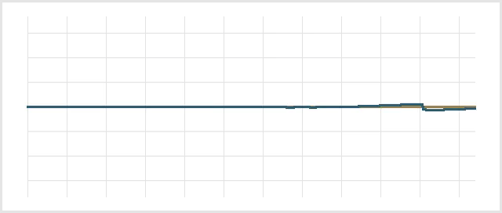
How to create a piece of music
Three main attributes of sound
Loudness (Amplitude)
Higher amplitude generates louder sounds
Human perception of loudness is logarithmic relative to sound amplitude
Notes:
An octave is divided into 12 semitones (half-steps). The frequency increases geometrically (via multiplication) rather than linearly (via addition).
Each semitone is higher than the previous one by a factor of the 12th root of 2
Twelve-Tone Equal Temperament

