Slide 1
FAIR-ART We Bring Technic To ethnic
Team No. – 23
Team Name - Pragmatics
Abhijeet Singh Panwar
Bhagyashree Sonawane
Mohit Salgaonkar
Prajakt Gunjal
Varun Maniar

Slide 2
Phase 1: problem formulation
Analyzed Challenge Statement
Brainstorming – Different Sectors
Problems Identification In Every Sector
Opportunity Assessment – Shortlist Sectors
Select Sector
Why Why Analysis – Identify root cause
Final Problem Statement

Slide 3
Challenge statement
Addressing the unorganized sector
Key Guidance: Skill maps and development, financial inclusion, identity management, market access

Slide 4
What is Unorganized Sector?
Unorganized Sector is a sector consisting of all unincorporated private enterprises owned by individuals or households engaged in the sale or production of goods and services operated on a proprietary or partnership basis and with less than ten total workers.*
*Report On Conditions Of Work And Promotion Of Livelihoods In The Unorganised Sector. Academic Foundation. 1 January 2008. p. 1774. ISBN 978-81-7188-678-4. Retrieved 26 March2013.

Slide 5

ETHNIC ARTS

Slide 6
Current scenario
Annual growth rate of 15.4%
Exports of USD 4.5 billion (FY 2015-16)*
Still being treated as a Sunset industry by the government
Many art forms are facing extinction
http://www.tradingeconomics.com/india/exports

Slide 7
DIFFICULTIES FACED
Limited patronage – Higher classes only (SEC A & B)
Huge skill gap – Elite class artisans and Semi-skilled artisans
Medium has become a boundary
Lower customer connect
Artisans are not in-tune with global trends

Slide 8
Problem statement
How do we market ethnic art in a way which will appeal the modern consumer?

Slide 9
Phase 2: Analysis
Stakeholders Mapping
Porter’s 5 Forces
Ishikawa diagram

Slide 10
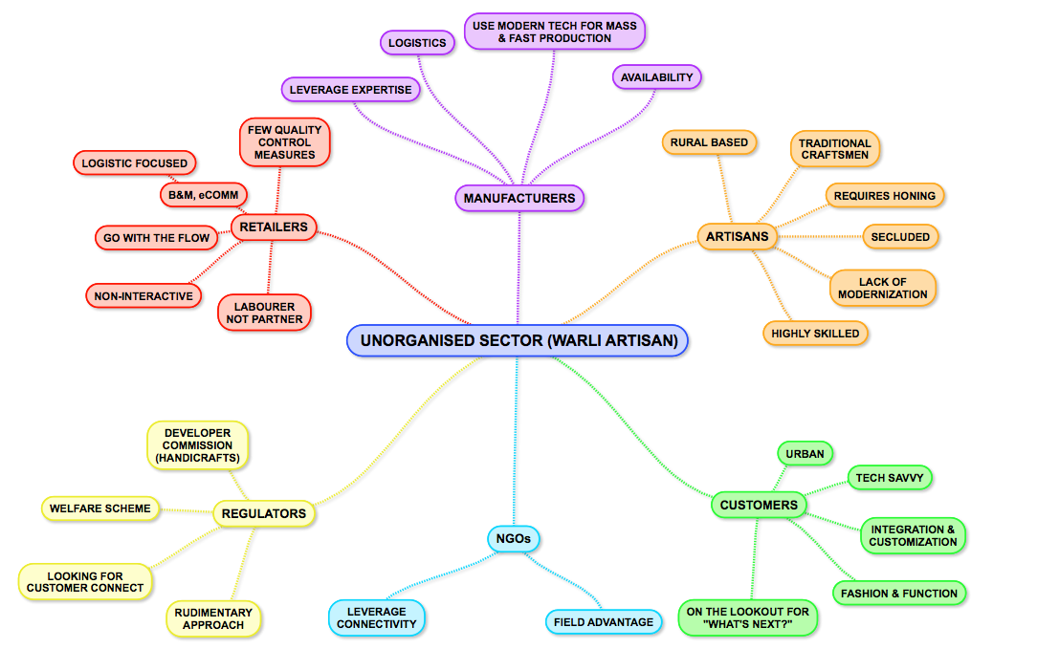
STAKEHOLDER MAP

Slide 11
PORTER ANALYSIS
Threat of Existing Rivals
Threat of New Entrants
Threat of Substitutes
Bargaining Power of Customers
Bargaining Power of Suppliers
LOW
HIGH
VERY HIGH
MEDIUM
Notes:
Existing Rivalry: -
1. Intense competition is forcing many vendors and operators to drastically change their business models or risk dropping out of the market as economies of scale, segment leadership, brand power and distribution become key determinants of success.
2. There is also very little differentiation between the competitors and the loss of market share of Nokia during recent years means that any new smart phones in the market will find it difficult to tempt existing competitor device consumers to switch.
3. The smartphone segment offers the largest returns for many in the mobile value chain, and it has therefore become the most competitive – attracting all the major vendors competing across various operating systems and price tiers. Huawei has set an ambitious goal for itself: to ship 60 million smartphones in 2012, an increase of 200% year-on-year.
4. : Brand identity is vital for long term success in mobile phones market. But there is still growing competition e.g. from Chinese 'microbrands' and grey market (mainly in the emerging regions like India).
5. Over 2011 Nokia’s sales were down 18% in China, 27% in Europe and 61% in North America. Nokia has faced increased competition from low-cost phone manufacturers such as ZTE and Huawei (mostly in China and Europe).
highly perishable products that depreciates quickly in the market. Producers need to sell quickly, which intens" is an easily defendable qualitative factor, so competing institutions will have a difficult time overcoming it.
Large industries allow multiple firms and produces to prosper without having to steal market share from each other. Large industry size is a positive for Smart Phone Industry This statements will have a short-term positive impact on this entity, which adds to its value.
When industries are growing revenue quickly, they are less likely to compete, because the total industry size is also growing. The only way to grow in slow growth industries is to steal market-share from competitors. Fast industry growth positively affects Smart Phone Industry.
When exit barriers are low, weak firms are more likely to leave the market, which will increase the profits for the remaining firms.
http://www.wikiwealth.com/five-forces:smart-phone-industry
New Entrants
Weak distribution networks mean goods are more expensive to move around and some goods don’t get to the end customer. The expense of building a strong distribution network positively affects Smart Phone Industry.
High capital requirements mean a company must spend a lot of money in order to compete in the market. High capital requirements positively affect Smart Phone Industry.
High sunk costs make it difficult for a competitor to enter a new market, because they have to commit money up front with no guarantee of returns in the end. High sunk costs positively affect Smart Phone Industry
If strong brands are critical to compete, then new competitors will have to improve their brand value in order to effectively compete. Strong brands positively affect Smart Phone Industry.
Advanced technologies make it difficult for new competitors to enter the market because they have to develop those technologies before effectively competing. The requirement for advanced technologies positively affects Smart Phone Industry.
Economies of scale help producers to lower their cost by producing the next unit of output at lower costs. When new competitors enter the market, they will have a higher cost of production, because they have smaller economies of scale. Economies of scale positively affect Smart Phone Industry.
When barriers are high, it is more difficult for new competitors to enter the market. High entry barriers positively affect profits for Smart Phone Industry.
High switching costs make it difficult for customers to change which products they normally purchase, due to costs. High switching costs positively affect Smart Phone Industry.
Patents that cover vital technologies make it difficult for new competitors, because the best methods are patented. Patents positively affect Smart Phone Industry.
In China It is strong for several key factors:
The economies of scale, the scale economies in production, R&D, marketing and finance is not large enough to be key barriers
the product differentiation level is high
The policies made by the Chinese government support the entry into the IT industry which includes the smart phone market.
Access to the distribution channel is not difficult.
Substitutes
Mobile phones have become necessity for everyday lives of people and its hard to replace with any substitute products especially when they are away from home.
There exist multiple substitute products e.g. for contacting people, usage of social media, emails and VOIP systems are substitutes, digital cameras for photography, TV/radio/iPod for listening music, tablets for internet browsing, reading books, emailing etc. But potentially all the value from substitute products could be derived from a single smartphone, needless to say each substitute product might cost more than the mobile phone and need to be carried all the time.
No other substitute product has the ability to make phone calls, send messages, surf the web, reading a book, listening to music, use GPS services, communicating via social media and many more in one device. The idea of being in constant communication with someone at anytime and anywhere makes the mobile phone a very important device to people and the perceived value by user (price-performance) ratio is very high.
Suppliers: -
Large number of substitute inputs
When there are a large number of substitute inputs, suppliers have less bargaining leverage over producers. This is due to competition among substitutes that is the equipment manufacturers . Greater competition positively affects Smart Phone Industry. There is competition among suppliers to cope up with the demand for fast growing requirements of device manufacturers
High competition among suppliers -High levels of competition among suppliers acts to reduce prices to producers. This is a positive for Smart Phone Industry.
Critical production inputs are similar-When critical production inputs are similar, it is easier to mix and match inputs, which reduces supplier bargaining power; a positive for Smart Phone Industry. Its like the same hardware configuration can be produced by different suppliers and hence they have competition in market to sell it.
Volume is critical to suppliers - When suppliers are reliant on high volumes, they have less bargaining power, because a producer can threaten to cut volumes and hurt the supplier’s profits. This can positively affect Smart Phone Industry
Supplier concentration: Nokia suppliers for hardware components are not concentrated and there are actually large number of equipment manufacturers that Nokia could switch to. including Nokia.  High differentiation of inputs: Nokia does not depend on a key equipment manufacturer. It buys different hardware components from multiple vendors and Nokia possesses its own assembling factories where the devices are assembled.  Moderate impact of inputs on cost or differentiation: There is growing trend of differentiation based on hardware specifications (dual-core processors, physical memory, NFC support, wide-screen, screen glass etc.) which affects the final selling price and margins. But overall, mostly margins are dictated by software and application ecosystem.
Consumers: -
2. Consumers (end buyers) volume is continuously increasing globally despite recession in recent years in some regions and saturation in some. Asia-Pacific market (developing countries) is expected to grow at even higher rate in coming years. The continued fall in handset prices in most segments, notably smartphones, with devices with greater capabilities now available at a lower price point have also lead to increase in consumer volumes.
3. Price differentiation is getting lower and lower as device manufacturers are facing fast changes in designs, technical and data capabilities leading the buyers to price sensitive in their buying decision. With lot of competitors offering similar packages, the buyers are seeking out best value for their money.
4. Some mobile operators have started building their own mobile phones under their brand (e.g. Videocon in India) but still have not been hugely popular. So the threat is still low. Most of the mobile phone manufacturers have their own stores to directly sell to consumers.
5. In the cut-throat mobile industry, the product differentiation factors are getting lower. If when player comes up with a new feature or technology improvement, it is taken by competitive player very soon e.g. dual-core processors, wide-screen, LTE, etc.
6. When produces have low dependence, distributors have less bargaining power. Low dependency positively affects Smart Phone Industry.

Slide 12
Ishikawa diagram
MEASUREMENT
MATERIALS
METHOD
Market Research
Skill Mapping
Raw Material
Venture product range
Literacy Rate
Pass on insights
Internet Penetration
MEASUREMENT
Success of FairArt
Fashion Trends
Marketers
ARS Systems
Logistics feasibility
Programmers
Production Utilities
Economic Outset
Artisans
Design Hardware
ENVIRONMENT
MANPOWER
MACHINE

Slide 13
theme
To liberalize the art form from the boundaries of medium by diversifying the product range
Incorporating the ethnic designs in daily use products for deeper customer connect
Ethnic Design – Not just aesthetics but functional value as well
Leverage the subliminal perception

Slide 14
Our role
Platform developer
Concerned with operations and marketing
Market research in order to understand consumer behavior
Passing on the insights to artisans

Slide 15
solutions
Centralize
Diversify + Fast fashion
Skill Mapping
Technology Infusion
Bring the designs to daily use
Enroll artisans
Understand strengths
Digitalize designs
Medium transformation
Catch up trends
Transfer artisans
Provide a platform
Interaction with customers

Slide 16
How are we different?
Artisans are screened and filtered – Authenticity
Diversified product range
Specifically for ethnic designs
Fair-Art facilitates the formation of cross functional teams – Refined products

Slide 17
Our process

Slide 18
prototype

Slide 19
Business model canvas

