Slide 1
Some other approaches (and software) for spatial modelling of distance sampling data
Primary reference:
Miller, D.L. et al. 2013. Spatial models for distance sampling data: recent developments and future directions. Methods in Ecology and Evolution. 4:1001-1010
More references at end…

Slide 2
General formulation¹
Point process model
Location of animals are a realization of an underlying process with intensity D(x,y)
Then, number of animals in an area A is Poisson(λ) where i.e. an inhomogeneous Poisson process (IPP)
¹see Hedley (2000) and Johnson et al. (2010)

Slide 3
Adding uncertain detection
Let g(x,y) be the probability of detection of an animal given it is at location x,y
Detection of animals represents a “thinning” of the IPP, which also yields an IPP, with
(Can use marked point process framework to deal with animal-level covariates in g())

Slide 4
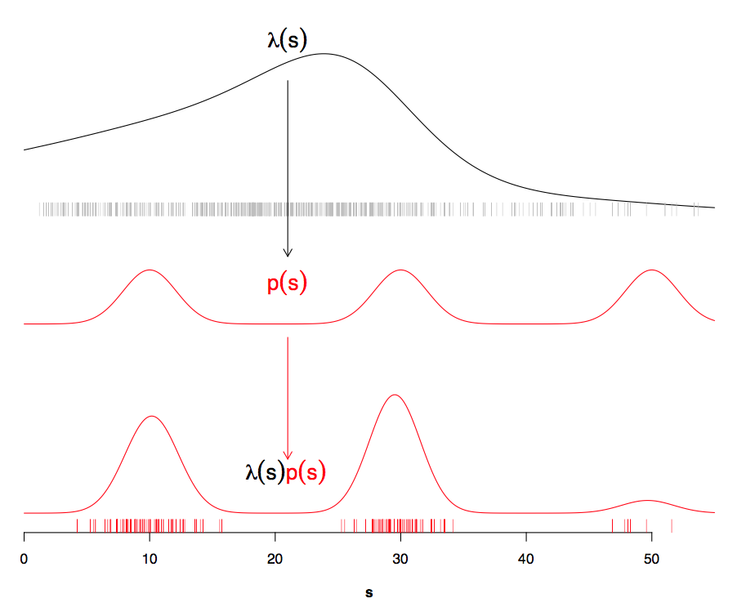

Slide 5
Full likelihood approach
Simultaneously estimate parameters of D() and g()
Is it worth it? Often little information about D() contained in the distances (which are used to fit the g())
width of transects small compared with width of study area,
little information about change in density in the x direction
contained in the observed distances from the transect

Slide 6
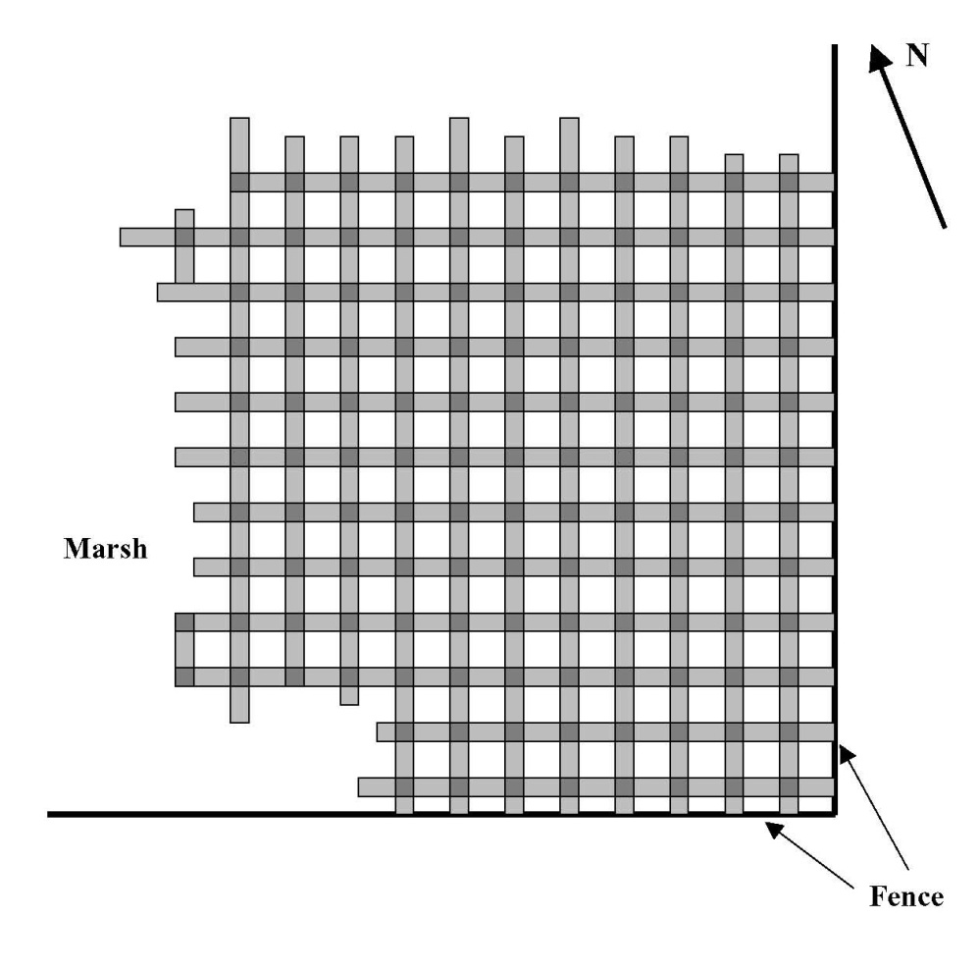
Exceptions
Covered area is a large proportion of study area

Slide 7
Example Applications
Hedley (2000)
Royle et al. (2004) (nicely illustrates lack of information about D() from the g()) – distsamp in R (package unmarked)
see also gdistsamp (same package)
Royle and Dorazio (2008, section 5.5.5) ¹ - WinBUGS
Johnson et al. (2010) – dspat in R (DSpat library)
inlabru R package; Yuan et al. (2017) software and training materials at https://sites.google.com/inlabru.org/inlabru/download
¹ See also Kéry and Royle 2015. Applied Hierarchical Modelling in Ecology Vol 1.

Slide 8
Two-stage methods
First fit g() using the distances
Then fit D() using the locations of observations, and the fitted g()
Example: method we’ve been using on this workshop (“Count method” of Hedley (2000), Hedley and Buckland (2004), Hedley et al. (2004))

Slide 9
Advantages
2 stage methods in general:
Divide and conquer
Count method:
Uses standard, well accepted tools for fitting
GLM/GAM is reliable, robust
Software available
Conceptually simple

Slide 10
Issues
Residual small-scale spatial clustering
Extrapolation problems
Animals in clusters (groups, pods, etc)

Slide 11
Residual small-scale clustering
Our models assume large-scale smooth pattern of D() but there is often residual unexplained variation at a smaller scale
short range
longer range
variance in counts between segments
plots courtesy of Louise Burt
distance apart

Slide 12
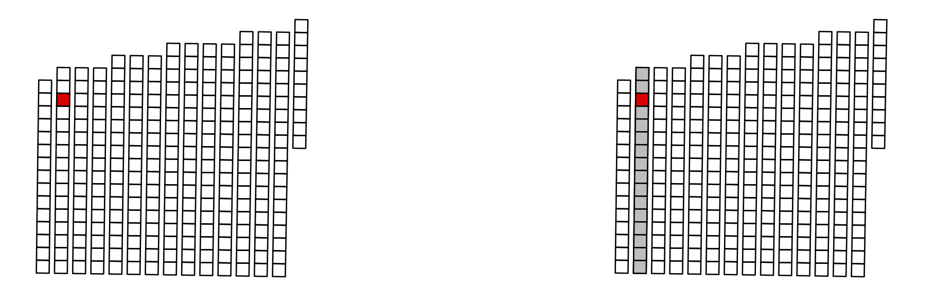
“Natural” structure

Slide 13
Solutions
Better/different models
Within GLM/GAM framework (see also next slide):
mixed models (GLMM/GAMM) with spatial correlation in the error structure (similar to extensions of kriging)
auto-regressive models
estimating equations (GEE) with spatial correlation in error structure
Extensions/alterations to IPP
spatial shot-noise Cox process (Waagepeterson and Schweder 2006)
Markov-modulated Poisson process (Skaug 2006)
Bayesian tesselations. (Niemi and Fernandez 2010; Kaimi and Fernandez 2008)

Slide 14
Animals in clusters/groups/pods
When object detected is a group of animals, can:
Model individuals directly, rather than clusters (can use this to indirectly get a density surface of clusters)
Model density surface of clusters, and then scale up by mean cluster size
Separately model density surface of clusters and density surface of cluster size, then put together (therefore 3 stage modelling – e.g., BWH approach)

Slide 15
The Future: DenMod
CREEM + Duke + NOAA + others (US Navy funded)
Next generation of spatial modelling in Distance
New methodology, R packages, practical advice
Multiple survey analysis
Segment size issues (MMPP etc)
Extrapolation
Group size uncertainty & more!

Slide 16
Selected additional references
Buckland, S.T., D.L. Borchers, A. Johnston, P.A. Henrys and T.A. Marques. 2007. Line transect methods for plant surveys. Biometrics 63: 989-998.
Ferguson, M.C., J. Barlow, P. Fiedler, S.B. Reilly and T. Gerrodette. 2006. Spatial models of delphinid (family Delphinidae) encounter rate and group size in the eastern tropical Pacific Ocean. Ecological Modelling 193: 645-662.
Kaimi, I. and C. Fernandez. 2008. Bayesian spatial modelling of line transect data. PhD chapter (Lancaster University).
Hedley, S.L. 2000. Modelling heterogeneity in cetacean surveys. PhD thesis, University of St Andrews. http://www.creem.st-and.ac.uk/sharon/public_html/thesis.pdf
Hedley, S.L. and S.T Buckland. 2004. Spatial models for line transect sampling. Journal of Agricultural, Biological and Environmental Statistics 9: 181-199.
Hedley, S.L., S.T. Buckland and D.L. Borchers. 2004. Spatial distance sampling models. Chapter 4 of Advanced Distance Sampling.
Johnson, D.S., J.L. Laake and J.M. Ver Hoef. 2010. A model-based approach for making ecological inference from distance sampling data. Biometrics 66: 310-318
Kastdalen, L, H.C, Pedersen, G. Fjone, and H.P. Andreassen. 2003. Combining resource selection functions and distance sampling: an example with willow ptarmigan. Proceeding Symp. Remote sensing and Resource Selection. (builds on book by B.F.J. Manly et al. 2002. Resource selection by animals.)
Niemi A. and C. Fernandez. 2010. Bayesian spatial point process modelling of line transect survey data. Journal of Agricultural, Biological and Environmental Statistics 15: 327.345.
Royle, J.A., D.K. Dawson and S. Bates. 2004. Modelling abundance effects in distance sampling. Ecology 85: 1591-1597.
Royle, J.A. and R.M. Dorazio. 2008. Hierarchical Inference and Modelling in Ecology. Academic Press.
Skaug, H.J. 2006. Markov modulated Poisson processes for clustered line transect data. Environmental and Ecological Statistics. 13: 199-211.
Waagepetersen, R. and T. Schweder. 2006. Likelihood-based inference for clustered line transect data. Journal of Agricultural, Biological and Environmental Statistics 11: 264-279.
Williams, R., S.L. Hedley, T.A. Branch, M.V. Bravington, A.N. Zerbini and K.P. Findlay. 2011. Chilean Blue Whales as a case study to illustrate methods to estimate abundance and evaluate conservation status of rare species. Conservation Biology 25: 526-535.
Yuan, Y. D.E. Bachl, D.L. Borchers, F. Lindgren, J.B. Illian, S.T. Buckland, H. Rue and T. Gerrodette. Submitted. Point process models for spatio-temporal distance sampling data. http://goo.gl/QUVhoK
Note: A more complete (but slightly out-of-date) list is contained in Miller et al. (2013).

