Slide 1
Distance Sampling Simulations

Slide 2
Overview
Why simulate?
How it works
Automated survey design
Coverage probability
Which design?
Design trade-offs
Defining the population
Population description
Detectability
Example Simulations

Slide 3
Why Simulate?
Surveys expensive, simulations cheap!
Test different survey designs
Test survey protocols
Investigate analysis properties
Investigate violation of assumptions

Slide 4
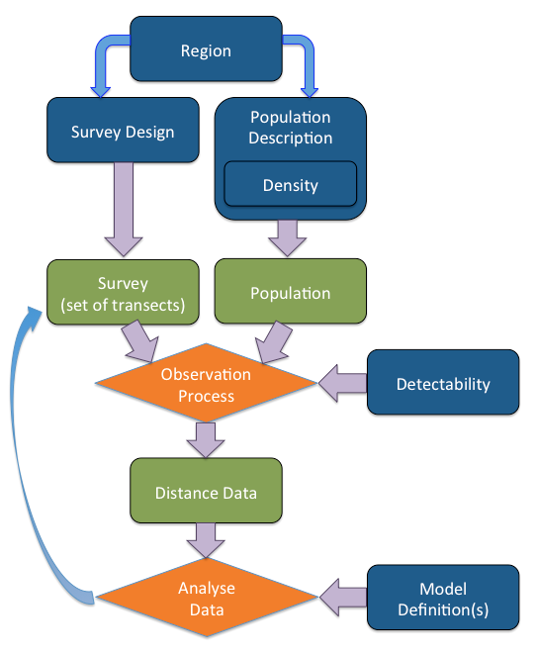
How it works
Blue rectangles indicate information supplied by the user.
Green rectangles are objects created by DSsim in the simulation process.
Orange diamonds indicate the processes carried out by DSsim.

Slide 5
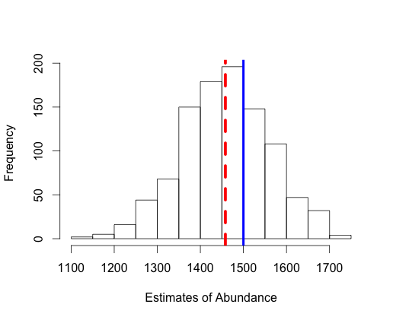
How it works
Assess:
Bias
Precision
CI coverage
Across different designs/scenarios

Slide 6
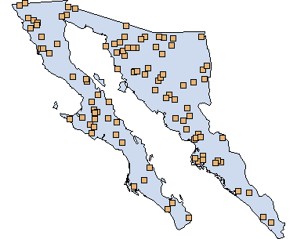
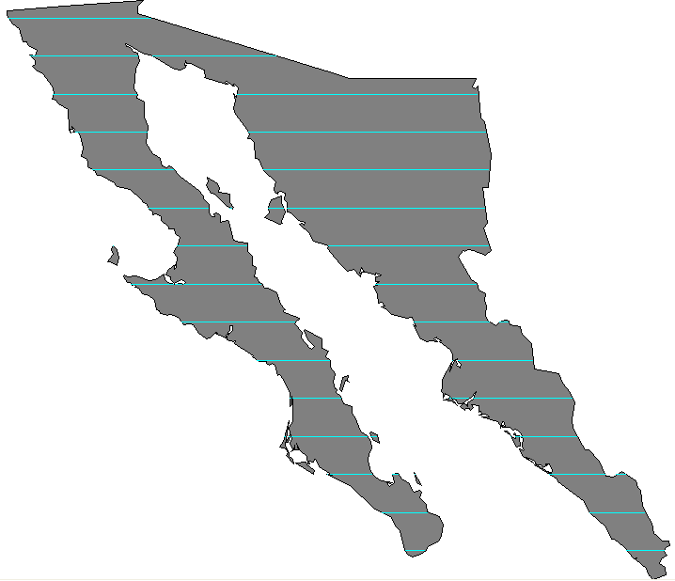
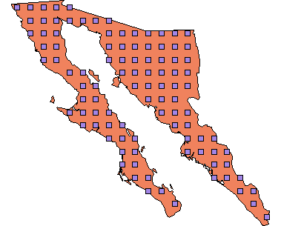
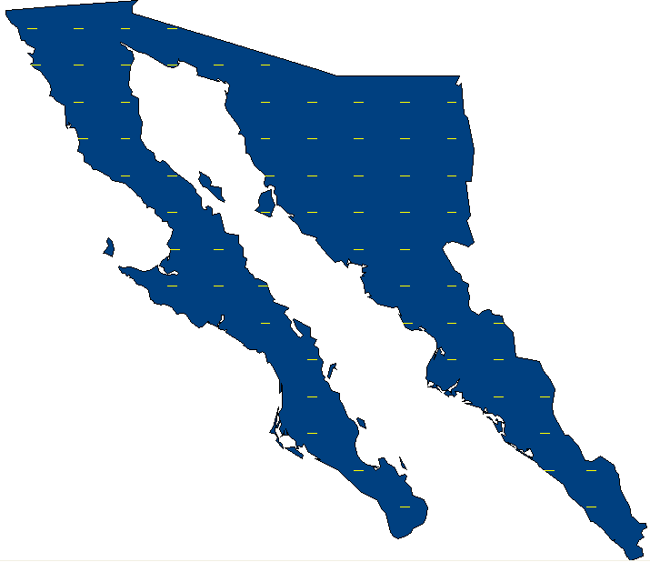
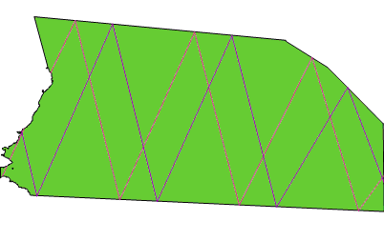
Automated Survey Design
Generate random sets of transects according to an algorithm
Assess design properties
Generate multiple transect sets for simulations

Slide 7
Automated Survey Design
Coverage Probability
P
Uniform coverage probability, π = 1/3
Survey Region
P
Uniform coverage probability, π = 1/3
Uneven coverage for any given realisation

Slide 8
Which Design?
Uniformity of coverage probability
Even-ness of coverage within any given realisation
Overlap of samplers
Cost of travel between samplers
Efficiency when density varies within the region

Slide 9
Design Trade-Offs
Convex hull
Survey Region
Survey Region
Minimum bounding rectangle

Slide 10
Population Definition
True population size?
Occur as individuals or clusters?
Covariates which will affect detectability?
How is the population distributed within the study region?
Ideally have a previously fitted density surface Otherwise test over a range of plausible distributions

Slide 11
Detectability
Distance needs:
shape and scale parameters on the natural scale
covariate parameters on the log scale

Slide 12
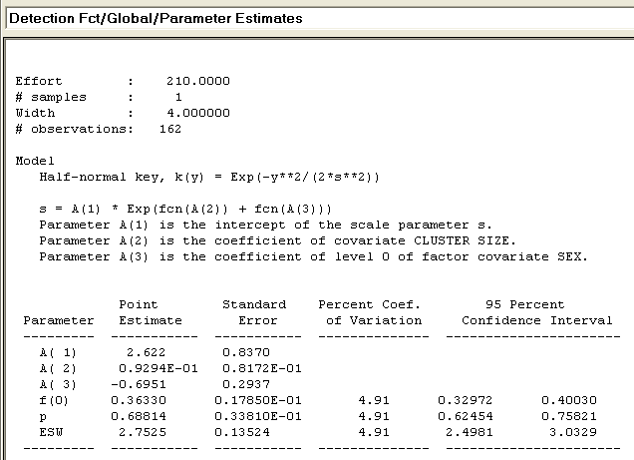
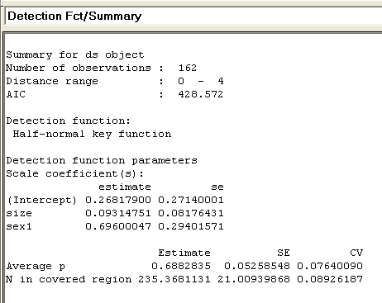
Detectability
Golftees project
exp(0.268179) = 1.307581
(MCDS)
(MRDS)
Natural scale
Log scale

Slide 13
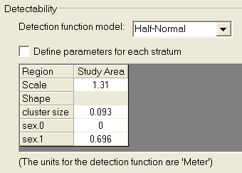
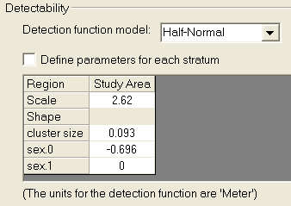
Detectability
In simulation:
exp(log(1.307581)+0.696) = 2.622633
exp(log(2.622)-0.696) = 1.307265

Slide 14
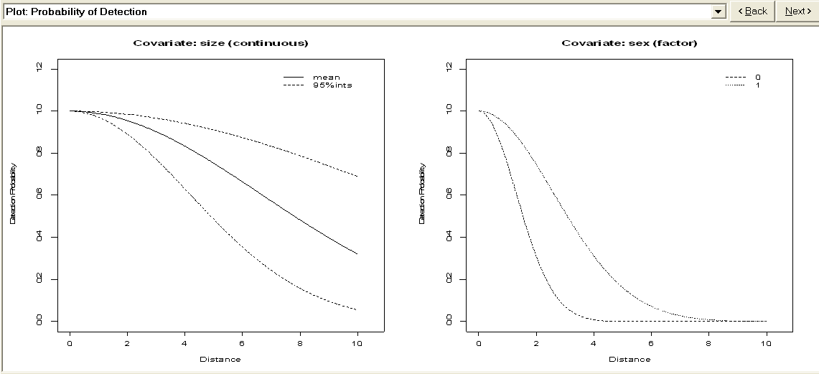
Detectability

Slide 15
Analysis
Data Filter must specify a right truncation distance
Model Definition must be either MRDS or MA
MRDS – for fitting a specific model
MA – for model selection (Note: MA model definitions require the creation of analyses)

Slide 16
Any questions so far…

Slide 17
Example Simulations
To bin or not to bin?
Testing pooling robustness in relation to truncation distance.
Comparison of subjective and random designs.

Slide 18
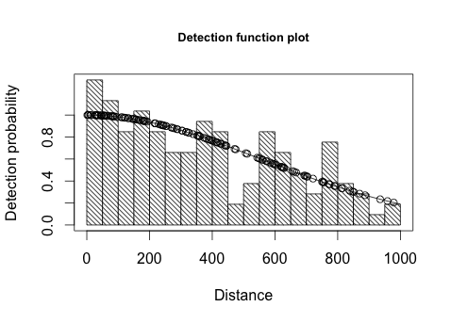
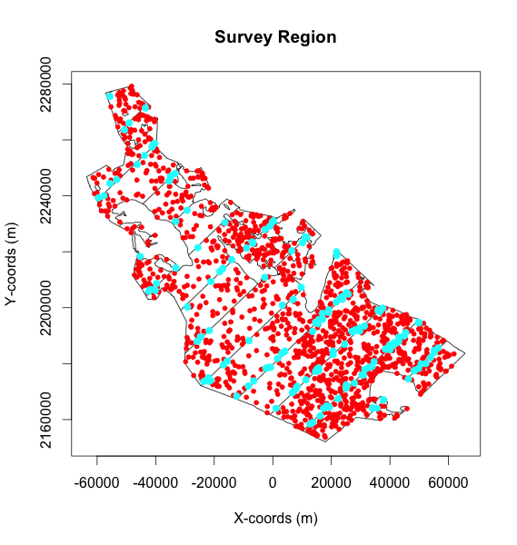
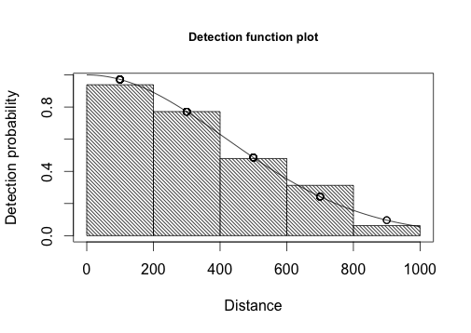
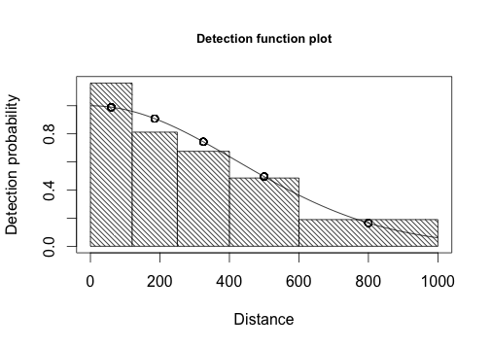
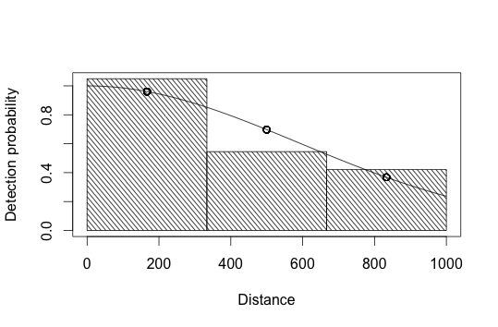
To Bin or Not to Bin?
Simulation:
Generated 999 datasets
Added multiplicative measurement error
Distance = True Distance * R
R = (U + 0.5), where U~Beta(θ, θ)¹
No error, ~15% CV (θ = 5), ~30% CV (θ = 1)
Analysed them in difference ways
Exact distances, 5 Equal bins, 5 Unequal bins, 3 Equal bins
Model selection on minimum AIC
Half-normal v Hazard rate
Average number of observations ~ 150
¹Marques T. (2004) Predicting and correcting bias caused by measurement
error in line transect sampling using multiplicative error models Biometrics 60:757--763
Notes:
The inspiration for this simulation came from the last Distance workshop I was teaching on. We had a lot of people who did bird surveys where it was difficult if not impossible to collect exact distance and they wanted to know if there was a cost involved with collecting binned data rather than exact distances.
I have also added some extra interest in the form of measurement error.
More on correcting for measurement error in Tiago’s paper too.

Slide 19
To Bin or Not to Bin Results
 | Exact Distances | 5 Equal Bins | 5 Unequal Bins | 3 Equal Bins
No Error | -1.16% bias 210 SE | -1.11% bias 217 SE | -0.16% bias 221 SE | -0.19% bias 255 SE
15% CV | 0.48% bias 214 SE | o.5% bias 221 SE | 1.36% bias 221 SE | 1.72%bias 264 SE
30% CV | 6.66% bias 237 SE | 6.61% bias 250 SE | 7.43% bias 262 SE | 8.20% bias 338 SE
Notes:
People struggled with this slide need to figure out the explanation.
Stress the conclusions collecting binned data versus exact distances make very little difference. So if you need to collect binned data for example bird surveys where there are just too many observations to collect exact distance you are not making much difference to your results.
Stress that in the top left corner has a little negative bias due to the minus sampling but this could quite easily have been positive bias depending on the density surface.

Slide 20
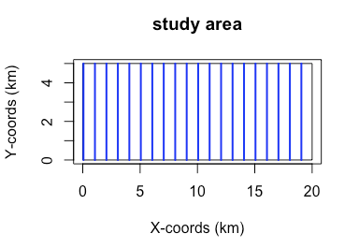
Pooling Robustness and Truncation
DSsim vignette
Rectangular study region
Systematic parallel transects with a spacing of 1000m

Slide 21
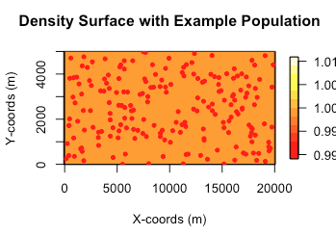
Pooling Robustness and Truncation
DSsim vignette
Uniform density surface
Population size of 200
50% male, 50% female

Slide 22
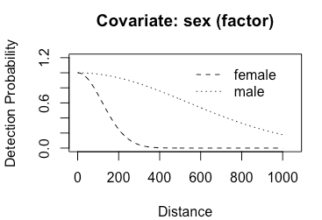
Pooling Robustness and Truncation
DSsim vignette
Half-normal shape for detectability
Scale parameter of 120 for the females
Scale parameter of ~540 for the males

Slide 23
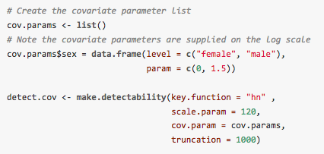
Pooling Robustness and Truncation
DSsim vignette
Half-normal shape for detectability
Scale parameter of 120 for the females
Scale parameter of ~540 for the males
exp(log(120)+1.5) = 537.8

Slide 24
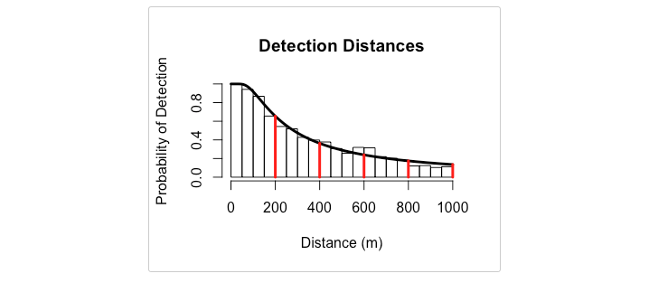
Pooling Robustness and Truncation
DSsim vignette
Two types of analyses:
hn v hr
hn ~ sex
Selection criteria: AIC
Histogram of data from covariate simulation with manually selected candidate truncation distances.

Slide 25
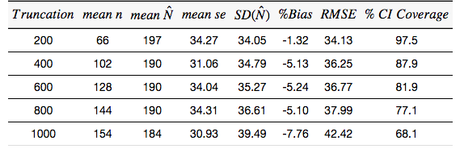
Pooling Robustness and Truncation
Results HN v HR:
Notes:
Take home don’t be afraid of truncation!

Slide 26
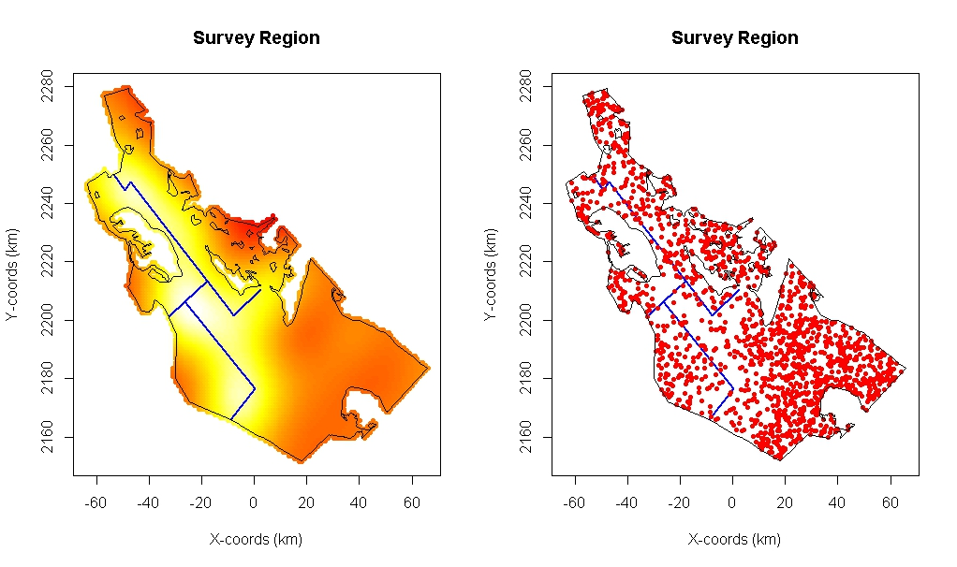
Example Simulation

Slide 27
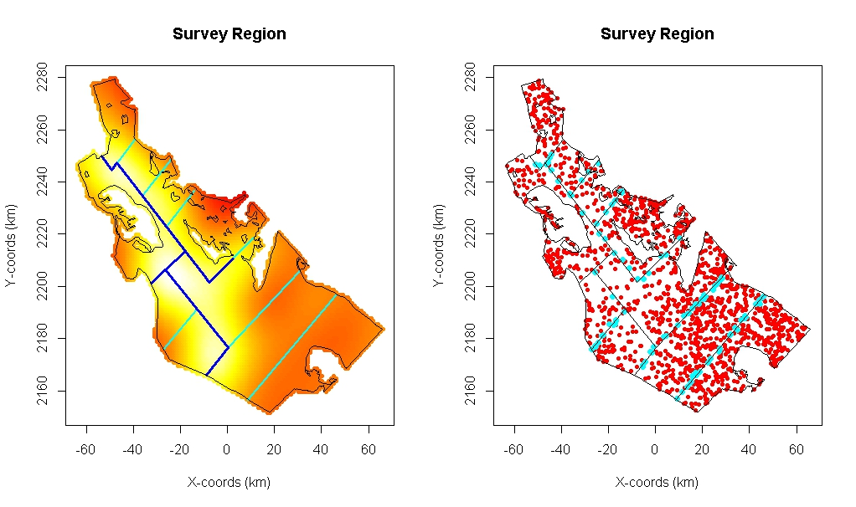
Subjective survey design
337 km effort

Slide 28
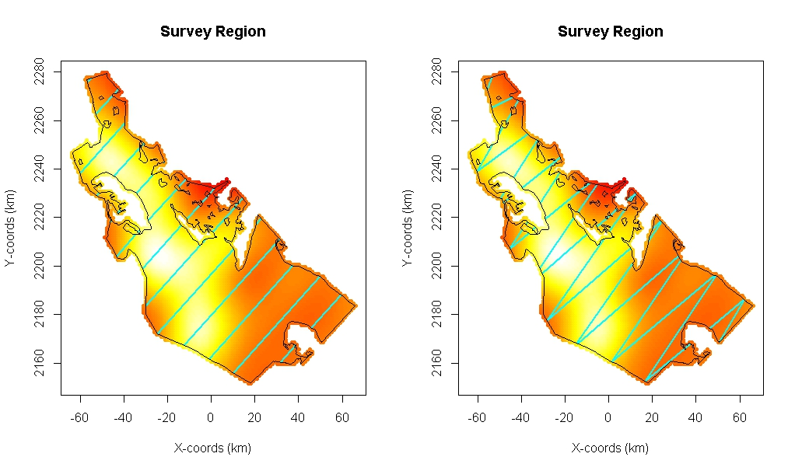
Random Designs
Mean cyclic track 845 km
Mean effort 474 km
Mean cyclic track 843 km
Mean effort 695 km

Slide 29
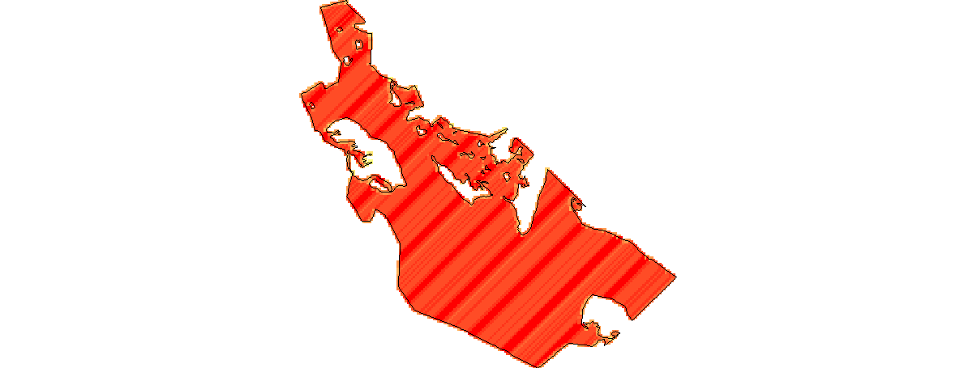
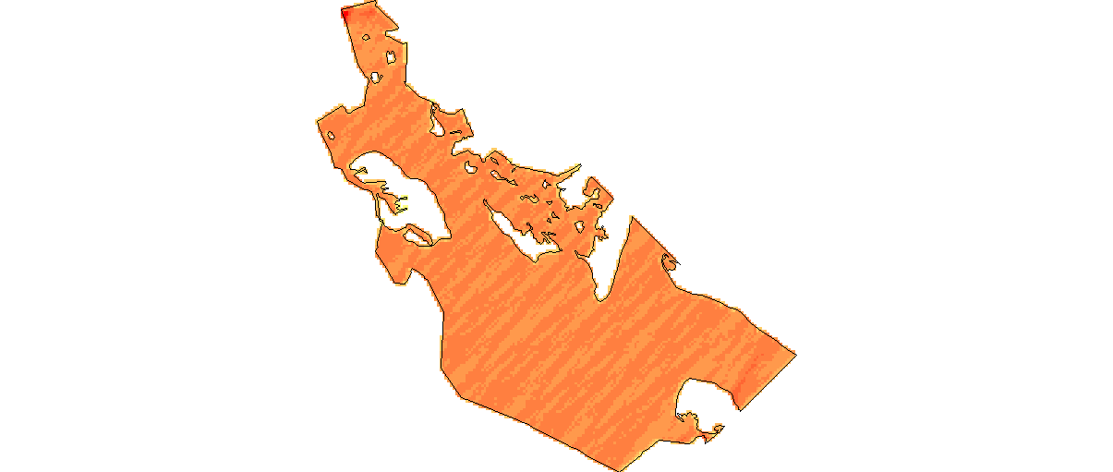
Coverage probability
Systematic Parallel Design
Equal Spaced Zigzag Design

Slide 30
Simulation
Generates a realisation of the population based on a fixed N of 1500
Generates a realisation of the design
Different each time for the random designs
The same each time for the subjective design
Simulates the detection process
Analyses the results
Half-normal
Hazard-rate
Repeats a number of times

Slide 31
Practical
Now attempt the DSsim practical:
R version – subjective design and parallel v zig zag
Distance version – parallel v zig zag only
You will need the library shapefiles.

