Slide 1
Estimation with incomplete detection at distance zero
“g(0)<1”
Chapter 6 of Advanced book (Methods for incomplete detection at distance zero by Laake and Borchers)
Borchers, D., Laake, J., Southwell, C. and Paxton, C. 2006. Accommodating unmodeled heterogeneity in double-observer distance sampling surveys. Biometrics 62: 372-378
Buckland, S.T., Laake, J.L. and Borchers, D.L. 2009. Double-observer line transect methods: levels of independence. Biometrics 66: 169-177
Laake, J.L., Collier, B.A., Morrison, M.L. and Wilkins, R.N. 2011. Point-based mark-recapture distance sampling. JABES 16: 389-408
Burt, M.L., Borchers, D.L., Jenkins, K.J. and Marques, T.A.M. 2014. Using mark-recapture distance sampling methods on line transect surveys. Methods in Ecology and Evolution 5: 1180-1191.

Slide 2
Conventional Distance sampling estimates are biased if g(0)<1:
D* = D× g(0)
where D is the true density and D* is the density obtained if you assume g(0)=1.
g(0)<1 when there is
Availability Bias
Perception Bias at distance 0

Slide 3
“Availability Bias”: When animals are unavailable for detection.
at distance 0
“Perception Bias”: When observers fail to detect animals although they are available
Animals available for detection
Missed
Seen
Animals UNavailable for detection

Slide 4
“Availability Bias”: When animals are unavailable for detection.
“Perception Bias”: When observers fail to detect animals on the transect although they are available
Availability
Bias
Perception
Bias

Slide 5
Visual Mark-Recapture
Seen by 2
=“marked”
Obs 1
=“trapping
occasion”
Obs 2
=“trapping
occasion”

Slide 6
Visual Mark-Recapture
Seen by 2
=“marked”
Seen by 2
=“marked”
Seen by 1
=“success”
Obs 1
=“trapping
occasion”
Obs 2
=“trapping
occasion”
Passes unseen by 1
=“failure”

Slide 7
Visual Mark-Recapture
Seen by 2
=“marked”
Seen by 2
=“marked”
Passes unseen by 1
=“failure”
Seen by 1
=“success”
We know 2 animals passed
(because Obs 2 saw them)
Of these, Obs 1 saw 1
So estimate:
Pr(Obs 1 sees) = = number “duplicates”
number seen by 2
Note: In this section, we use p, not g for the detection function

Slide 8
Class Exercise
Obs 2 detections:
100s: 101,102,103,104,105,106,107,108,111,112,114,115,116,118,134 15 11/15 13 17.7
200s: 201,202,204,205,206,207,211,214,215,218 10 4/10 7 17.5
300s: 301,303,304,305,307,313,314 7 3/7 3 7.0
400s: 402,404,407,416,417,418 6 2/6 2 6.0
38
25
48.2

Slide 9
Fit smooth curve using Logistic Regression
(instead of grouping into distance intervals)

Slide 10
Duplicate Identification
Field methods
Use a dedicated “duplicate identifier”
Record measure of confidence in duplicate identification.
Record positions and times as precisely as possible
Record ancillary data
Have at least one observer “track” animals

Slide 11
Duplicate Identification
Analysis methods
Bracket "best" estimate by two extremes
Rule-based duplicate identification after the survey. (e.g. Schweder et al., 1996)
Probabilitistic duplicate identification after the survey. (e.g. Hiby and Lovell, 1998, Stevenson et al. submitted)
Stevenson, B.C., Borchers, D.L. and Fewster, R.M. Cluster capture-recapture to account for identification uncertainty on aerial surveys of animal populations. (under revision for Biometrics).
Schweder, T., Hagen, G., Helgeland, J. and Koppervik, I. 1996. Abundance estimation of northeastern Atlantic minke whales. Rep. Int. Whal. Commn. 46: 391-405.
Hiby, A. and Lovell, P.1998. Using aircraft in tandem formation to estimate abundance of harbour porpoise. Biometrics 54: 1280-1289.

Slide 12
Probabilistic Duplicate Identification

Slide 13
Probabilistic Duplicate Identification

Slide 14
Design to deal with availability bias
Use enough effort for certain detection at x=0: May not be possible
Use cue-based methods : Need to estimate availability process
Separate search areas of the observers (see pp 176-177 Adv. book)
Use different types of observers (e.g. visual and acoustic; visual and radio-tag)
Availability bias correction factor: Need to be careful if animals in veiw for more than very small fraction of their availability cycle time.

Slide 15
Problem?
Unmodelled Heterogeneity
here

Slide 16
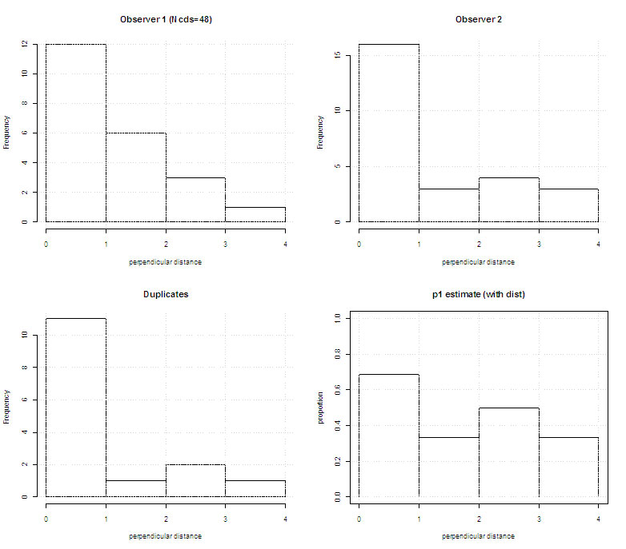
Full Independence (FI) Model:
p₁(0)
p₁(0)
Detection function

Slide 17
Point Independence (PI) Model:
Detection function
p₁(0)
Conditional detection function
(given detection by Observer 2)

Slide 18
Point vs Full Independence
Full Independence
Point Independence
Class e.g. Nhat= 48.
Sensitive to unmodelled heterogeneity: negative bias.
Assumption of uniform animal distribution not required - so useful if there is responsive movement.
Don’t use unless you have to.
Class e.g. Nhat= 70.
Much less sensitive to unmodelled heterogeneity.
Assumption of uniform animal distribution required – so no good if there is responsive movement.
Use it unless there is responsive movement (or other non-uniform distribution).

Slide 19
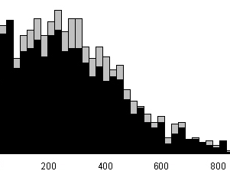
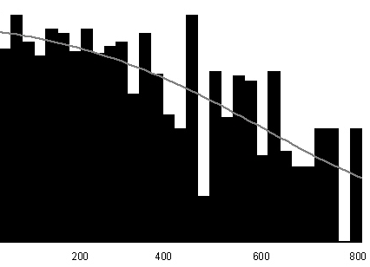
Example: Pack-Ice Seals
Observer 1 detections
Unmodelled Heterogeneity
here
Proportion of Observer 2 detections seen by Observer 1

Slide 20
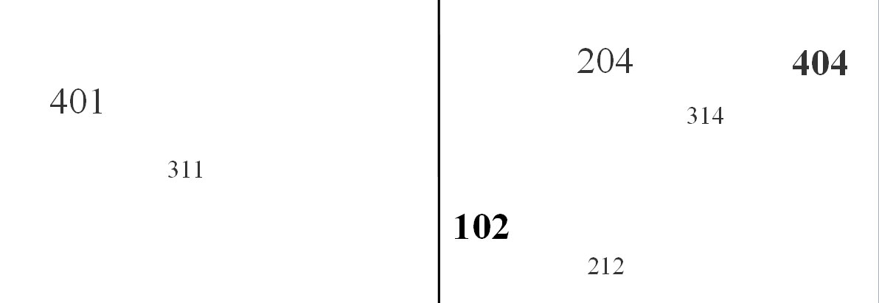
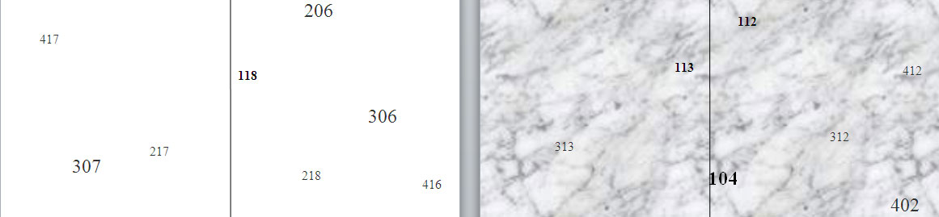
Sources of Heterogeneity
The animals themselves (size, boldness)
The environment (clear/”misty”)

Slide 21
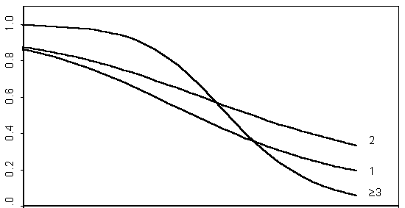
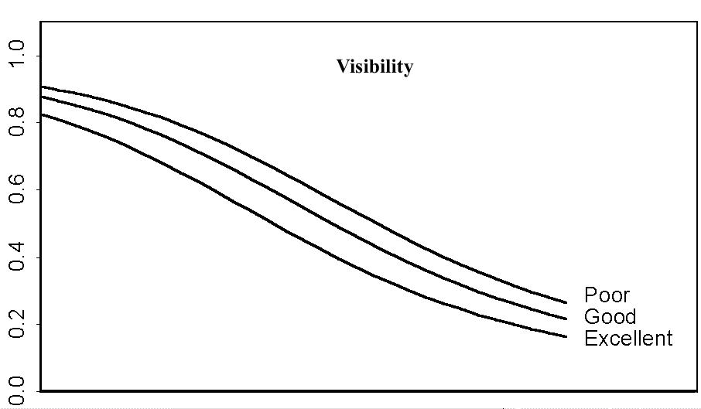
Sources of Heterogeneity
The animals themselves (distance, size, availability, ...)
The environment (sea state, ground cover, ...)
Group size

Slide 22
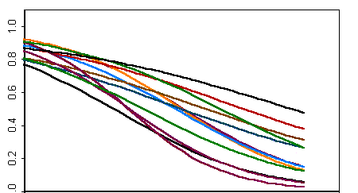
The kind of survey effort (the observers, their platforms, ...)
Observer

Slide 23
Configuration: Trial-Observer
Observer 2
sets up trials for
Observer 1
to estimate p₁
The Observer at the end of an arrow must be
independent of
the Observer at the start of the arrow

Slide 24
Configuration: Independent Observer
to estimate p₂
Observer 2
sets up trials for
p. = p₁ + p₂ - ( p₁ p₂ )
Observer 1
to estimate p₁
The Observer at the end of an arrow must be
independent of
the Observer at the start of the arrow

Slide 25
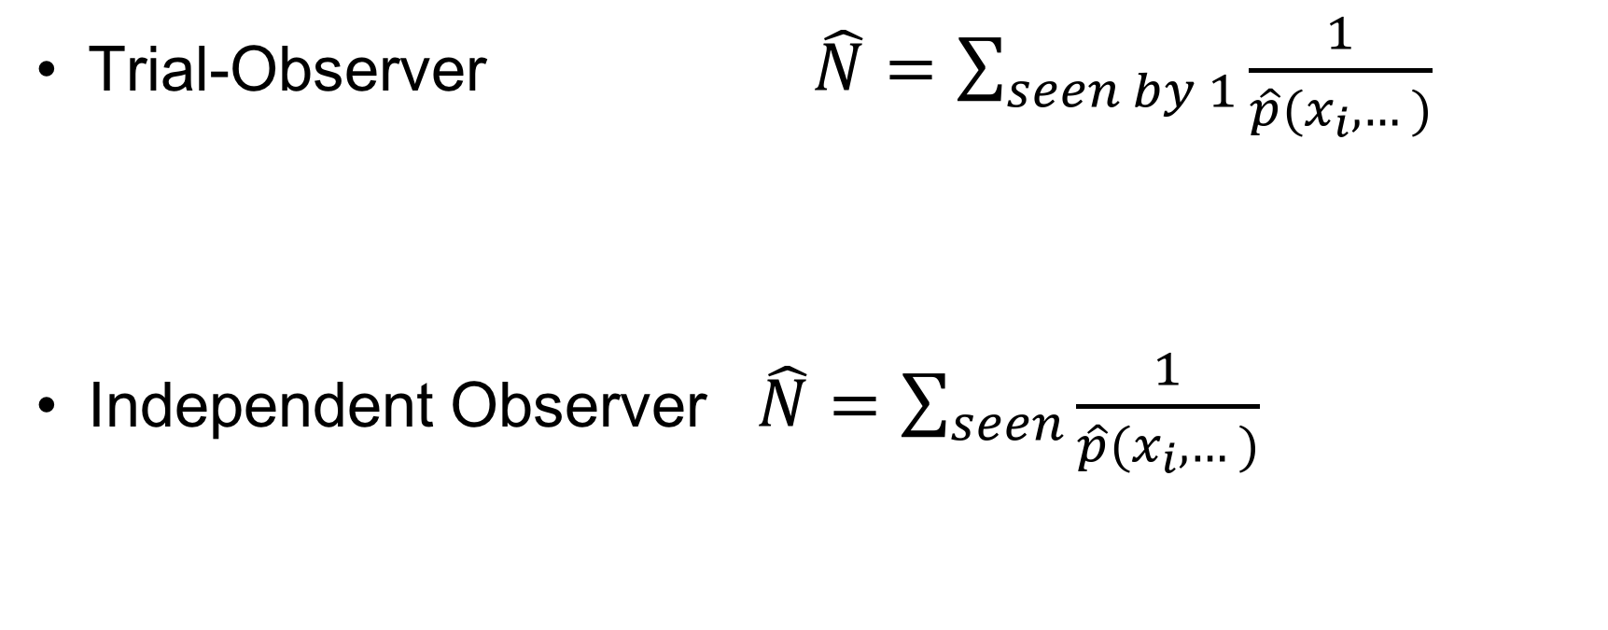
Abundance Estimation
Trial-Observer $\hat{N}=\sum_{seen by 1}{\frac{1}{\hat{p}(x_{i},…)}}$
Independent Observer $\hat{N}=\sum_{seen}{\frac{1}{\hat{p}(x_{i},…)}}$

Slide 26
Double-Platform Analysis Types
Cue-based methods:
Cues (not animals) are units; estimate p(see cue)
Getting adequate estimates of cue generation process can be difficult.
Able to incorporate heterogeneity due to availability (cue-ing) process.
Animal-based methods:
We focus on these; in some applications cue-based methods perform better
Animals are units; estimate p(see animal)
Don’t need to estimate availability/cue-ing process.
More difficult to incorporate heterogeneity due to availability process.

Slide 27
Related Models not covered:
Limiting Independence
Point Transects
Assume no unmodelled heterogeneity not at any point, but only as p approaches 1.
See Buckland, S.T., Laake, J.L. and Borchers, D.L. 2009. Double-observer line transect methods: levels of independence. Biometrics 66: 169-177
Can also do full, point and limiting independence with Point Transects.
See Laake, J.L., Collier, B.A., Morrison, M.L. and Wilkins, R.N. 2011. Point-based mark-recapture distance sampling. JABES 16: 389-408

Slide 28
Critical Assumptions of Mark Recapture Line Transect
Have the required independence between observers
No unmodelled heterogeneity
Duplicates (resightings) known (else need to include uncertainty in duplicate status in estimated variance)

