Slide 1


A primer on R
for the Intermediate Distance Sampling workshop

Slide 2
Learning goals
Obtain a working knowledge of the R language and environment, to be able to implement analysis for the Intermediate Distance Sampling workshop
Learn how to access R via the RStudio software
The learning session will be almost entirely hands-on. Thanks to Tiago Marques and Danielle Harris for tutorial material.

Slide 3
About R
R is both a programming language and an environment for statistical computation
R is free open source software
Created in 1995 by Ross Ihaka and Robert Gentleman, (University of Auckland, Auckland)
Based on previously established language, S
Now managed by the “R Core Development Team”
Software and resources available at
http://www.r-project.org
Latest version was R version 3.4.1

Slide 4
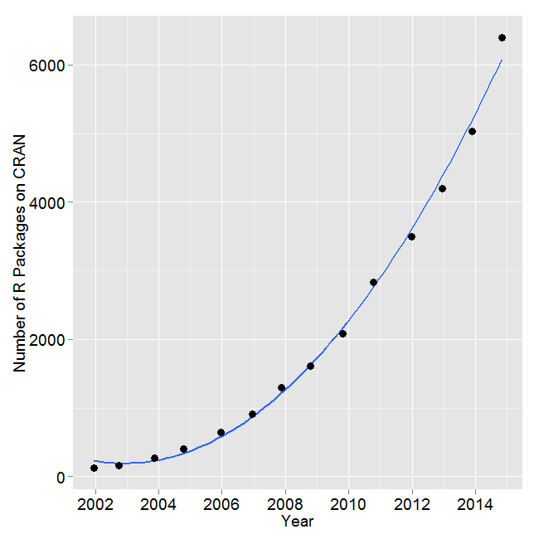
The R base + packages
R base installation comes with some packages that provide access to a large number of commonly used features (e.g. fancy plotting, survival analysis, nonlinear modelling, etc)
Many more packages are available online, contributed by users
Source: http://r4stats.com/articles/popularity/

Slide 5
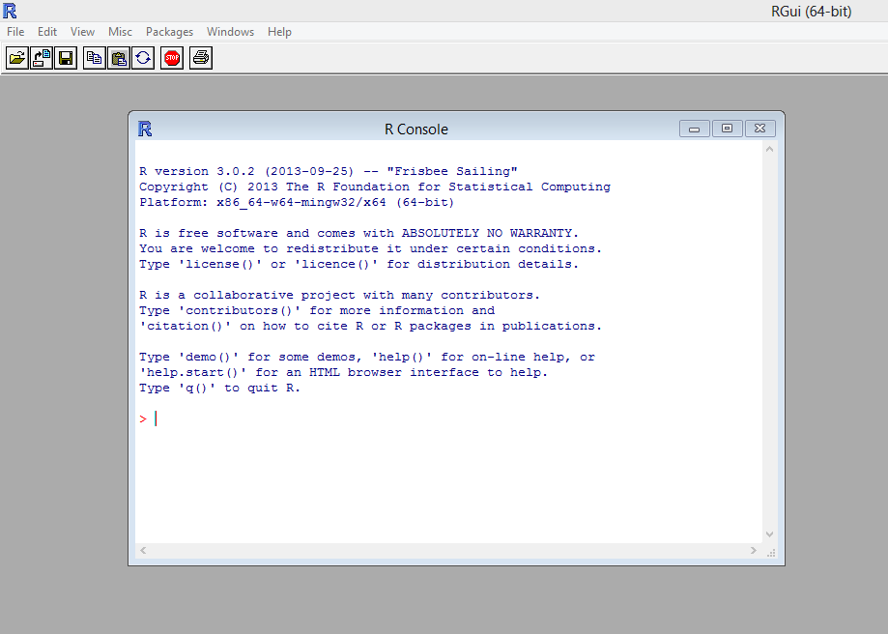
The R environment
R comes with a simple interface, allowing you to
type/paste commands
view plots
... but RStudio is much easier to use

Slide 6
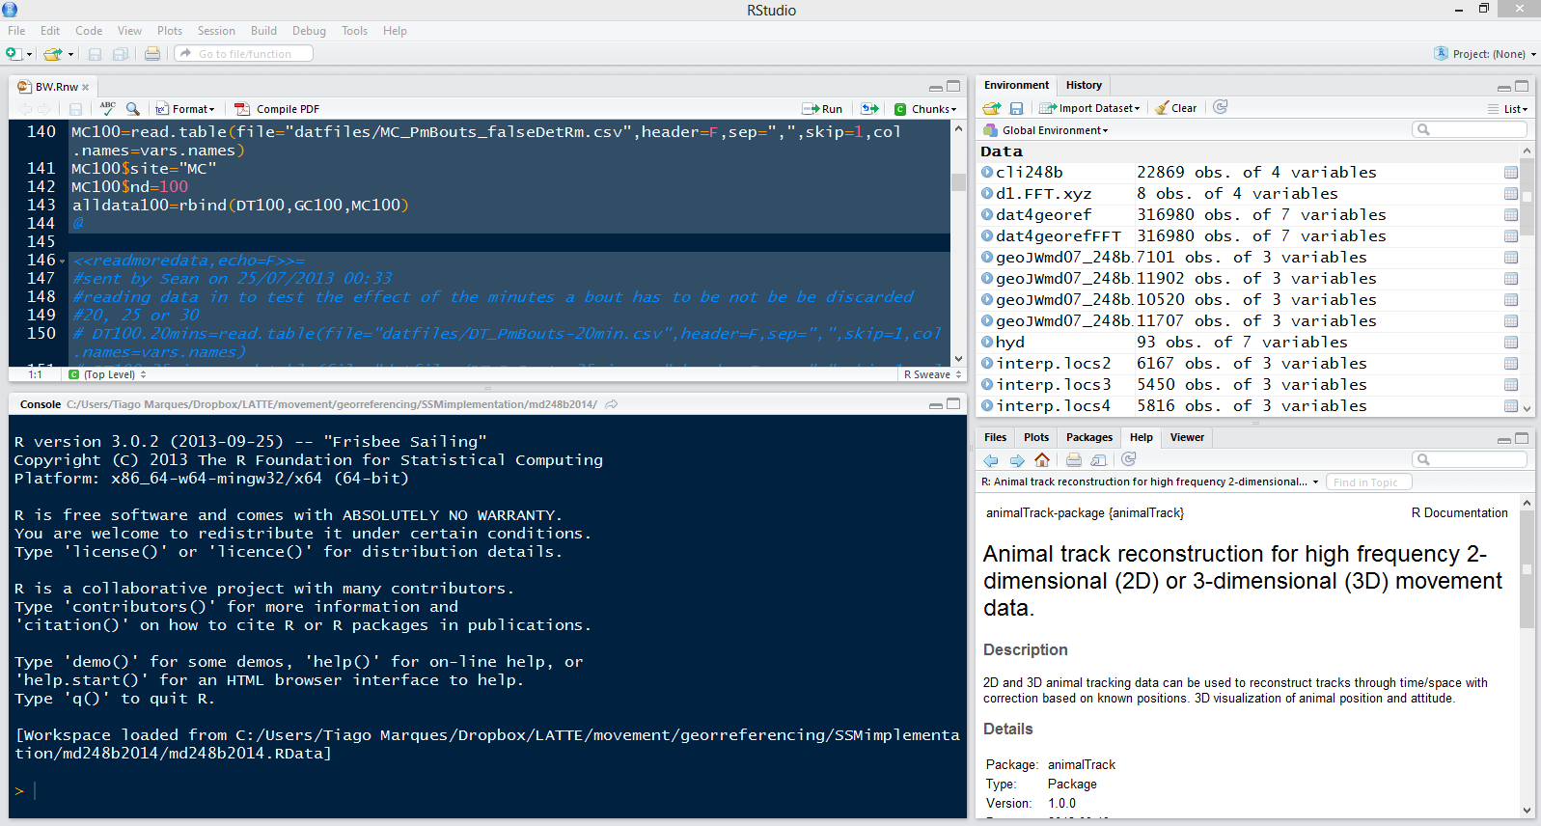
RStudio
An feature-rich “integrated development environment” for data analysis
Simplifies the user interaction with R
In a single application you have access to a number of windows containing your code files, an execution console, your plots, help, a file explorer, etc.
(as R) Free and open source

Slide 7
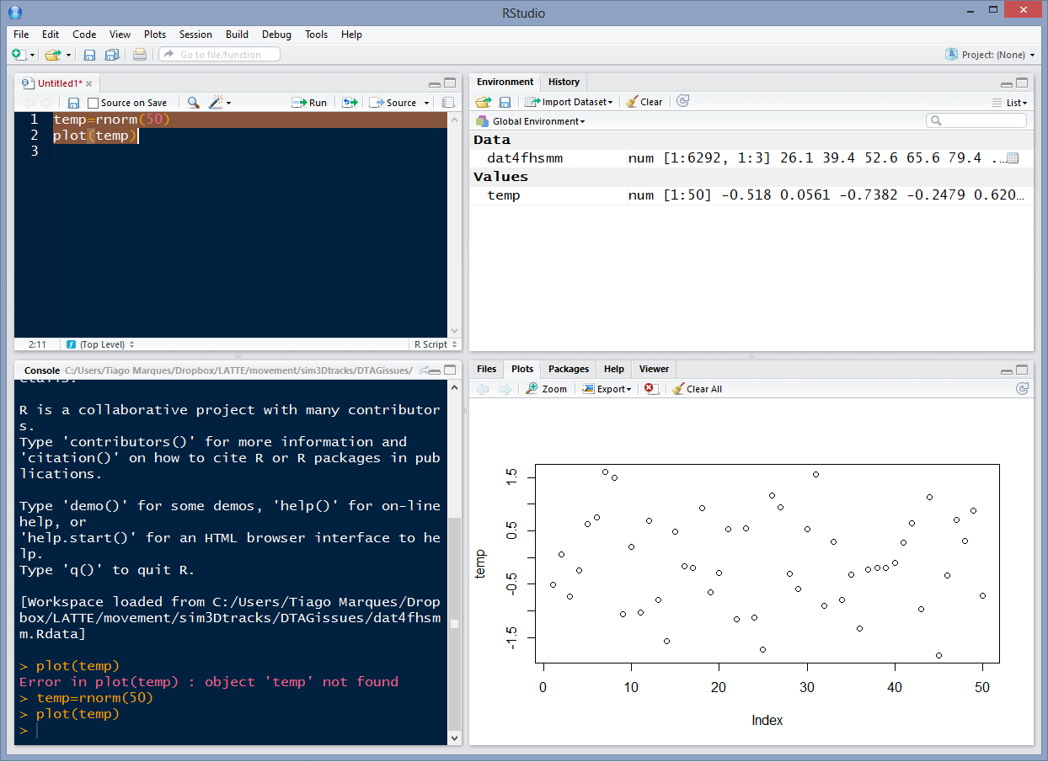
4 windows; 4 ways to interact with R
code file (“script”)
“environment” – i.e., list of variables
active console
plots

Slide 8
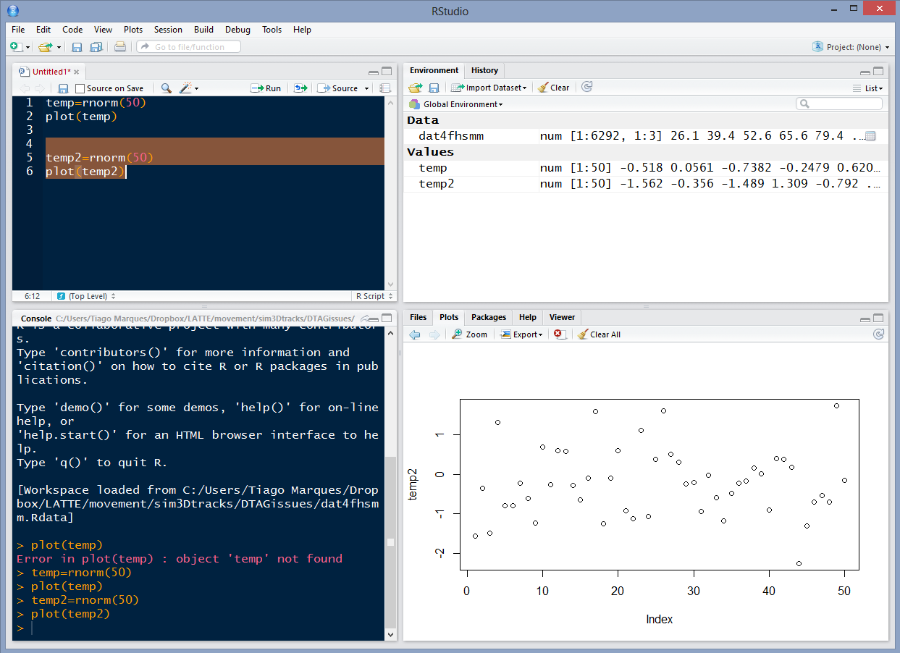
The code and plots tabs
Sends and executes current line or selected text to console
Move back and forth in a figure log
Export figures as pdf or jpeg

Slide 9
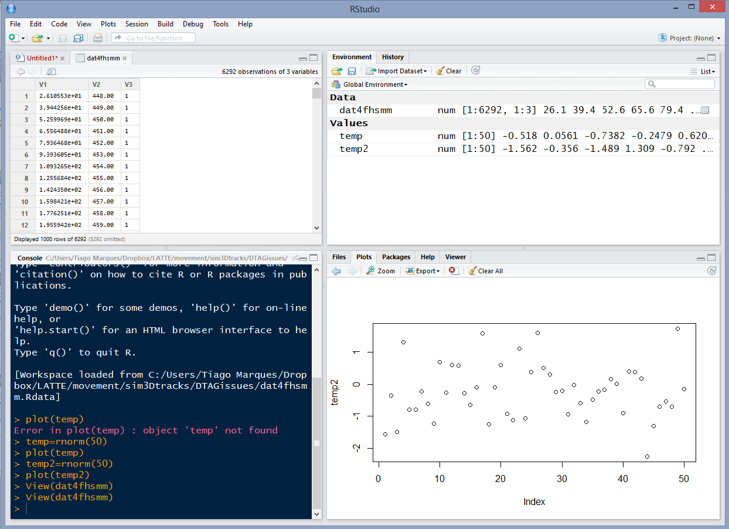
The environment tab
Shortcut for data import
Objects available in workspace (+ details)
Pressing most objects names gives you a preview of what they are

Slide 10
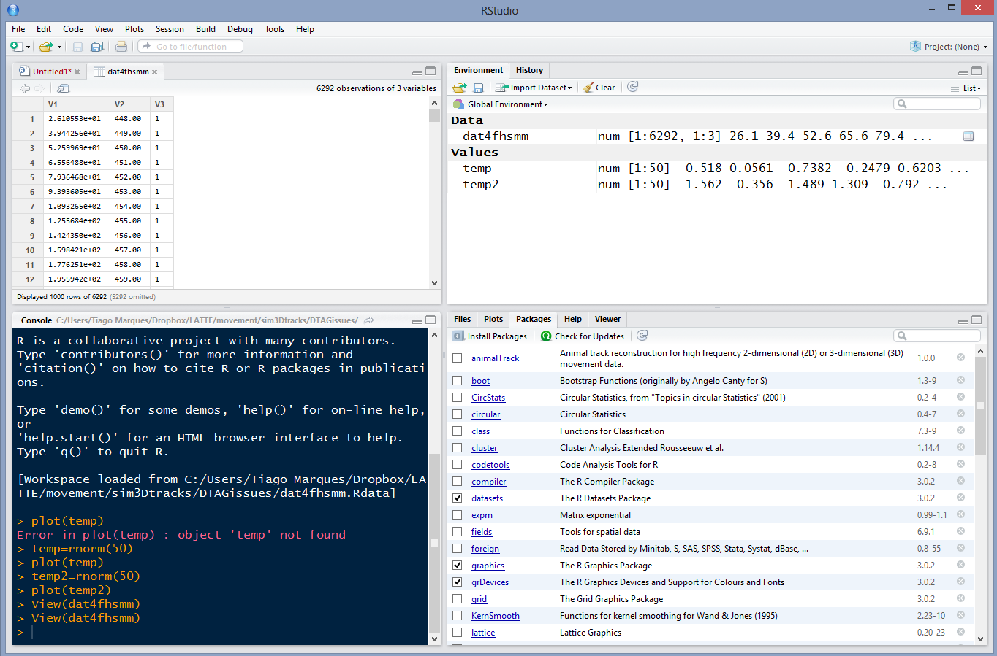
The packages tab
install a package
an installed package
an installed and loaded package
click the name for package description

Slide 11
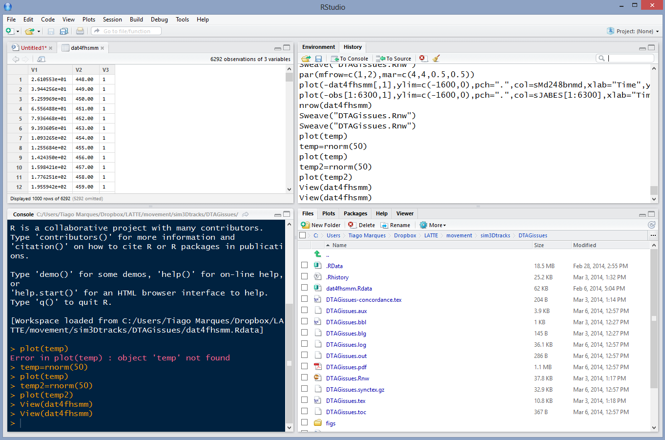
The history and files tabs
The command history (with shortcuts to send commands to source or console)
To see the files in your working directory
(select a file to load or open it)

Slide 12
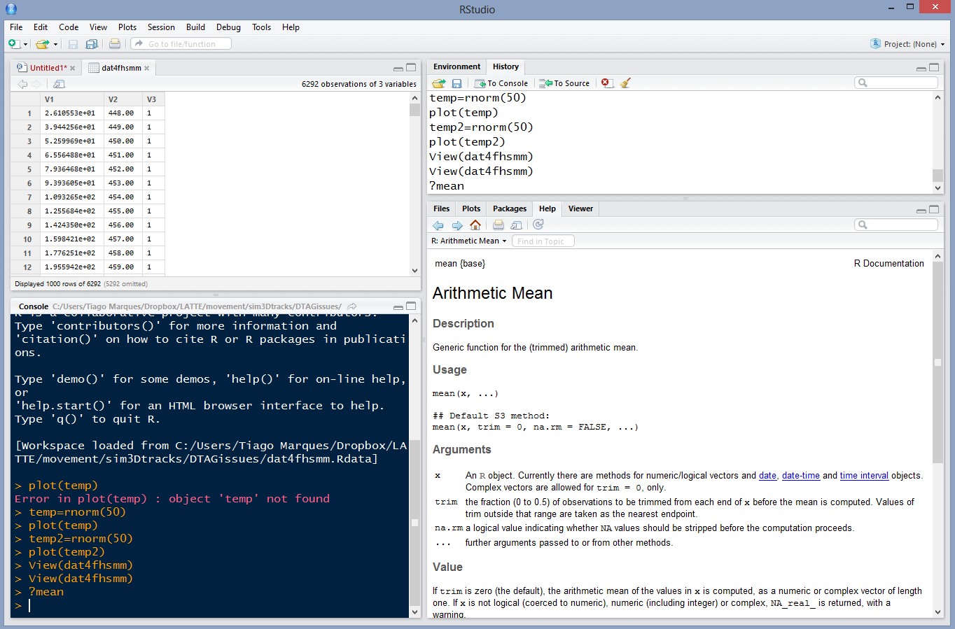
The help tab
If you call for help...
This is where it will show up
With hyperlinks for easy navigation

Slide 13
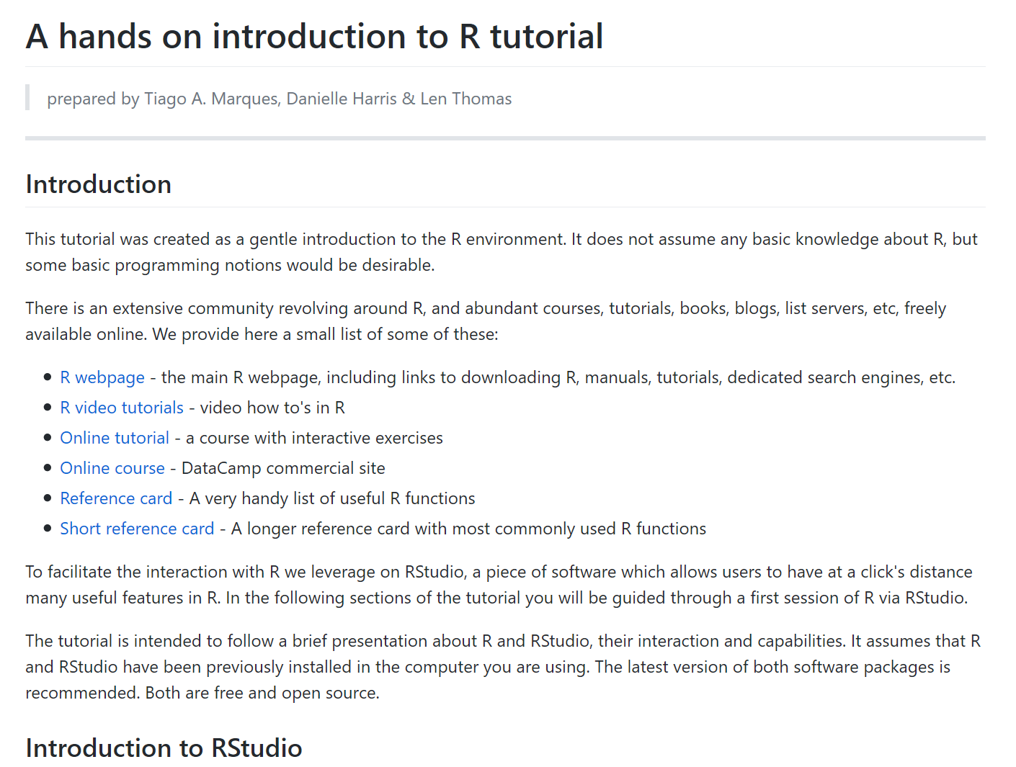
Now... open the hands on tutorial

Slide 14
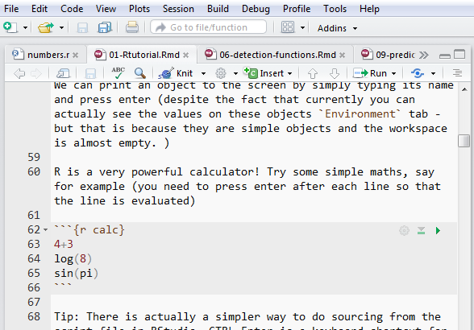
Working with Rmarkdown files
Having downloaded and opened 01-Rtutorial.Rmd
You will see a mixture of readable text along with R code
The bits of R code are called “chunks” and those chunks usually have labels
We are likely to refer to these chunk names when describing computation steps
Lines 62-66 is a chunk named ‘calc’
Green box indicates icons that can be clicked to send code within chunk to console for processing
Orange ellipse indicates icon that can be used to render entire document

