Slide 1
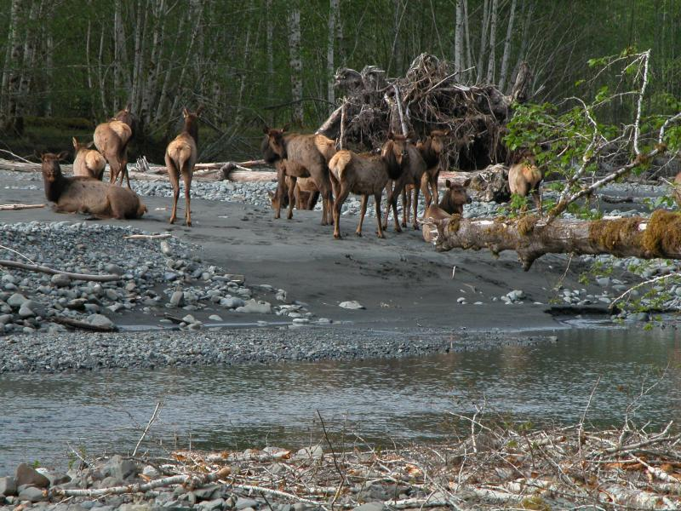
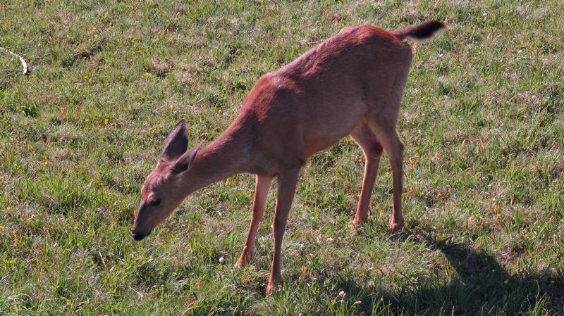
MRDS Example: faecal pellet survey
Photos from US National Park Service photo gallery

Slide 2
Pellet survey design
Survey of faecal pellets of elk and deer in Olympic National Park, Washington, USA, to estimate abundance:
Double observer line transect survey to estimate abundance of pellets incorporating perception bias
Plot clearing experiment to estimate deposition/decay rates of pellets
Stratified random sampling was used to select sampling units
Region (East;West); elevation (<300m;>300m); accessibility (<1km from road;<1km from hiking trail;>1km from road or trail)
Within each sampling unit, 2 parallel transects 200m in length were selected
Two observers worked independently and walked along each of the transects (observer 1) looking for faecal pellet groups within 2m of centre line
Collected information on pellets – perpendicular distance, number of pellets, dispersion, condition
And environmental conditions – ground cover, substrate
Observers swapped transects (observer 2) and repeated survey
Reconciled which pellet groups had been seen by observer 1 only, observer 2 only and by both observers
References
Jenkins KJ and Manly BFJ (2008) A double-observer method for reducing bias in faecal pellet surveys of forest ungulates. J. App. Ecol. 45, 1339-1348
Burt ML, Borchers DL, Jenkins KJ and Marques TA (2014) Using mark-recapture distance sampling methods on line transect surveys. M. E. E. doi: 10.1111/2041-210X.12294 Appendix S2: Running an MRDS analysis is Distance and R: a tutorial

Slide 3
Fitted models: IO configuration
DS model: hazard rate, no covars
MR model: distance + sizegroup
Obs 1 | Obs 2
Obs 2 | Obs 1
Point independence = DS + MR
Full independence = MR

Slide 4
Estimates of detection probability
 | Point independence |  | Full independence
Estimates | Model used | Estimate | Model used | Estimate
Probability of detection assuming g(0)=1 | DS | 0.69 (0.03) | -
Probability of detection on the trackline | MR | 0.94 (0.01) | MR | 0.94 (0.02)
Overall probability of detection | MRDS | 0.65 (0.03) | MR | 0.86 (0.02)
Estimated N in covered region |  | 2116 (0.04) |  | 1601 (0.02)

Slide 5

Detection function summary: IO point independence
Summary for io.fi object MR model
Number of observations : 1380 Pooled
Number seen by primary : 1094 Observer 1
Number seen by secondary : 1102 Observer 2
Number seen by both : 816 Duplicates
AIC : 2457.952
Conditional detection function parameters:
estimate se
(Intercept) 0.28098736 0.188557908
distance -0.00835025 0.001517454
sizegroup2 0.46927834 0.207238009
sizegroup3 1.78569572 0.193560108
sizegroup4 3.19715740 0.440773795
Estimate SE CV
Average primary p(0) 0.7952424 0.017075328 0.02147185
Average secondary p(0) 0.7952424 0.017075328 0.02147185
Average combined p(0) 0.9416874 0.009603405 0.01019808
DS model
assuming g(0)=1
Summary for ds object
Number of observations : 1380
Distance range : 0 - 150
AIC : 13612.95
Detection function:
Hazard-rate key function
Detection function parameters
Scale coefficient(s):
estimate se
(Intercept) 4.425513 0.05855335
Shape coefficient(s):
estimate se
(Intercept) 0.6851006 0.1247415
Estimate SE CV
Average p 0.6924608 0.02190796 0.03163784
Summary for io object MRDS model
Total AIC value : 16070.9 = 2457.952 + 13612.95
Estimate SE CV
Average p 0.6520816 0.02167574 0.03324085
N in covered region 2116.2996331 78.02162494 0.03686700
On the trackline
Overall distances
$${\hat{N}}_{covered}= \frac{1380}{0.652}$$

Slide 6

Detection function summary: IO full independence
Summary for io.fi object MR model
Number of observations : 1380 Pooled
Number seen by primary : 1094 Observer 1
Number seen by secondary : 1102 Observer 2
Number seen by both : 816 Duplicates
AIC : 16217.81
Conditional detection function parameters:
estimate se
(Intercept) 0.28098736 0.188557908
distance -0.00835025 0.001517454
sizegroup2 0.46927834 0.207238009
sizegroup3 1.78569572 0.193560108
sizegroup4 3.19715740 0.440773795
Estimate SE CV
Average p 0.8617999 0.014769988 0.01713854
Average primary p(0) 0.7854780 0.015519397 0.01975790
Average secondary p(0) 0.7854780 0.015519397 0.01975790
Average combined p(0) 0.9368971 0.009788271 0.01044754
N in covered region 1601.2998003 32.267117776 0.02015058
Overall distances
$${\hat{N}}_{covered}= \frac{1380}{0.862}$$
On the trackline

