Slide 1

自动化 Web Service
--介绍
SF系统管理部

Slide 2

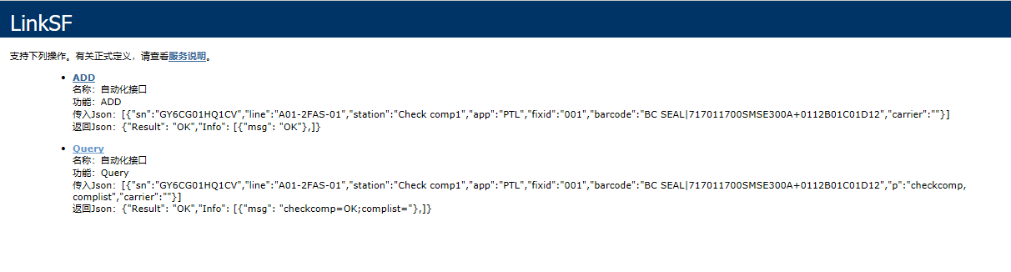
Webservice
SUB段: http://10.55.4.100/Automation_Sub/LinkSF.asmx
组装\镭射\包装段: http://10.55.4.100/Automation/LinkSF.asmx
Query: 用于自动化设备向MES获取数据(check逻辑)
ADD: 用于自动化设备向MES传送数据（过站）

Slide 3
Query传入与输出
传入：[{"sn":"GY6CG01HQ1CV","line":"A01-2FAS-01","station":"Check comp1","app":"PTL","fixid":"001","barcode":"BC SEAL|717011700SMSE300A+0112B01C01D12","p":"checkcomp, complist","carrier":""}]
输出：{"Result": "OK","Info": [{"msg": "checkcomp=OK;complist="},]}
备注：输出的msg里有多少信息取决于传入的P参数，传入有多少个P参数，输出的msg里就会有多少个值

Slide 4
ADD传入与输出
传入：[{"sn":"GY6CG01HQ1CV","line":"A01-2FAS-01","station":"Check comp1","app":"PTL","fixid":"001","barcode":"BC SEAL|717011700SMSE300A+0112B01C01D12","carrier":""}]
输出：{"Result": "OK","Info": [{"msg": "OK"},]}
备注：输出的Result会有OK/NG，Result就OK表示正常完成，Result是NG的表示异常，此时msg里会显示异常信息

Slide 5
Webservice
参数 | 重要 | 示例 | 说明
c | 必传 | c=QUERY | ADD或QUERY
sn | 必传 | sn=F9W2222J28MLKKH22 | ADD为主序号，Query可为主序号及材料序号
barcode | 必传 | barcode=H0001,btn11111 | 格式：材料序号1,材料序号2，如果不link材料只过站即传NA
line | 必传 | Line=A1_2F_HSG_01 | 按实际线传送
station | 必传 | station=Link BTN holder | 按实际站别
app | 必传 | app=PTL或者app=PQC | Link材料站传PTL，不link过站PQC，Laser镭雕
fixid | 必传 | fixid=ict_001 | 实际机台ID
errcode | 不良代码 | Errcode=PASS | PQC过站使用
carrier | Add时必传 | carrier=carrier001 | 有link carrier，传carrier序号，不link传空值，checkcarrier检查治具有无维护
p | Query时必传 | p=model,pn | 如下面P值列表（多个参数用，隔开）

Slide 6
Webservice
P值
sn
Model：机种
wo
PN；GB料号
stage
config
Checkrouting:检查流程
Labeltemplate：pack模版
bcm
hous
spacer
region
cust_pn
bezel_color：颜色
Country国别
BCM_Artwork
mod
moped
Usb_mac_address
Udid
Device_ID
BB_SNUM
IMEI
Ecid
Wifi_mac_address
bt_mac_address
BC_ANT
sensorflex
rxcoilsn
checkhold
checkComp：检查bom
Complist：返回材料特征码
LaserTemplate：镭雕模版
Checkcarrier：检查治具是否维护

Slide 7
示例：checkrouting
Checkrouting检查流程是否正确，返回参数：checkrouting=ok，表示流程正确，否则流程错误。
PC-SF:
[{"sn":"FGR9452883CN7G956P014","line":"A01-2FT-01","station":"Link NA flex","app":"PTL","fixid":"001","barcode":"N FLEX|C4512312312PKFG12","p":"checkrouting","carrier":""}]
SF-PC:
1.流程正确：
{"Result": "OK","Info": [{"msg": "checkrouting=OK"},]}
2.流程不对，检查GB流程，TO：下一流程：
{"Result": "OK","Info": [{"msg": "wo=TESTBCM-A-001;checkrouting=From:SA-Coil---To:Encapsulate dispense and UV cure"},]}
3.流程错误，检查station是否正确：
{"Result": "OK","Info": [{"msg": "checkrouting=checkRouting NG:Routing outstation information not found"},]}

Slide 8
示例：checkcomp
checkcomp检查需要link材料的特征码是否正确，返回参数：checkcomp=ok，表示该材料特征码正确可link，否则不能link。
PC-SF:
[{"sn":"FGR22222222N7GG222229","line":"A01-2FT-02","station":"Link NA flex","app":"PTL","fixid":"001","barcode":"N FLEX|C4512312312PPKX12","p":"checkcomp","carrier":""}]
SF-PC:
1.该材料可用正常使用：
{"Result": "OK","Info": [{"msg": "checkcomp=OK"},]}
2.材料特征码没有维护，或者刷错料：
{"Result": "OK","Info": [{"msg": "checkcomp=序号:C4512312312PPKX121,没有定义相应规则的特殊码"},]}
3.该材料已被使用过：
{"Result": "OK","Info": [{"msg": "checkcomp=序号:C4512312312PPKX12,已经被使用过，不能重复使用!"},]}

Slide 9
示例：checkcarrier
checkcarrier检查治具是否正确，系统是否维护，正确返回参数： checkcarrier=OK,不需要link治具:carrier=“”
PC-SF:
[{"sn":"FGR22222222N7GG222229","line":"A01-2FT-02","station":"Link NA flex","app":"PTL","fixid":"001","barcode":"N FLEX|C4512312312PPKX12","p":"checkcarrier","carrier":"LA1AC-AME-P2-2516&OL0001301"}]
SF-PC:
1.该治具可用正常使用：
{"Result": "OK","Info": [{"msg": "checkcarrier=OK"},]}
2.治具没有维护或者治具编号刷错：
{"Result": "OK","Info": [{"msg": "checkcarrier=NG"},]}

Slide 10
示例：Laser/packing
PC-SF:
[{"sn":"TES01654TEST","line":"A01-2FAS-01","station":"Laser etching 11","app":"Laser","fixid":"001","barcode":"NA","p":"PN,checkrouting,checkcarrier,bezel_color,country,LaserTemplate,model,WO","carrier":"001"}]
SF-PC:
{"Result": "OK","Info": [{"msg": "LaserTemplate=LA1A-AL-HC;PN=L00WS346-CS-H-2A;checkrouting=From:Laser etching 11---To:Folsom IR Dino check FATP;checkcarrier=OK;country=LL;model=LA1A;bezel_color=30;WO=TESTGB0005"},]}
1. Labeltemplate /LaserTemplate：返回模版名
2. country;model;bezel_color：国别，机种，颜色
3.PN返回GB料号，complist可用返回该站料号及特征码

Slide 11
P参数
P可带多个参数“,”隔开。
PC-SF:
[{“sn”:“FGR22222222N7GG222223”,“line”:“A01-2FT-02”,“station”:“Link NA flex”,“app”:“PTL”,“fixid”:“001”,“barcode”:“N FLEX|C4512312312PPKX12”,“p”:“checkcomp,checkrounting,complist,wo,pn","carrier":"LA1AC-AME-P2-2516&OL00013011"}]
SF-PC:
返回材料特征码，工单号，GB料号
{"Result": "OK","Info": [{"msg": "config=CS-R12b-f;wo=TESTBCM-A-002;complist=121-0000Z0-104H|N FLEX|0|C45********PPKX**,121-0000Z0-104H|N FLEX|0|C46********PKFG**;pn=L00WS207-CS-H-BCM"},]}

Slide 12
Webservice error信息
1.line error(线体不对)：
{"Result": "OK","Info": [{"msg": "checkcarrier=OK;checkrouting=checkRouting NG:Routing Instance information not found"},]}
2.station error(制程名不对):
{"Result": "OK","Info": [{"msg": "checkcarrier=OK;checkrouting=checkRouting NG:Routing outstation information not found"},]}
3.sn error（SN长度或者特征码不对，检查SN是否有问题）：
{"Result": "OK","Info": [{"msg": "checkcarrier=OK;checkrouting=checkRouting NG:Routing outstation information not found"},]}
4.station 不在此站（SN的流程不在此站，可先查询此SN流程）:
{"Result": "OK","Info": [{"msg": "checkcarrier=OK;checkrouting=From:SA-Coil---To:Encapsulate dispense and UV cure"},]}
5.carry error（治具没有维护或者刷错carry sn）：
{"Result": "OK","Info": [{"msg": "checkcarrier=NG;checkrouting=OK"},]}

Slide 13
Webservice error信息
6.kpsn error（link材料sn不对，检查kpsn与工单bom维护是否一致，可用complist to query）:
{"Result": "OK","Info": [{"msg": "checkcarrier=OK;checkcomp=序号:624,没有定义相应规则的特殊码;complist=121-0000Z0-104H|N FLEX|0|C45********PPKX**;checkrouting=OK"},]}
7.kpsn 已被使用过（此料已被使用过，检查kpsn）:
{"Result":"OK","Info":[{"msg":"checkcomp序号:DK312312312PQ1T12,C4712312312M80912,C4712312312PN9K12,已经被使用过，不能重复使用!;checkcarrier=OK;checkrouting=From:Link Sip SN/3x flex SN---To:COS S2"},]}
8.kpsn 数量与工单不一致（检查上传kpsn与工单bom数量是否一致）:
{"Result": "OK","Info": [{"msg": "checkcomp=设备只传2个Barcode,实际需要捡3颗料;checkcarrier=OK;checkrouting=From:Link Sip SN/3x flex SN---To:COS S2"},]}
9.SN 已link 过kpsn（此站主SN已经link过kpsn，不能在重复link）:
{"Result" "NG","Info" [{"msg" "ORA-00001 违反唯一约束条件 (SHOPFLOOR.PK_PTL_AUTOLINKMATERIAL_COMP)"},]}
10.参数格式错误（上传json格式不对）:
{"Result": "NG","Info": [{"msg": "在位置 0 处没有任何行。"},]}

Slide 14
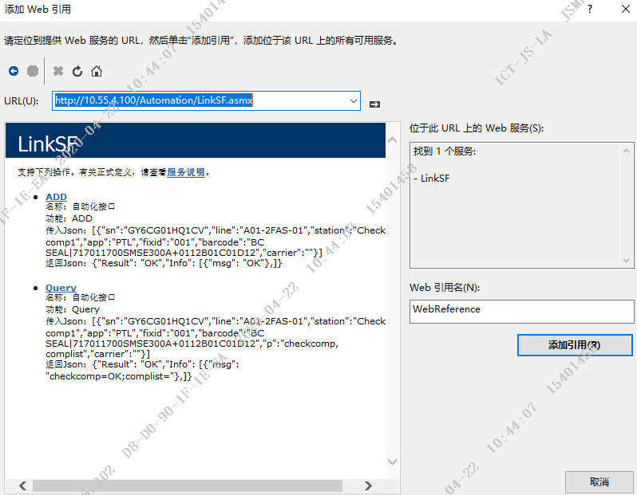
C#调用webservice
LinkSF sf = new LinkSF()
String result = sf.Query(json);
If(){
}
else{
}

Slide 15
谢谢

