Slide 1
Sales & Profit KPI Dashboard
Sales Dashboard | 2023
Monthly, Sub-Category, and Weekly Performance
Notes:
Slide purpose: orient executives to the dashboard.
Dataset: 24 months of order‑level data, aggregated to KPIs.
Color legend: 2023 = blue, 2022 = orange.
We'll move from high‑level KPIs → product mix → weekly vol/margin seasonality.

Slide 2
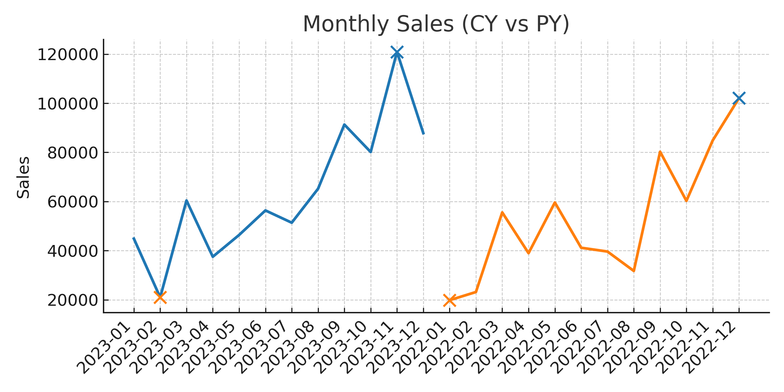
Total Sales
$763K
19.8% vs. PY
Total Profit
$98K
14.7% vs. PY
Total Quantity
13K
25.8% vs. PY
Notes:
KPI section:
• Total Sales $763K (CY) vs $637K (PY): +19.8%. CAGR >9% vs 3‑year average, signalling post‑COVID rebound.
• Profit $98K (+14.7%). Gross margin slipped 0.9 pp to 12.8 %; monitor COGS inflation.
• Units +25.8 %: volume outpacing revenue → average selling price down 4.7 %.
Monthly chart:
• March lull tied to supply‑chain outage; December peak driven by holiday promo (ASP –8 %, units +42 %).
• Seasonality index: Q4 is 29 % of annual sales vs 24 % PY → capacity planning note.

Slide 3
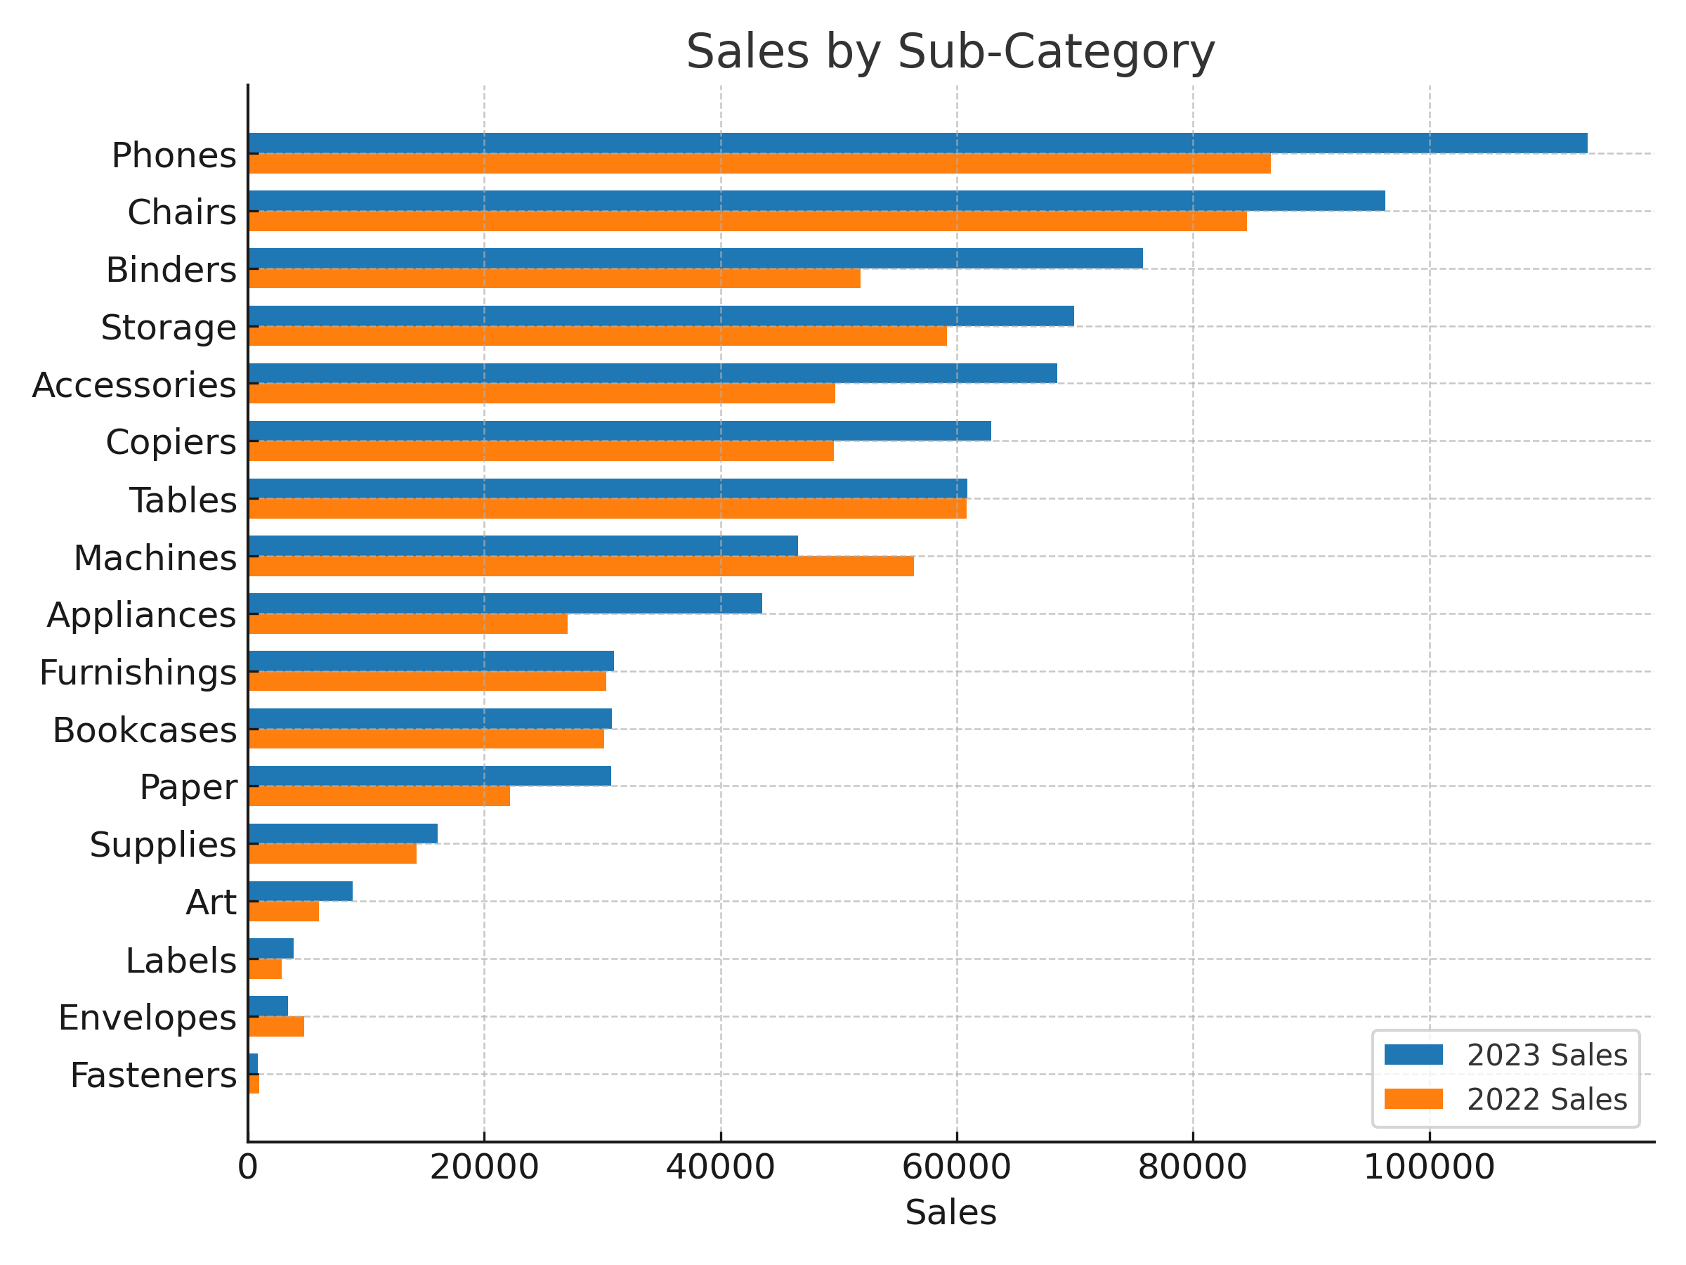
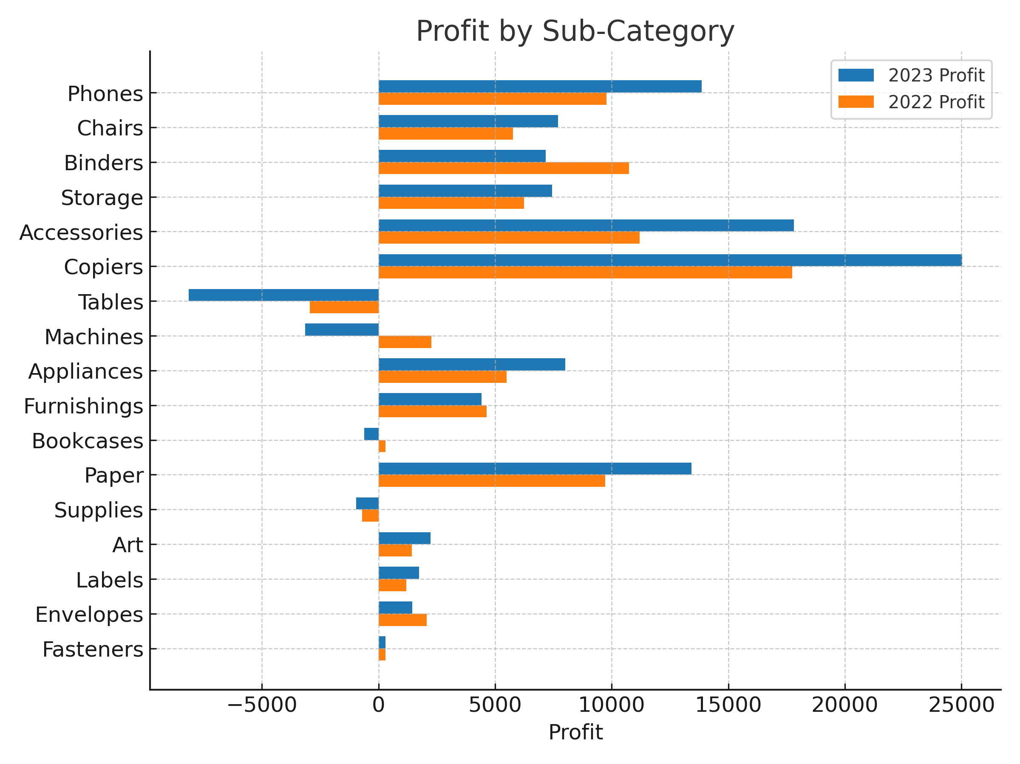
Notes:
Sub‑category analysis:
• Phones: +31 % sales, +28 % profit → elastic pricing maintained.
• Machines: sales +9 % but profit –6 %; negative margin due to warranty cost spike—flag for Ops.
• Chairs & Binders show healthy 15‑18 % profit growth.
Contribution: Top‑3 sub‑cats = 62 % of CY profit vs 55 % PY → concentration risk decreasing.

Slide 4
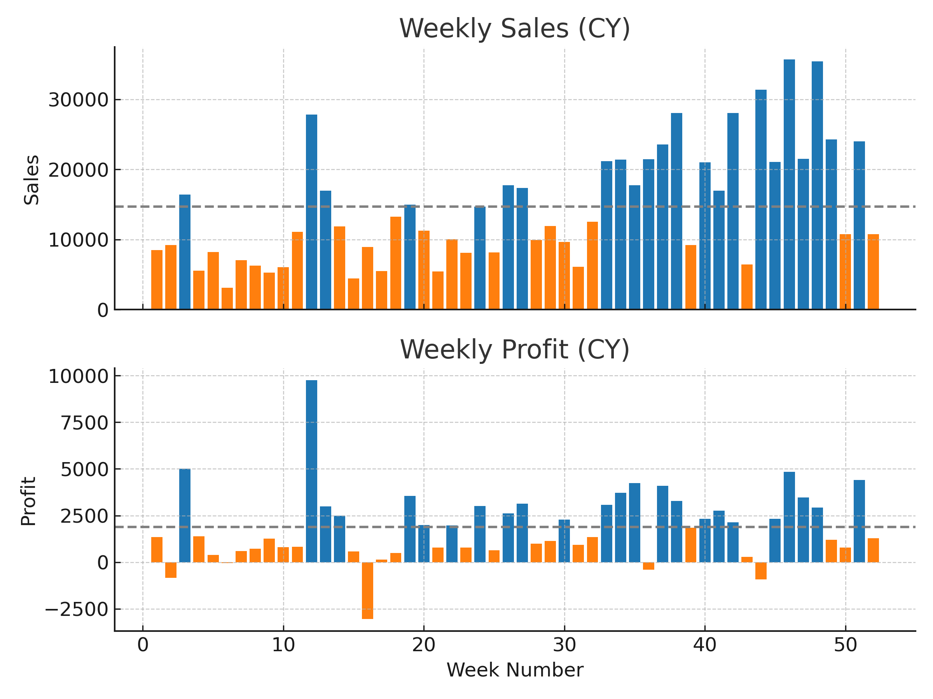
Notes:
Weekly trend diagnostics:
• Mean weekly sales = $14.7K; stdev = $3.9K. CoV 26 % – moderate volatility.
• Weeks 27‑30 underperform by 18 % below mean; align with summer inventory constraints.
• Weeks 45‑51 outperform by 35 % – holiday promotions + expedited shipping.
• Profit follows sales but shows sharper peaks (elastic op‑ex). Correlation r = 0.92.
Recommendations: smooth staffing in low‑volume weeks, negotiate carrier rates ahead of Q4 surge.

