Slide 1

ISYS3450
BLOCKCHAIN FOR BUSINESS
Blockchain Collaborative Network Analysis Framework

Slide 2
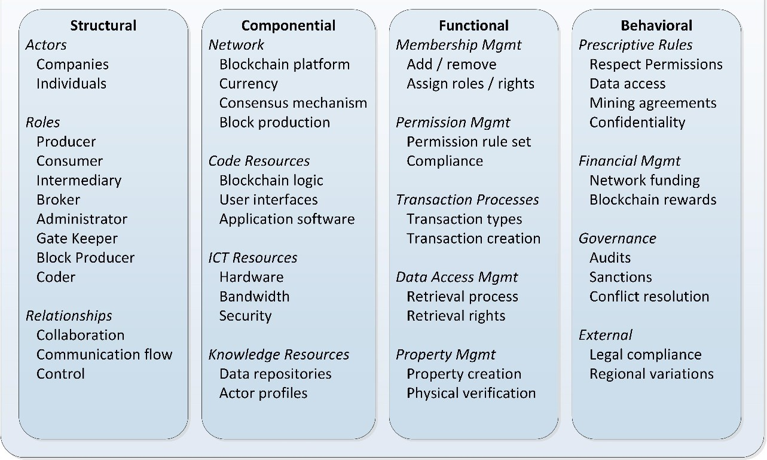
Blockchain Collaborative Network Development Framework
Adamopoulos, Davey, Bruno, Dick, 2019. “Blockchain Collaborative Network Development Framework”. SSRN.

Slide 3
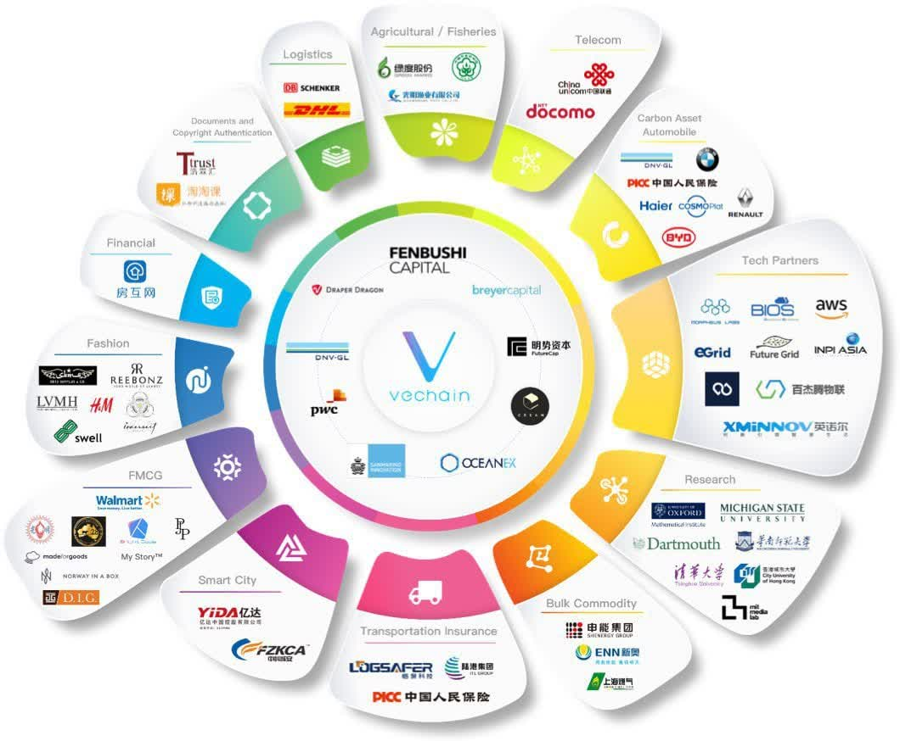
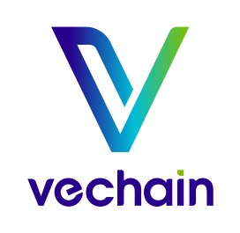
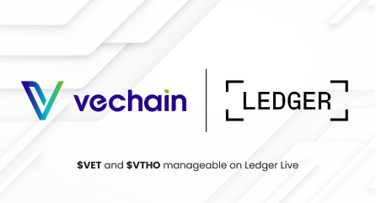

Slide 4
1. Structural: ‘who’ of the collaborative network
The structural elements encompass all the participants of the collaborative network, or the ‘who’ of the network
Actors
Depending on the specific collaborative network, participants may be individuals, companies, government departments, community organizations or industry bodies.
The collaborative network will need a protocol that defines who can participate and in what role or capacity they are allowed to participate.
In some collaborative networks, all participants may be of equal ranking (e.g. an interbank transfer network) whereas other networks may have one dominant participant, especially where government is involved (e.g. a property title registry).

Slide 5
1. Structural: Roles
Producer
Participants that are the creators or originators of the product being recorded on the blockchain. For example, in supply chain networks this could be the primary producer, mining company or manufacturer.
Consumer
Participants who are the consumer of a product or service being recorded on the blockchain. In a supply chain scenario the end consumer may be the retailer, rather than members of the public. In a health information blockchain, the consumer may be the patient or the doctor.
Intermediary
Intermediaries in the network are participants that play some role between the producer and consumer. E.g. wholesalers or transport companies.

Slide 6
1. Structural: Roles
Broker
Brokers act as a channel between the collaborative network and the outside world.
E.g. in a property registry blockchain, real estate agents may be brokers.
Administrator
The blockchain network will need participants to maintain and manage the network itself. This role may be shared by between principal members or have a natural central administrator, such as a health network being administered by the government.
Gate Keeper
A collaborative network may include one participant that has the sole responsibility of adding members to the network and allocating them appropriate keys and permissions.

Slide 7
1. Structural: Roles
Block Producer
Some participants will provide computational power to maintain the actual blockchain. The block production or mining may be shared amongst principal members of the network, or it may be centralised and provided by a single party.
Another alternative is that the blockchain maintenance may be completely outsourced by the network to a third party provider.
Coder
Blockchain networks based on smart contracts require somebody to actually write and maintain the code for the contracts and transactions. The network members may share these duties or they may outsource this role to a third party.

Slide 8
1. Structural: Roles – Example (VeChain)
Roles include
Producers: Businesses using VeChain for product tracking.
Consumers: End users verifying product authenticity.
Intermediaries: Logistics companies ensuring product traceability.
Administrators: VeChain Foundation members overseeing network operations.
Coders: Developers maintaining and improving the VeChain blockchain platform.
Block Producers: These are nodes responsible for validating transactions and creating new blocks in the VeChain blockchain. They play a crucial role in maintaining the network's integrity and security.
Brokers: They act as intermediaries between the VeChain network and external entities. Brokers could be involved in facilitating transactions, integrating external data sources, or connecting VeChain's blockchain services with external business systems.
Gatekeepers: In the context of VeChain, gatekeepers might manage access to the network, ensuring security and compliance. They could be responsible for issuing or validating credentials, managing permissions, and overseeing the addition of new participants to the network.

Slide 9
1. Structural: Relationships
Another element of the structure of the collaborative network is the relationships that may exist between actors.
Some of these relationships may be via the blockchain itself while there may also be other relationships between the actors as part of the network that do not directly use the blockchain. For example, several members of the network may officially collaborate to accomplish a particular role, such as developing the code.
There may be communication flows between members or from one central member to all other participants. Some blockchain networks may have a natural central member that has considerable control over some other members in the network, particularly, for example, with government controlled blockchains.

Slide 10
Blockchain Collaborative Network Development Framework
Adamopoulos, Davey, Bruno, Dick, 2019. “Blockchain Collaborative Network Development Framework”. SSRN.

Slide 11
2. Componential: Resources Required
The componential elements of the framework represent the various resources that are needed to create and maintain the operation of the blockchain collaborative network – the ‘what’ of the network.
Network: Blockchain Platform
There are a number of blockchain platforms available so a choice must be made as to which platform the collaborative network will utilize.
If smart contracts are required, the choice will need to be a platform that supports smart contracts such as Ethereum or Hyperledger.
The platform choice may also be influenced by the permission controls required in the blockchain.

Slide 12
2. Componential: Network
Currency
In some collaborative networks a currency or token will be a key element in providing a trading or payment mechanism between participants, whereas for other networks a currency is not relevant.
Consensus Mechanism
Choice of consensus mechanism. Proof of authority, proof of work, proof of stake etc.
Block Production
Some networks may have all participants contribute as miners/producers/validators to avoid the possibility of any single participant controlling the blockchain. In other networks, one or a few trusted members may operate as block producers. Yet another option is to outsource to a “blockchain as a service”

Slide 13
2. Componential: Network (VeChain)
Network: Blockchain Platform:
VeChain uses a hybrid blockchain model, incorporating elements of both public and permissioned blockchains. Here are the details:
Public Blockchain: VeChainThor, the blockchain that VeChain operates on, is fundamentally a public blockchain. This means that anyone can join the network, read the data on the blockchain, and participate in the consensus process. This aspect ensures transparency and decentralization, key features of public blockchains.
Permissioned Features: While VeChainThor is a public blockchain, it includes permissioned features to enhance security and efficiency, particularly for enterprise use cases. The permissioned aspects allow certain nodes and participants to have special roles and permissions, enabling better control and compliance with regulatory requirements.
Currency:
VeChain utilizes a dual-token system comprising VET and VTHO. VET is the primary token used for transactions and other activities on the VeChain platform. It represents the right to use the VeChain blockchain and is used for staking and governance. VTHO, on the other hand, is used to pay for the execution of transactions and smart contracts. This dual-token model stabilizes transaction costs and separates the cost of using the blockchain from market speculation.

Slide 14
2. Componential: Network (VeChain)
Consensus Mechanism:
VeChain employs a Proof of Authority (PoA) consensus mechanism. In this system, 101 Authority Masternodes, chosen based on strict KYC procedures, are responsible for reaching consensus on transactions and blocks. This approach is chosen to balance decentralization, security, and speed, optimizing the blockchain for enterprise use. The PoA system is energy-efficient and ensures a high throughput, making it suitable for a variety of business applications.
Block Production:
In the VeChainThor blockchain, blocks are produced by the Authority Masternodes every 10 seconds, ensuring a fast and efficient transaction process. This rapid block production is essential for applications requiring quick transaction times, like supply chain tracking. The block producers (Authority Masternodes) are incentivized to maintain the network's integrity and security, as their reputation and identities are known.

Slide 15
2. Componential: Code Resources
Every blockchain collaborative network will need software to operate.
If smart contracts are needed, someone will have to write them
Software goes far beyond smart contracts and includes application software and user interfaces to allow participants to interact with the system.
Human resources will need to be organized to develop and maintain the software.
May be done by each member independently, shared or outsourced to a third party.

Slide 16
2. Componential: ICT Resources
ICT resources will need to be provided by the collaborative network members.
Agreements will need to be put in place as to which members will provide ICT resources for the network and what computing power and network bandwidth will be needed.
Alternatively the network provision could be outsourced completely to a “blockchain as a service” provider, in which case the collaborative network would need agreement on how the service provider will be financed.

Slide 17
2. Componential: Knowledge Resources
The collaborative network will also need knowledge resources to be maintained that are not actually part of the blockchain itself.
These include all documents and agreements that are necessary to form and operate the collaborative network.
Data repositories will also be needed to record the participants of the network, their actor profiles and permission sets.

Slide 18
Blockchain Collaborative Network Development Framework
Adamopoulos, Davey, Bruno, Dick, 2019. “Blockchain Collaborative Network Development Framework”. SSRN.

Slide 19
3. Functional: Operations and Actions
The functional elements of the framework represent the various operations and actions that members of the collaborative network will perform – the ‘how’ of the network
Membership Management
Need a set of protocols to determine how members of the network will be chosen, how they will be added to the network and how they will be granted permissions.
Protocols will also be needed to assign members to various roles and control the rights and permissions they have to create transactions and view data.
Membership management may be distributed, allowing multiple members to invite and manage others, or might be controlled solely by a central authority member.

Slide 20
Functional
Permission Management:
The collaborative network will also need to define the permission rules that the network will operate under. These rules will determine who is allowed to create transactions, access details of the transactions, and what details each party is allowed to access.
E.g. in a supply chain network, a manufacturer can enter details of a product once it is manufactured, but a retailer can only verify the date of manufacture.
The permission management will be very important to ensure the members of the collaborative network trust the network and that data they place into the blockchain will remain secure and only be used as intended.
Some collaborative networks may implement audit or compliance processes to ensure that members abide by the rules and take action against members who do not.

Slide 21
Functional
Transaction Processes
These are transactions that are to be performed by collaborative network members.
These transactions need to be defined and then implemented in smart contracts.
The collaborative network members need to know what types of transactions are possible and who has permission to perform certain types of transactions.
Data Access Management
The ability to control which data on the blockchain members have access to.
As well as code to record transactions into the blockchain, code will also be needed to view information found in the blockchain.
The retrieval processes will need to determine, following the rule sets, which data a particular network member is allowed to view.

Slide 22
Functional
Property Management
Blockchains may record property that members have a right to or ownership of, such as intellectual property or property that exists physically in the real world.
Protocols and/or processes are required to be able to verify that what is recorded in the blockchain accurately reflects the property in the real world.
E.g. if the blockchain records that a box of baby formula was manufactured, a physical audit may be needed to verify the baby formula and has not been tampered with.

Slide 23
Functional – VeChain
Membership Management: VeChain may use a structured process to verify and authenticate the identities of network participants, such as businesses and end-users. This process could include specific criteria for joining the network and determining the roles of different participants.
Permission Management: VeChain likely has a system to regulate who can initiate and verify transactions, and who has access to certain parts of the blockchain. This is crucial for maintaining a balance between transparency and privacy, especially for enterprise applications.
Transactional Processes: VeChain probably uses smart contracts to automate transaction processes. This is especially vital for supply chain use cases, where contracts can be set to execute automatically when certain conditions are met.
Data Access Management: In VeChain, there would be mechanisms to control who has access to which data stored on the blockchain. This ensures data security and integrity, allowing only authorized entities to access sensitive information.
Property Management: VeChain's blockchain is likely used to manage the ownership and transfer of assets. This is particularly important in supply chain scenarios where the blockchain can be used to authenticate and track products throughout the supply chain

Slide 24
Blockchain Collaborative Network Development Framework
Adamopoulos, Davey, Bruno, Dick, 2019. “Blockchain Collaborative Network Development Framework”. SSRN.

Slide 25
4. Behavioural: Expectations and Rules
The behavioural elements of the framework represent the behaviours that are expected from members of the network and also various processes that are necessary to operate the collaborative network
Financial Management
Agreements are needed to cover the financing of all resources and activities. Some networks may require members to each provide their own resources while other networks may require members to contribute towards a central fund.
Where the private blockchain uses a blockchain currency or token, the mining process may produce token rewards for the miner as a form of payment.

Slide 26
4. Behavioural: Prescriptive Rules
The collaborative network will require a set of rules that members of the network agree to abide by. These rules prescribe how members are expected to behave in order for the collaborative network to function.
At a basic level, the members of the network agree to respect all permission rules and blockchain processes and not to circumvent the security controls in the blockchain.
There needs to be agreement as to which members will maintain the blockchain itself, and agreement that members will not take actions that would give them access or control over the blockchain they are not entitled to.
The rules also need to cover how members access data and what they are allowed to do with the data. The collaborative network may also require that members keep data they have access to confidential and not pass data on to outside parties.

Slide 27
4. Behavioral: Expectations and Rules
Governance
A set of rules and processes to provide governance is needed.
Audit processes to ensure members abide by the rules.
Where non-compliance is discovered, there may need to be sanctions imposed.
Rules that determine how conflicts between members are handled.
External
Expected behaviors may also be prescribed by external requirements.
The collaborative network needs to abide by the laws of the countries the network spans.
There may be regional differences in each country that need to be accounted for.

Slide 28
4. Behavioral - VeChain
Prescriptive Rules: VeChain's governance structure ensures that all participants comply with the network's rules and regulations. This includes the roles and responsibilities of authority nodes, regular nodes, and other participants. VeChain likely has specific operational rules for network members to ensure efficient and ethical blockchain practices, including adhering to smart contract protocols and maintaining data integrity. VeChain leverages smart contracts to enforce these prescriptive rules automatically. Smart contracts can control access to data, manage transactions, and ensure compliance with the network's protocols without the need for manual oversight.
Financial Management: In the VeChain network, members are required to provide their own resources for participating in the network. This includes computational power, storage, and other infrastructural resources necessary to maintain the blockchain. While VeChain does not typically require a central fund from its members, certain collaborative projects within the ecosystem might pool resources for specific purposes.
VeChain ensures that the financial aspects of maintaining the blockchain and the network are efficiently managed. Enterprises leveraging VeChainThor do not need to invest heavily in infrastructure, as they can utilize VeChain’s BaaS offerings.
VeChain's dual-token system (VET and VTHO) may define its financial management structure, with VET for governance and staking, and VTHO for transaction costs. The dual-token system provides a balanced approach to incentivize participation and investment in the network. VET holders benefit from the generation of VTHO, which is essential for transaction processing.

Slide 29
4. Behavioral - VeChain
Governance: VeChain's governance could involve how decisions are made within the network, including updates to the blockchain protocol and managing the Proof of Authority consensus.
Governance Structure: VeChain's governance is led by the VeChain Foundation and a Steering Committee, ensuring participants are aware of rules and responsibilities. The Foundation oversees development and strategic direction, while the Committee, comprising representatives from various sectors, makes key decisions on blockchain development and updates.
Audit: Regular audits and compliance checks maintain the blockchain's security and integrity. Smart contracts on VeChainThor are rigorously audited to ensure they meet security and functional standards.
Sanctions for Non-Compliance: Non-compliance results in predefined sanctions, such as loss of authority node status, reduced rewards, or network exclusion. Reputation within the network is crucial, and non-compliance can damage it, affecting future participation.
Conflict Resolution: VeChain handles conflicts through mediation by the Foundation or arbitration by a third party. The Proof of Authority (PoA) consensus mechanism helps minimize conflicts by clearly defining roles and ensuring transparent decision-making.

Slide 30
4. Behavioral - VeChain
External Aspect: Compliance with external legal and regulatory requirements is crucial, especially given VeChain's enterprise focus, necessitating adherence to various regional and international laws and standards.
VeChain operates globally, which means it must comply with the legal frameworks of various countries. This includes adhering to regulations related to data privacy, financial transactions, and blockchain technology. Different regions may have specific laws that impact how blockchain technology can be used. For example, the European Union has stringent data protection regulations (GDPR) that VeChain must comply with when operating in Europe.
VeChain must ensure that its financial operations, including token issuance and transactions, comply with the financial regulations of the countries it operates in. This includes Anti-Money Laundering (AML) and Know Your Customer (KYC) regulations. Some countries have specific regulations for blockchain and cryptocurrency activities. VeChain needs to navigate these regulations to ensure that its operations are lawful and transparent.

