Slide 1
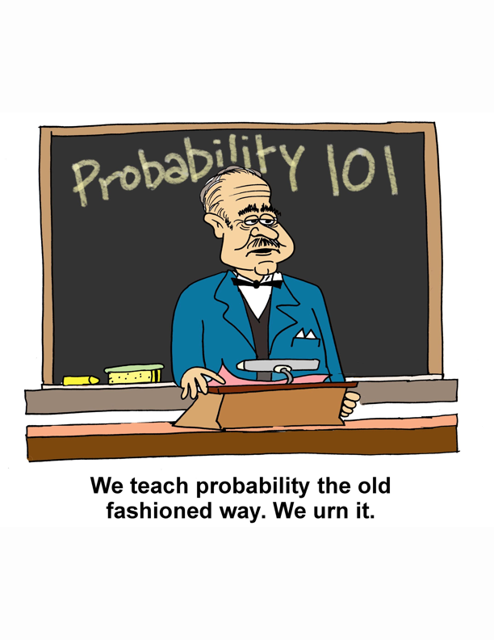

Slide 2
Interactive Probability Instruction
Ivo Dinov, UCLA
Dennis Pearl, OSU
Kyle Seigrist, UAH
www.distributome.org/meetings/USCOTS_2013
www.distributome.org/V3

Slide 3
Login
Username = san060417
Password = 25565

Slide 4
A Paradigm
Reality
The Model
The Analysis
statistics
assumptions
approximations

Slide 5
Questions to ask (to understand how well probability statements reflect reality)
What assumptions are being made? Are they realistic?
Can model deviations from reality be quantified?
What approximations are being made?
Are they accurate? Are they necessary?
Do data agree with model predictions?
Does the model need to be refined or simplified?

Slide 6
Jigsaw Review
Teams work together on solving a set of problems.
New teams are formed taking one member from each original team.
Members of the solving team must explain the solution to their problems to their new team.

Slide 7
What’s the distribution? A
X = how much ice will be used on the next full Southwest Airline flight from Denver, CO to Raleigh/Durham, NC.
X = how long until the next 2001 Toyota Prius hybrid goes through a toll booth on the Golden Gate Bridge.
X = how many randomly chosen people will it take to find 10 who are left-handed.
X= how many randomly chosen people will it take find one who is left-handed.

Slide 8
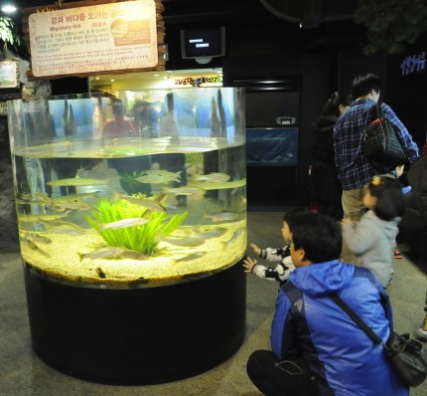
What’s the distribution? B
X = the number of red-flowering plants in 100 crosses between pink flowering plants
X = the position (degrees clockwise from you) of a fish swimming in a cylindrical tank.
X = median position of the same fish wrt the first person visiting the aquarium each day this week.
X = the average amount of time that a sample of 500 regular subscribers to the New York Times spend on the Sunday crossword puzzle.

Slide 9
What’s the distribution? C
X = how many 2001 Toyota Prius hybrids go across the Golden Gate bridge tomorrow.
X = the average age of the quarters in the pockets of 100 men at a NY Yankees baseball game.
Four participants in this workshop will be picked to form the first team for a “jigsaw review”. X = how many graduate students are on that team.
X = In a sample of just one person – how many favor imposing a uniform sales tax on internet purchases.

Slide 10
What’s the distribution? D
X = how many hours until the next diet coke is purchased from a vending machine.
X = how many hours until five separate people purchase a diet coke from a vending machine.
X = how many of the next ten parties that a waiter serves will leave a tip of more than 20% of the bill.
X = the birth month of the next person to board a plane from Honolulu to Los Angeles.

Slide 11
Follow-ups
A: Worldwide 11% of people are left-handed. Are the workshop participants unusual in this regard?
B: An icthyologist suggests that fish will tend to shy away from the visitor. What median angles would give strong evidence for this theory?
C: Is the number of grad students in your team unusual? What about the highest number in any team?
D: Do you think it’s likely to have at least two months with no birthdays for the people in the room?
ALL GROUPS: suggest your own follow-up that can be investigated by students

