Slide 1
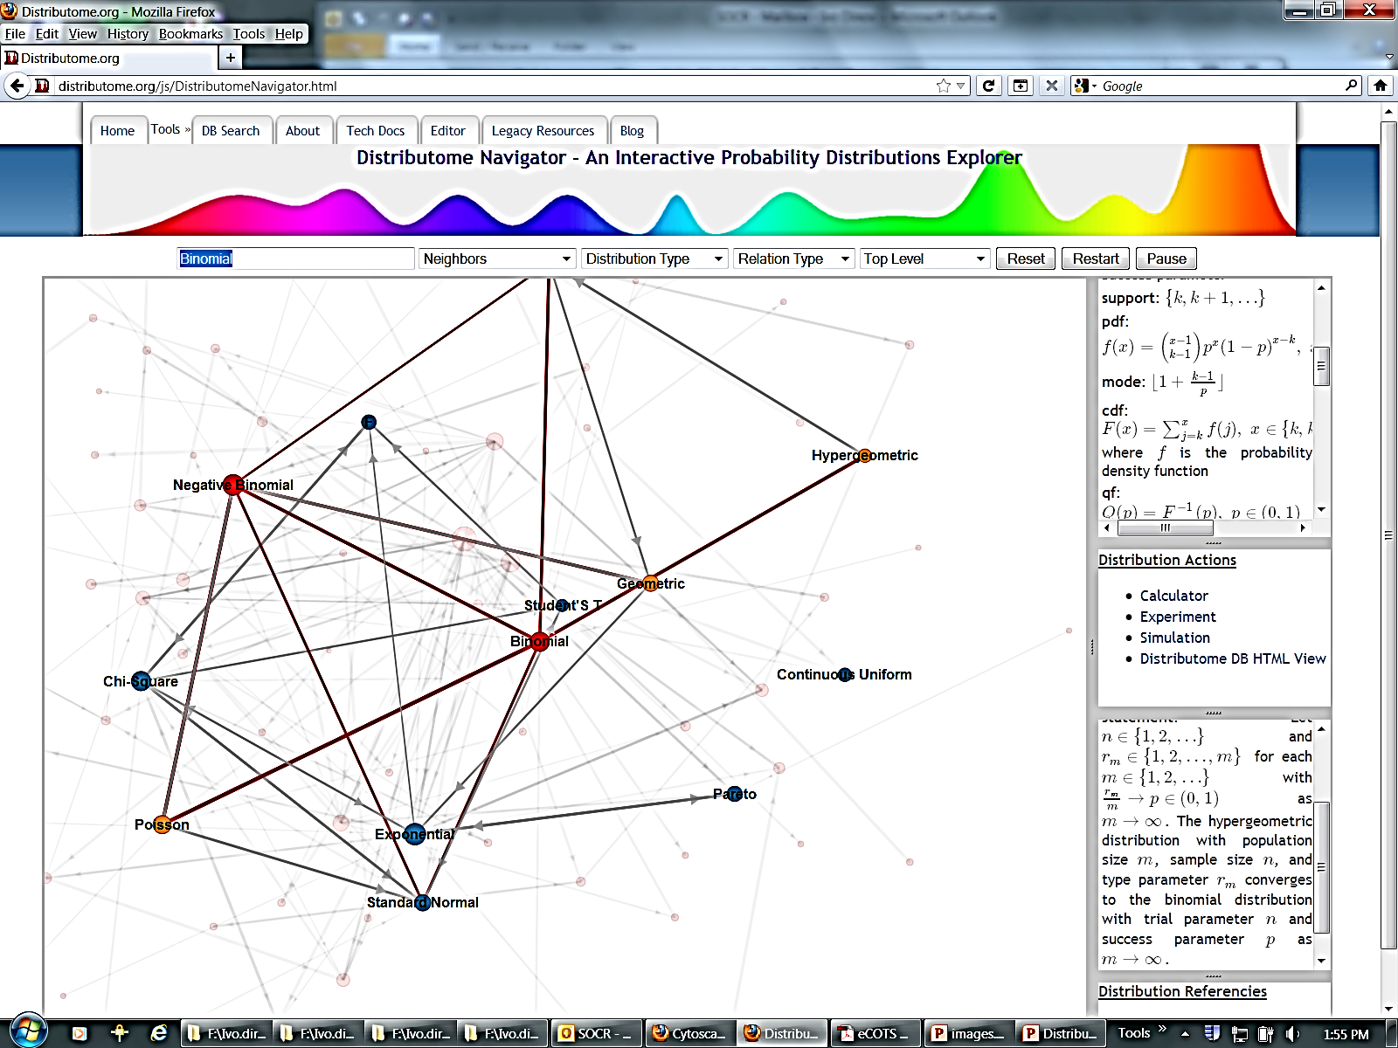



Hands-on Distributome Activities for Teaching Probability Interactive Teaching of Probability Distributions Theory & Applications using Data, Models and Webapps
http://Distributome.org
UCLA
Ivo D. Dinov
Kyle Siegrist
Distributome
Dennis Pearl

