Slide 1
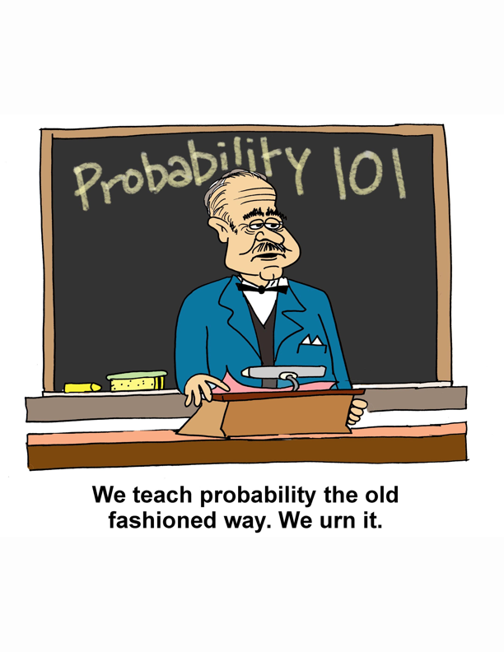

Slide 2
Web Resources for Interactive Probability Instruction
Ivo Dinov, UM
Dennis Pearl, OSU
Kyle Siegrist, UAH
www.distributome.org/meetings/eCOTS_2014

Slide 3
The Distributome Project
Open Source resources for Teaching and Learning Probability
Advisory Board
Lang Moore, Duke University & Math DL
Bob Dobrow, Carleton College & Probability Web
David Aldous, U.C. Berkeley

Slide 4
A Paradigm
Reality
The Model
The Analysis
statistics
assumptions
approximations
Notes:
Paradigm for making conclusions from data. Some situations you control the random mechanism that creates the data (randomized experiments random samples) but most data is observational and you need to draw analogies between raw chance process and the behavior of data.
Analyze what kinds of data would come from model - > Approximations at the analysis stage can be theoretical or simulations
Then statistics let’s you apply the analysis model to draw conclusions (confidence intervals, posterior distributions, significance tests, etc…)

Slide 5
Questions to ask (to understand how well probability statements reflect reality)
What assumptions are being made? Are they realistic?
Can model deviations from reality be quantified?
What approximations are being made?
Are they accurate? Are they necessary?
Do data agree with model predictions?
Does the model need to be refined or simplified?
Notes:
Turn over to Ivo at end of this slide

Slide 6
An Active In-class Review: The Jigsaw
Teams work together on solving a set of problems. For example – problems in assigning models to real situations from the game database
New teams are formed taking one member from each original team.
Members of the solving team must explain the solution to their problems to their new team.

Slide 7
What’s the distribution? A
X = how much ice will be used in the drinks on the next full Southwest Airline flight from Denver, CO to Raleigh/Durham, NC.
X = how long until the next 2001 Toyota Prius hybrid goes through a toll booth on the Golden Gate Bridge.
X = how many randomly chosen people will it take to find 10 who are left-handed.
X= how many randomly chosen people will it take find one who is left-handed.

Slide 8
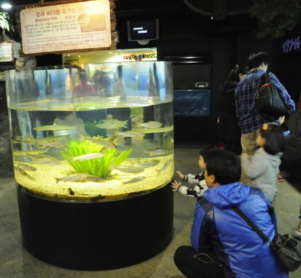
What’s the distribution? B
X = the number of red-flowering plants in 100 crosses between pink flowering plants
X = the position (degrees clockwise from you) of a fish swimming in a cylindrical tank.
X = median position of the same fish wrt the first person visiting the aquarium each day this week.
X = the average amount of time that a sample of 500 regular subscribers to the New York Times spend on the Sunday crossword puzzle.

Slide 9
What’s the distribution? C
X = how many 2001 Toyota Prius hybrids go across the Golden Gate bridge tomorrow.
X = the average age of the quarters in the pockets of 100 men at a NY Yankees baseball game.
Four participants in this workshop will be picked to form the first team for a “jigsaw review”. X = how many graduate students are on that team.
X = In a sample of just one person – how many favor imposing a uniform sales tax on internet purchases.

Slide 10
What’s the distribution? D
X = how many hours until the next diet coke is purchased from a vending machine.
X = how many hours until five separate people purchase a diet coke from a vending machine.
X = how many of the next ten parties that a waiter serves will leave a tip of more than 20% of the bill.
X = the birth month of the next person to board a plane from Honolulu to Los Angeles.

Slide 11
Follow-up Activities
Follow in-class Jigsaw review with a follow-up activity using Distributome; SOCR; or Virtual Lab tools
Example for group A - Worldwide 11% of people are left-handed. Are the students in our class unusual in this regard?

Slide 12
Follow-ups
A: Worldwide 11% of people are left-handed. Are the workshop participants unusual in this regard?
B: An icthyologist suggests that fish will tend to shy away from the visitor. What median angles would give strong evidence for this theory?
C: Is the number of grad students in your team unusual? What about the highest number in any team?
D: Do you think it’s likely to have at least two months with no birthdays for the people in the room?
ALL GROUPS: suggest your own follow-up that can be investigated by students

Slide 13
Distributome games
Out-of-class Activity
Learning Objectives
Develop probability models for real situations
Recognize the relationship between data histograms and the density they were sampled from.
Know the shapes of important probability densities

