Slide 1
Censusables
Group 7
Economic Mashups: Informing Economic Development Decisions through Traditional and Emerging Data

Slide 2
Original Project
Russ Rezek – Project coordinator/developer
Jeff Chen – Group mentor
  Acting Chief Data Scientist for Dept of Commerce
Traditional economic analysis relies on mature data which tracks long term trends
With emerging data from tech sector, we wanted improve insight into current economic trends

Slide 3
Background – Census Data
Census data is extremely rich data set that can be used to measure economic activity (income, poverty, costs, etc)
Small geographic size:
  ZCTA = Most frequent zip code in area
  Tract Level = 1,500 to 8,000 people
  Block Level = 0 to 100 people
Data released, by law, one year after census day (April 1, 2010)
Only taken every 10 years – decade long gaps in data
Stop gap: American Community Survey (ACS)

Slide 4
ACS Data
Distinguishing features of ACS 1-year, 3-year, and 5-year estimates
1-year estimates | 3-year estimates* | 5-year estimates
12 months of collected data Example: 2014 ACS 1-year estimates Date collected between: January 1, 2014 and December 31, 2014 | 36 months of collected data Example: 2011-2013 ACS 3-year estimates Date collected between: January 1, 2011 and December 31, 2013 | 60 months of collected data Example: 2010-2014 ACS 5-year estimates Date collected between: January 1, 2010 and December 31, 2014
Data for areas with populations of 65,000+ | Data for areas with populations of 20,000+ | Data for all areas
Smallest sample size | Larger sample size than 1-year | Largest sample size
Less reliable than 3-year or 5-year | More reliable than 1-year; less reliable than 5-year | Most reliable

Slide 5
ACS Data (con't)
1-year estimates | 3-year estimates* | 5-year estimates
Most current data | Less current than 1-year estimates; more current than 5-year | Least current
Best used when | Best used when | Best used when
Currency is more important than precision Analyzing large populations | More precise than 1-year, more current than 5-year Analyzing smaller populations Examining smaller geographies because 1-year estimates are not available | Precision is more important than currency Analyzing very small populations Examining tracts and other smaller geographies because 1-year estimates are not available

Slide 6
What problem are we trying to solve?
Census data: most reliable, but taken only 10 years
ACS data more reliable every 5 years, less reliable at 3 and 1 year estimates
Geographic areas large for most current data (i.e. MSA for 1 year estimates)
Need current, available, and reliable data to measure economic activity for smaller geographic areas: use emerging data

Slide 7
Tools Used
Python
  Pandas
  Scikit-learn
  Vincent
Web Application/Data Visualization
  jQuery
  D3 via Vincent

Slide 8
Original Solution
Use Starbucks location Data to predict shifts from locally driven retail to big box/chain retail
Use Yelp Data to measure economic activity by geolocation (long/lat)
  Star ratings
  Review counts

Slide 9
Challenges with Data
Starbucks data only had location data, not store open date
  Hard to gauge trends over time
Yelp data
  Data for only 6 cities in US released
  No correlation found between census and Yelp data at census tract level

Slide 10
Project Pivot
Refocus on other datasets:
  ACS 5 year data, Zillow Data (Housing Cost)
Per Jeff Chen, project owner, suggested that we develop app that allows a user to weight key features to identify neighborhoods that align to their interests
Use Principal Component Analysis (PCA) to compute top zip codes and heat map of US

Slide 11
PCA Analysis: What is it?
Procedure in statistics
A orthogonal linear transformation used to emphasize variation
It is a way to identify strong patterns of variation in a dataset
Best used when you have many variables

Slide 12
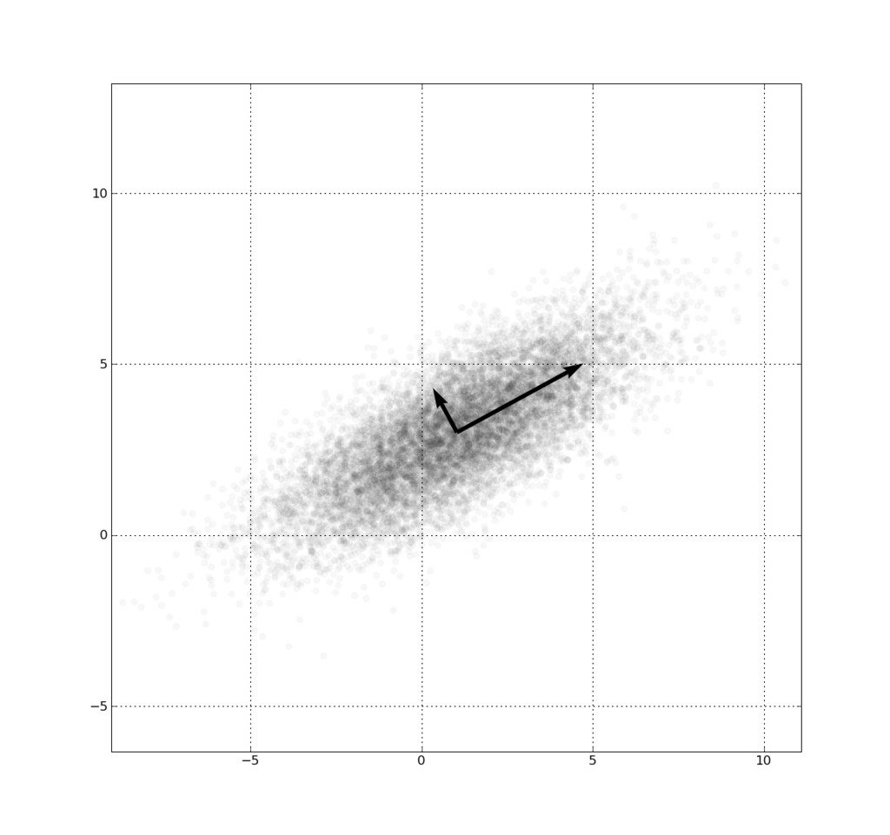
PCA (con't)
Best used to visualize data

Slide 13
Final Project
Web Application
  4 sliders
  Income: ACS Income, SNAP, Poverty Index
  Housing Cost: Zillow Housing and Rental
  Diversity: Diversity Index calculated from ACS data (http://diversity.missouristate.edu/DiversityIndex.html)
  Population Density: Population vs. Land in Square Meters

Slide 14
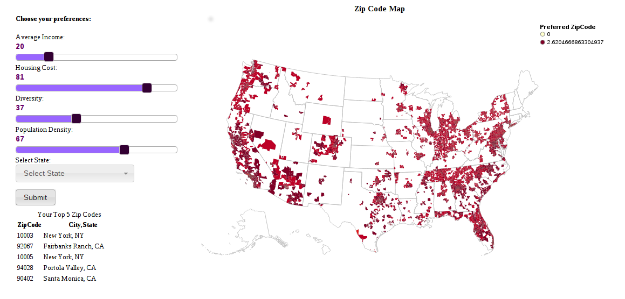
User Interface

Slide 15
Application: Utility
Allows someone from the public to quickly identify preferred zip codes based upon their own preferences
Helpful for someone looking to move to area that better fits their lifestyle
Helpful for businesses looking to startup/relocate to areas that aligned them to customers/employees
Ability to filter by state

Slide 16
Application: Technical Design
Simple Flask web application
Modern interface controls via jQuery
Heat maps based upon slider input that show preferred zip codes
Option to display state map
Maps rendered using Vincent (leverages Vega and D3 technologies)

Slide 17
Application: Novelty
Map visualizations
Multiple sources of data
Mix of traditional and new emerging data from tech sector
  Relatively new concept
Extendable as social media becomes more accessible

Slide 18
Challenges
Group attrition
Skill deficits
  Web development
Data accessibility/robustness
  Yelp data only for select cities
  Limited attributes on Starbucks data
  API limits/costs on Google Review data
  Zillow data for ~18,000 out of 45,000 US zip codes

