Slide 1
Shibboleth
A deployed machine learned NLP classifier identifying political party affiliation
Jo Anna Capp, Kevin O’Gallagher, Will Sankey

Slide 2
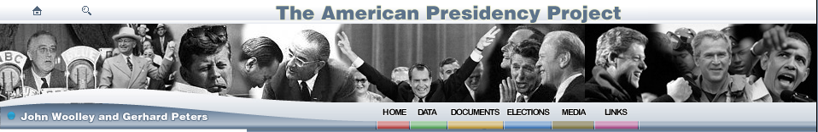
Introduction and Methods
Motivation: Can we train a model that identifies political leaning of text?
Data: The American Presidency Project (APP), non-profit and non-partisan, the leading source of presidential documents on the internet.
Important because it’s:
Labelled
Relatively clean
Can be verified

Slide 3
Text Processing Workflow:
input HTML
parse/label paragraphs
tokenize / stem text
vectorize text
select most important words
classification
graphical / manual semantic analysis
validation / scoring

Slide 4
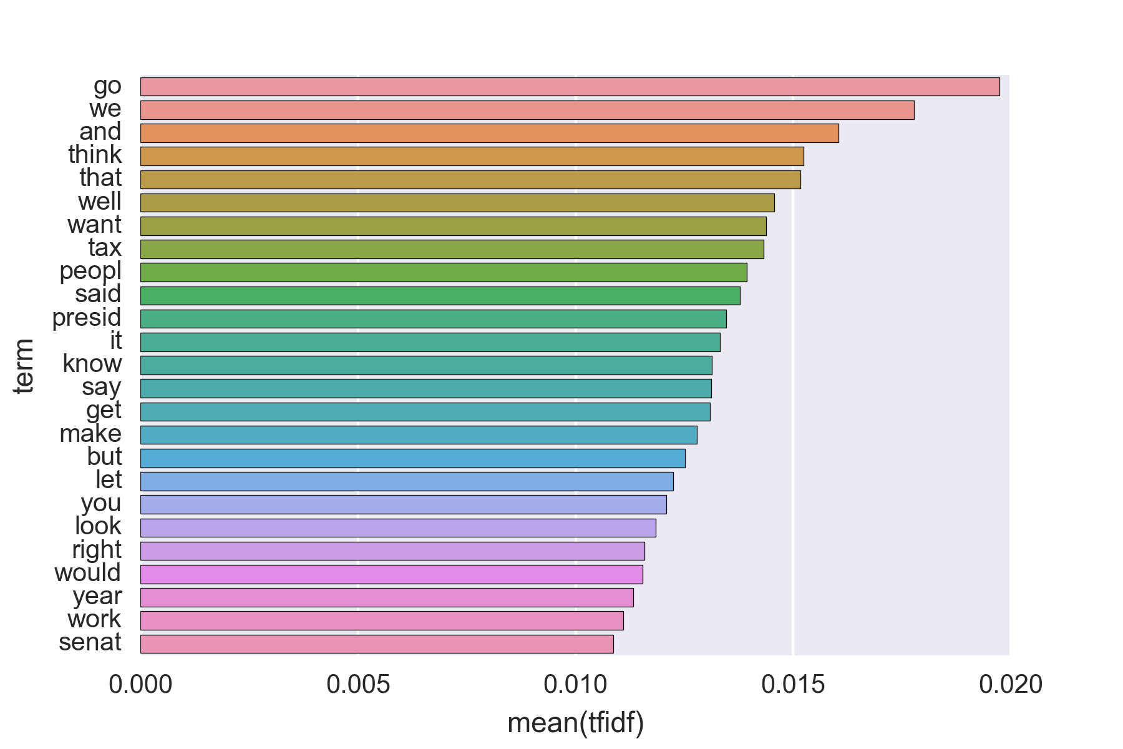
TF-IDF Vectorization
Term-frequency – inverse document frequency
Ranks importance of words based on paragraph frequency – offset by corpus frequency.

Slide 5
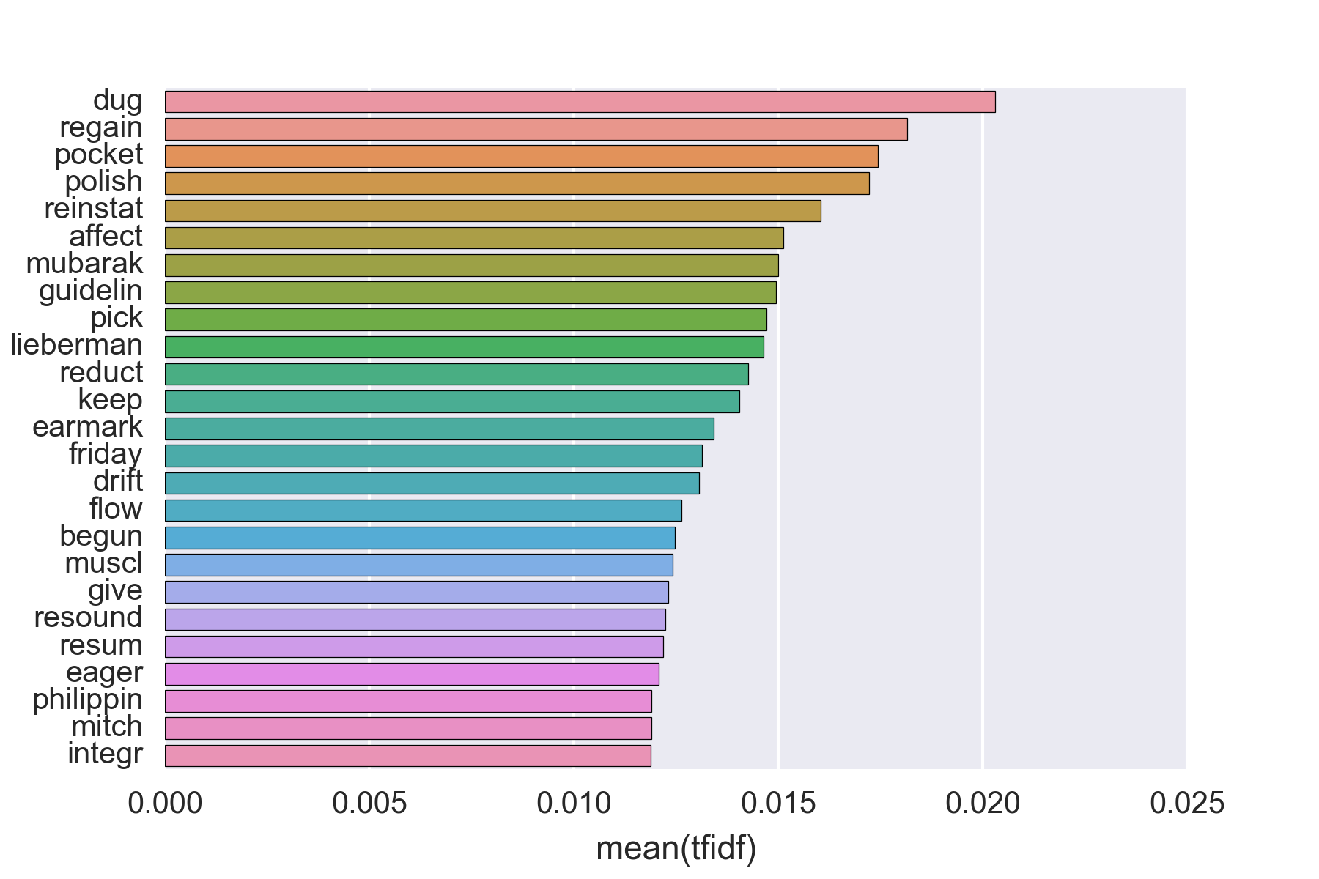
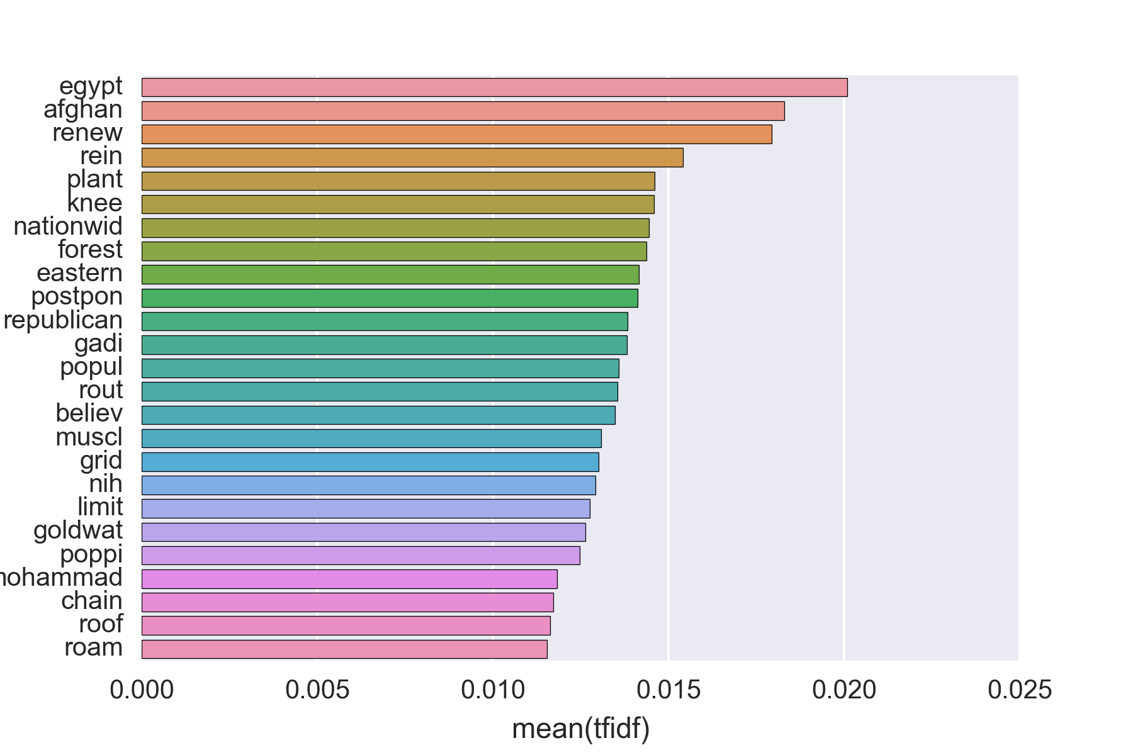
TF-IDF Vectorization
Top (mean) terms – Democrat corpus
Top (mean) terms – Republican corpus

Slide 6
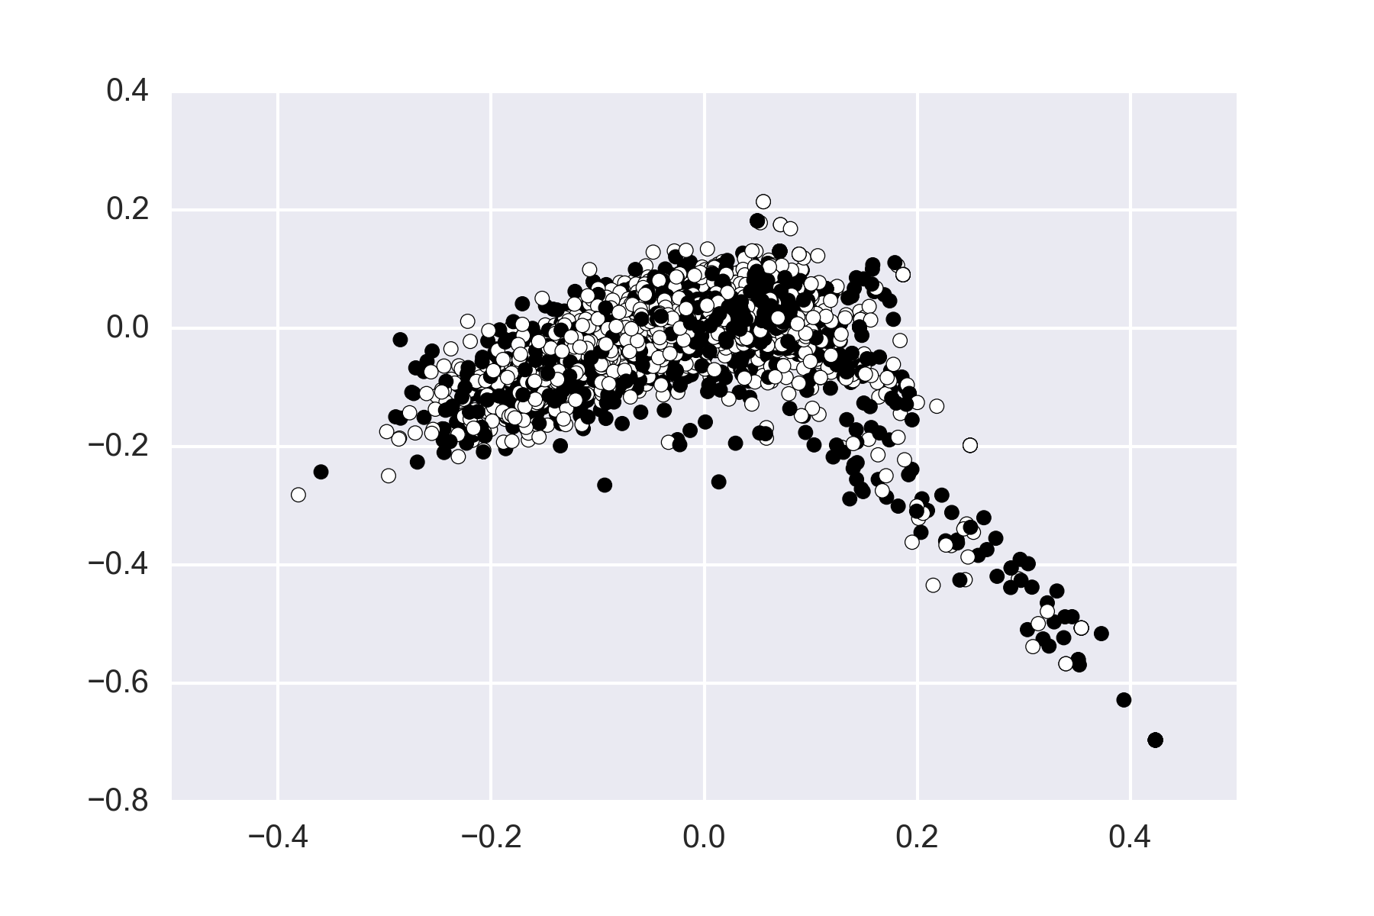
TF-IDF Vectorization
Is there separation of unigrams between the two classes?
PCA of TF-IDF unigram matrix plotted for two classes
Each marker is a paragraph in the corpus, reduced to two principle components based on TF-IDF vectorization.
White: Democrat
Black: Republican
Unigrams alone may not provide adequate separation of features.

Slide 7
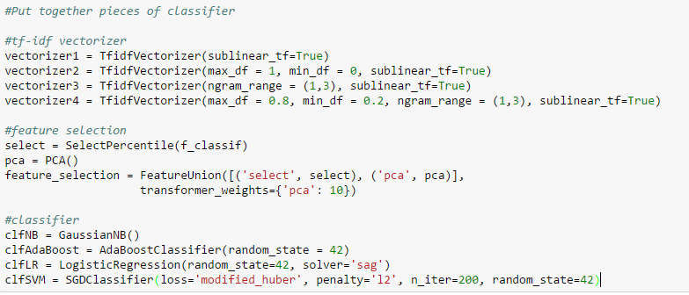
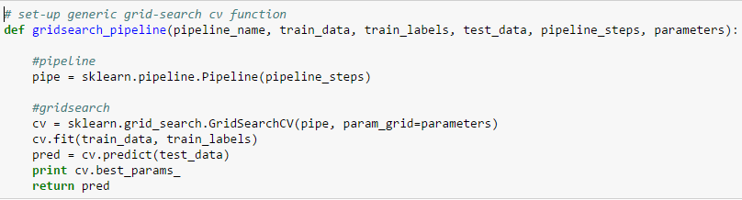
Building/Testing the Classifier

Slide 8
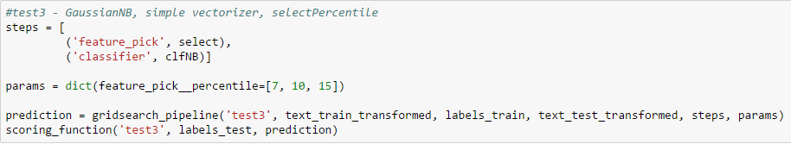
Building/Testing the Classifier

Slide 9
Building/Testing the Classifier

Slide 10
Deploying Classifier - Shibboleth

Slide 11
Additional Directions: adding more features
input HTML
parse/label paragraphs
tokenize / stem text
vectorize text
feature selection
classification
graphical / manual semantic analysis
POS tagging
sentiment analysis
clustering
feature selection

