Slide 1
RRDtool
Tobias Oetiker <tobi@oetiker.ch>
OETIKER+PARTNER AG
Switzerland

Slide 2
Monday Morning

Slide 3
8 am

Slide 4
I‘m reading my mail

Slide 5
Riiing!

Slide 6
Boss calls!

Slide 7
Boss, so early ???

Slide 8
OETIKER!
That server is f*&ing slow again today. Gotto finish this presentation. Plane goes in 90 Minutes. You really disappoint me here with that broken infrastructure of yours. I trusted you! This has got to change. When I’m back I want a full report and a plan on how you are going to fix this f&*ing mess.

Slide 9
The

Slide 10
Boss

Slide 11
is

Slide 12
back in

Slide 13
3 Days

Slide 14
OH

Slide 15
MY

Slide 16
GOD!

Slide 17
The therapy

Slide 18
was in vain

Slide 19
the nightmare

Slide 20
is

Slide 21
back!

Slide 22
breathe

Slide 23
organize

Slide 24
Approach:
Collect data
Identify bottleneck
Resolve problem

Slide 25
That would be too easy!

Slide 26
repeate

Slide 27
Approach:
Collect data
Identify bottelneck
Present analysis
Propose solution
Organize financing
Resolve problem

Slide 28
My proposal has

Slide 29
to be

Slide 30
simple

Slide 31
and

Slide 32
clear

Slide 33
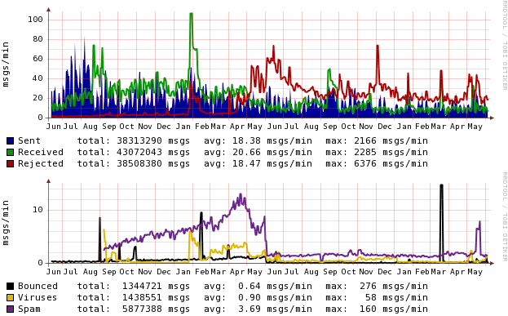
greylisting introduced - spam drastically reduced

Slide 34
rrdtool helps

Slide 35
Use
RRDtool keep the initiative make your boss look good all at the same time …

Slide 36
An Image

Slide 37
sais

Slide 38
more

Slide 39
than

Slide 40
1’000 words

Slide 41
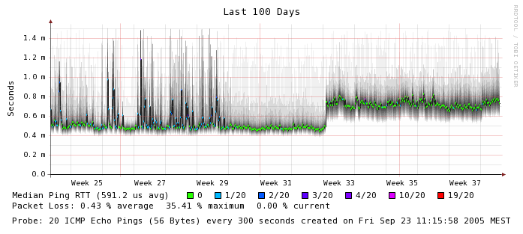
VLANs intoduced – Latency only marginally increased

Slide 42
what remains

Slide 43
is the question

Slide 44
what can
RRDtool do?

Slide 45
ok

Slide 46
RRDtool:
Collect
&
Present Data

Slide 47
RRD is the

Slide 48
Round
Robin
Database

Slide 49
Just feed your data in.

Slide 50
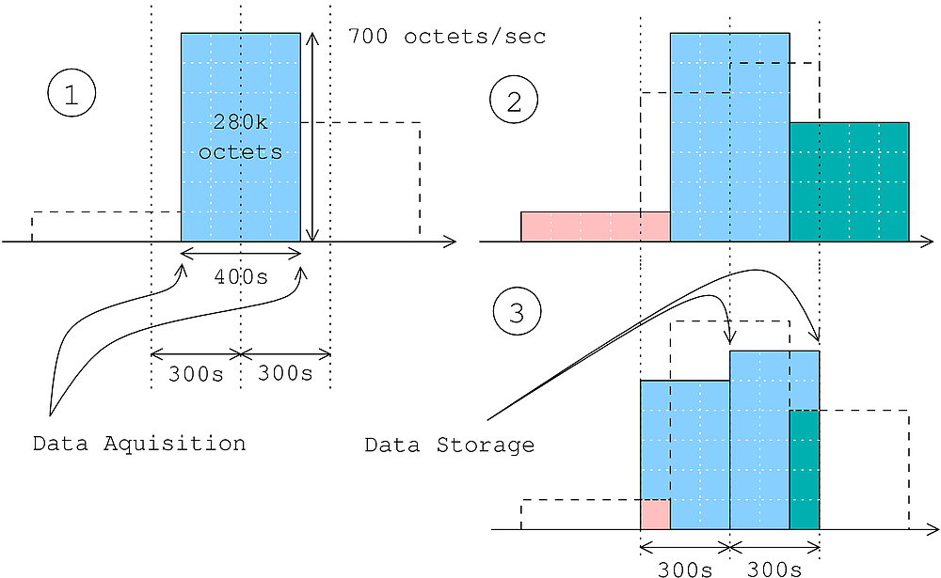

Slide 51
rrdtool update x.rrd N:2.3

Slide 52
Several rotating fixed size data stores.

Slide 53
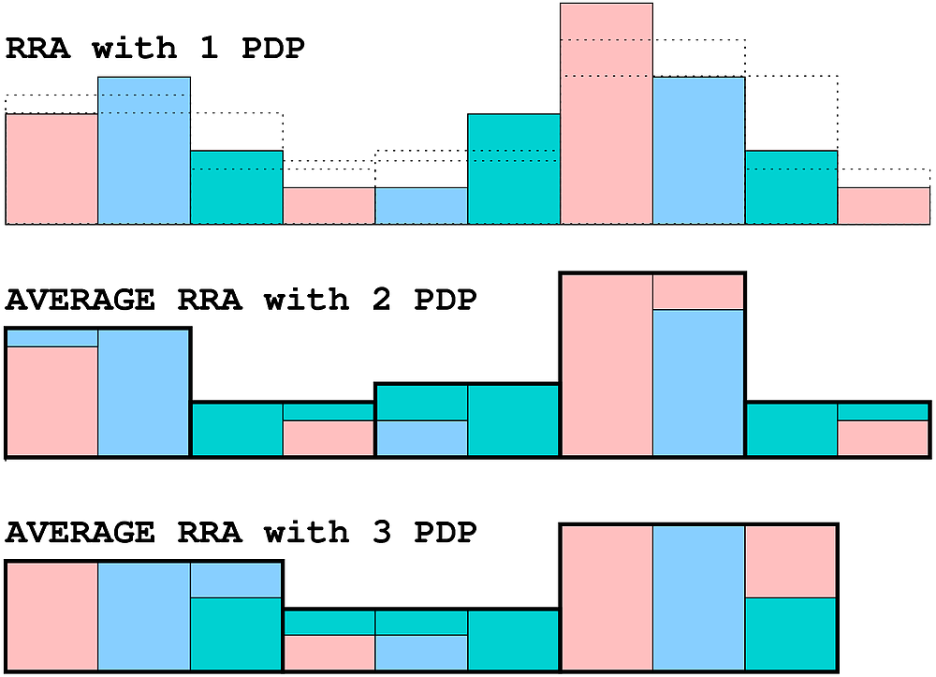

Slide 54
The older that data, the less interesting it is.

Slide 55
Old

Slide 56
data

Slide 57
has to

Slide 58
go.

Slide 59
RRDtool is fast.

Slide 60
Hundreds of updates a second.

Slide 61
All well

Slide 62
But

Slide 63
you

Slide 64
can‘t

Slide 65
sell

Slide 66
that.

Slide 67
Visualization

Slide 68
makes data accessible.

Slide 69
anti-aliasing

Slide 70
alpha transparency

Slide 71
PNG

Slide 72
EPS

Slide 73
PDF

Slide 74
SVG

Slide 75
TrueType Fonts

Slide 76
rrdtool \
graph \
file.png \
DEF:x=my.rrd:in:AVERAGE \
LINE1:x#ff0000:Input

Slide 77
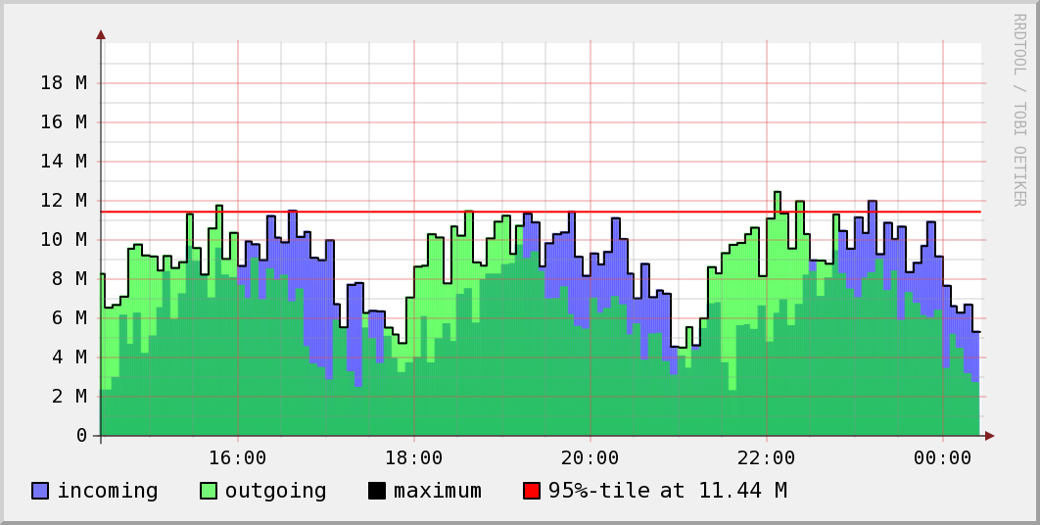

Slide 78
Data massage with RPN
(1,3,+)

Slide 79
rrdtool \
graph \
file.png \
DEF:x=my.rrd:in:AVERAGE \
CDEF:y=x,8,* \
LINE1:y#ff0000:Input8

Slide 80
Shell Scripts

Slide 81
Perl

Slide 82
Python

Slide 83
TCL

Slide 84
PHP

Slide 85
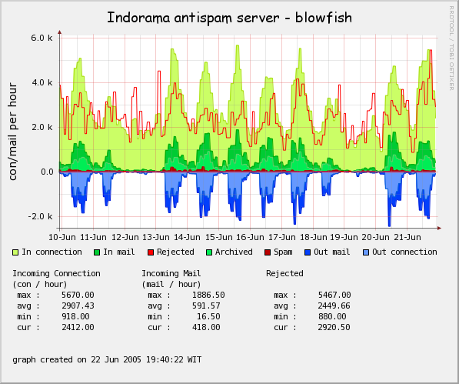

Slide 86
And

Slide 87
in

Slide 88
reality?

Slide 89
A Mailserver …

Slide 90
big responsability

Slide 91
must work at all times

Slide 92
huge logfiles

Slide 93
Logfiles

Slide 94
are

Slide 95
not

Slide 96
sexy

Slide 97
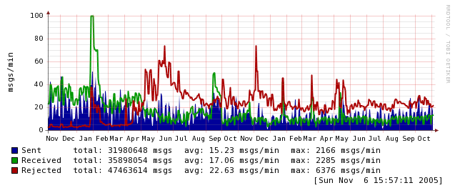
MailGraph by David Schweikert
What does my Mailserver do? Trends?
November 2000:
300 Lines
+Viren, +Spam
August 2006
1140 Lines
3 Forks

Slide 98
Another Examplel

Slide 99
February 2001

Slide 100
finally DSL

Slide 101
long time ago

Slide 102
but all the same

Slide 103
performance

Slide 104
was

Slide 105
bad

Slide 106
ISP

Slide 107
did

Slide 108
not

Slide 109
agree

Slide 110
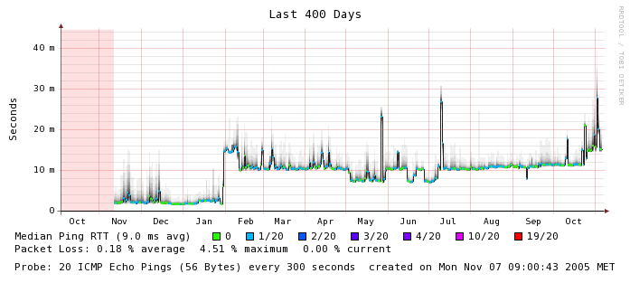
SmokePing by Tobi Oetiker
My DLS-Line didn’t work.
Nov 2001 / 1500 l.
1 Plug-in
+Alarme, +Graphexplorer
Aug 2006 / 10500 l.
24 Plug-ins

Slide 111
RRDtool is …
fast
powerfull
configurable
versatile
gnu-ish free
colorful
transparent
simple and complx
anti-aliased
multi-platform
open-source
scriptable
presentation-save
an industry standard
… for you too!

Slide 112
Tobias Oetiker <tobi@oetiker.ch>
OETIKER+PARTNER AG www.oetiker.ch

