Slide 1




AstraPulse
Mission Readiness & Predictive Maintenance Copilot
From sensor data to mission decision — in one pipeline.
Team KMstra | Track: AI | IBM Bob AI Hackathon
01

Slide 2




Disconnected Signals
Sensor & HUMS data contains early degradation signals but remains siloed — disconnected from failure risk, RUL estimates, and mission requirements.
The
Problem
Reactive Decisions
No Readiness Score
Manual, reactive maintenance creates compounding risks: safety incidents, unplanned downtime, and escalating operational costs across mission-critical fleets.
Without a unified readiness signal, operators cannot assess true mission readiness — every decision is a guess under pressure with incomplete information.
02

Slide 3



The Solution
IsolationForest
XGBoost
RandomForest
Detects anomalies and scores asset health from raw sensor streams. Flags early degradation signals before failure thresholds are reached.
Predicts failure risk probability using engineered features. Classifies assets as Low, Medium, or High risk based on sensor patterns.
Estimates Remaining Useful Life (RUL) in cycles. Provides time-to-failure horizon to inform scheduling and mission planning.
0–100
Mission Readiness Score
4-Tier
Maintenance Priority
3-Way
Asset Status: READY / ADVISORY / NOT READY
03

Slide 4
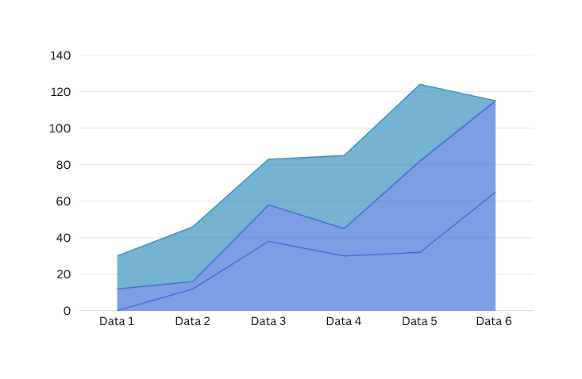
System
Architecture
End-to-End Pipeline
  NASA C-MAPSS FD001 raw sensor data → Preprocessing (17 features + RUL labels) → Feature Engineering (85 features) → Train 3 ML Models (IsolationForest, XGBoost, RandomForest) → Readiness Engine → asset_readiness.csv
  Runtime: FastAPI backend → React Mission Intelligence UI. IBM Bob connects via MCP with 5 operator tools for fleet readiness, asset status, time series, maintenance priorities, and mission readiness decisions.
04
View Demo

Slide 5



Live Demo
Walkthrough
Step 1: Upload
Step 3: Output
Upload multi-cycle CSV from an unseen engine. System validates, cleans data, and engineers 85 features automatically.
Step 2: Assess
Frontend displays Health Score, Failure Risk, RUL, Readiness Status, and maintenance priority in real time.
POST /api/assess runs 3 ML models: IsolationForest health, XGBoost failure risk, RandomForest RUL on latest engine cycle.
05

Slide 6




MCP Tools
5 operator tools via MCP: fleet readiness, asset status, asset time series, maintenance priorities, and mission readiness. Structured context handoff.
IBM Bob
Copilot
Operator Layer
Context Handoff
Bob converts ML model outputs into plain-language operator decisions. It is not the predictive model — it interprets and communicates results.
Structured context from readiness engine is passed to Bob. Each query returns actionable guidance: go/no-go, maintenance urgency, and fleet status.
06

Slide 7


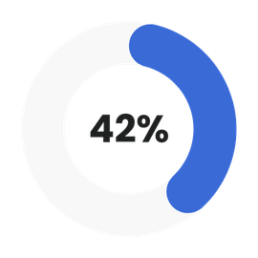



Results & Impact
  100 test engines assessed: 70 READY, 10 ADVISORY, 20 NOT READY.
  Mean readiness score: 73.2/100.
  High-risk alerts: ENG-034 and ENG-024 flagged for immediate action.
  Maintenance priorities: 12 immediate, 10 high, 8 medium, 70 low.
READY Engines
Health Normal
Low Failure Risk
  Health distribution: 57 normal, 22 warning, 21 critical.
  Failure risk: 78 low, 4 medium, 18 high. RUL classification: 44 healthy, 56 advisory.
  AstraPulse delivered end-to-end readiness assessment across all 100 unseen engines with zero manual intervention.
NOT READY
RUL Healthy
Mean Readiness
07

Slide 8

Team KMstra
  Vaibhavi Kariya (ML + Integration)
  Pushti Kansara (ML Health)
  Disu Makadiya (ML Failure)
  Rutvi Shah
  Shared Build: NASA C-MAPSS Pipeline · Synthetic Data · 3 ML Models · Readiness Engine · FastAPI + React · IBM Bob MCP · Automated Testing + Frontend + Data
Sensor Data → Health → Failure Risk → RUL → Readiness → Mission Decision
08

