Slide 1
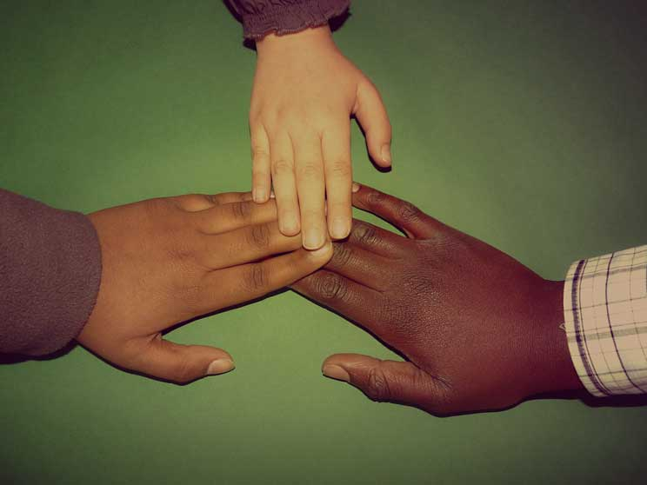
WHAT IS RACISM
The term ‘racism’ is often poorly understood. The Oxford Dictionary defines it as, "Prejudice, discrimination, or antagonism directed against someone of a different race based on the belief that one’s own race is superior." However, this is a simplified explanation of a complex issue.
The concepts within that definition, such as discrimination and racial superiority, are not always straightforward. Views on these concepts are often fluid, changing over time with new social contexts and new ways of thinking.

Slide 2
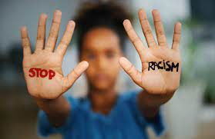
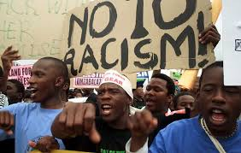
WHY DOES RACISM EXIST
For many hundreds of years, white British society has enjoyed a position of economic, social, and political power over non-white people in Britain and across the world through empire and colonialism and their after-effects. Although people in Scotland often know little about this history, the social attitudes that developed over this time are still present in our society. This is known as ‘white ideology’, or sometimes as ‘white supremacy’. The advantages that this still brings to white majority ethnic Scottish people are known as ‘white privilege’.
White ideology, however, doesn’t only affect white majority ethnic groups. Whiteness is not just about skin color. Non-white groups can also be influenced by white ideology, reflecting it in their own attitudes and behaviour in order to benefit from some of the power it brings or reduce the risk of being discriminated against. This would include, for instance, people being afraid to talk about racism for fear of offending their white friends. Those who speak out are often judged to have gone against the ‘normal’ (i.e. white ideological) view that racism is uncommon and mostly about personal prejudice. Disrupting that view makes people who subscribe to it uncomfortable. Black and minority ethnic people therefore often put their white friends’ feelings of sensitivity about race above their own need to address the racism they face.
At the most basic level, racism still exists in Scotland because white majority ethnic Scottish people are viewed as ‘normal’ in comparison to ‘other’ ‘diverse’ communities. Someone doesn’t have to feel hostile towards people from a minority ethnic group in order to have racist attitudes or to act in a racist way. The fact that Black and minority ethnic people are constantly treated as being different, even if several generations of their family have been born in Scotland, means that they face racism to some degree throughout their lives.
Someone’s experience of racism is not about their ethnicity or appearance, but about other people’s perception of those things and stereotypes that impact that perception. The risk that someone will experience racism depends on whether the signs that they are not from the dominant ethnic group (in our case, white majority ethnic Scottish and/or British) are visible to others.

Slide 3
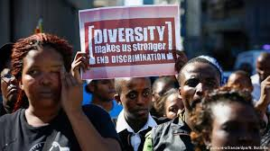
WHAT DOES RACE DISCRIMINATION MENS IN LEGAL TERMS
The legal definition of race discrimination doesn’t only cover ‘race’ in the sense described here. People of any color, nationality, and ethnic or national origin are protected from race discrimination under the Equality Act 2010. This includes white majority ethnic Scottish people, although they are unlikely to need that protection as they’re not generally at risk of discrimination. Hate crime legislation defines race in a similar way.

Slide 4
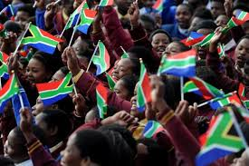
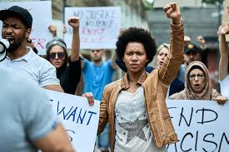
          IM NOT RACIST;SO WHY SHOULD ANTI-RACISM MATTER T ME
Very few people could be fairly described as ‘racists’, but anyone can behave or think in a racist or xenophobic way. As previously explained, structural racism is deeply ingrained in our society. The result of this is that minority ethnic people, especially those who are more visibly minority ethnic, experience everyday racism. This has a big impact on their lives. It pervades all areas of life and is hard to challenge, so in some ways it can have a bigger impact than obvious forms of racism.
Everyday racism acts to silence and demean minority ethnic people, and reinforces the inequalities they face. For example, constantly being asked “Where are you from?” undermines people’s sense of identity and belonging, impacting their confidence, wellbeing, and mental health. This happens even to people whose grandparents were born in Scotland. Even equality workers sometimes use language which suggests that minority ethnic people are less skilled or capable than white British or Scottish people, despite having statistically higher levels of educational qualifications. The organization they work for often know that minority ethnic people are under-represented as employees or service users, but do nothing to find out why and resolve it.
Structural racism can’t be dealt with simply by telling people it’s wrong to be racist. It can’t be dealt with by holding ‘diversity’ events, which often reinforce perceptions of difference and racial stereotypes.
To stop racism, we need to become anti-racist as a society. This means changing the way we think and act, and being prepared to challenge others to do the same.

Slide 5
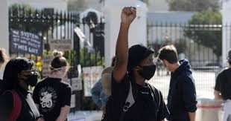
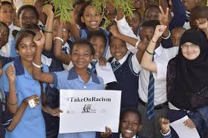
What is its impact going to be in the future?
Inequalities in health and health care by racial and ethnic group are abundant but their underlying cause, and the contribution of racism, is a complex but insufficiently debated matter in Europe. Arguably, the major cause of inequalities in health, and even more of inequalities in access to health care, is inequality in social and economic circumstances.8 Minority groups generally find it difficult to overcome inequalities in wealth, partly because of racially discriminating actions and policies. On arrival most migrants tend to hold unskilled jobs. This legacy may be passed on to their children (though there are many exceptions). Inequalities may widen in the face of both political interest and research. This is almost certain because wider economic and social policies are increasing inequality. Such inequalities and inequities, and their causes—more particularly the role of racism—severely challenge European health care systems. We have recently seen open and severe social tensions, partly reflected racially, in a number of countries including the UK, France, Denmark, and Holland. European researchers, scholars, policymakers, and practitioners need to contribute vigorously to international discussions and evidence, particularly in the light of European legislation promoting equality. The topic demands greater academic attention with the ultimate goal of producing effective interventions to lead to a harmonious, healthy, and fair multi-ethnic Europe.

Slide 6
REFERENCES
WHAT IS RACISM
My knowledge
WHY DOES RACISM EXIST
internet
WHAT DOES RACE DISCRIMINATIO MEANS IN LEGAL TERMS
Internet
IM NOT RACIST SO WHY SHOULD ANTI-RACISM MATTER TO ME
internet
WHAT IS ITS IMPACT GOING TO BE IN THE FUTURE
internet

