Slide 1
Performance Anomaly Detection and Bottleneck Identification
Detect changes in observable performance metrics
  E.g. Increased response time
Check if the application performance is explained by the workload
Identify bottlenecks in the cloud platform
No invasive application instrumentation

Slide 2
Roots Architecture
Server access logging,
Request ID generation
Loadbalancer
Anomaly detection,
Workload change point analysis
Data Store
App Server
SDK call tracing,
SDK call time measurement
PaaS SDK
Bottleneck identification
Notes:
Data collection in green. Analysis in red.

Slide 3
Anomaly Detection
SLO-based detection
  Probe the application periodically and record SLO
  Periodically compute the observed SLA satisfaction level
Correlation-based detection
  Statistically detect increases in response time that are not correlated with increases in workload
  Pearson’s R and dynamic time warping

Slide 4
Workload Analysis
Detect change points (level shifts) in workload traces
  Especially the sudden increases in workload that precede a detected performance anomaly
Binary segmentation
Pruned Exact Linear Time (PELT)
Chen & Liu method

Slide 5
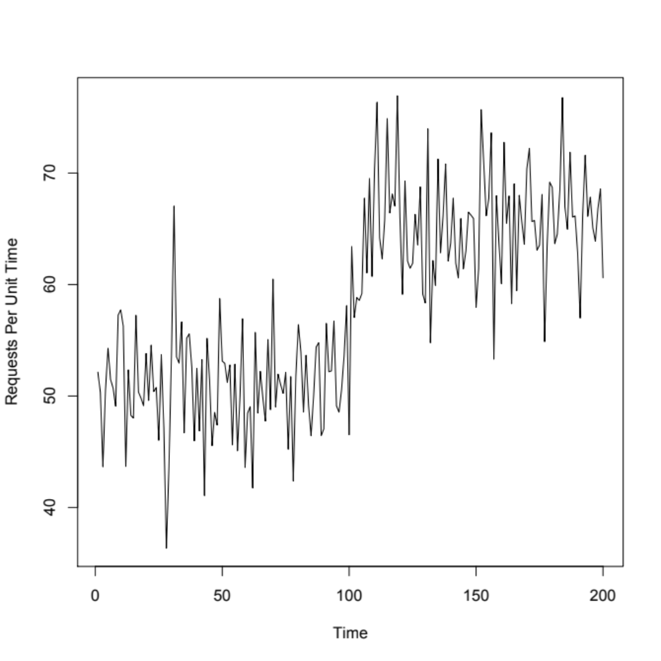
Chen & Liu Method Example
Series: ts(data)
ARIMA(0,0,0) with non-zero mean
Coefficients:
intercept LS101
50.9053 14.4054
s.e. 0.4768 0.6743
sigma^2 estimated as 22.73: log likelihood=-596.16
AIC=1198.32 AICc=1198.44 BIC=1208.22
Outliers:
type ind time coefhat tstat
1 LS 101 101 14.41 21.36
Notes:
Outlier at t = 101 detected as a Level Shift (LS).

Slide 6
Bottleneck Identification
Suppose an application makes 3 SDK calls for each HTTP request.
Linear regression model: Total = A + B + C
Relative importance metric indicates the portion of variance in “Total” explained by each independent variable
A | B | C | Total
10 | 18 | 12 | 44
9 | 20 | 11 | 42

Slide 7
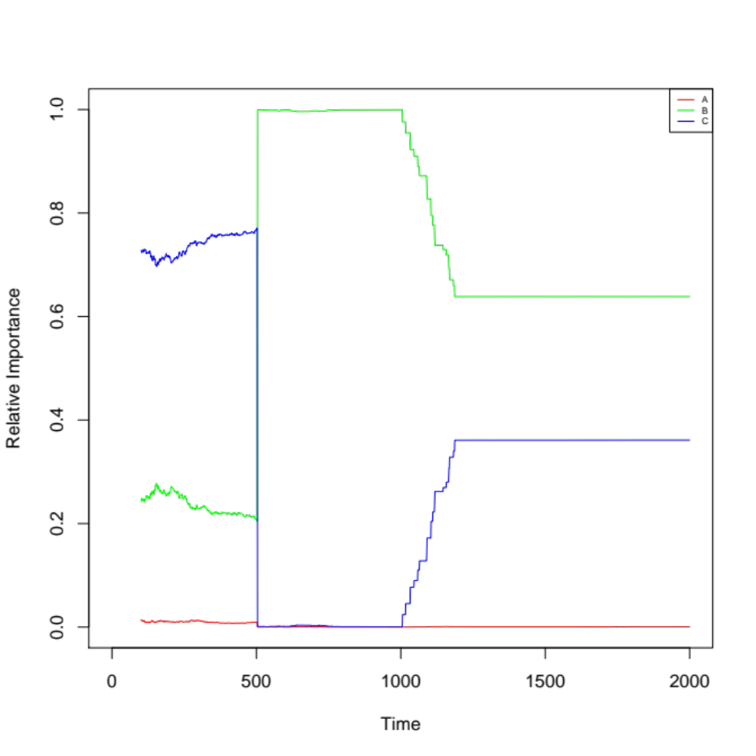
Simulation Results
At t = 500, API call B starts behaving erratically causing its relative importance score to increase significantly.

