Slide 1


Service-Level Agreement Durability for Web Service Response Time
Hiranya Jayathilaka
Prof. Chandra Krintz
Prof. Rich Wolski
Computer Science Dept., UC Santa Barbara
IEEE CloudCom 2015

Slide 2
Web APIs
Promotes service reuse
Internet
Service
Web API
Client
Application
Leverages IT resources of the service provider

Slide 3
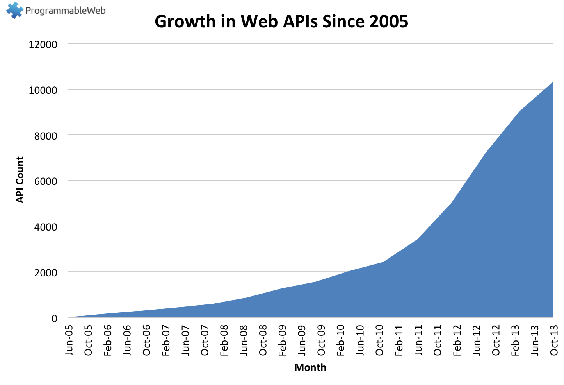
Number of API Today: 14,000+
Source: http://www.programmableweb.com/api-research

Slide 4

Web APIs as IT Resources
Client
Application
APIs impact user experience
SLA
APIs do not provide strong guarantees
API
API
API
Web Application
Web Application
Web Application

Slide 5
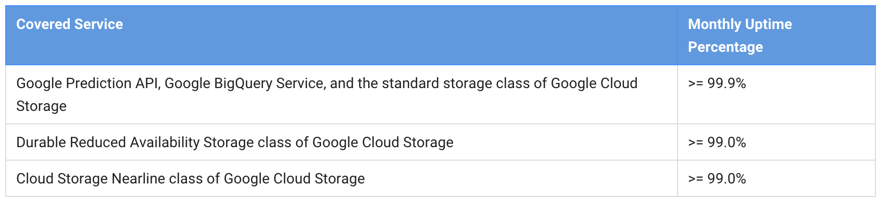
Application SLAs and “The Cloud”
Modern cloud platforms only provide some uptime SLAs for individual APIs
Cloud platforms do not provide SLAs on deployed user applications and APIs.

Slide 6
Automatic Prediction of SLAs
We designed and implemented Cerebro
Response Time Service-Level Agreements for Cloud-hosted Web Applications [SOCC ‘15]
Predicts statistical upper bounds for the response-time of web APIs
Designed to operate in PaaS clouds
Produces accurate and tight predictions

Slide 7
Service-Level Agreements
Minimum service level promised by the service provider regarding some non-functional property of a service
Has a correctness probability (0 ≤ p ≤ 100)
We keep the legal and social aspects of typical SLAs out of our discussion

Slide 8
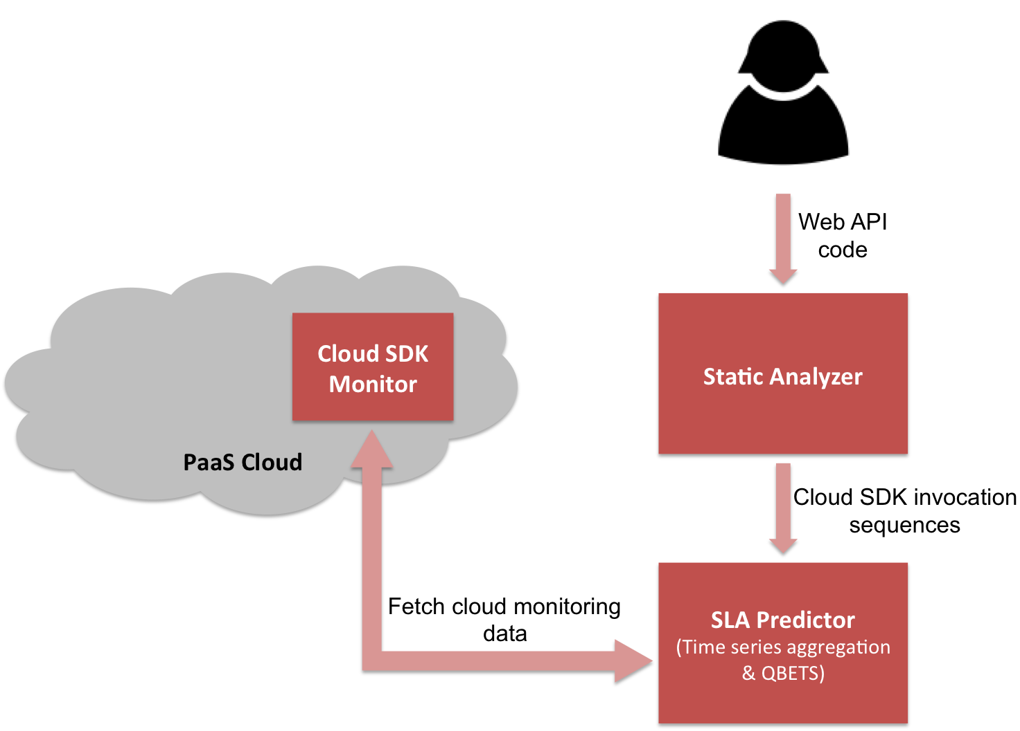
Cerebro Architecture

Slide 9
SLA Durability
Cloud platforms are highly dynamic
Predicted SLAs do not hold correct forever
SLA validity period: the time period until a predicted SLA can no longer be considered correct
Ideally we want predicted SLAs to have long validity periods

Slide 10
Research Questions
Can we detect when a predicted SLA has become invalid?
Can we assess the durability of response time SLAs predicted for cloud-hosted web APIs?

Slide 11
Statistical Model
Suppose at time t Cerebro predicts value Q as the p^{th} percentile of some APIs response time.
The probability of API’s response time being greater than Q:
(1 – 0.01p)
Probability of observing n consecutive readings greater than Q:
(1 – 0.01p)^{n}

Slide 12
A Concrete Example
Suppose Cerebro predicts that some API responds under 100ms, 95% of the time.
Probability of API response time exceeding 100ms is (1 – 0.01 * 95) = 0.05
Probability of observing 3 consecutive such readings is 0.05³ = 0.000125
This value 3 is conservative with regard to autocorrelation
E.g. To get the same small value 0.000125 with 0.5 autocorrelation, we need to observe 5 events

Slide 13
Detecting SLA Invalidation
Each time Cerebro makes a prediction, it computes the current autocorrelation in the time series
Autocorrelation can be used to lookup a table, and determine C_{w}; the number of consecutive readings greater than Q, that constitute a rare event
We consider the SLA to have become invalid if this rare event occurs

Slide 14
SLA Negotiation in Cerebro
API consumers acquire an initial SLA as part of the API subscription process
Cerebro calculates both Q and C_{w}, and records them for future reference
Cerebro continuously monitors the response time of deployed APIs
If it observes more than C_{w} response time measurements greater than Q, it considers the prediction to have become invalid

Slide 15
Experiment Objectives
We applied the above statistical model and the SLA negotiation approach to a set of web APIs deployed in Google App Engine.
We wanted to calculate the SLA validity periods and the SLA renewals necessary for each API consumer when using Cerebro on Google App Engine.

Slide 16
Step 1: Data Gathering
We deployed a set of APIs in Google App Engine, and monitored their response time over 3 months.
We also measured and recorded the response time of individual cloud SDK calls made by these APIs.
Using Cerebro’s Cloud SDK Monitor

Slide 17
Step 2: SLA Prediction
We used Cerebro to make response time SLA predictions for the test web APIs.
Cerebro analyzed the cloud SDK performance data gathered over 3 months, and made 95th percentile predictions for the test web APIs.
One prediction per minute, thus forming time series of SLA predictions
Each prediction is accompanied by a C_{w} value

Slide 18
Step 3: Simulation
We used the predicted SLAs, and the actual API response times measured during the 3 month period in a series of simulations.
User 1 SLA Renewal
125,000+ Users
User 1
User 2
User 3
Predicted SLAs:
40
42
41
41
42
42
42
41
41
42
C_{w}:
3
3
3
4
4
4
4
4
4
4
Actual values:
35
38
39
41
41
42
41
41
41
42
User 1 SLA Validity Period
User 1 SLA Invalidation

Slide 19
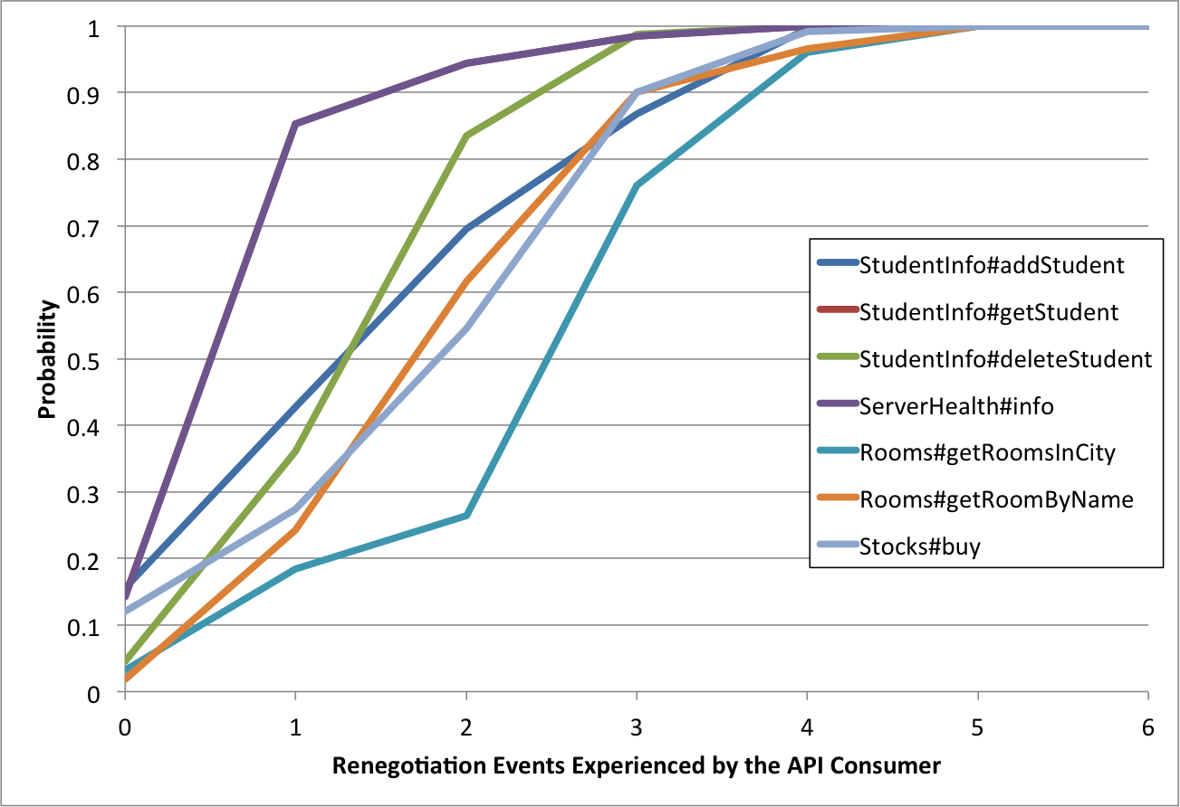
SLA Renewals Per User

Slide 20
SLA Validity Periods (In Hours)
API | 5th Percentile | Mean | 95th Percentile
StudentInfo#getStudent | 12.97 | 631.24 | 1911.19
StudentInfo#deleteStudent | 7.65 | 472.07 | 2031.59
ServerHealth#info | 12.96 | 630.01 | 1911.19
Rooms#getRoomByName | 8.48 | 345.13 | 1096.53
Rooms#getRoomsInCity | 20.56 | 296.44 | 1143.45
Stocks#buy | 8.46 | 411.75 | 815.5

Slide 21
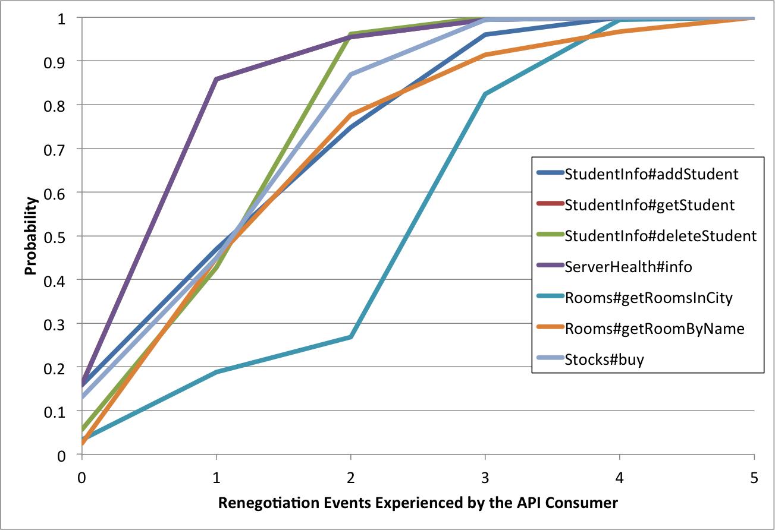
SLA Renewals (10% threshold)

Slide 22
Conclusions
Web APIs impact the performance of the applications that depend on them.
Cerebro provides a way to automatically predict response-time SLAs for APIs.
We present a statistical model that can detect when a predicted SLA has become invalid.
We extend Cerebro with a simple SLA acquisition and renewal model.
We show that Cerebro predicted SLAs are highly durable, and the API consumers do not have to renew them too often.

