Slide 2
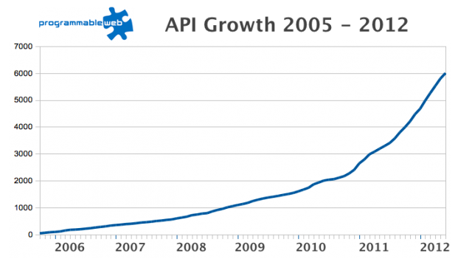
Number of APIs Today: 13516

Slide 3

Cerebro: Response-time SLAs for Web Services in PaaS Clouds
Web Service
Cloud SDK
Cloud Platform
Web Service code
PaaS Cloud
Static Analyzer
Cloud SDK Monitor
Cloud SDK invocation
sequences
Fetch cloud monitoring
data
SLA Predictor
(Time series aggregation & QBETS)

Slide 4
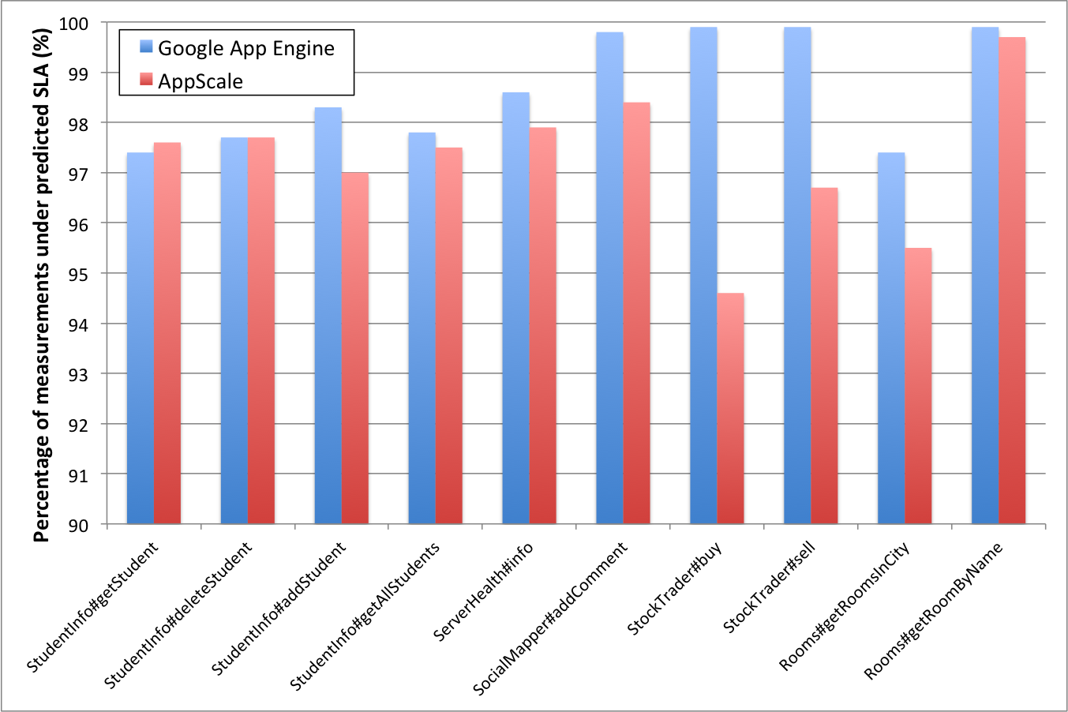
Cerebro: Prediction Accuracy Results

