Slide 1


Response Time SLAs for Cloud-hosted Web Applications
Hiranya Jayathilaka
Prof. Chandra Krintz
Prof. Rich Wolski
Computer Science Dept., UC Santa Barbara
SOCC 2015

Slide 2
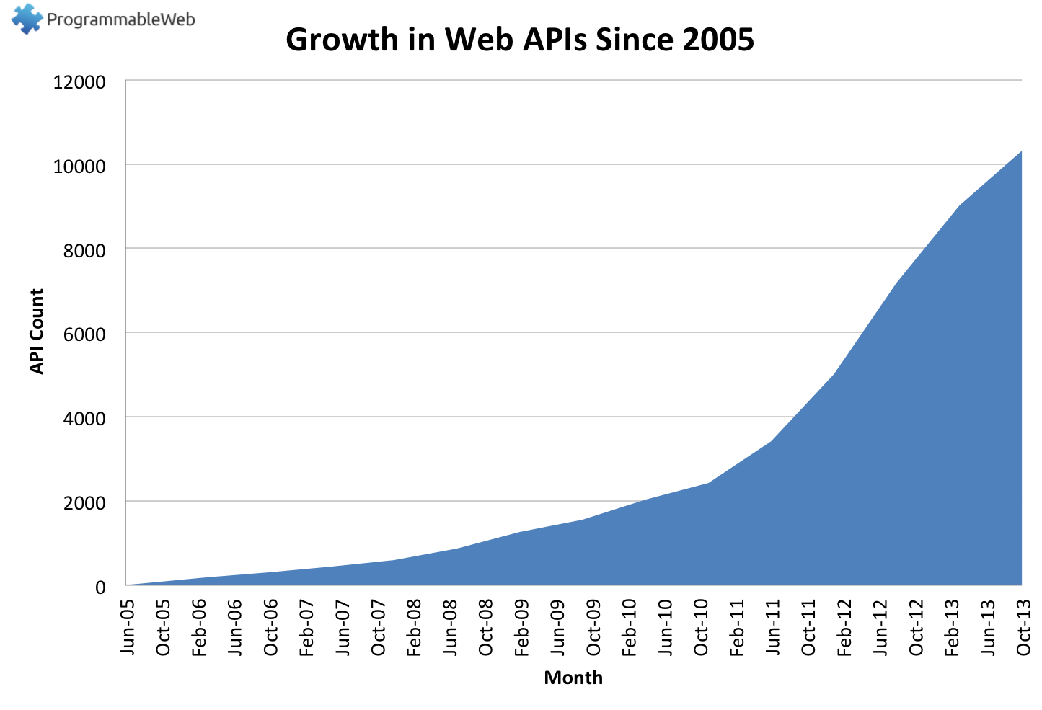
Number of API Today: 13800+
Source: http://www.programmableweb.com/api-research

Slide 3
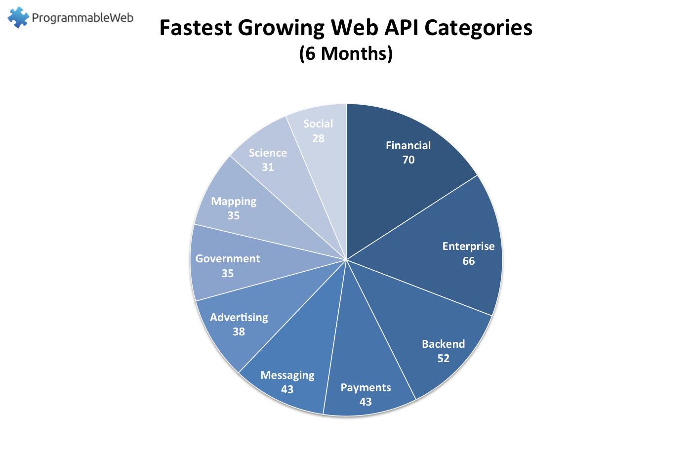
Non-commercial entities are joining the API party too…
White House API Program: https://www.whitehouse.gov/digitalgov/apis
IEEE APIs: http://ieeexplore.ieee.org/gateway/
UC Berkeley APIs: https://api-central.berkeley.edu/

Slide 4
Web APIs are Now IT Resources
API dependencies require management and maintenance
Client
Application
APIs impact user experience
APIs do not provide strong guarantees
APIs obscure functionality changes
API
API
API
Web Application
Web Application
Web Application

Slide 5
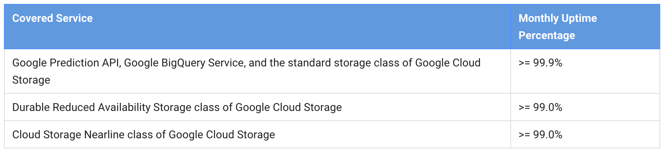
Application SLAs and “The Cloud”
Application SLAs depend on
SLAs of individual APIs
The ability to compose/combine API SLAs
Modern cloud platforms only provide some uptime SLAs for individual APIs

Slide 6
Performance SLAs in the Cloud
Question: Is it possible to determine, automatically, performance SLAs for cloud-hosted applications and APIs?
Our solution: Cerebro
Predicts the response time of future web-API invocations from historical measurements
For PaaS clouds
Fully automatic

Slide 7
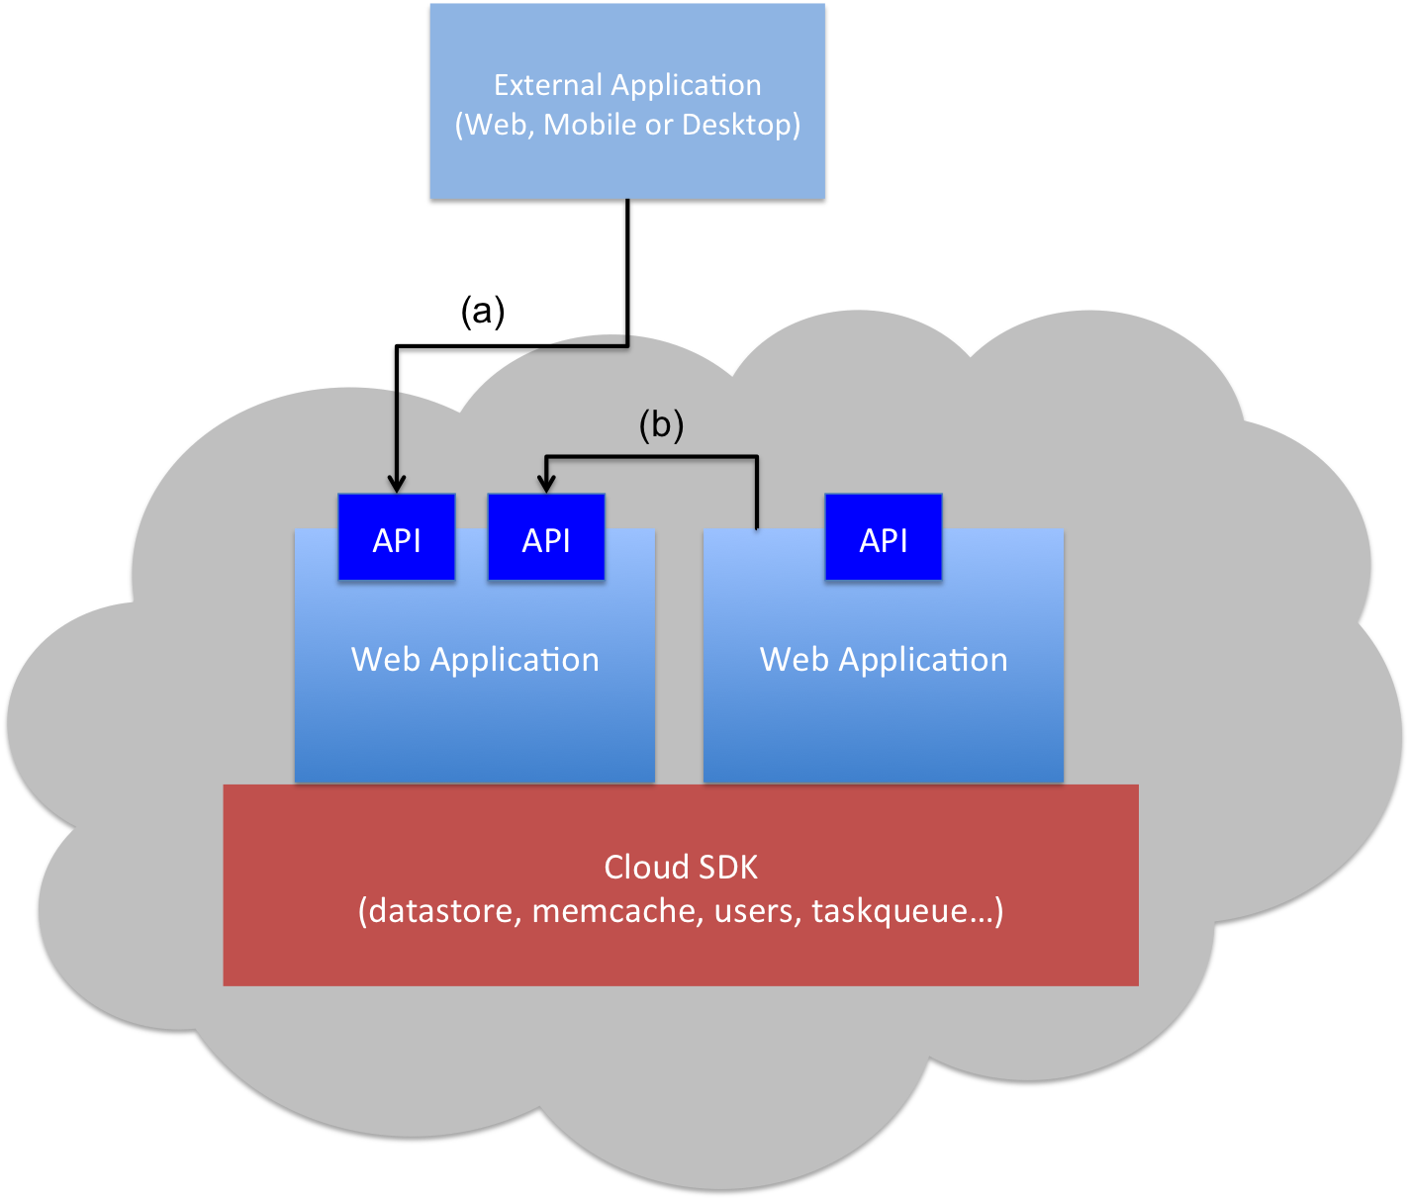
PaaS Clouds for Web Services
Client Application
(Web, Mobile or Desktop)
Request-response driven programming model
Scalable, high available and cost effective
Restricted I/O capabilities
Application code must adhere to the provided cloud SDK
Restrictions on threads

Slide 8
PaaS Client Application Survey
PaaS Client Applications…
Don’t have many branches
99% of the methods have < 36 paths
Don’t have many loops
88% of the methods have no loops
Spend most of their time executing cloud SDK calls (> 94%)
So…
PaaS applications are highly amenable to static analysis
Cloud SDK calls essentially define client-perceived application performance

Slide 9
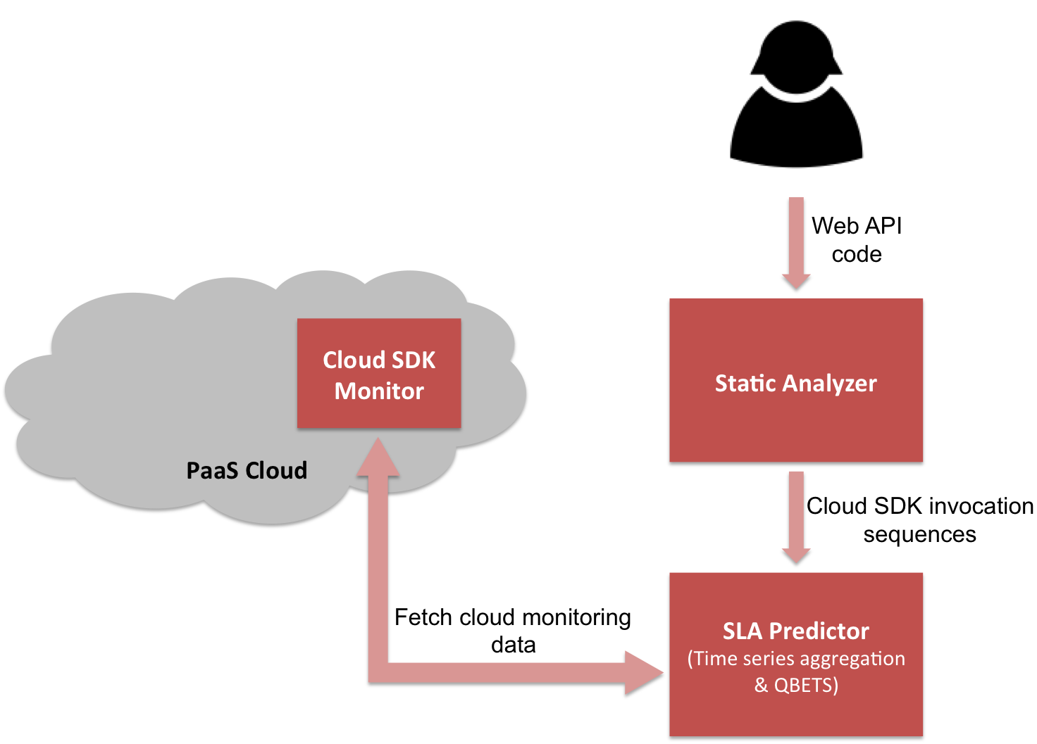
Cerebro Architecture

Slide 10
QBETS: Queue Bounds Estimation from Time Series
Predicts instantaneous bounds on the percentiles of a time series
Analyzes the first n entries in a time series
Predicts an upper bound for the (n+1)^{th} entry
QBETS([x₁,x₂,…x_{n}], p) = Q where p ∈ (0,1)
P(x_{n+1} ≤ Q) ≥ p
Cerebro uses QBETS to predict response time SLAs of the form:
Operation O responds under T milliseconds (100p)% of the time

Slide 11
Prototype and Experiments
Static analyzer: Java (Soot framework)
SDK monitor: App Engine Java app
SLA predictor: Java, Go, C
Tests conducted on Google App Engine public cloud, and AppScale private cloud (running on a 4-node Eucalyptus cluster)
Network delay between client and Google is included but not modeled or predicted explicitly

Slide 12
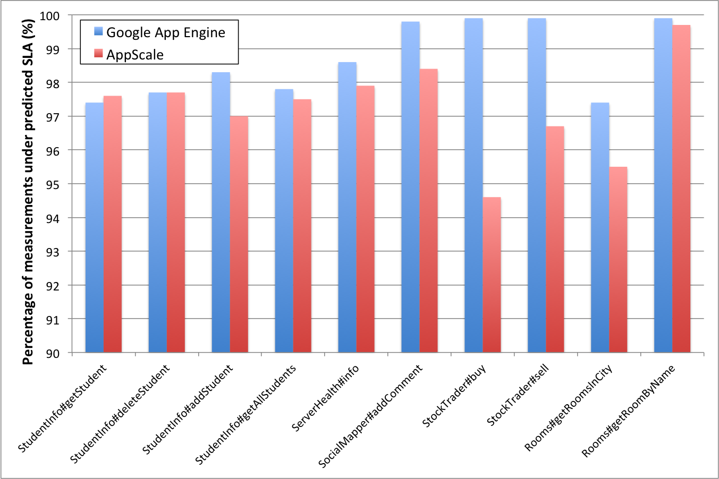
Evaluation: Prediction Correctness

Slide 13
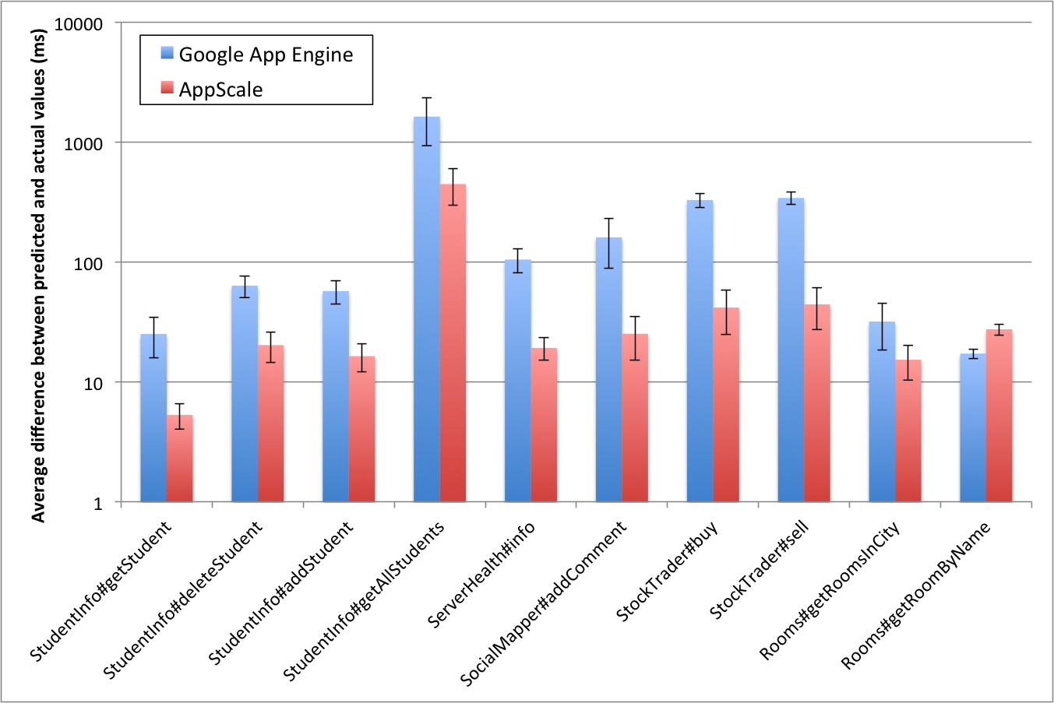
Evaluation: Prediction Tightness

Slide 14
Conclusions and Future Work
Cerebro predictions are correct and moderately tight
Necessary conditions for use in an SLA
SLA durability period analysis
GAE: 26.8 hours
AppScale: 33.7 hours
SLA-related policy enforcement at deployment time with EAGER
Adaptive benchmarking for cloud SDK monitor

Slide 15
Thank You! Questions?
Hiranya Jayathilaka (hiranya@cs.ucsb.edu)
The UCSB Lab for Research on Adaptive Computing Environments
The RACELab -- http://www.cs.ucsb.edu/~ckrintz/racelab.html

