Slide 1


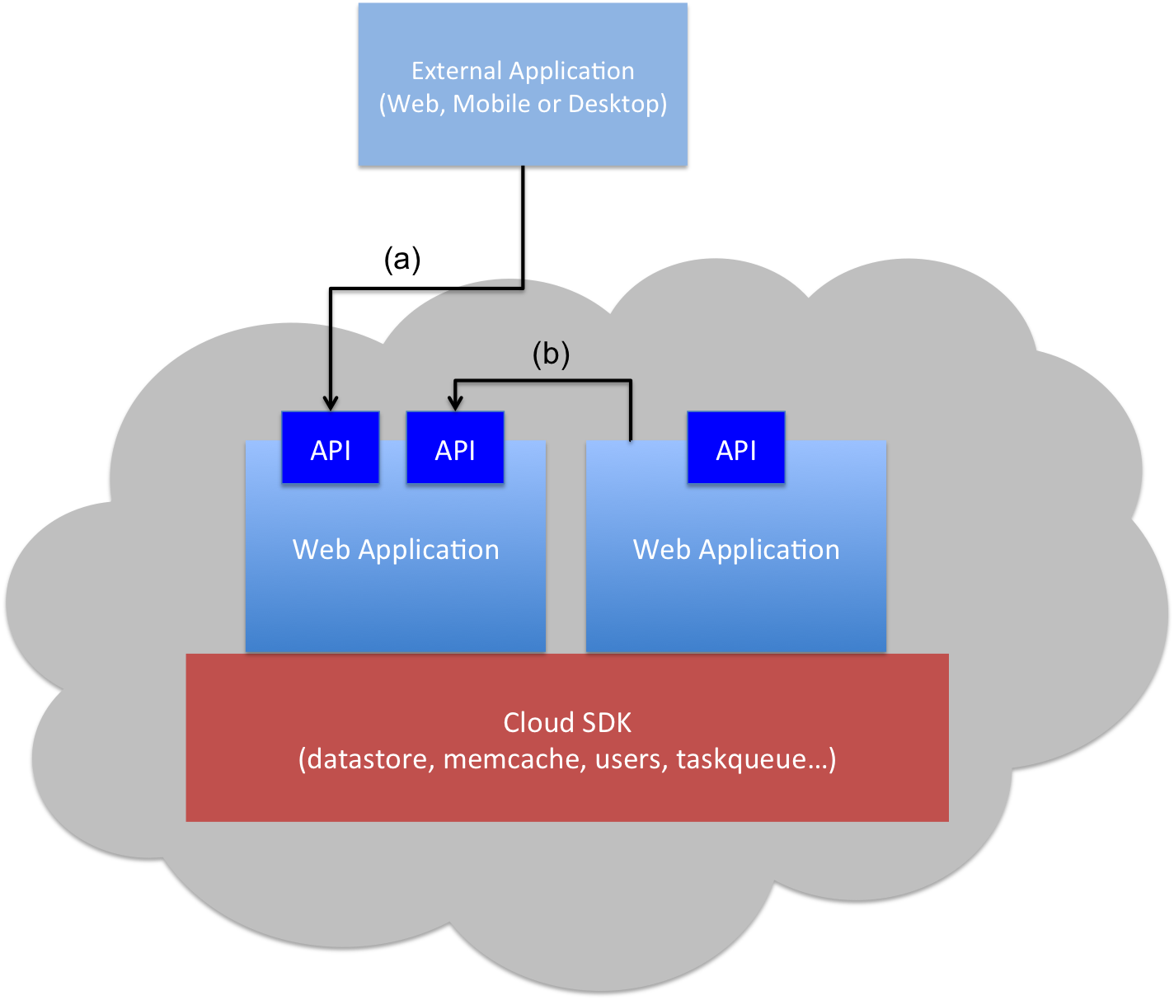
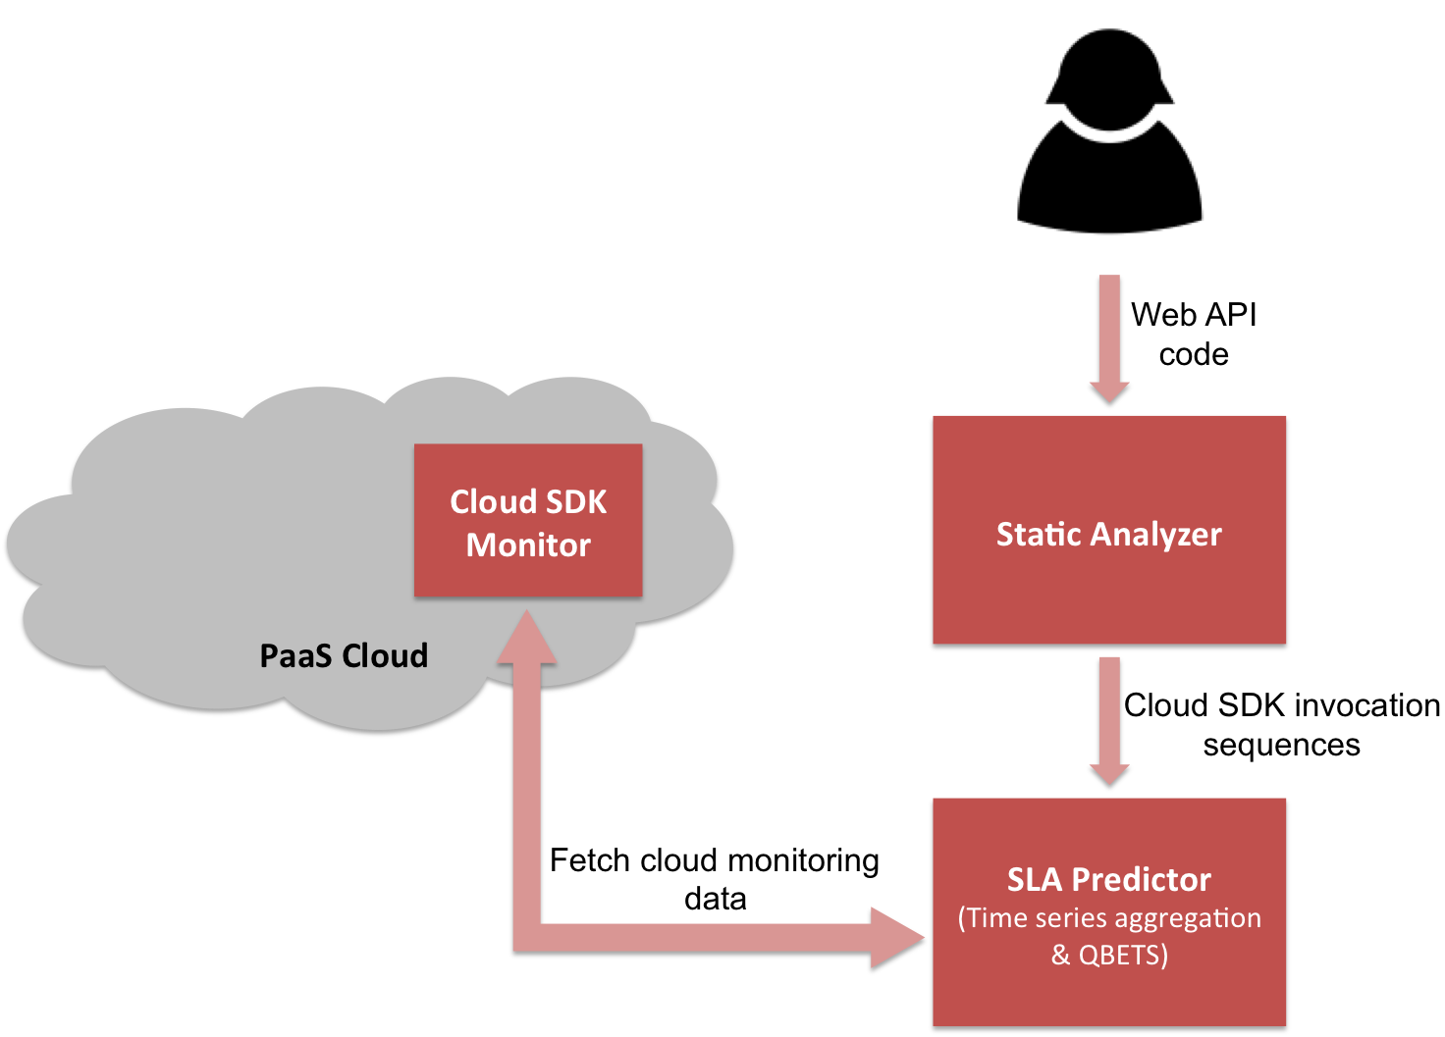
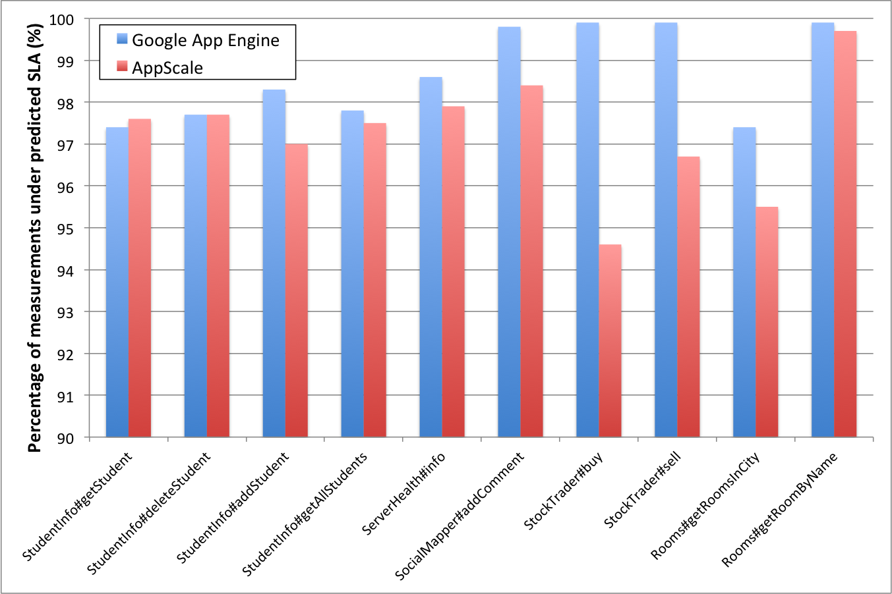
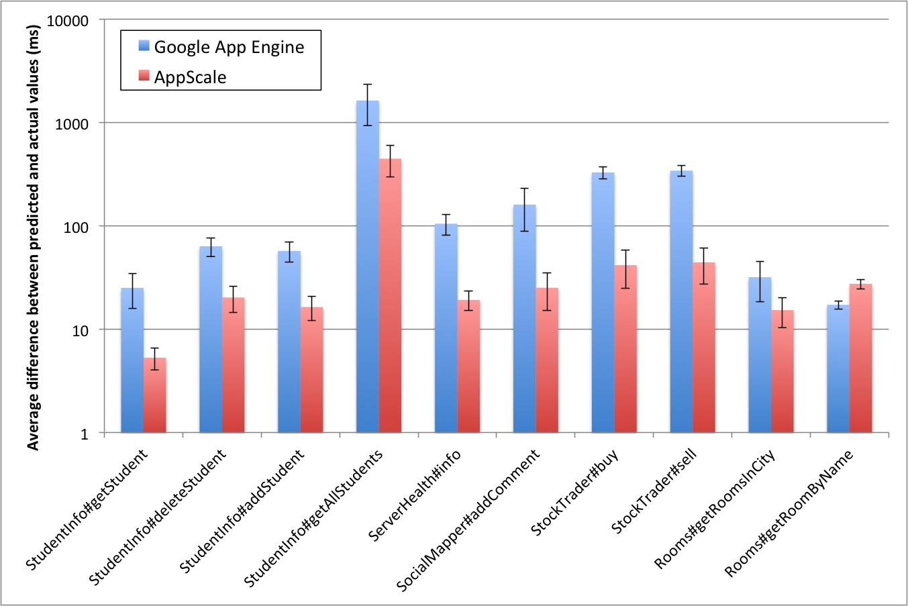
Response Time Service Level Agreements for Cloud-hosted Web Applications
Hiranya Jayathilaka, Chandra Krintz and Rich Wolski
University of California, Santa Barbara
Motivation
Many applications rely on the web APIs deployed in the cloud.
But modern cloud platforms do not provide any guarantees regarding the performance of deployed web APIs and applications.
There is a lack of tools for reasoning about the performance of cloud-hosted applications.
Our Solution: Cerebro
Computes statistical bounds on the response time performance of web applications/APIs deployed in PaaS clouds.
Combines static analysis of PaaS applications with runtime monitoring of the cloud platform to automatically predict performance SLAs for cloud-hosted web applications.
PaaS-hosted Applications
Cerebro Architecture
We implemented this architecture for Google App Engine public PaaS, and AppScale private PaaS.
Scalable, high available & cost effective
Request-response driven programming model
Extracting cloud SDK calls
Periodic benchmarking and time series building
Restrictions on I/O and threads
90+% of the Application’s Execution Time
Prediction Accuracy
Prediction Tightness
When application performance is highly variable, Cerebro trades off tightness for accuracy.
Percentage of actual response time measurements lower than the predicted 95th percentile SLA.
Average difference between predicted SLAs and actual response time measurements.

