Slide 1


Response Time SLAs for Cloud-hosted Web Applications
Hiranya Jayathilaka
Prof. Chandra Krintz
Prof. Rich Wolski
Computer Science Dept., UC Santa Barbara
SOCC 2015

Slide 2
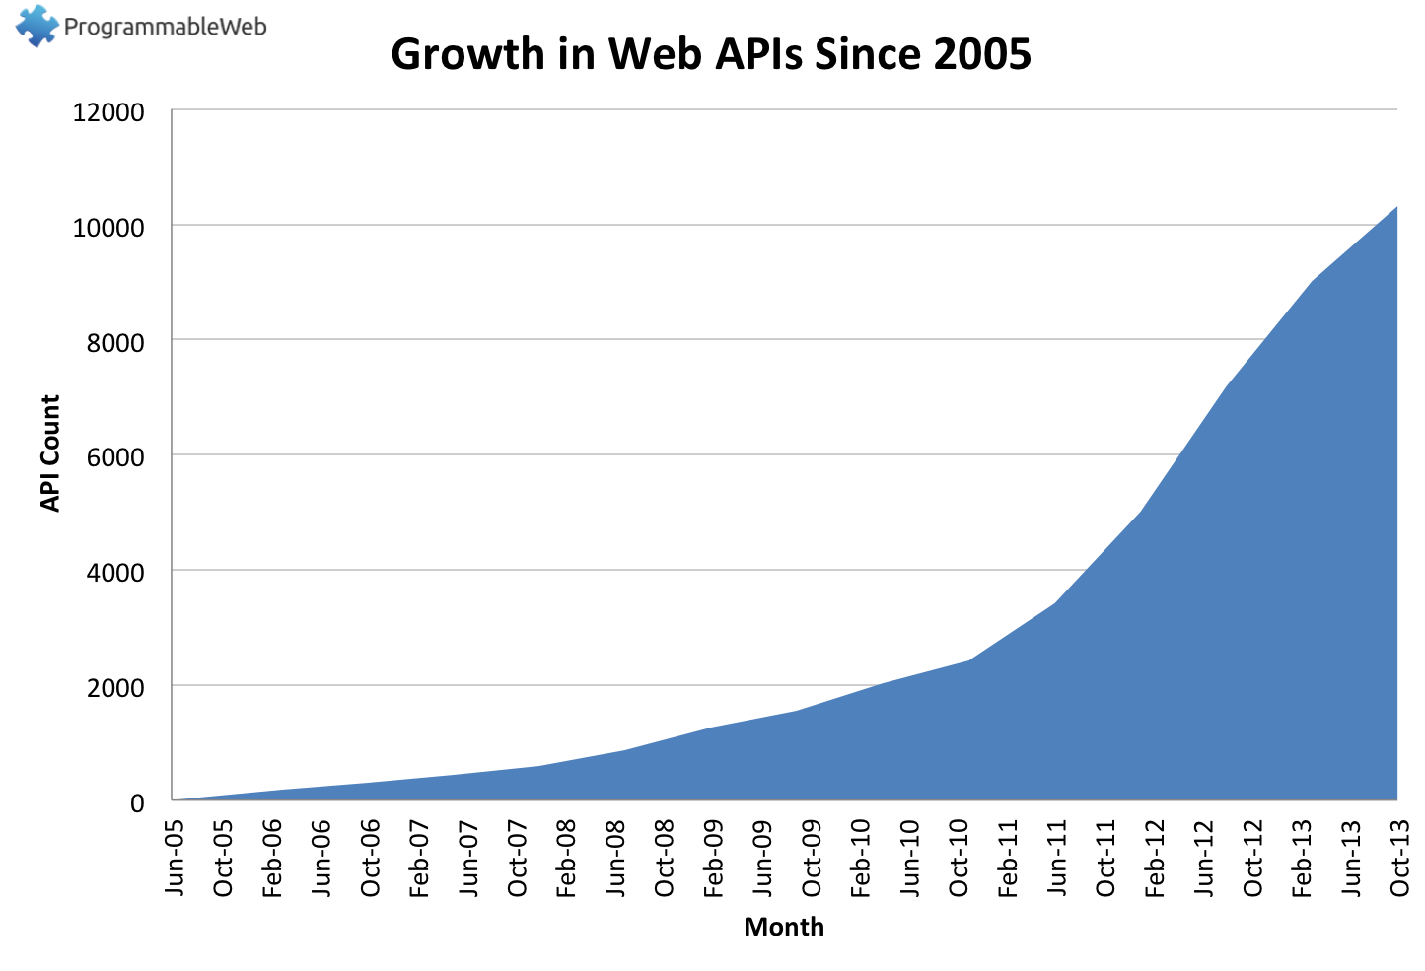
Number of API Today: 13800+
Source: http://www.programmableweb.com/api-research

Slide 3
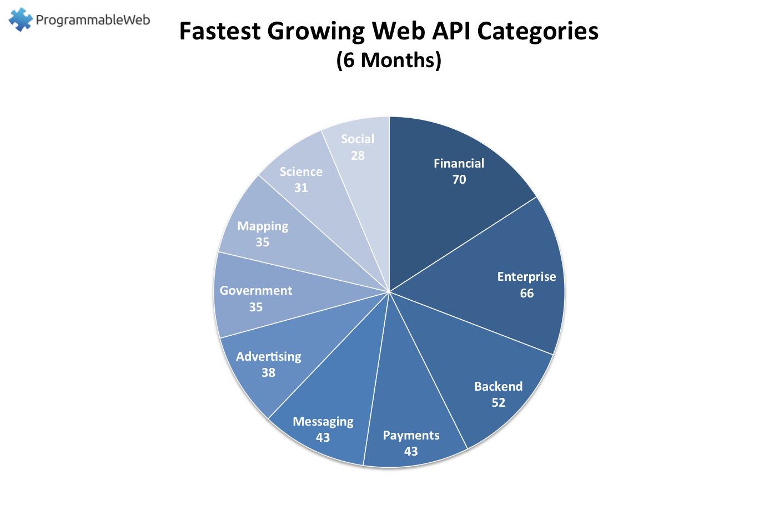
Non-commercial entities are joining the API party too…
White House API Program: https://www.whitehouse.gov/digitalgov/apis
IEEE APIs: http://ieeexplore.ieee.org/gateway/
UC Berkeley APIs: https://api-central.berkeley.edu/

Slide 4
Web APIs are now IT Resources
API dependencies require management and maintenance
Client
Application
APIs called by application impact user experience
APIs do not typically provide performance guarantees
APIs obscure functionality changes
API
API
API
Web Application
Web Application
Web Application

Slide 5
Client Service Level Agreements and “The Cloud”
Problem: Because much client application functionality depends on the APIs it calls, client-side SLAs depend on
SLAs for individual APIs
The ability to compose API SLAs into an SLA for the client
Current cloud platforms (Google, AWS) provide some reliability SLAs for individual APIs only

Slide 6
Client-Side Performance SLAs
Question: Is it possible to determine, automatically, a client-side performance SLA for cloud-based applications?
Cerebro
Predicts the response time of future web-API invocations from historical measurements
Composes API predictions into a client-side SLA
Fully automatic
No load testing or instrumentation of applications
Static analysis, cloud-side monitoring, and on-line statistical forecasting
PaaS based
Automated analysis
Deployment-time enforcement

Slide 7
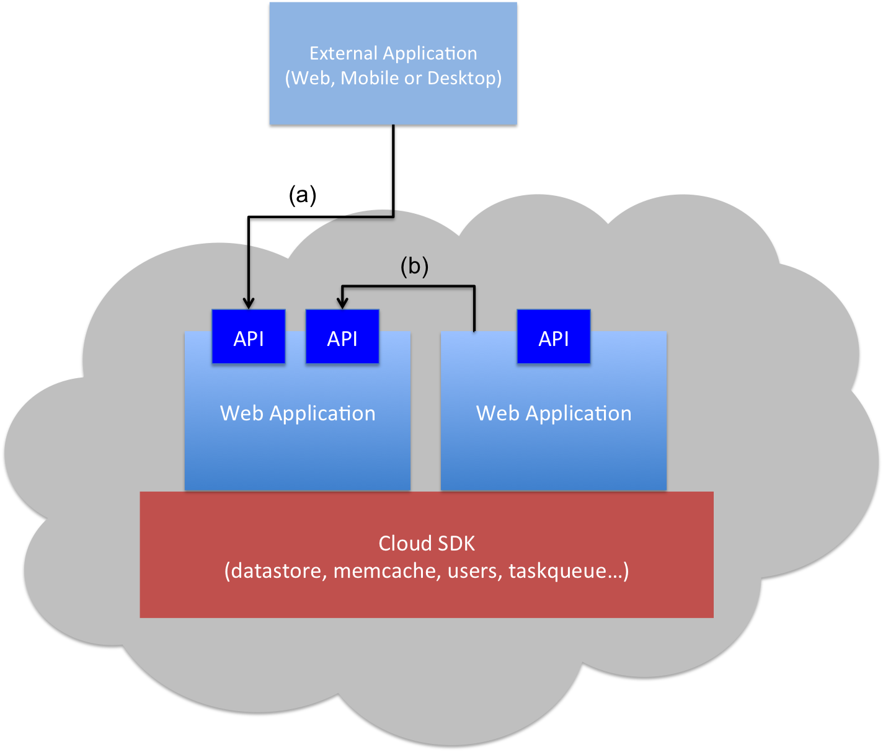
PaaS Clouds for Web Services
Client Application
(Web, Mobile or Desktop)
Request-response driven programming model
Scalable, high available and cost effective
Restricted I/O capabilities
Application code must adhere to the provided cloud SDK
Restrictions on threads

Slide 8
PaaS Client Application Survey
PaaS Client Applications…
Don’t have many branches
99% of the methods have < 36 paths
Don’t have many loops
88% of the methods have no loops
Spend most of their time executing cloud SDK calls (> 94%)
So…
PaaS applications are amenable to static analysis
Client API calls to the PaaS essentially define client-perceived application performance

Slide 9
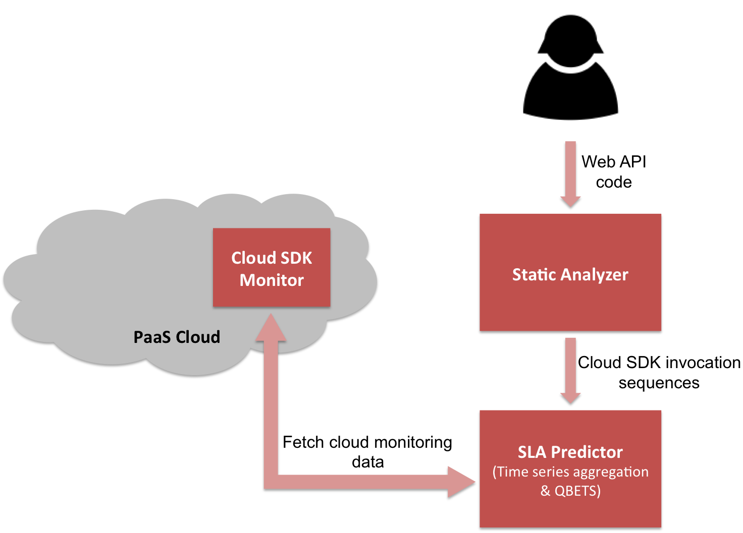
Cerebro Architecture

Slide 10
QBETS: Quantile Bounds Estimation from Time Series
Predicts instantaneous bounds on the quantiles of “current” distribution in a time series
Non-parametric – based on Binomial analysis
Accounts for autocorrelation and change-points
Efficient on-line implementation
Analyzes the first n entries in a time series
Predicts an upper bound for the (n+1)^{th} entry
QBETS([x₁,x₂,…x_{n}], p) = Q where p ∈ (0,1)
P(x_{n+1} ≤ Q) <= p
Originally developed for HPC systems to predict bounds on batch queue waiting times
Cerebro uses QBETS to predict response time SLAs of the form:
Operation O responds under T milliseconds (100*p)% of the time

Slide 11
Prototype and Experiments
Static analyzer: Java (Soot framework)
SDK monitor: App Engine Java app
SLA predictor: Java, Go, C
Tests conducted on Google App Engine public cloud, and AppScale private cloud (running on a 4-node Eucalyptus cluster)
Dates: from XXX to XXX
Network delay between client and Google is included but not modeled or predicted explicitly

Slide 12
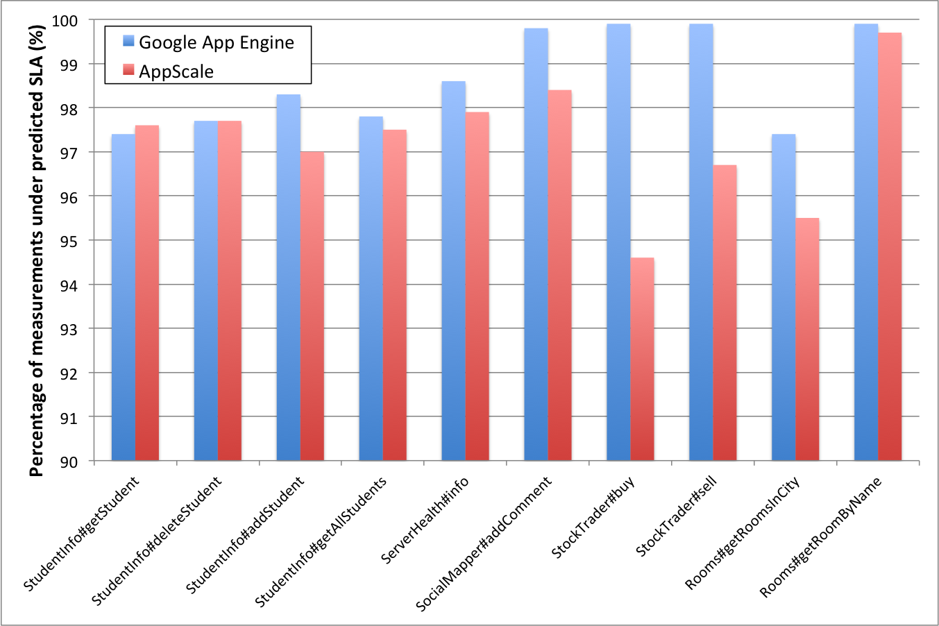
Evaluation: Prediction Correctness

Slide 13
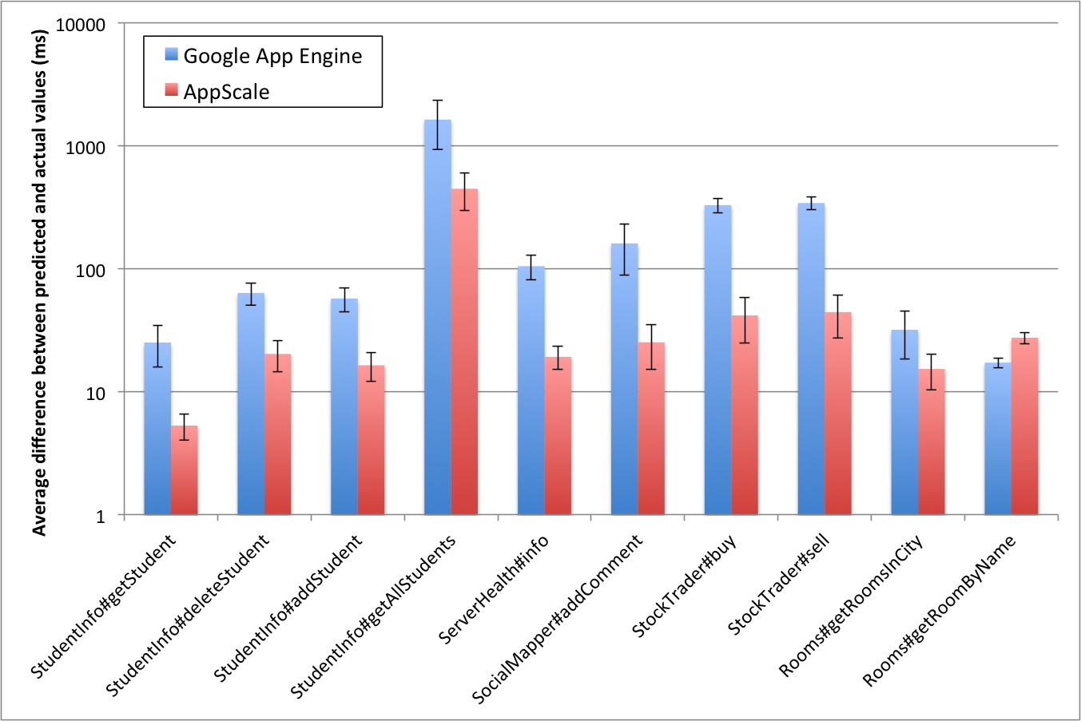
Evaluation: Prediction Tightness

Slide 14
Conclusions, Ongoing, and Future Work
Cerebro predictions are correct and moderately tight
Necessary conditions for use in an SLA
Average durability:
GAE: 26.8 hours
AppScale: 33.7 hours
More long term analysis of SLA durability periods, and automatic SLA renegotiation
SLA-related policy enforcement at deployment time with EAGER
Adaptive benchmarking for cloud SDK monitor

Slide 15
Thank You! Questions?
Hiranya Jayathilaka (hiranya911@gmail.com)
The UCSB Lab for Research on Adaptive Computing Environments
The RACELab -- http://www.cs.ucsb.edu/~ckrintz/racelab.html

