Slide 1


Response Time SLAs for Cloud-hosted Web Applications
Hiranya Jayathilaka
Prof. Chandra Krintz
Prof. Rich Wolski
Computer Science Dept., UC Santa Barbara
SOCC 2015

Slide 2
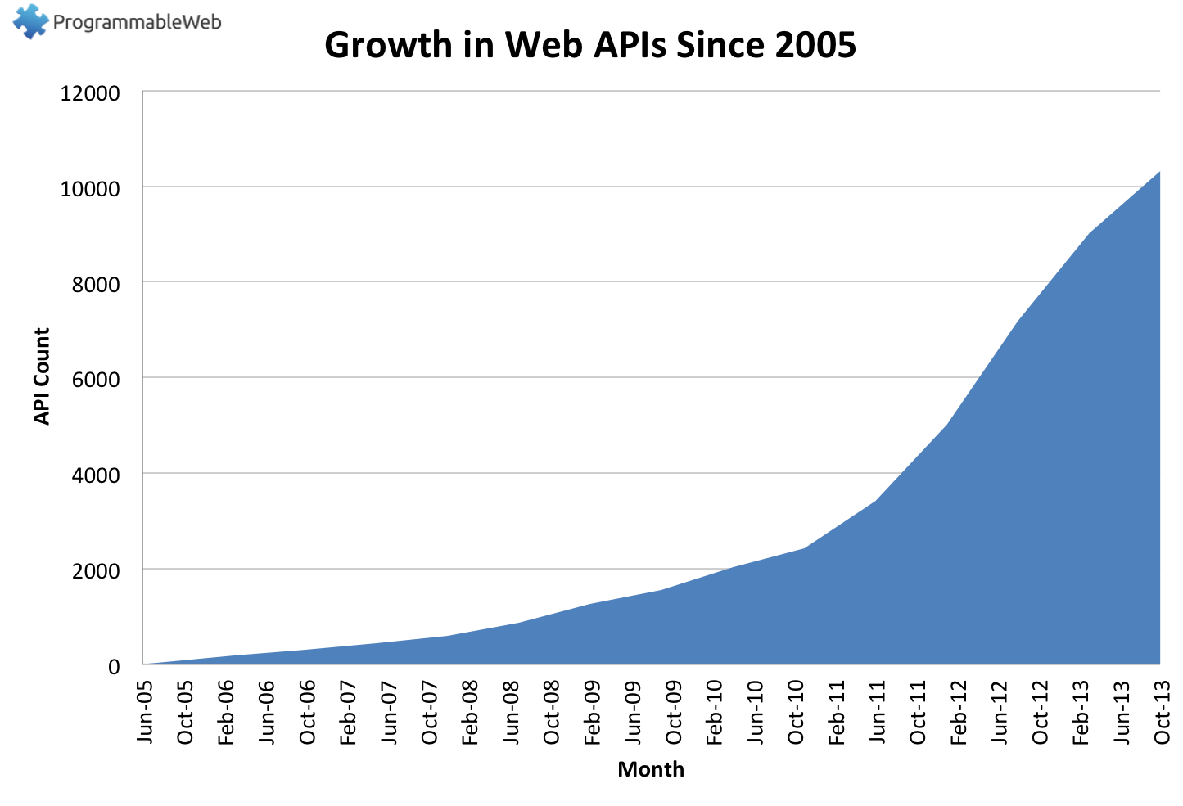
Number of API Today: 13800+
Source: http://www.programmableweb.com/api-research

Slide 3
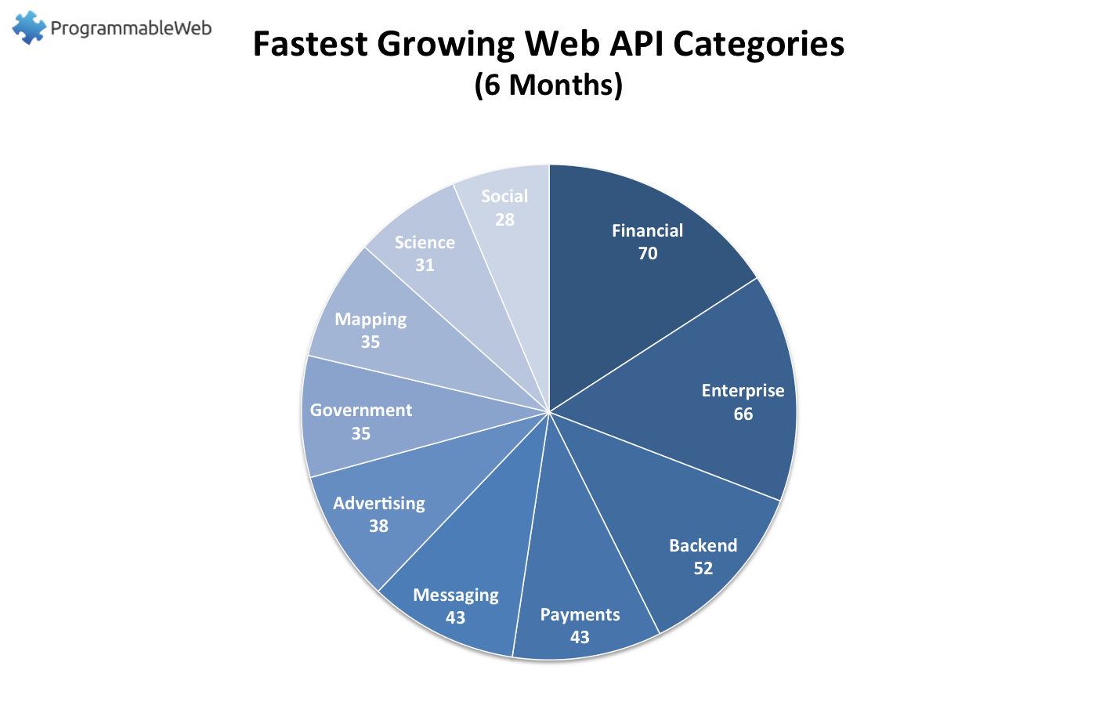
Non-commercial entities are joining the API party too…
White House API Program: https://www.whitehouse.gov/digitalgov/apis
IEEE APIs: http://ieeexplore.ieee.org/gateway/
UC Berkeley APIs: https://api-central.berkeley.edu/

Slide 4
Web API Drawbacks
Lack of tools to reason about API dependencies
Client
Application
Application behavior is impacted by the APIs
Most APIs do not provide any guarantees
Services underneath APIs can change
API
API
API
Web Application
Web Application
Web Application

Slide 5
Cerebro
Predict the response time SLAs of web API
Designed to operate with PaaS clouds
Fully automatic
No load testing or instrumentation of applications
Static analysis and statistical forecasting

Slide 6
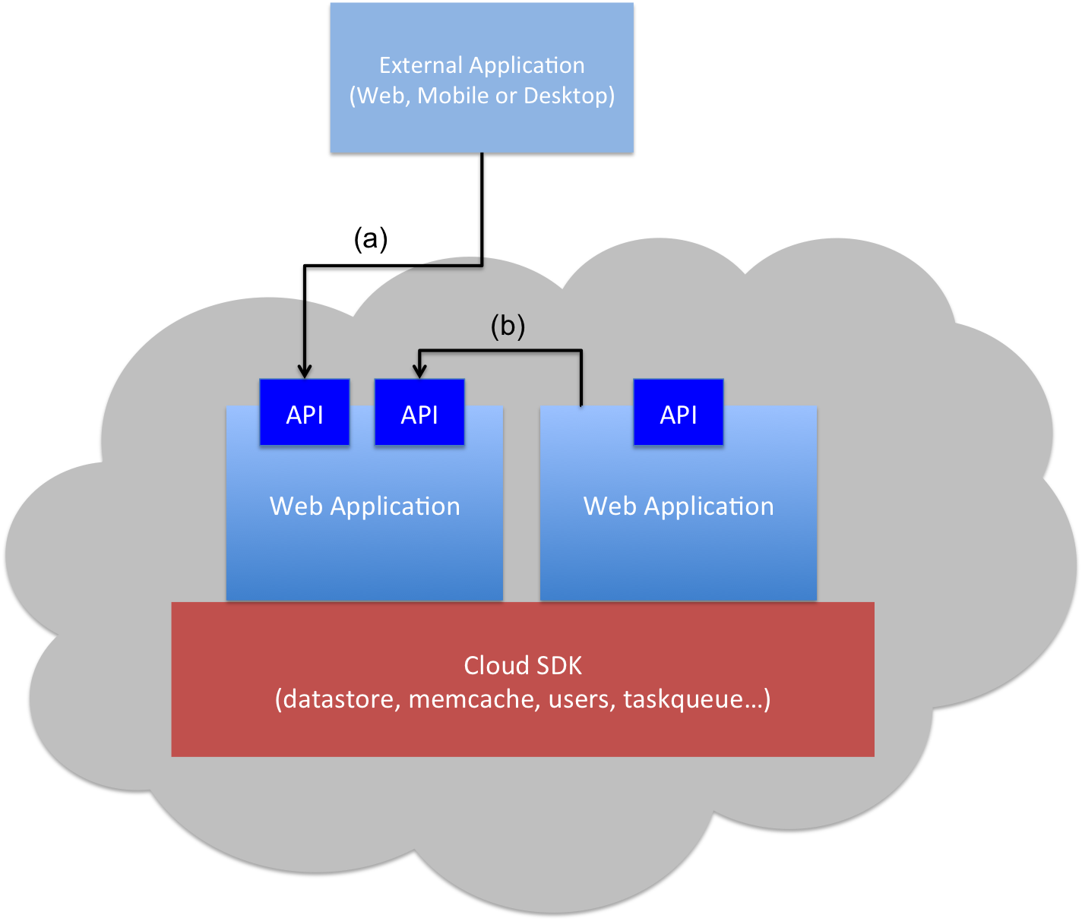
Why PaaS Clouds?
Client Application
(Web, Mobile or Desktop)
Request-response driven programming model
Scalable, high available and cost effective
Restricted I/O capabilities
Application code must adhere to the provided cloud SDK
Restrictions on threads

Slide 7
PaaS Application Survey Results
PaaS Applications…
Don’t have many branches
99% of the methods have < 36 paths
Don’t have many loops
88% of the methods have no loops
Spend most of their time executing cloud SDK calls (> 94%)
Translation…
PaaS applications are amenable to static analysis
Cloud SDK calls from PaaS application reveal important insights regarding application performance

Slide 8
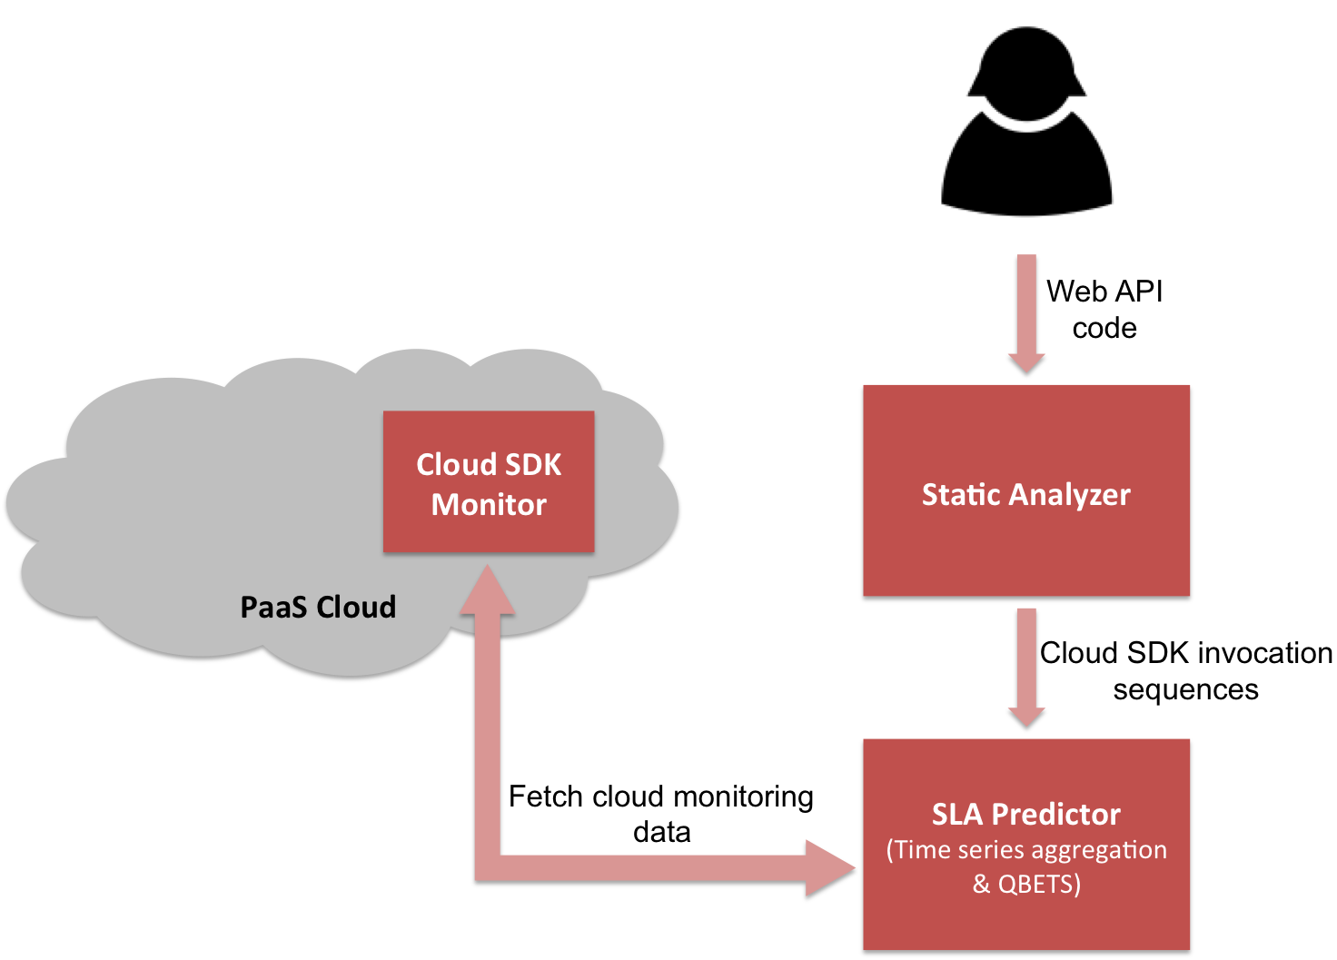
Cerebro Architecture

Slide 9
QBETS
Analyzes the first n entries in a time series
Predicts an upper bound for the (n+1)^{th} entry
QBETS([x₁,x₂,…x_{n}], p) = Q where p ∈ (0,100)
P(x_{n+1} ≤ Q) = p%
Cerebro uses QBETS to predict response time SLAs of the form:
Operation O responds under T milliseconds p% of the time

Slide 10
Prototype and Experiments
Static analyzer: Java (Soot framework)
SDK monitor: App Engine Java app
SLA predictor: Java, Go, C
Tests conducted on Google App Engine public cloud, and AppScale private cloud (running on a 4-node Eucalyptus cluster)

Slide 11
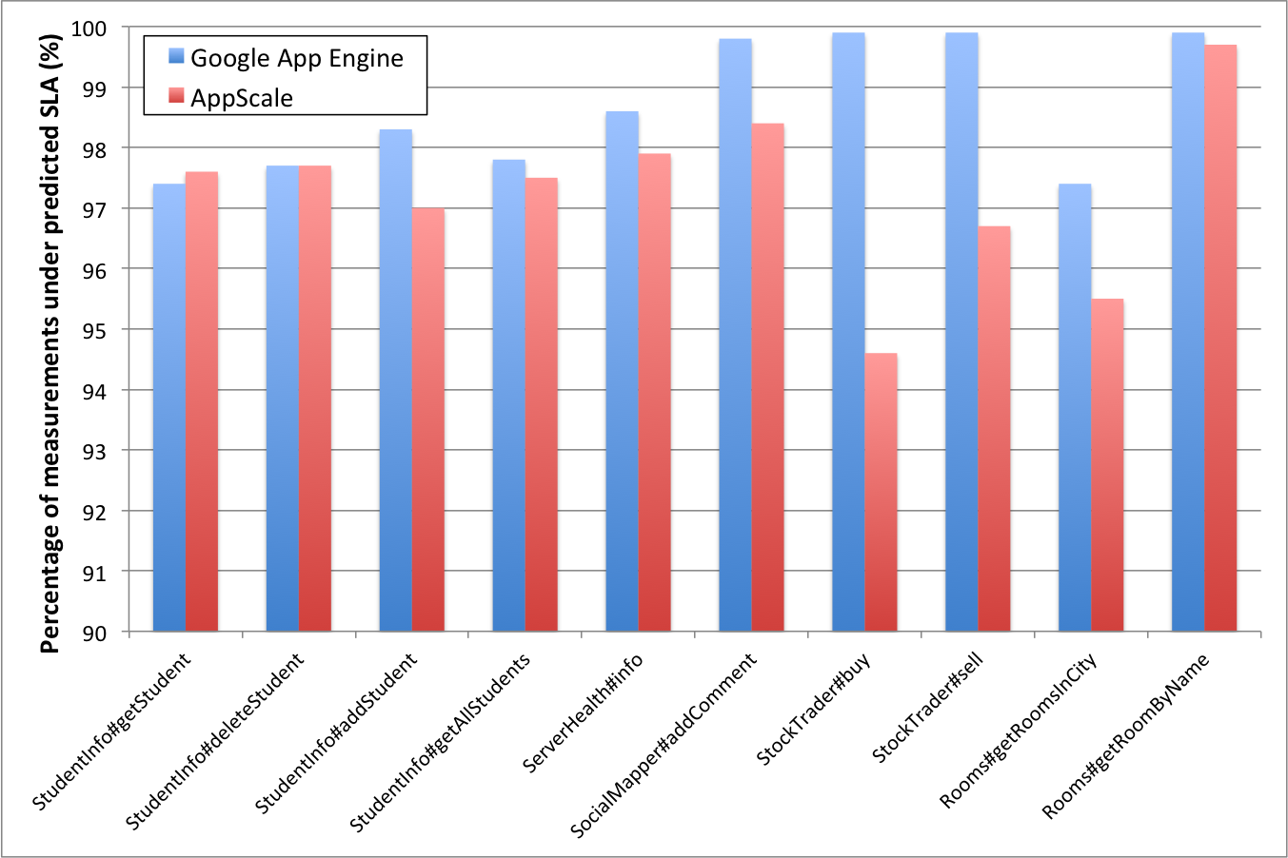
Evaluation: Prediction Correctness

Slide 12
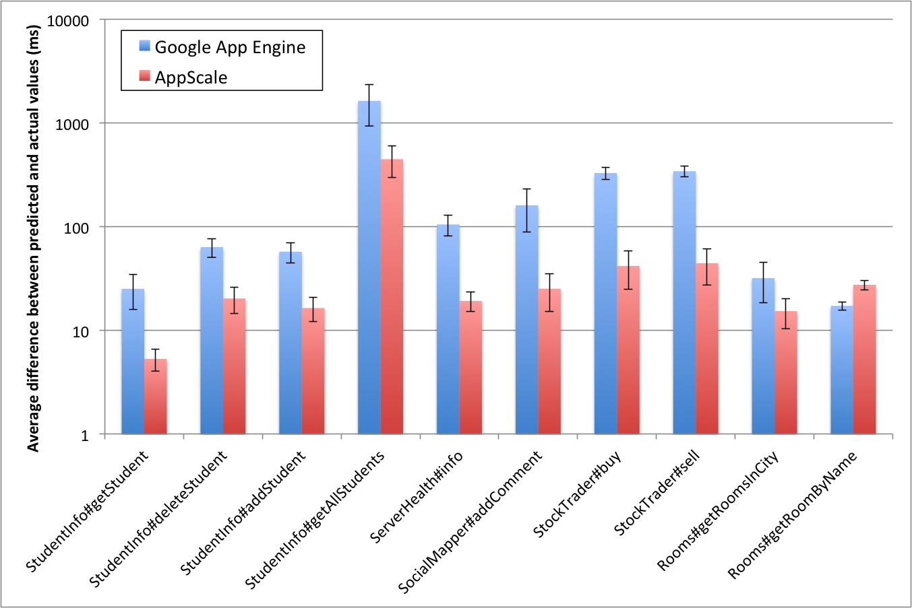
Evaluation: Prediction Tightness

Slide 13
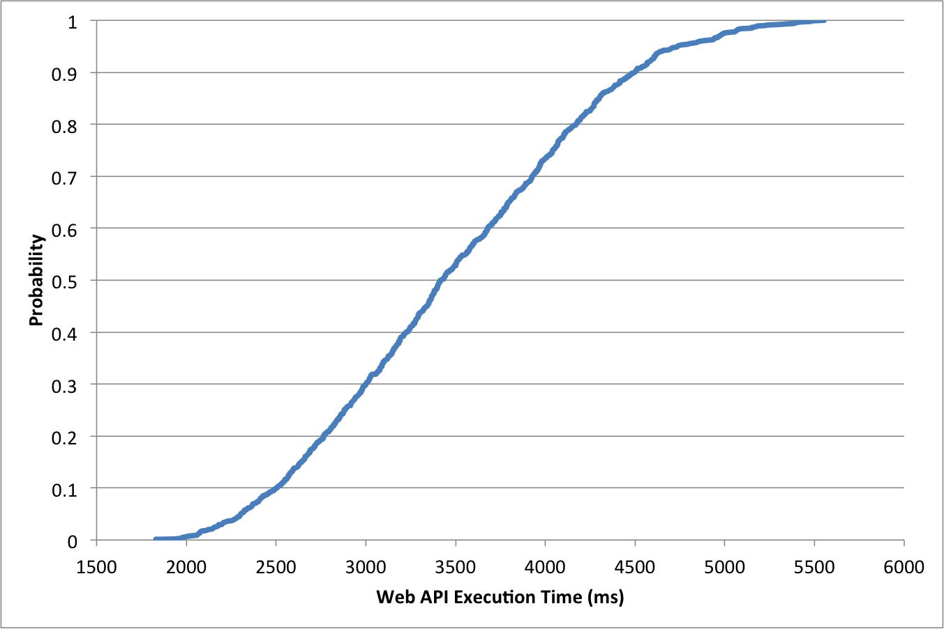
Evaluation: getAllStudents on GAE

Slide 14
Ongoing and Future Work
Validity period of Cerebro predictions
GAE: 26.8 hours
AppScale: 33.7 hours
More long term analysis of SLA validity periods, and automatic SLA renegotiation
SLA-related policy enforcement with EAGER
Adaptive benchmarking for cloud SDK monitor

Slide 15
Summary
We need powerful tools to analyze and reason about the APIs we use
Cerebro predicts response time bounds for web APIs in PaaS environments
Using a combination of static analysis, and runtime monitoring, Cerebro enables providing SLAs for web API response time

Slide 16
Thank You! Questions?

