Slide 1

EAGER: API Governance for Modern PaaS Clouds
Hiranya Jayathilaka
Chandra Krintz
Rich Wolski
hiranya@cs.ucsb.edu
GSWC 2014

Slide 2



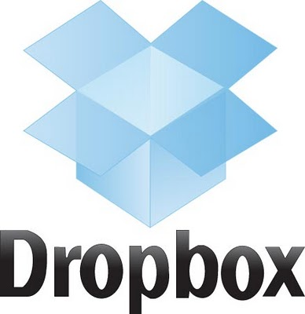





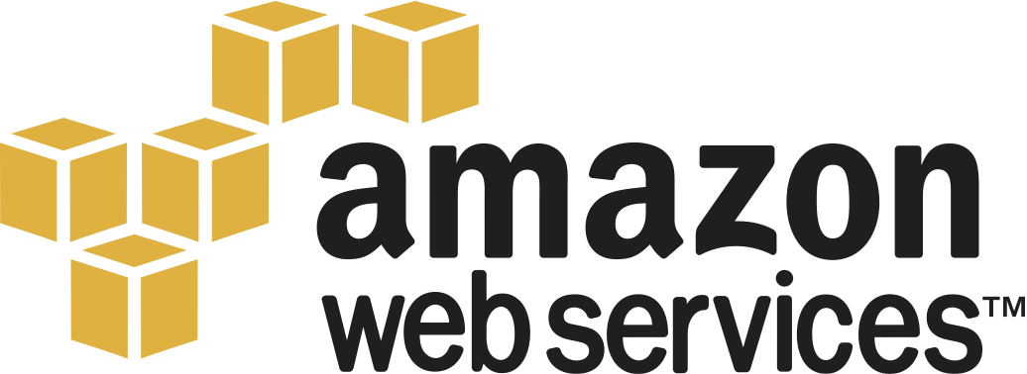




Web APIs in Our Day-to-day Lives
Web applications
Mobile apps
Cloud services
Notes:
Web APIs play a crucial role in our lives. Just think about all the web applications, mobile apps and cloud services that we consume in a day-to-day basis. These systems or services may come from many different business domains like search, social networking, online shopping and video streaming; but they all have one thing in common. That is they heavily rely on web APIs to deliver functionality and data to end-users.

Slide 3
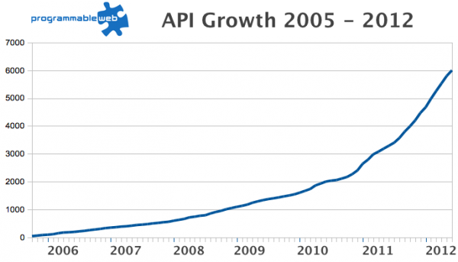
API Numbers are on the Rise!
Today: 12,000+ APIs
Notes:
Interestingly, the number of apps based on web APIs isn’t the only thing that has been growing. The number of web APIs itself has been increasing at an alarming rate over the last decade.

Slide 4
Need for Strong API Governance
Lack of API governance in a proliferating API ecosystem causes many issues
Poor code reuse
Security breaches, DoS attacks etc.
Violation of API service-level agreements
Naming and branding issues

Slide 5
What is API Governance?
Deployment/Design time governance
Enforcing API reuse
Dependency management
API versioning and lifecycle management
Run time governance
Access control
Rate limiting
SLA enforcement
Policies
+
Policy Engine

Slide 6



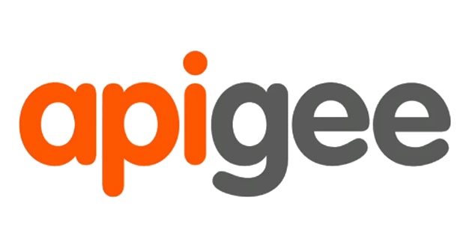


State of the Art
Many API management solutions
Operate as standalone servers or external cloud services that need to be integrated with the API deployment

Slide 7

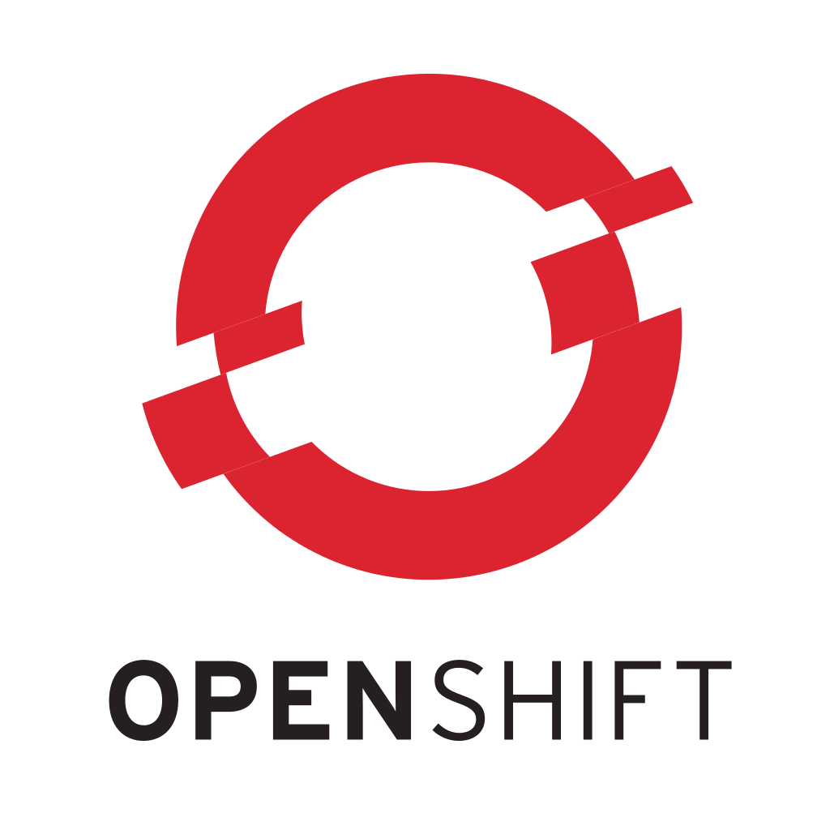
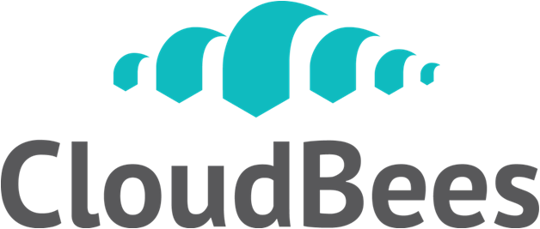





Web API Development in the Cloud
Today, many web applications and APIs are developed and deployed in cloud settings

Slide 8
What about API Governance in the Cloud?
Virtually non-existent
PaaS clouds do not integrate well with external API management systems
External API management systems cannot access the internal subsystems of the cloud

Slide 9
Our Proposal
Facilitate API governance as a built-in, native cloud service
Enable both deployment and run time enforcement of governance policies in the cloud
Leverage existing cloud features (fault tolerance, scalability etc.) to facilitate better governance
Perform most governance checks at the deployment time

Slide 10
EAGER
Enforced API Governance Engine for REST
A model and an architecture for facilitating API governance as a native feature in modern PaaS clouds
Can be easily built into existing cloud platforms
Facilitates comprehensive policy enforcement at deployment and run time of APIs

Slide 11
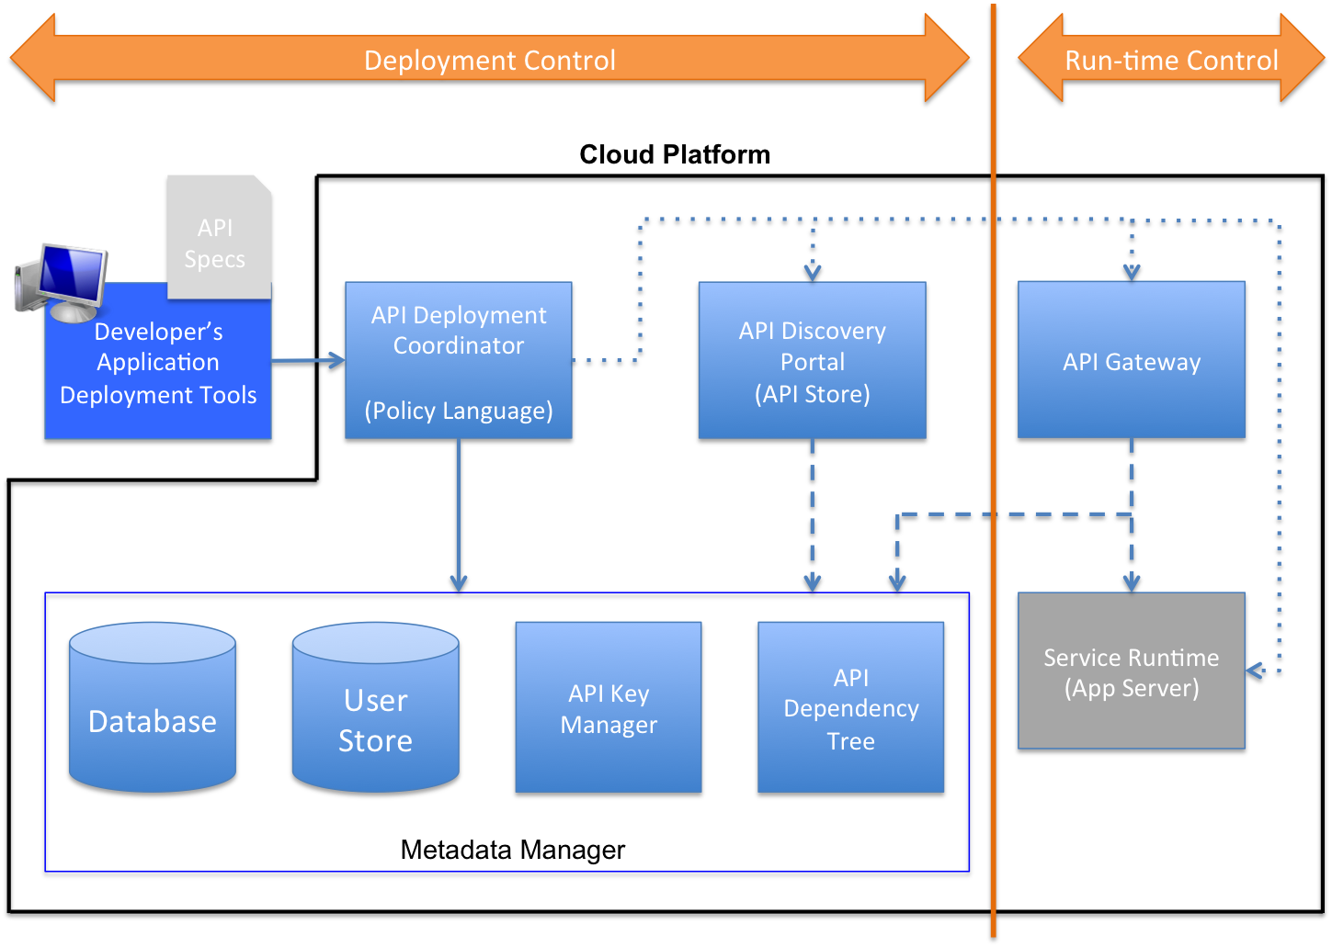
Architecture

Slide 12
API and Dependency Validation
EAGER validates API and dependency metadata for well-formedness.
Proper naming and versioning
No broken or non-existing dependencies
API specification comparison for retaining backward compatibility.
Recording API specifications and updating the global dependency graph.

Slide 13
Policy Language
Based on Python
No file system or network access
Restricted access to other Python modules
Policy conditions are expressed using assertion functions
assert_true(…)
assert_false(…)
assert_app_dependency(…)
assert_not_app_dependency(…)
assert_app_dependency_in_range(…)

Slide 14
Example Policies
if app.owner.endswith(‘@engineering.test.com’):
assert_app_dependency(app, ‘Log’, ‘1.0’)
elif app.owner.endswith(‘@sales.test.com’):
assert_app_dependency(app, ‘AnalyticsLog’, ‘1.0’)
else:
assert_app_dependency(app, ‘GenericLog’, ‘1.0’)
deprecated = filter(
lambda dep: dep.status = ‘Deprecated’,
app.dependencies)
assert_false(deprecated,
‘must not use deprecated dependencies’)

Slide 15

Prototype Implementation
Implemented into AppScale
http://appscale.com
Metadata Manager – MySQL
API Gateway and Discovery Portal – WSO2
All additional processes integrated into the task management subsystem of AppScale
Minimal code changes/additions

Slide 16
EAGER Dev Tools
Currently only supports Java (JAXRS)
Apache Maven archetype for setting up a web API project with the required libraries
Maven plug-ins for auto-generating API specs from Java code
Swagger 1.2 (http://swagger.io)

Slide 17
Detecting APIs and Dependencies
Each JAXRS annotated class is considered a separate API
Dependencies are manually specified by the developer in a YAML file
Automating the detection of dependencies is left for future work
All code and related resources are uploaded to the cloud as a single archive (.war)

Slide 18
Experiments
All experiments conducted on a single-node AppScale installation
Ubuntu 12.04 VM on Vagrant
Time to deploy an app in AppScale (without EAGER): 20-30 seconds
We measure the deployment overhead caused by EAGER

Slide 19
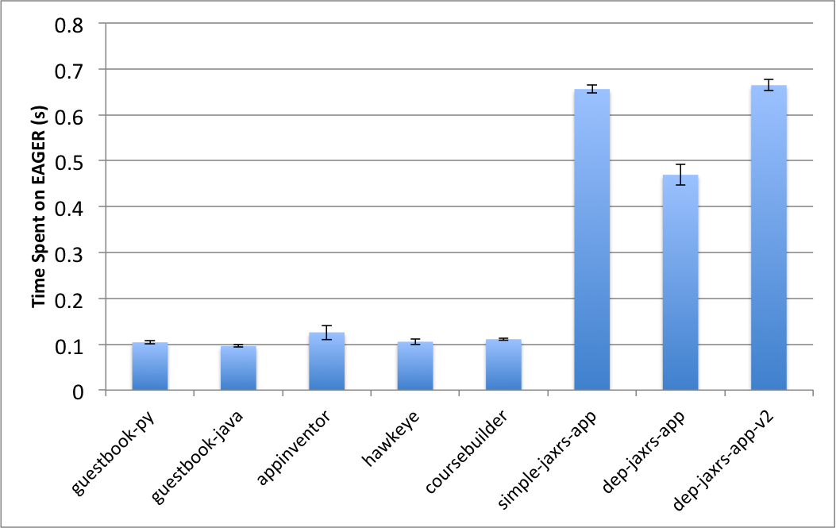
EAGER Overhead by App

Slide 20
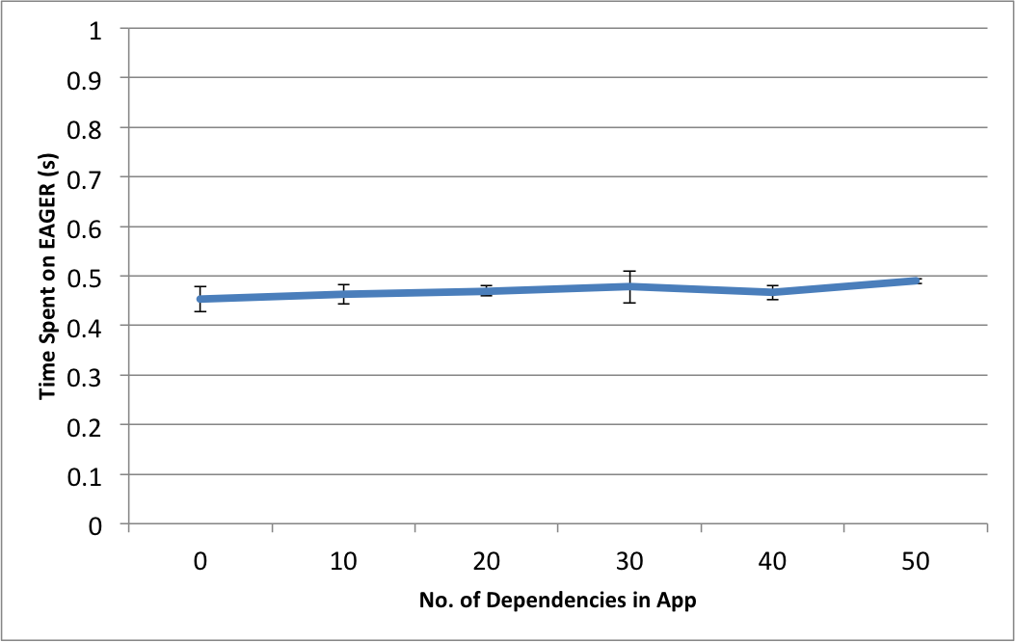
EAGER Overhead vs Dependencies

Slide 21
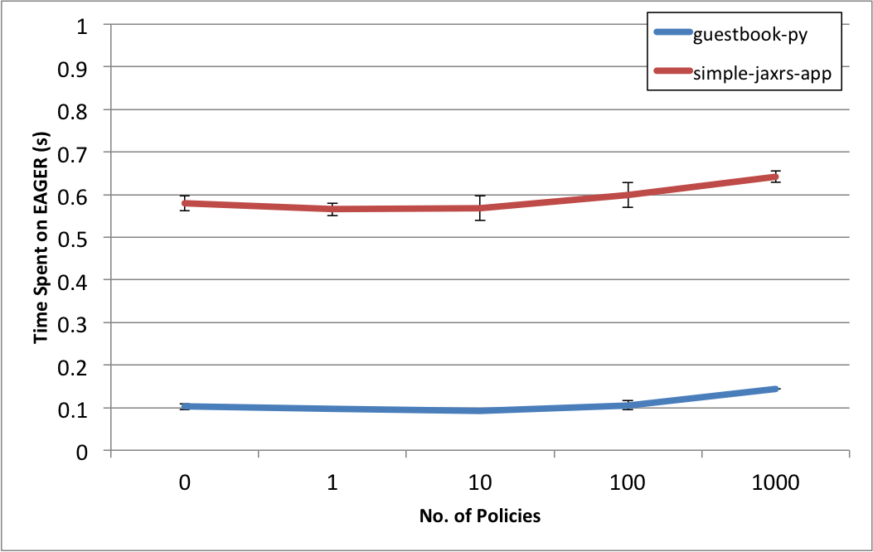
EAGER Overhead vs Policies

Slide 22
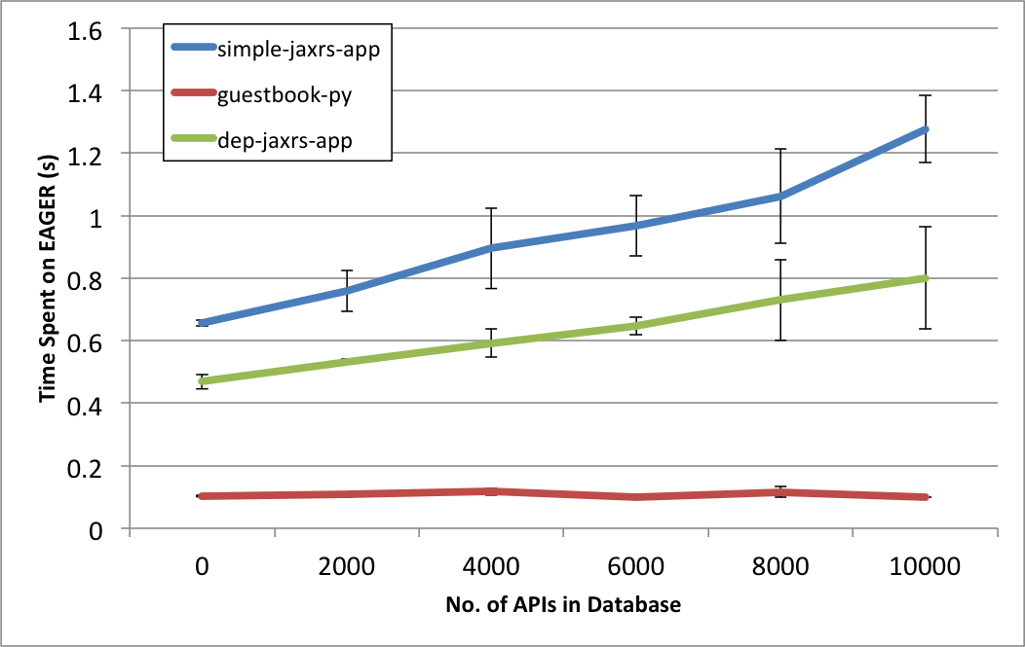
EAGER Overhead vs Metadata Volume

Slide 23
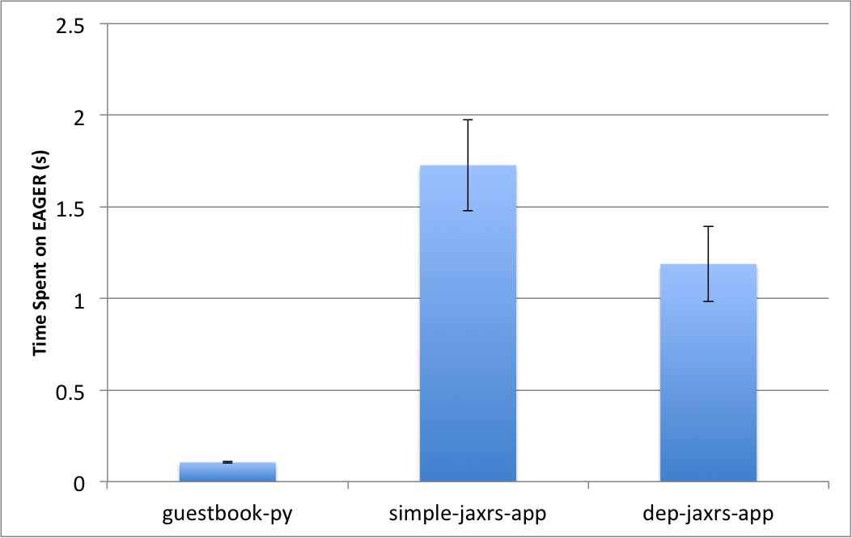
ProgrammableWeb Dataset
0 policies; 18322 APIs in DB; 33615 dependency edges

Slide 24
Conclusions
EAGER augments existing clouds to support API governance as a cloud-native feature.
It supports many software development and maintenance best practices.
EAGER supports thousands of APIs, hundreds of dependencies and policies with no noticeable performance overhead.
The Python-based policy language facilitates easy development and debugging of policies.

Slide 25
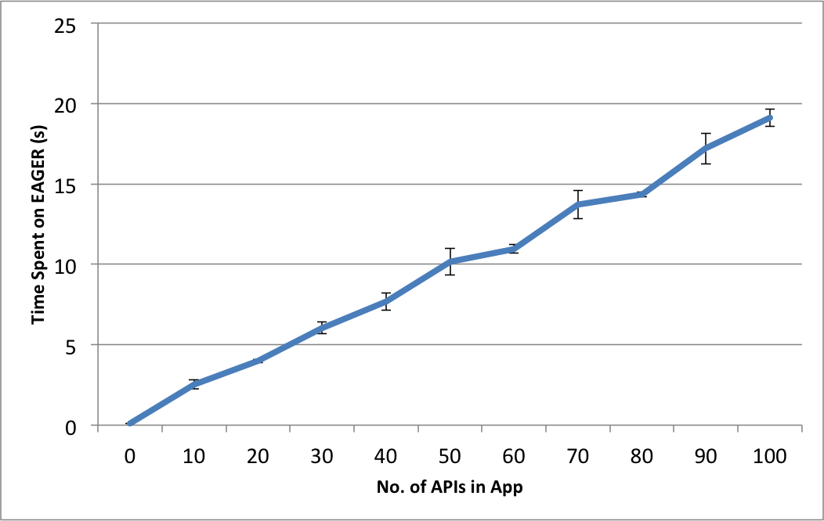
EAGER Overhead vs APIs

