Slide 2
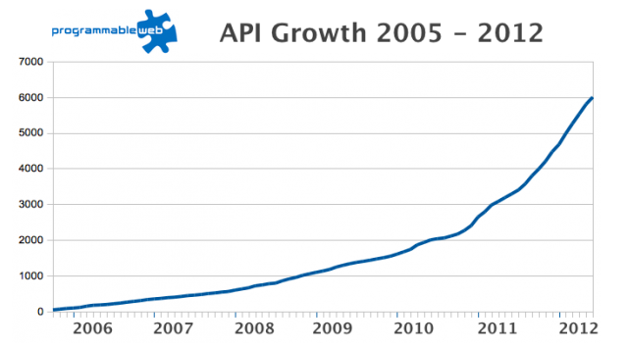
Number of APIs Today: 13516

Slide 3

Cerebro: Response-time SLAs for Web APIs in PaaS Clouds
Web API
Cloud SDK
Cloud Platform
Web API code
PaaS Cloud
Static Analyzer
Cloud SDK Monitor
Cloud SDK invocation
sequences
Fetch cloud monitoring
data
SLA Predictor
(Time series aggregation & QBETS)

Slide 4
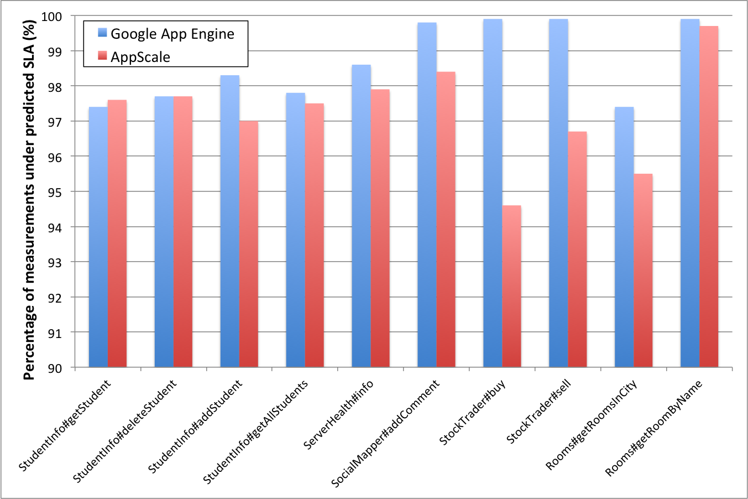
Cerebro: Prediction Accuracy Results

