Slide 1
Improved Server Architecture for Highly Efficient Message Mediation
Hiranya Jayathilaka (UCSB)
Pradeep Fernando, Dushan Abeyruwan, Kasun Indrasiri, Paul Fremantle, Sanjiva Weerawarana, Srinath Perera (WSO2)
Supun Kamburugamuwa (Indiana University)
Sadeep Jayasumana (ANU)

Slide 2
Outline
Enterprise Service Bus (ESB)
Typical ESB architecture and its limitations
Proposed architectural improvements
Evaluation
Future work

Slide 3
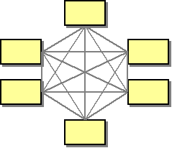
Enterprise Integration and Spaghetti Architecture
Large enterprises do not emerge out of nothing
More often than not, they have humble beginnings.
Grow iteratively
Acquire heterogynous software/systems in the process
At some point these systems has to be integrated
Point to point integration is not a good idea
O(n²) connection growth
Maintenance difficulties
[Image : http://www.eaipatterns.com/ramblings/03_hubandspoke.html]

Slide 4
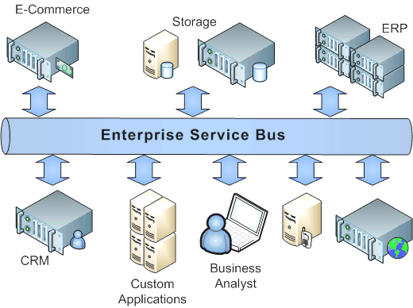
Enterprise Service Bus (ESB)
Connectivity layer in the distributed enterprise software architecture
Allows space de-coupled communication and mediation
switching wire-level protocols
switching message data formats
content-based routing
enriching messages, using some other data source
A fast operating ESB is crucial for achieving high application performance.
[Image: http://www.centeractive.com/content/enterprise-service-bus]

Slide 5
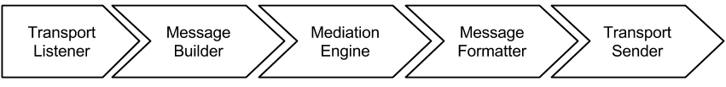
Typical ESB Architecture
Transport listeners – Receive messages over different wire-level protocols (HTTP/S, JMS , SMS etc.)
Message builder – Transforms the incoming message to canonical representation (canonicalization)
Mediation engine – Processes and mediates messages
Message formatter – Converts the canonical format to output wire format
Transport sender – Send messages to their destination endpoints (HTTP/S, JMS, SMS etc.)

Slide 6
Mediation Engine: Mediators
Mediation engine is comprised of a number of components referred to as mediators
Each mediator is designed to perform some processing on received messages
Users configure and combine mediators to construct useful message flows and services
ESB implementations may provide a DSL or a GUI to configure mediators and message flows

Slide 7
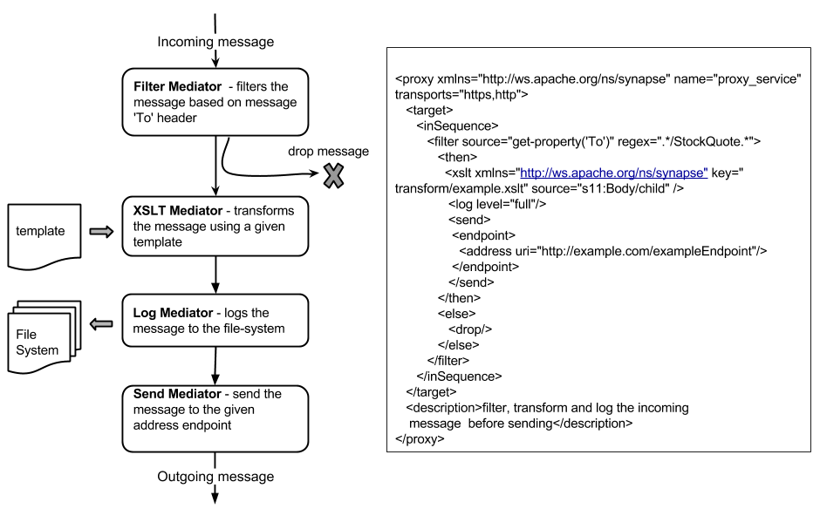
Message Flow Example (Apache Synapse)

Slide 8
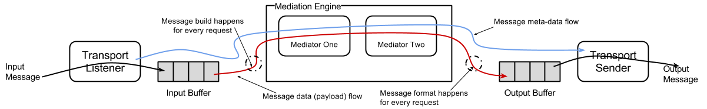
Typical Message Flow (Dual Buffer)
Pros :
Simple, and allows all the mediators to act upon messages and manipulate them.
Provides a uniform view for the mediator developers.
Cons:
All messages must go through the canonicalization process.
Slow and high memory utilization.
Think about URL based routing.

Slide 9
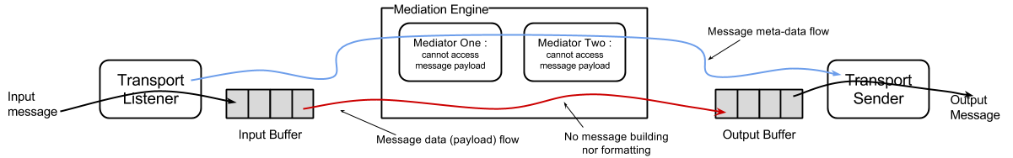
Optimization 1: Omitting Message Building Altogether
Pros
No message building and formatting overhead (no canonicalization).
Cons
Still the messages are read into the memory. This is problematic for large messages.
Mediators that access the message body do not work with this optimization.

Slide 10
Optimization 2: Selective Building at the Mediation Engine
We group mediators into two categories.
Content aware mediators
Content unaware mediators
During the development time of the ESB, we annotate the mediators so that the engine can identify whether a message flow is content aware or not
A message flow is content aware, if at least one mediator in the flow is content aware
The canonicalization of the message depends on deployment time information
What if there are if/else constructs in the flow configuration ?

Slide 11
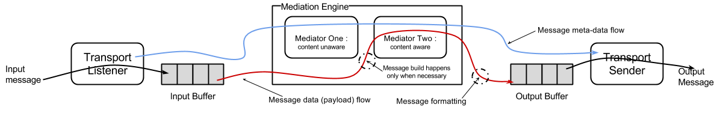
Optimization 3: Deferred Building at the Mediation Engine
Content awareness/Not awareness is decided at runtime (as opposed to deployment time)
If the mediation flow encounters an content aware mediator, it builds (canonicalizes) the message.
Otherwise, original byte stream itself is passed along the mediators.
ESB can now deal with If/else constructs in a smart manner.

Slide 12
Optimization 4: Pull Parsing and Stream Duplication
Make use of pull parsing in XML with the StAX API
Unlike DOM, StAX parsers are capable of creating a partial object model
The rest of the input stream is left in the original input buffer
ESB reconstructs the original message by serializing the partial object model constructed by StAX and simply transferring the remaining bytes from the input buffer to the output buffer

Slide 13
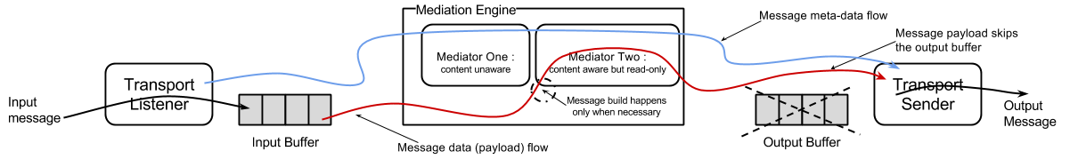
Optimization 5: Single Buffer to Process Messages
With the previous optimizations in place we can now identify mediation flows that alter the original input stream vs. the ones that do not
If the mediation flow is a read-only flow, the original message is preserved in the input buffer (+ partial object model)
Later we can simply read the input buffer to get the outgoing message.
This eliminates the output buffer and XML object serialization in some mediation flows

Slide 14
Implementation
We implemented the proposed optimizations on Apache Synapse
Open source
Implemented in Java
Less than 1000 lines of code changes in the mediation engine
We shall refer to the optimized ESB implementation as WSO2 ESB

Slide 15
Evaluation
EC2 c1.xlarge
EC2 c1.xlarge
EC2 c1.xlarge
WSO2 ESB
Heap: 2GB
Threads: 500
Tomcat
+
Echo service
Apache Bench Load Generator
EC2 c1.xlarge: 64-bit, 8 vCPUs based on an Intel Xeon processor, 7GB memory, High network performance, Operating on Ubuntu Linux

Slide 16
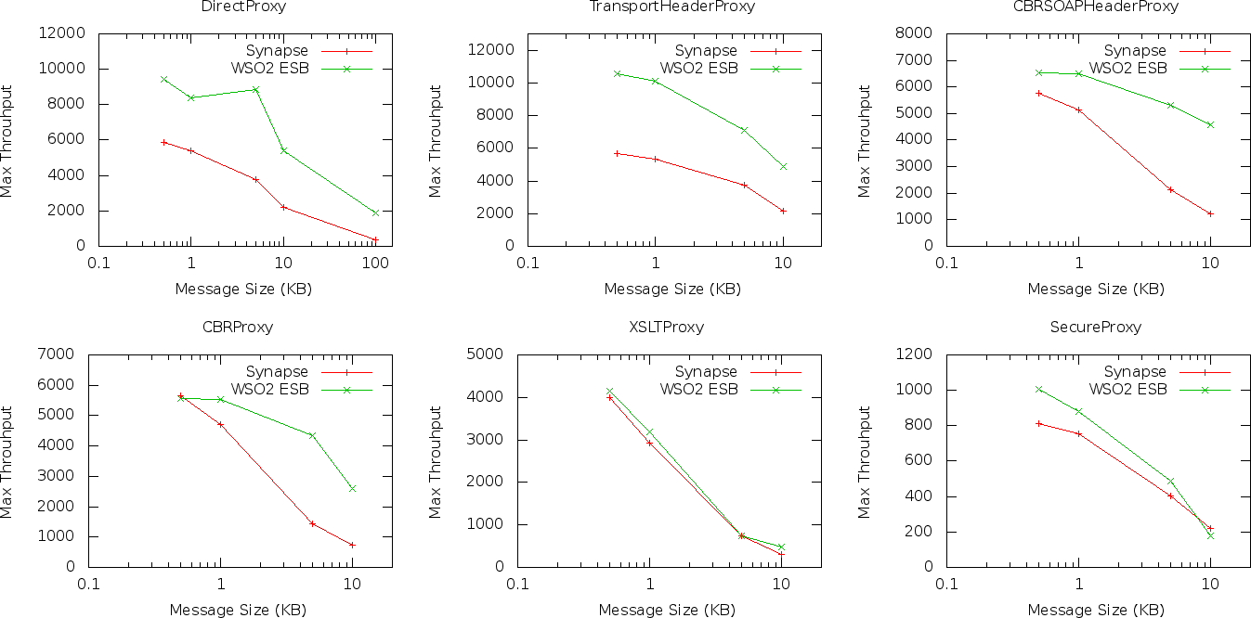
Results

Slide 17
Future Work
Right now the incoming message buffers get copied from kernel buffers to user buffers and back.
If the incoming message is not altered then we could write to the output network interface from the kernel buffer itself (zero copy pass through).

Slide 18
Summary
ESB is a crucial component in the enterprise software architecture. A slow ESB equates to sluggish application performance all-around.
Selective building and deferred building to reduce the canonicalization overhead.
Pull parsing and single buffer mediation model to further reduce the in-memory message copying and serialization overheads.
Proposed optimizations successfully implemented on an open source ESB to achieve up to 2x performance gain.

