Slide 1
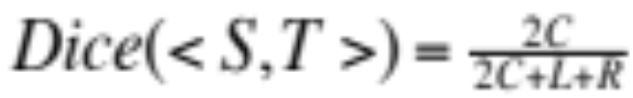
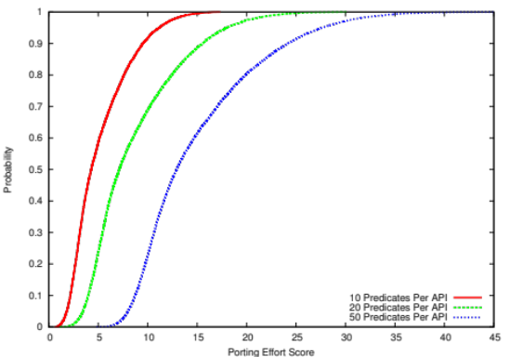
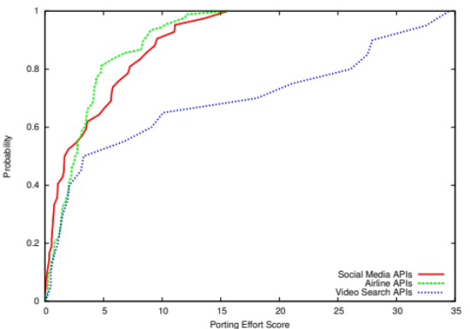
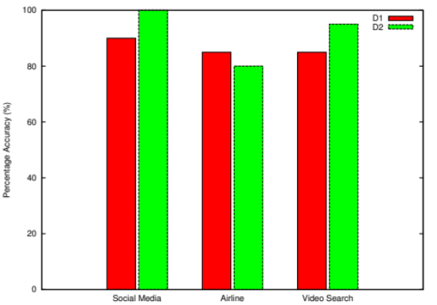
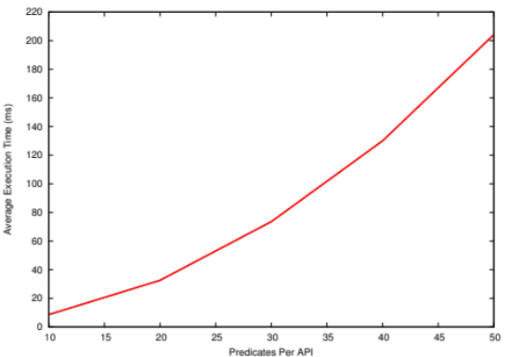


H. Jayathilaka, C. Krintz, R. Wolski
Towards Automatically Estimating Porting Effort Between Web Service APIs
As more and more applications are implemented using web APIs, we need new techniques to reason about them. In this work we develop a methodology for quantifying and comparing the difficulty of porting an application from one web API to another.
Our methodology compares web APIs based on their semantic compatibility. It involves documenting the axiomatic semantics of APIs using a Python subset, and then processing them through a Dice coefficient-based AST comparison algorithm.
Example Semantic Predicates
Preconditions:
input.x > 0
input.y > 0
Postconditions:
input.sum == input.x + input.y
Porting Effort CDF for Randomly Generated APIs
Porting Effort CDF for Real APIs
Percentage Accuracy of API Classification
Algorithm Execution Time
We also run k-means clustering on the calculated porting effort values to classify API pairs into 2 groups (“easy” and “hard”) based on how difficult it is to port applications among them.
Our approach is simple, fast and easy to implement. Experimental results show that our approach captures the porting effort associated with real world APIs accurately.
Department of Computer Science, UC Santa Barbara
hiranya@cs.ucsb.edu

