Slide 1

EAGER: API Governance for Modern PaaS Clouds
Hiranya Jayathilaka
Chandra Krintz
Rich Wolski
hiranya@cs.ucsb.edu
IEEE International Workshop on Future of PaaS 2015

Slide 2



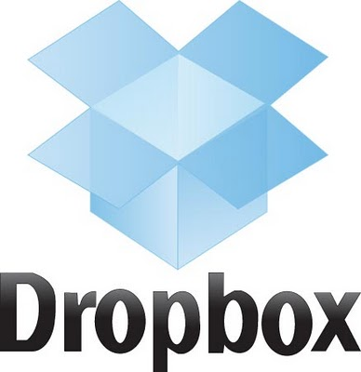





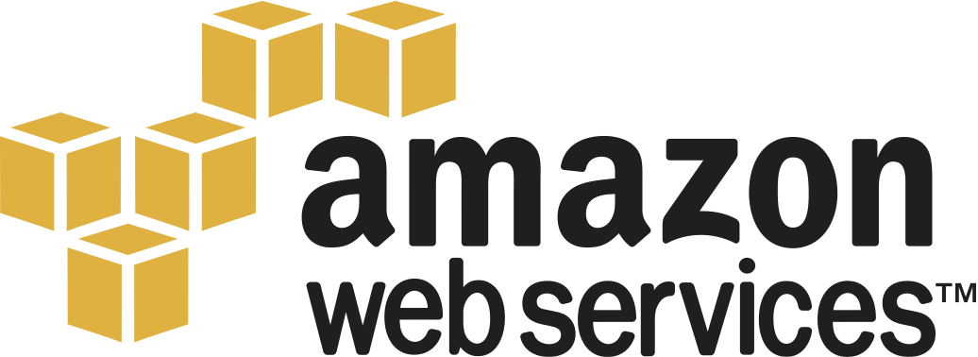




Web APIs in Our Day-to-day Lives
Web applications
Mobile apps
Cloud services
Notes:
Web APIs play a crucial role in our lives. Just think about all the web applications, mobile apps and cloud services that we consume in a day-to-day basis. These systems or services may come from many different business domains like search, social networking, online shopping and video streaming; but they all have one thing in common. That is they heavily rely on web APIs to deliver functionality and data to end-users.

Slide 3
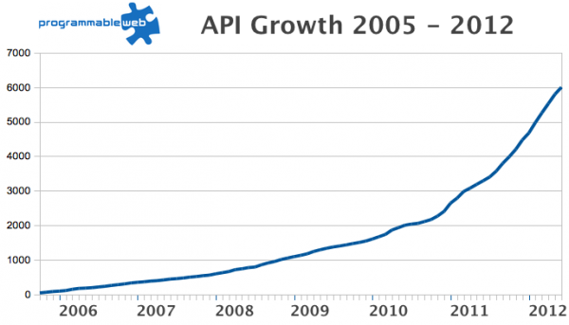
API Numbers are on the Rise!
Today: 12,000+ APIs
Notes:
Interestingly, the number of apps based on web APIs isn’t the only thing that has been growing. The number of web APIs itself has been increasing at an alarming rate over the last decade.

Slide 4
Need for Strong API Governance
Lack of API governance in a proliferating API ecosystem causes many issues
Poor code reuse
Security breaches, DoS attacks etc.
Violation of API service-level agreements (or lack thereof)
Naming, versioning and branding conflicts

Slide 5
What is API Governance?
Deployment/Design time governance
Enforcing API reuse
Dependency management
API versioning and lifecycle management
Run time governance
Access control
Rate limiting
SLA enforcement
Policies
+
Policy Engine

Slide 6



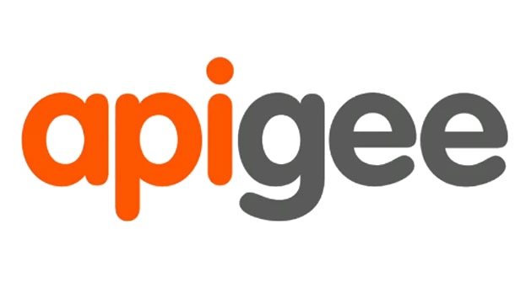


State of the Art
Many API management solutions
Operate as standalone servers or external cloud services that need to be integrated with the API deployment

Slide 7

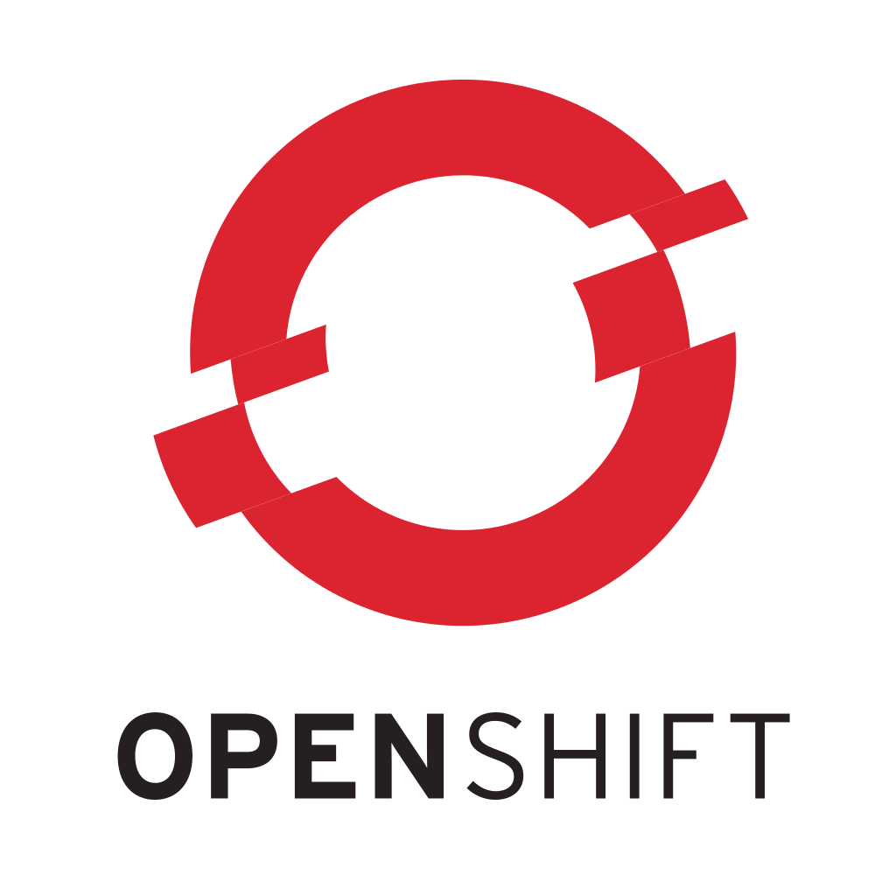
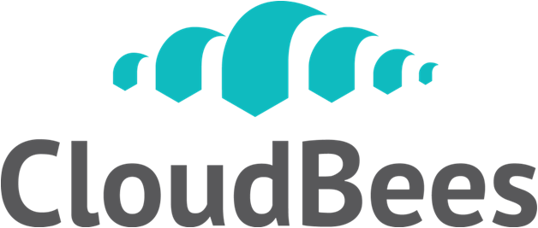





Web API Development in the Cloud
Today, many web applications and APIs are developed and deployed in cloud settings
Notes:
But most APIs today are deployed in cloud environments (PaaS).

Slide 8
What about API Governance in the Cloud?
Virtually non-existent
PaaS clouds do not integrate well with external API management systems
External API management systems cannot access the internal subsystems of the cloud
Notes:
And clouds don’t integrate well with 3rd party API management solutions.
Even when such an integration between the PaaS cloud and the API management system is possible, its benefits are usually offset by the extra monetary and manpower cost incurred.

Slide 9
Our Proposal
Facilitate API governance as a built-in, native cloud service
Enable both deployment and run time enforcement of governance policies in the cloud
Leverage existing cloud features (fault tolerance, scalability etc.) to facilitate better governance
Perform most governance checks at the deployment time

Slide 10
EAGER
Enforced API Governance Engine for REST
A model and an architecture for facilitating API governance as a native feature in modern PaaS clouds
Can be easily built into existing cloud platforms
Facilitates comprehensive policy enforcement at deployment and run time of APIs

Slide 11
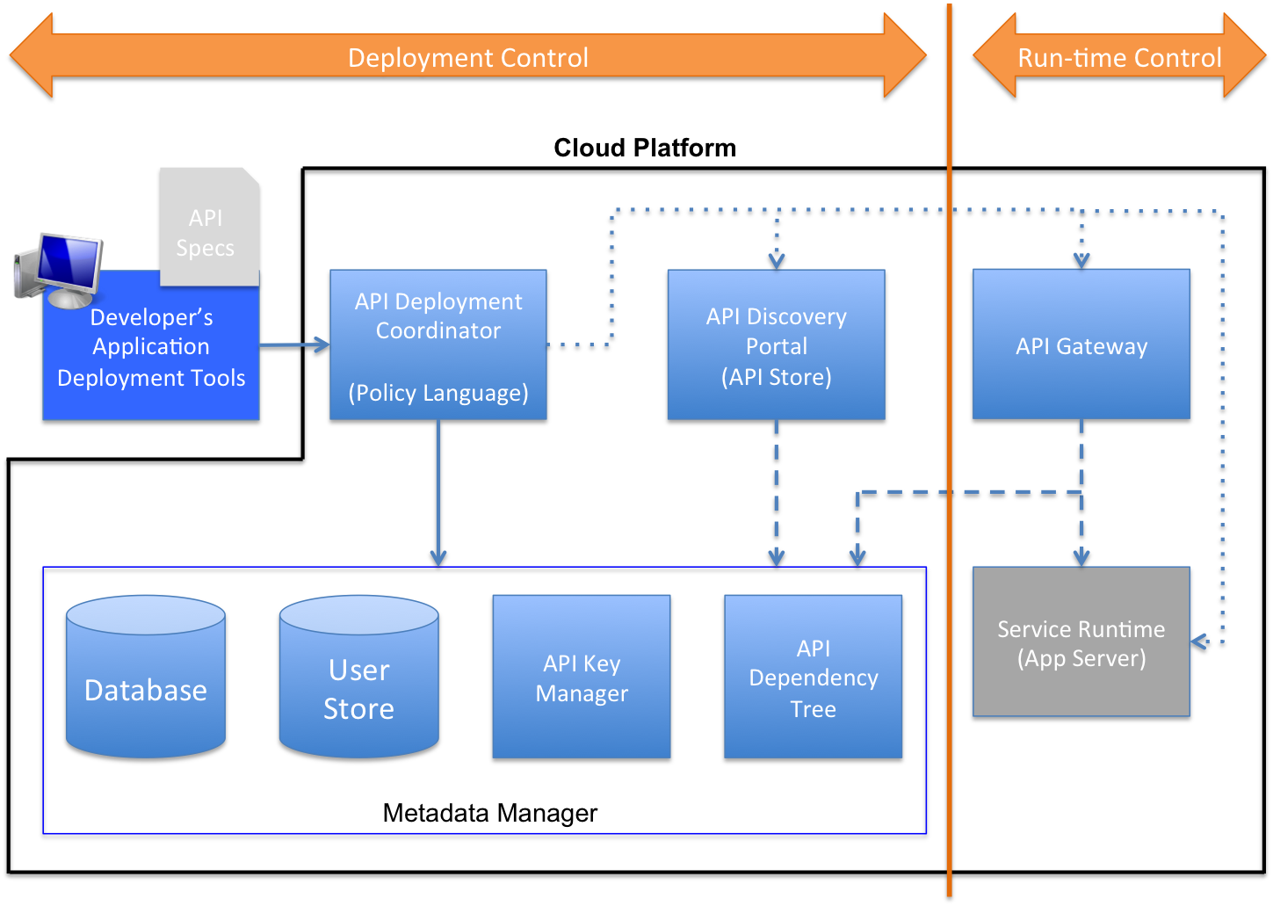
Architecture
Notes:
Developer uploads the application to the cloud using application deployment tools
API Deployment Coordinator (ADC) intercepts the request, runs the validations, and policies
If all good, API metadata is saved in the Metadata Manager, and the APIs are published to the discovery portal and API gateway
API gateway is used in run-time governance.

Slide 12
Default Validations
EAGER validates API and dependency metadata for well-formedness.
Proper naming and versioning
No broken or non-existing dependencies
API specification comparison for retaining backward compatibility.
Recording API specifications and updating the global dependency graph.
Notes:
EAGER performs a default set of deployment-time sanity checks on each application. These checks are always performed, regardless of what policies are in place.

Slide 13
Policy Language
Based on Python
No file system or network access
Restricted access to other Python modules
Policy conditions are expressed using assertion functions
assert_true(…)
assert_false(…)
assert_app_dependency(…)
assert_not_app_dependency(…)
assert_app_dependency_in_range(…)
Notes:
Language doesn’t allow file or network I/O. Most 3rd party python modules are also blocked (we use a whitelisting method). Language also doesn’t allow global in-memory state.

Slide 14
Example Policies
if app.owner.endswith(‘@engineering.test.com’):
assert_app_dependency(app, ‘Log’, ‘1.0’)
elif app.owner.endswith(‘@sales.test.com’):
assert_app_dependency(app, ‘AnalyticsLog’, ‘1.0’)
else:
assert_app_dependency(app, ‘GenericLog’, ‘1.0’)
deprecated = filter(
lambda dep: dep.status = ‘Deprecated’,
app.dependencies)
assert_false(deprecated,
‘must not use deprecated dependencies’)
Notes:
1st policy: Tenant-aware dependency check
2nd policy: Preventing dependencies on deprecated APIs

Slide 15

Prototype Implementation
Implemented into AppScale
http://appscale.com
Metadata Manager – MySQL
API Gateway and Discovery Portal – WSO2
All additional processes integrated into the task management subsystem of AppScale
Minimal code changes/additions

Slide 16
EAGER Dev Tools
Currently only supports Java (JAXRS)
Apache Maven archetype for setting up a web API project with the required libraries
Maven plug-ins for auto-generating API specs from Java code at compile-time
Swagger 1.2 (http://swagger.io)
EAGER uses these specs for backward compatibility checking of APIs

Slide 17
Detecting APIs and Dependencies
Each JAXRS annotated class is considered a separate API
Dependencies are manually specified by the developer in a YAML file
Automating the detection of dependencies is left for future work
All code and related resources are uploaded to the cloud as a single archive (.war)

Slide 18
Experiments
All experiments conducted on a single-node AppScale installation
Ubuntu 12.04 VM on Vagrant
Time to deploy an app in AppScale (without EAGER): 20-30 seconds
We measure the deployment overhead caused by EAGER

Slide 19
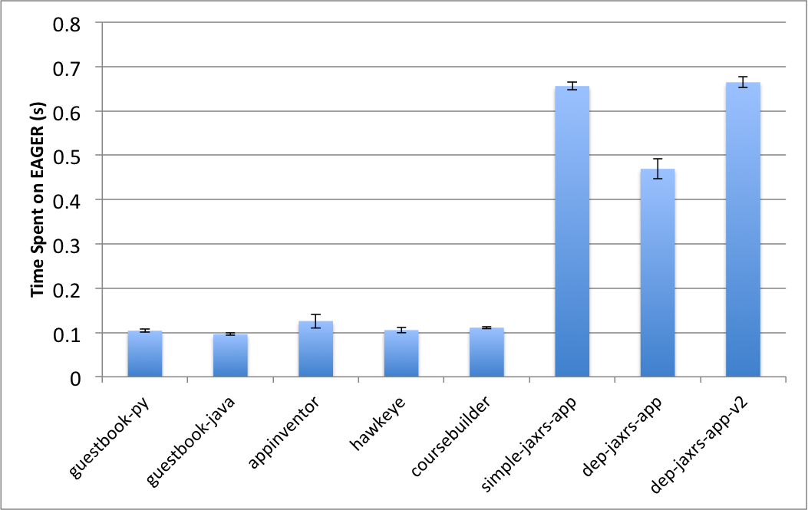
EAGER Overhead by App
Notes:
App applications (even the ones that do not export APIs like guestbook-py) are subjected to the default validations performed by EAGER.
Simple-jaxrs-app: 2 APIs
Dep-jaxrs-app: 1 API and 1 dependency
Dep-jaxrs-app-v2: 2 APIs and 1 dependency
Everything else: No APIs or dependencies

Slide 20
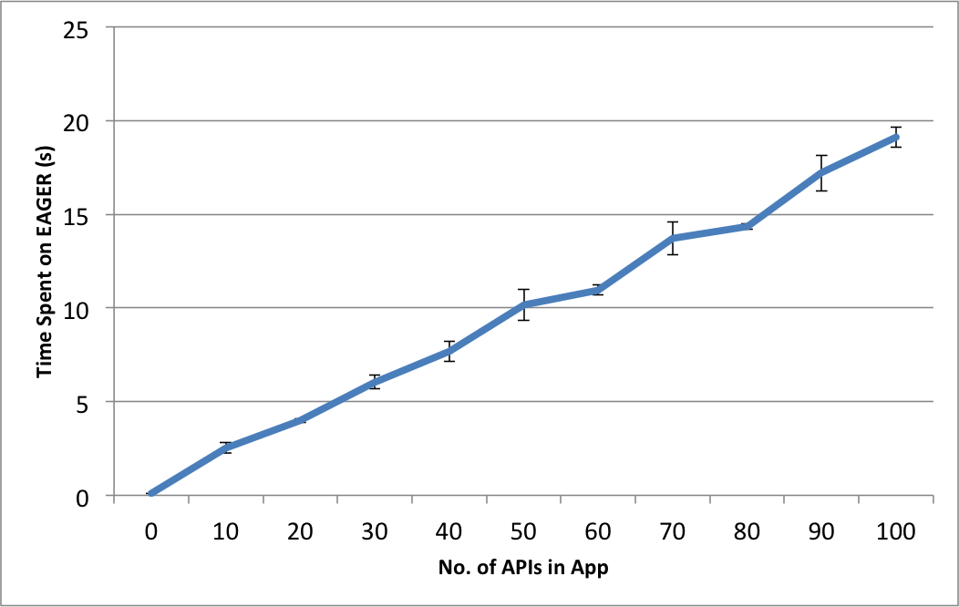
EAGER Overhead vs APIs
Notes:
EAGER iterates through APIs to check metadata. This can be parallelized if needed.

Slide 21
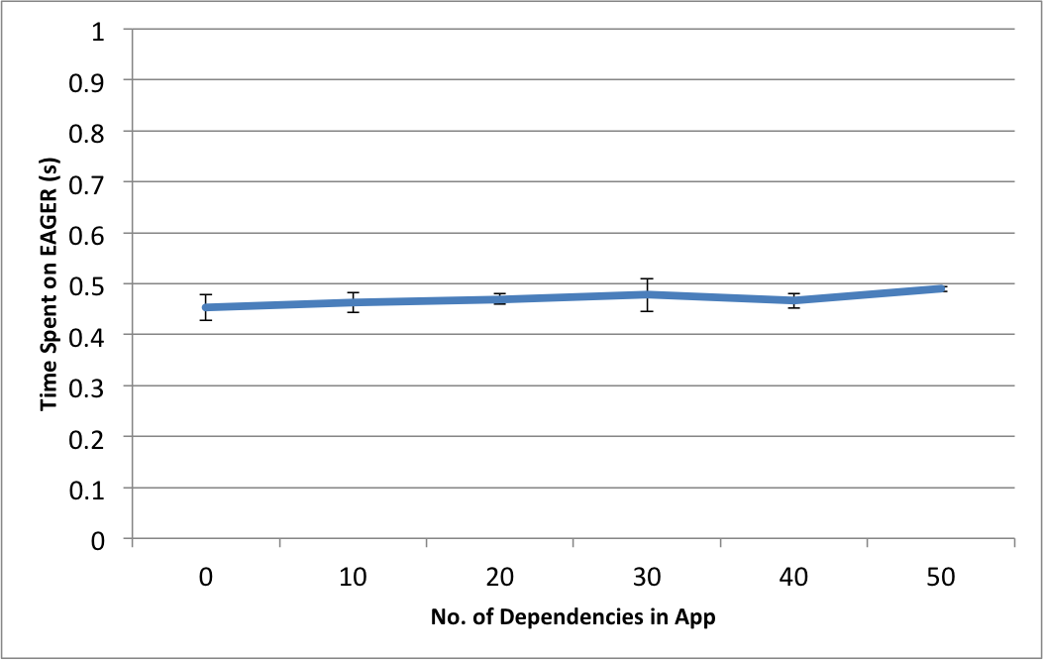
EAGER Overhead vs Dependencies
Notes:
We use batch operations to deal with dependencies.

Slide 22
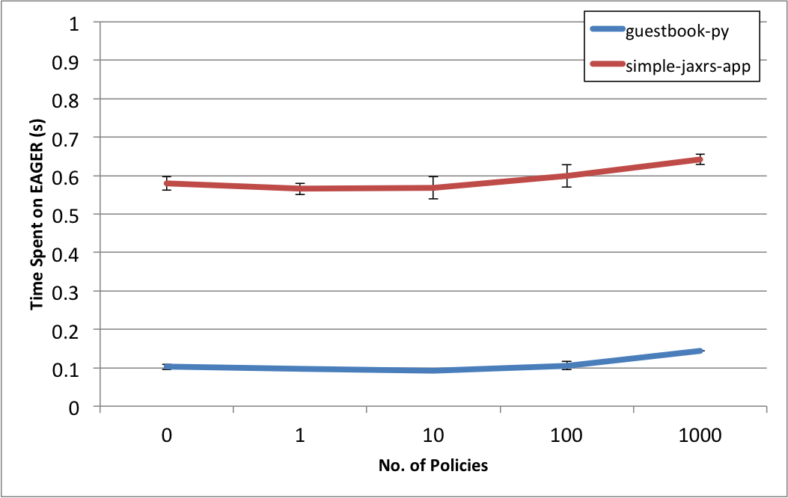
EAGER Overhead vs Policies
Notes:
The test policy used has a loop that iterates through the APIs exported by the application. Guestbook has no APIs and hence, that part of the policy doesn’t get executed.

Slide 23
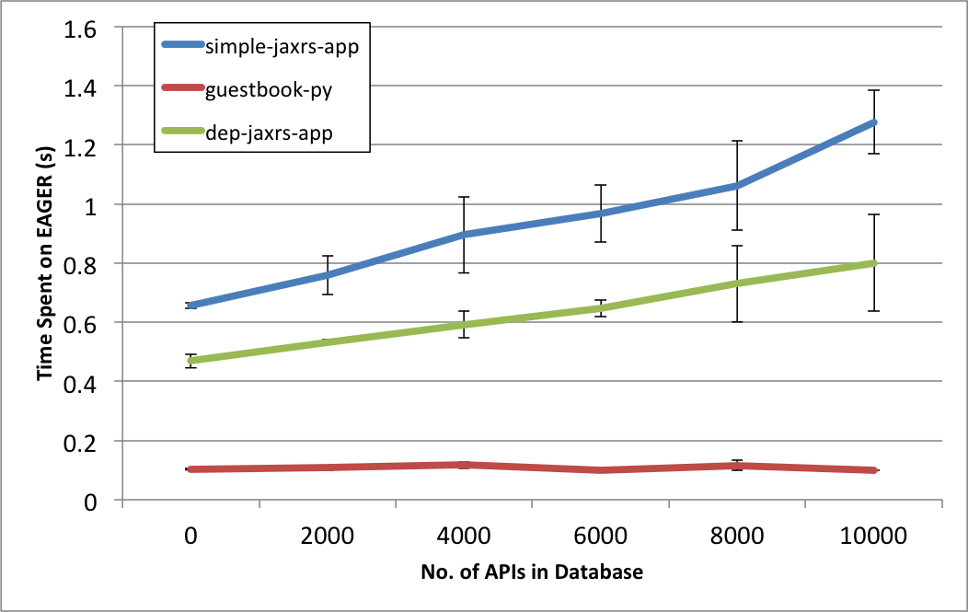
EAGER Overhead vs Metadata Volume

Slide 24
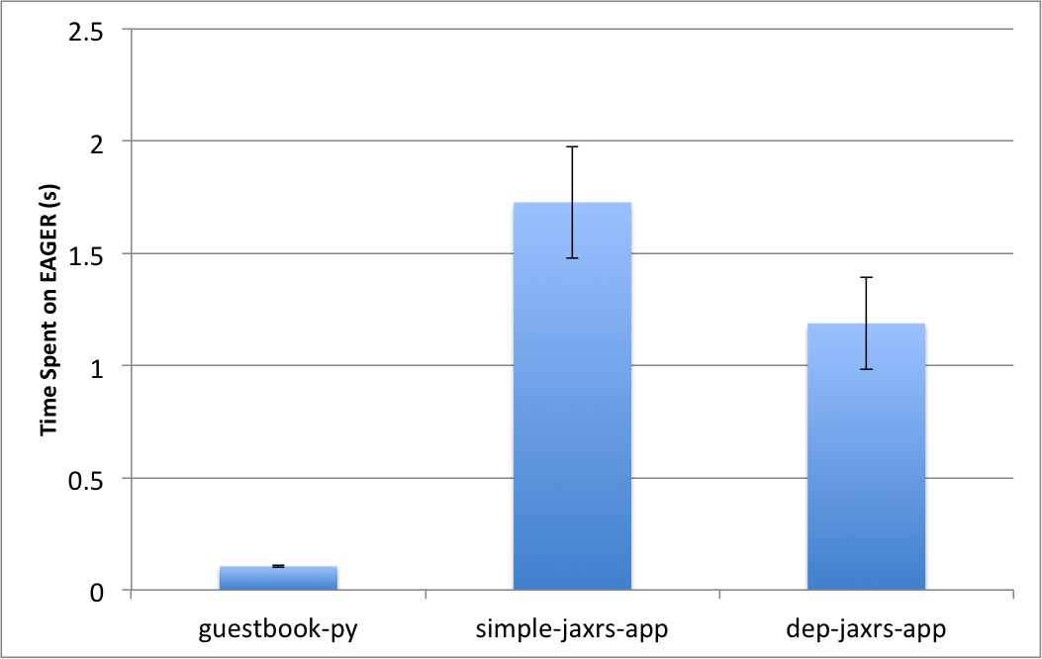
ProgrammableWeb Dataset
0 policies; 18322 APIs in DB; 33615 dependency edges
Notes:
What if all APIs in the world were deployed in the same cloud? Can EAGER deal with that metadata blowup? It can.

Slide 25
Future and Ongoing Work
Deployment-time governance is particularly attractive in cloud environments.
Scalable and avoids repetitive checks
Currently EAGER performs deployment-time governance by looking at application and API metadata.
API specifications, dependency declarations etc.
Can we do more? Can we do better?

Slide 26
API Performance SLAs
Can we reason about the response time of web APIs at deployment-time?
Without having to run an extensive amount of performance tests on the web APIs
Before the APIs become available for public use
This can potentially enable EAGER to enforce SLA-aware policies.
E.g. “No API should have a response time higher than 100ms”

Slide 27
Our Approach
Each webapp is implemented using zero or more programming interfaces provided by the PaaS.
Lets call them “PaaS calls” to avoid confusion
Google App Engine: datastore, memcache, blobstore…
Static analysis on the webapp can reveal the paths of PaaS calls.
Continuous runtime monitoring of the cloud (not the application) can reveal the performance metrics of the PaaS calls over time.
Notes:
Lightweight, automatic monitoring of the cloud – happens in the background; app developers don’t have to worry about it.

Slide 28
SLA Prediction
Combine static analysis results with cloud monitoring results to predict the performance of a given webapp.
Queue Bounds Estimation from Time Series (QBETS) to predict the response time percentiles for webapps.
Powerful machine learning technique
Makes accurate predictions with known confidence levels

Slide 29
Preliminary Experiments
We perform the proposed analyses for a number of test applications on GAE.
Predict the 95th percentile of web API response time and compare the predictions to the actual response times.
Compute the percentage accuracy of the predictions over time.

Slide 30
StudentInfo App (getStudent API)
Notes:
JAXRS app that uses the GAE datastore API. getStudent invokes datastore.get().

Slide 31
StudentInfo App (deleteStudent API)
Notes:
JAXRS app that uses the GAE datastore API. getStudent invokes datastore.get() followed by datastore.delete().

Slide 32
StockTrader App (buy API)
Notes:
Java servlet. Uses GAE datastore API. Buy operation makes up to 7 PaaS calls (get and put)

Slide 33
More on the Way
Initial results have been very encouraging
Other related questions we are working on:
Handling branches in the code
Handling loops
Validity period of SLA predictions
Performance degradation due to database growth
SLA-related policy enforcement

Slide 34
Conclusions
EAGER augments existing clouds to support API governance as a cloud-native feature.
EAGER supports thousands of APIs, hundreds of dependencies and policies with no noticeable performance overhead.
The Python-based policy language facilitates easy development and debugging of policies.
We are working on improving EAGER to perform SLA predictions at deployment-time.

