Slide 1


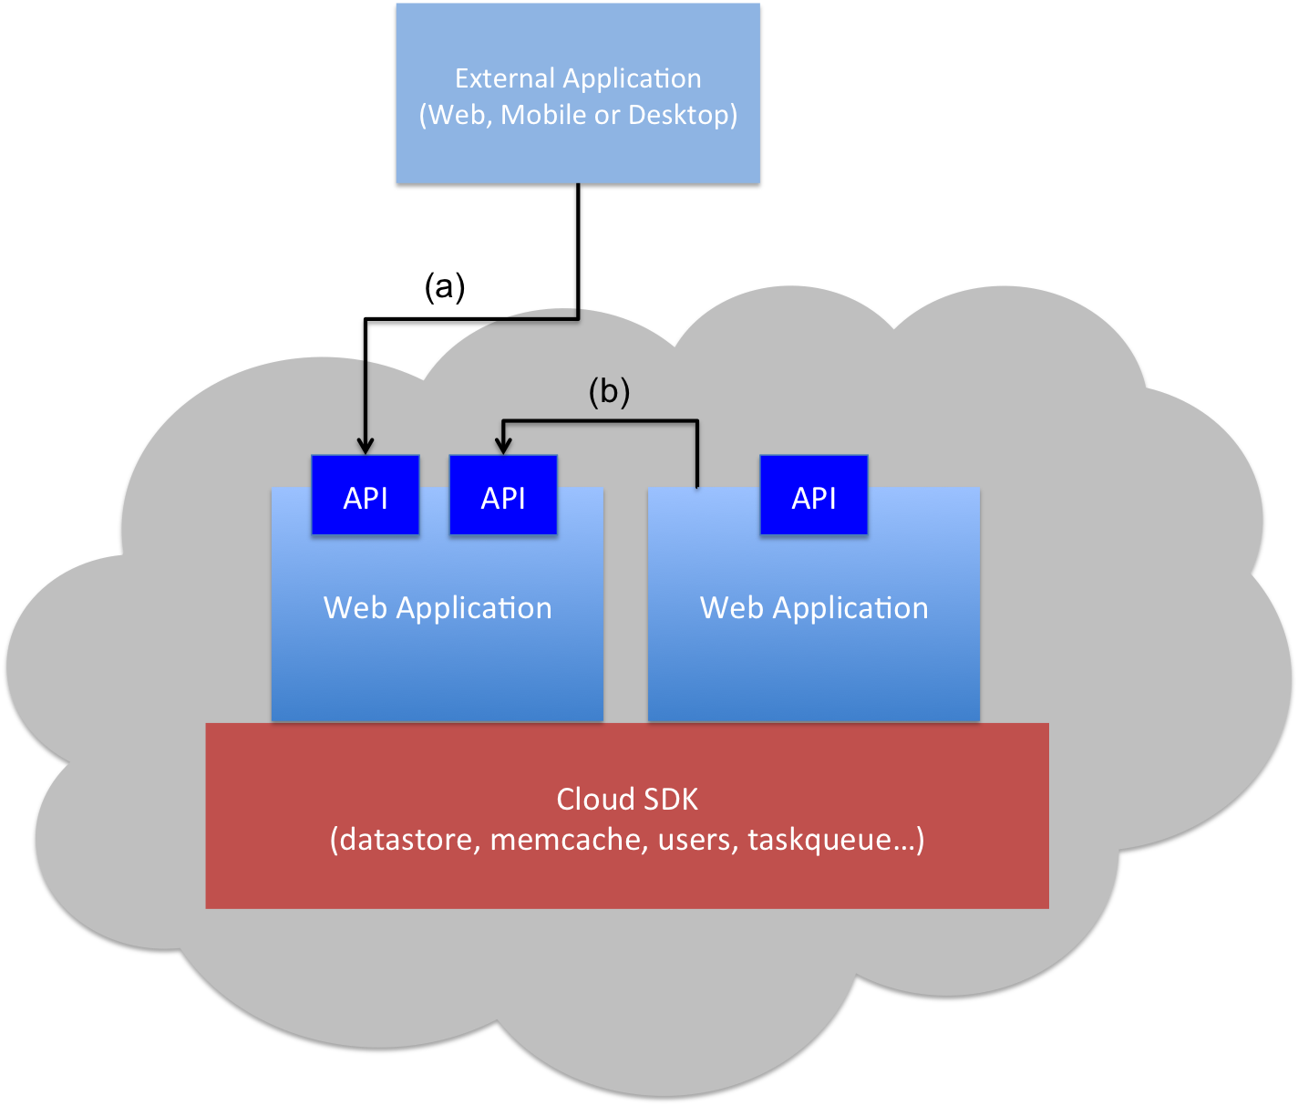
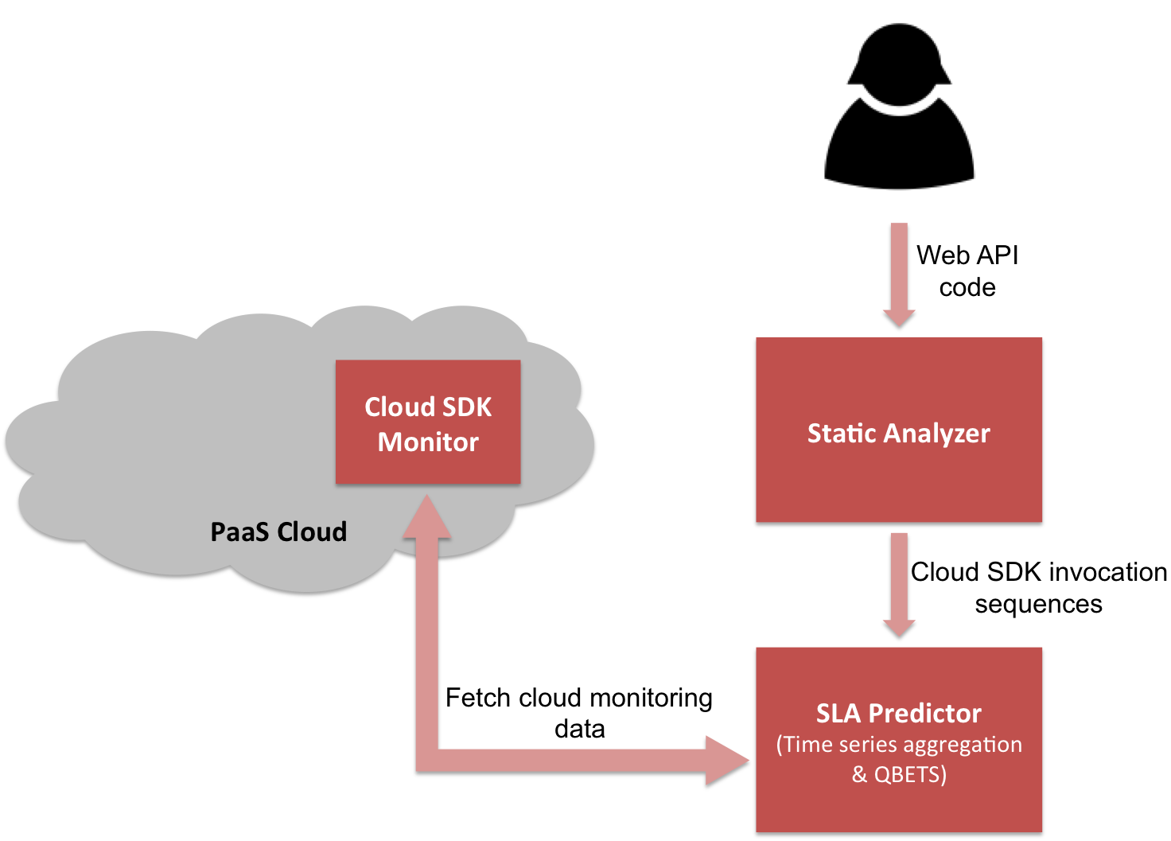
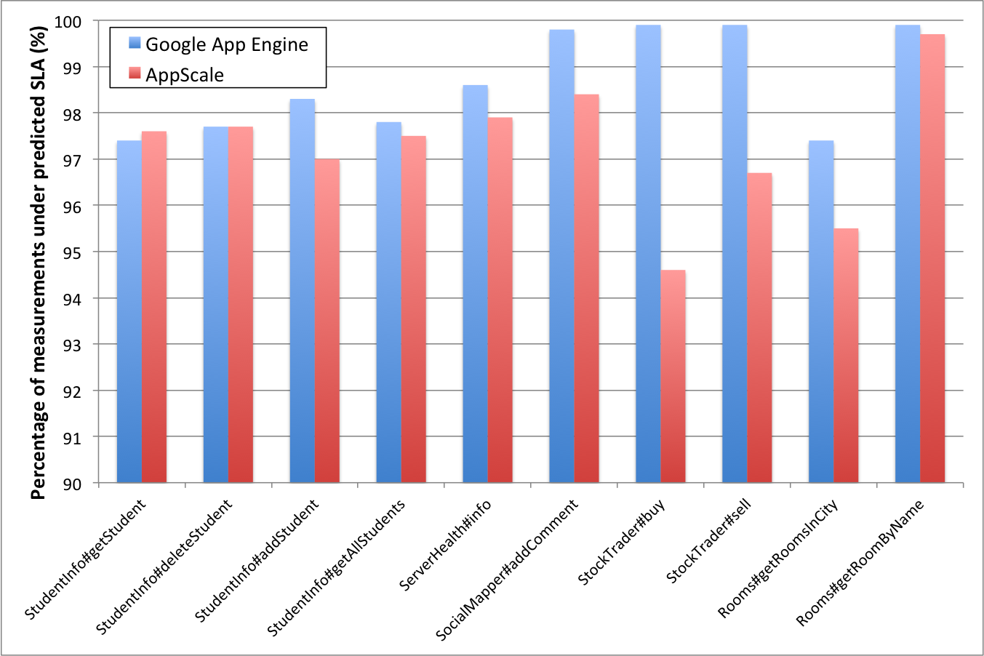
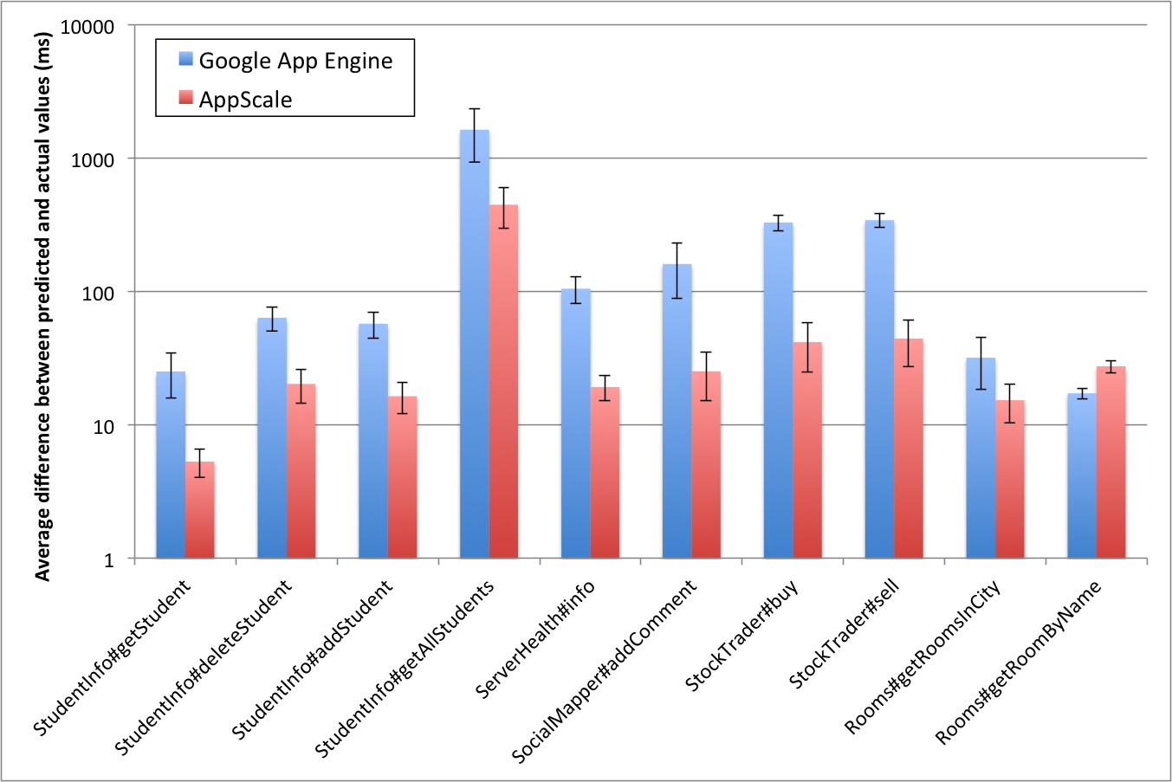
Response Time Service Level Agreements for Cloud-hosted Web Applications
Hiranya Jayathilaka, Chandra Krintz and Rich Wolski
University of California, Santa Barbara
Motivation
Modern cloud platforms do not provide any guarantees regarding the performance of deployed applications. This makes it difficult to use cloud-hosted web applications and web APIs for developing a wide range of other programs. Without proper tools to reason about the performance of cloud applications, developers must resort to extensive testing and profiling, which is tedious and costly.
Our Solution
We propose Cerebro, a new approach that predicts statistical bounds on the response time performance of web applications deployed in Platform-as-a-Service (PaaS) clouds. Cerebro combines static analysis of PaaS applications with runtime monitoring of the underlying cloud platform to automatically predict performance SLAs for cloud-hosted web applications.
PaaS-hosted Applications
Cerebro Architecture
We implemented this architecture for Google App Engine public PaaS, and AppScale private PaaS.
90+% of the Application’s Execution Time
Prediction Accuracy
Prediction Tightness
When application performance is highly variable, Cerebro trades off tightness for accuracy.
Percentage of actual response time measurements lower than the predicted 95th percentile SLA.
Average difference between predicted SLAs and actual response time measurements.

