Slide 1
Application Platform Monitoring
Architecture and Early Prototypes

Slide 2



APM Overview
Data Visualization
Filters and projections
Aggregations
Data Storage
Schema and indexing
Data Collection
Sensors and agents
Log Scrapers
Keys and data relationships
Charts and tables
Data Export APIs
Data Processing
Sharding and Replication
Complex metric calculation
Notes:
Superimpose ELK stack here

Slide 3
Data Visualization
Filters and projections
Aggregations
Data Storage
Schema and indexing
Data Collection
Sensors and agents
Log Scrapers
Keys and data relationships
Charts and tables
Data Export APIs
Data Processing
Sharding and Replication
Complex metric calculation
Notes:
Superimpose ELK stack here

Slide 4
APM Based on ELK Stack
Custom UI
Indexing
Replication and Sharding
Filtering and Aggregation
Custom Data Processing System
Data Collection Agent
Data Collection Agent
Data Collection Agent
Data Collection Agent

Slide 5
Custom UI
Custom Data Processing System
Data Collection Agent
Data Collection Agent
Data Collection Agent
Data Collection Agent

Slide 6
Data Processing
Data Visualization
Data Storage
Data Collection Agent
Data Collection Agent
Data Collection Agent
Data Collection Agent
Data Collection Agent

Slide 7
Data Collection Modes
High-level data collection
Doesn’t require complex instrumentation
Metrics directly exposed by monitored services
Logs and heartbeats
Low-level data collection
Requires instrumentation deep within the stack
Offers comprehensive insights on component functionality
Useful in detecting anomalies and faults

Slide 8
Application Access Logs
All applications in AppScale are fronted by an Nginx server
We configure Nginx to record application accesses in typical HTTPD format
Host-A
Host-B
Nginx Server
(Hosts Application Foo)
ElasticSearch
Foo Access Log
Filebeat
Logstash

Slide 9
Monitoring HAProxy
All application traffic in AppScale gets routed through an HAProxy load balancer
HAProxy exposes metrics through a UNIX socket
echo "show info;show stat" | socat stdio unix-connect:/etc/haproxy/stats
HAProxy
UNIX Socket Call
Agent
(Python)
JSON+HTTP
ElasticSearch
CronJob
Notes:
System availability and resource utilization can be monitored in a similar fashion

Slide 10
AppScale Cloud Stack
Front-end Server (Nginx)
Load Balancer (HAProxy)
Application Server (GAE Dev App Server)
Datastore
Memcache
Taskqueue
Users
Blobstore
Images
Cloud SDK Front-end (PBServer)

Slide 11
Monitoring Cloud SDK Invocations
Added some instrumentation to PBServer to record all cloud SDK calls
Timestamp
Source application and HTTP request
Target cloud SDK service and operation
Request size and hash (PB payload)
Time spent executing the SDK call
PBServer accumulates this information in memory, and reports to ElasticSearch in batches

Slide 12
HTTP Request to SDK Call Correlation
Front-end server (Nginx) tags each incoming request with a unique ID
PBServer records this “HTTP request ID” whenever inspecting a cloud SDK call
ElasticSearch can aggregate (group) cloud SDK calls by HTTP request ID
Implemented a Python script that performs a SDK call time analysis at request level

Slide 13
Overall APM Architecture
Access logs and other request traffic metrics
Analytics and Visualization
Generate unique request IDs
Frontend Server/
Load Balancer
App Server
App Server logs
App
Cloud SDK call data
PaaS SDK
(Core PaaS Services)
Resource usage data
Cloud Infrastructure
(Containers, VMs, Virtual Networks etc)

Slide 14
Client
Generate request ID: R
Frontend Server/
Load Balancer
Access logs
Data Storage
Data Analysis
Anomaly detectors
and
Anomaly handlers
REQ_ID: R
R
App Server logs
Application Server
REQ_ID: R
R
PaaS kernel invocation data
PaaS Kernel
REQ_ID: R
R
Query: Select events where REQ_ID = R
Resource usage data
Cloud Infrastructure
REQ_ID: R

Slide 15
Cerebro on ElasticSearch
Cerebro is an SLA prediction system for PaaS clouds
Response Time SLAs for Cloud-hosted Web Applications (SOCC 2015)
SLA Durability for Web Service Response Time (CloudCom 2015)
Uses a combination of static analysis and performance benchmarking

Slide 16
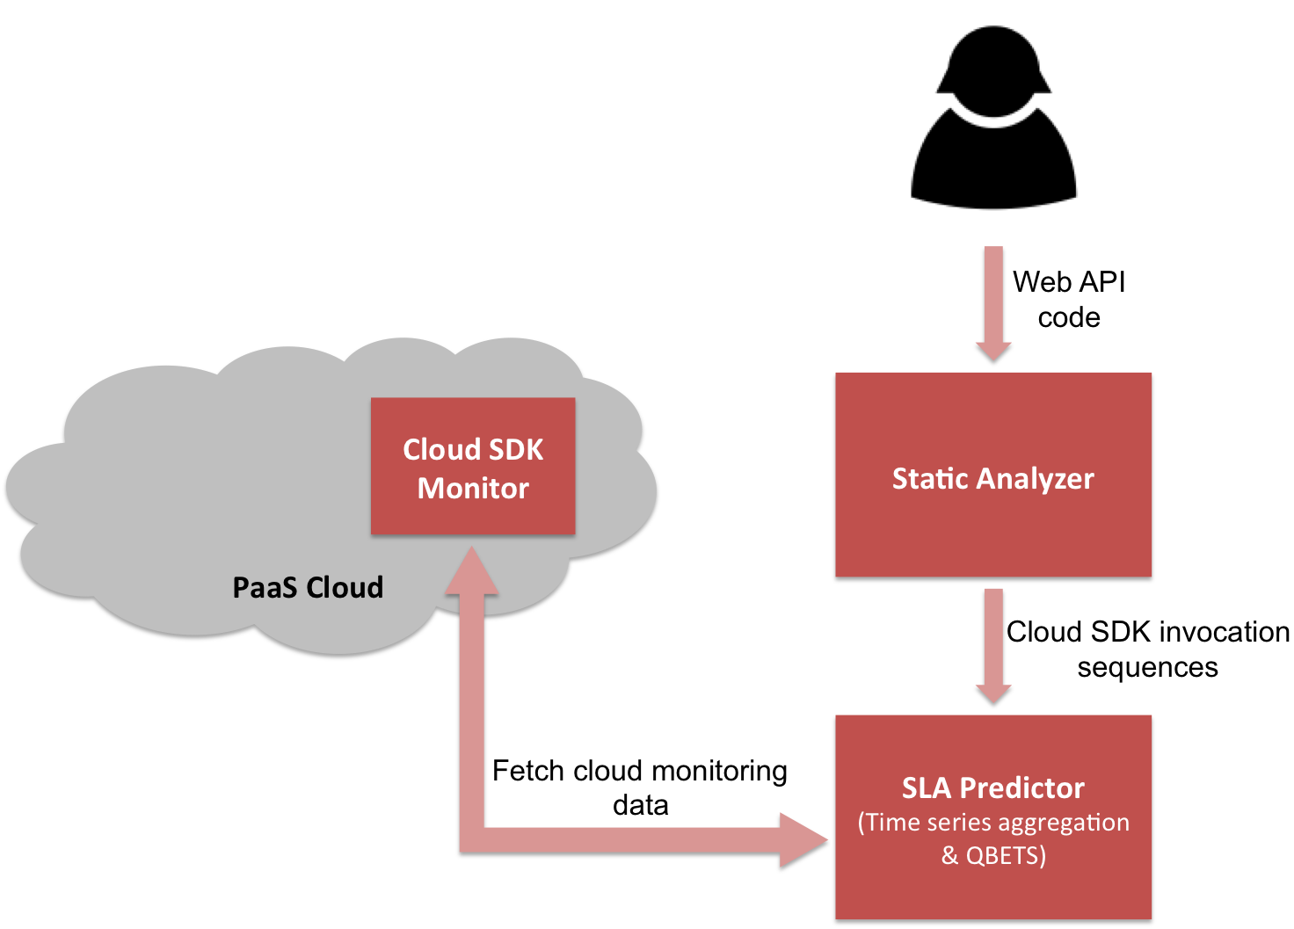
Cerebro Architecture
Modified the SDK Monitor to store data in ElasticSearch
Modified the SLA Predictor to retrieve data from ElasticSearch

Slide 17
App 1
App 2
Data Storage
B
B
D
D
D
Internal Communication Bus
H
H
Roots Pod

Slide 18
Front-end Servers
Logstash
ElasticSearch Cluster
Application Servers
PaaS Kernel Services
Pod 1
Pod 2
AppScale PaaS Cloud

