Slide 1

Roots: Application Performance Monitoring & Diagnosis
Hiranya Jayathilaka
Chandra Krintz
Rich Wolski

Slide 2
Motivation
Cloud platforms do not provide adequate performance debugging support
Rudimentary monitoring features only
Complex architecture and implementation
Runtime details hidden by cloud abstractions
Difficult to identify the root cause of detected performance bugs

Slide 3
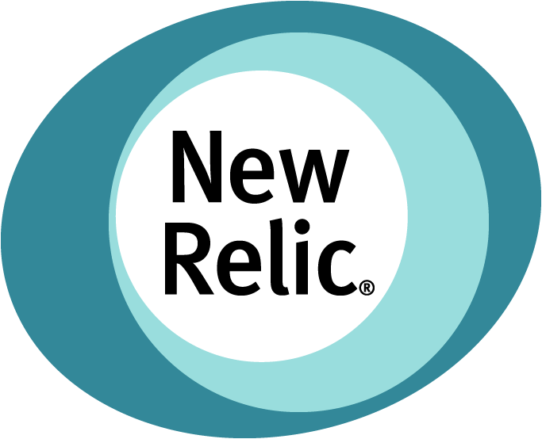

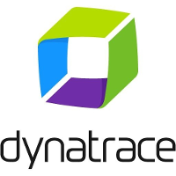

Existing Solutions
Many third-party solutions available for monitoring cloud applications
Requires code instrumentation
Expensive (effort and financial cost)
Lack of penetrative power

Slide 4
Roots
An extensible framework for detecting performance SLO violations, anomalies and diagnosing potential root causes
Full-stack monitoring without instrumenting application code
Support multiple methods to analyze the collected data in near real-time
H. Jayathilaka, C. Krintz and R. Wolski, “Performance Monitoring and Root Cause Analysis for Cloud-hosted Web Applications” under review at World Wide Web Conference 2017 (WWW).
H. Jayathilaka, C. Krintz and R. Wolski, ”Bottleneck Identification in Cloud-hosted Web Applications,” under review at IEEE Transactions on Cloud Computing (TCC).
Notes:
A monitoring and diagnostic framework built into PaaS clouds.
It supports application monitoring as another fundamental service offered by the cloud platform. Therefore it doesn’t require any third party monitoring tools.
Roots does not require instrumenting application code. Instead it collects data from within the cloud platform, by directly integrating with the major components of the cloud platform that are involved in application request processing.
We have designed Roots as en extensible framework so it can support different methods and algorithms for analyzing the collected data.

Slide 5
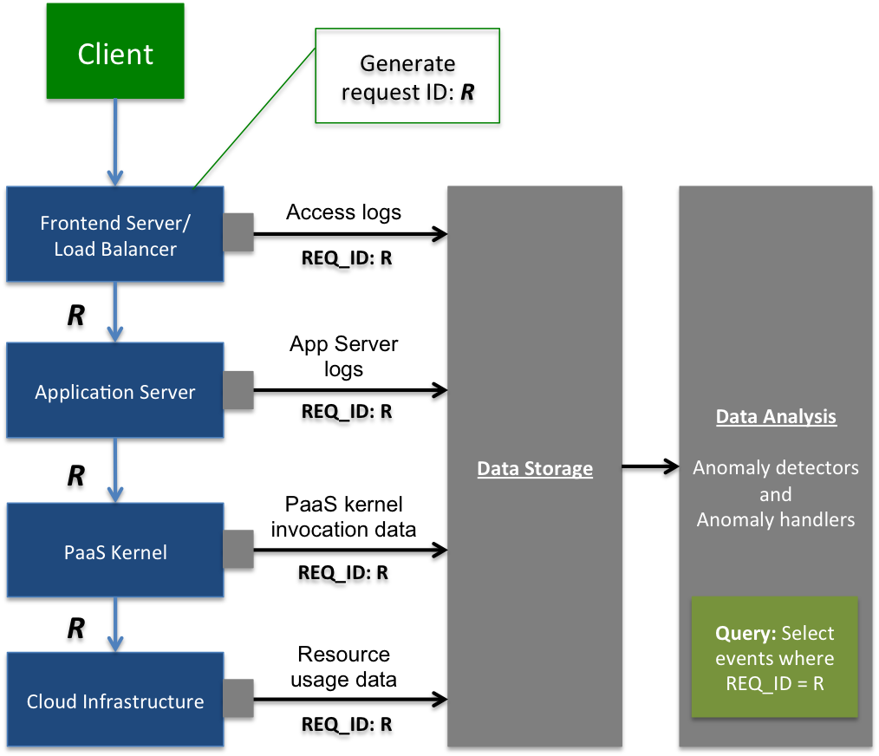
Architecture
Pod
Notes:
LB metadata injection is normal

Slide 6
Detecting SLO Violations
Benchmark applications (APIs) at regular intervals to measure their response time
Periodically assess the proportion of measurements that are below a preconfigured threshold (the SLO)
E.g. SLO: 100ms at 95%
Raise an alarm if the SLO has been violated
Notify users & trigger root cause analysis

Slide 7
Root Cause Analysis
Step 1: Workload analysis
Detect change points (level shifts) in workload
Sudden increases in workload that precede a detected SLO violation
Pruned Exact Linear Time (PELT) [KFE12]
Step 2: Bottleneck identification
Hybrid approach that combines linear regression and quantile analysis
Notes:
Define workload
If workload change detected, that’s the root cause
Discuss citation

Slide 8
Linear Regression
protected void doGet(HttpServletRequest req, HttpServletResponse res) { String userId = req.getParameter("user"); Entity entity = datastore.get(newKey("USER_INFO", userId)); // X populateResponse(userId, entity, res); Entity userEvent = new Entity("USER_EVENT"); userEvent.setProperty("user", userId); userEvent.setProperty("date", System.currentTimeMillis()); datastore.put(userEvent); // Y }
Model total response time using multiple linear regression (Total = X + Y)
Relative importance metric indicates the portion of variance in “Total” explained by each independent variable [G06]
Notes:
Handles multicolinearity
Looks for most variance

Slide 9
Quantile Analysis
For each kernel invocation made by an API (e.g. X and Y), compute and compare the high quantiles (e.g. 0.99 quantile)
Detecting the operation that is generally slow
For each kernel invocation, check for tail-end values that exceed the 0.99 quantile
Detecting rare, high-valued outliers
Notes:
Looks for most deviant (outliers) – point anomalies
Using these different metrics – both linear regression and quantile analysis – Roots selects up to 4 candidates for the bottleneck. Then we pick the candidate chosen most often as the actual bottleneck that caused the SLO violation. In case of a tie, we give higher priority to the candidate selected by the linear regression method.

Slide 10
Implementation
Implemented for the AppScale open source PaaS
Frontend server: Nginx
App server: Google App Engine dev app server
Data storage: ElasticSearch, LogStash
Data analysis: Java, R
A pod is a Java process
Detectors and handlers executed as threads

Slide 11
Diagnosis Accuracy
StockTrader app
8 kernel invocations per request
Faults injected every two hours
Slowing the 1st invocation
Slowing the 2nd invocation

Slide 12
Diagnosis Accuracy
Faulty Node
G1
G8
G2
G4
G3
G4
G6
G5
G7
G6
G7
G1
G8
G2
G3
G5
Notes:
Anomalies are “only” detected from the apps in faulty node

Slide 13
Workload Change Analysis

Slide 14
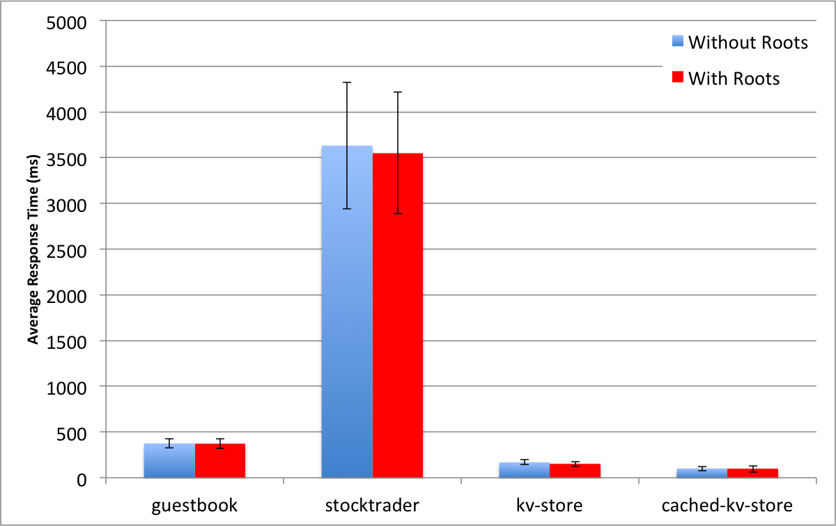
Roots Performance Impact
Notes:
Diagnosis can be performed after the fact
Don’t want to perform heavy ops at runtime

Slide 15
Roots Scalability (Pod-level)
Pod deployed on a quad-core, 2GB virtual machine.
Able to run 40,000 concurrent detectors before hitting CPU limit.

Slide 16
Conclusion
Roots is a performance monitoring and diagnostics framework built into PaaS clouds
Performance diagnostics as a cloud-native feature
Detects performance SLO violations in near real time
Determines if each violation was caused due to a workload change or a system bottleneck
Comfortably scales to 1000’s of applications

