Slide 1


Response Time SLAs for Cloud-hosted Web Applications
Hiranya Jayathilaka
Prof. Chandra Krintz
Prof. Rich Wolski
Computer Science Dept., UC Santa Barbara
SOCC 2015

Slide 2
Web APIs
Promotes service reuse
Internet
Service
Web API
Client
Application
Leverages IT resources of the service provider

Slide 3
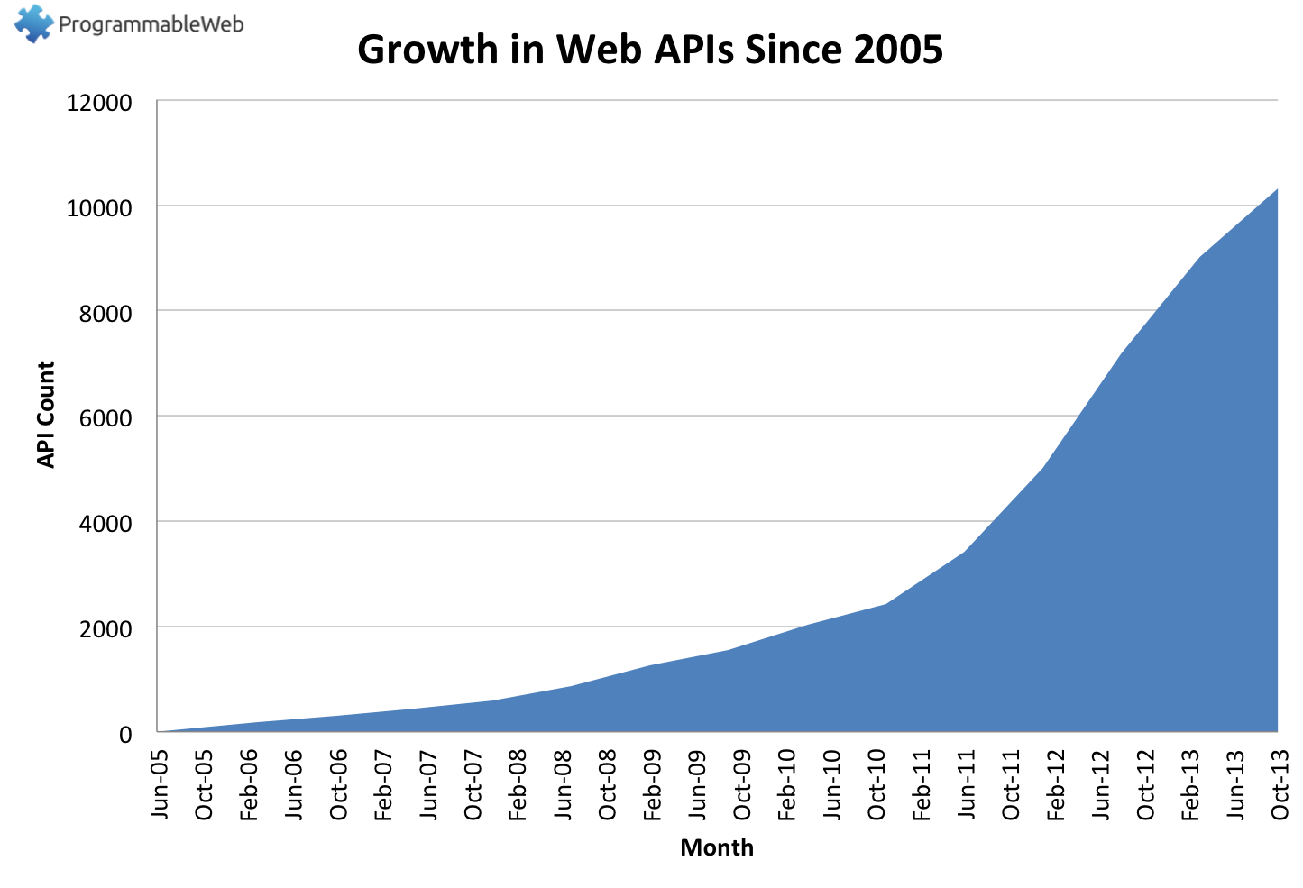
Number of API Today: ~14,000
Source: http://www.programmableweb.com/api-research

Slide 4

Web APIs are Now IT Resources
Client
Application
APIs impact user experience
SLA
APIs do not provide strong guarantees
API
API
API
Web Application
Web Application
Web Application

Slide 5
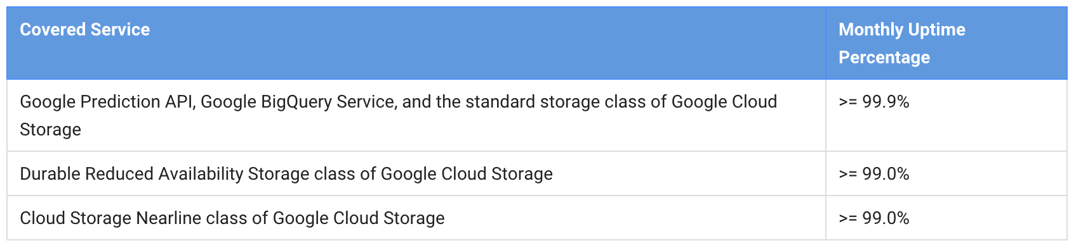
Application SLAs and “The Cloud”
Modern cloud platforms only provide some uptime SLAs for individual APIs
Cloud platforms do not provide SLAs on deployed user applications and APIs.

Slide 6
Performance SLAs in the Cloud
Question: Is it possible to determine, automatically, performance SLAs for cloud-hosted applications and APIs?
Our solution: Cerebro
Predicts the response time of future web-API invocations from historical measurements
Fully automatic
For PaaS clouds

Slide 7
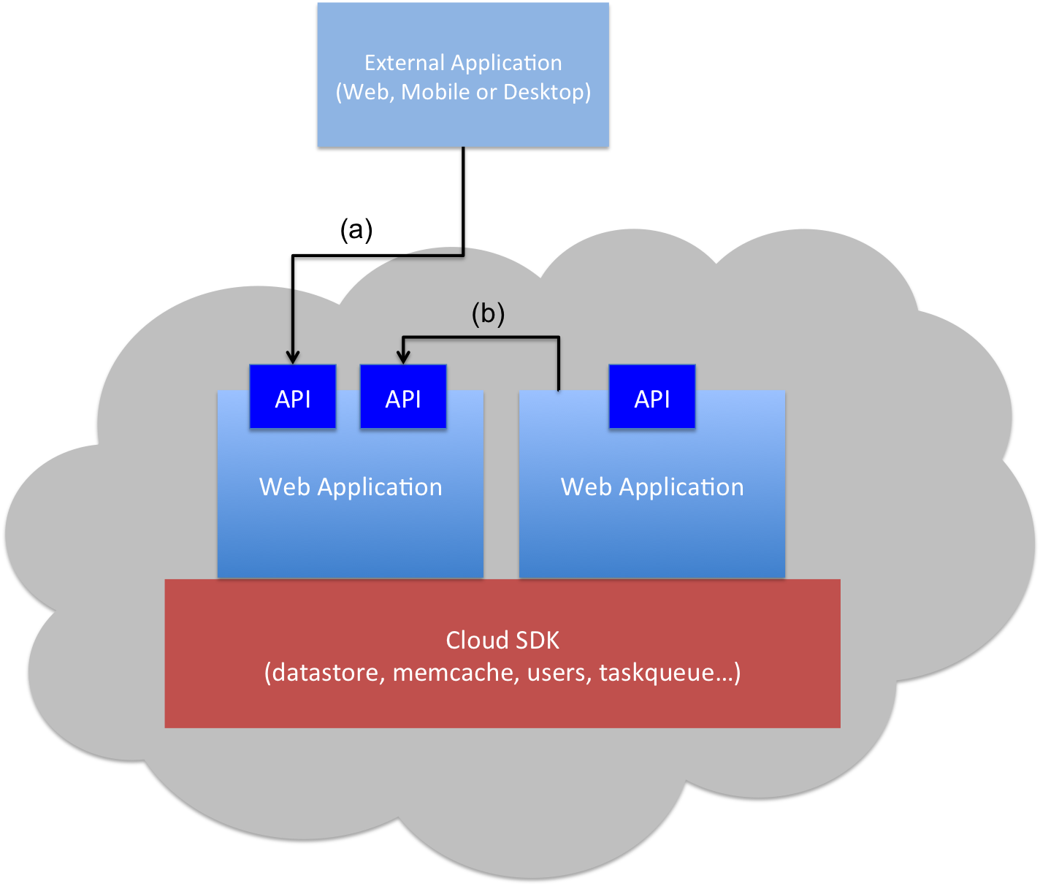
PaaS Clouds for Web Services
Client Application
(Web, Mobile or Desktop)
Scalable, high available and cost effective
Restricted I/O and threading capabilities
Application code must adhere to the provided cloud SDK

Slide 8
PaaS Client Application Survey
PaaS Client Applications…
Don’t have many branches
99% of the methods have < 36 paths
Don’t have many loops
88% of the methods have no loops
Spend most of their time executing cloud SDK calls (> 94%)
So…
PaaS applications are highly amenable to static analysis
Cloud SDK calls essentially define client-perceived application performance

Slide 9
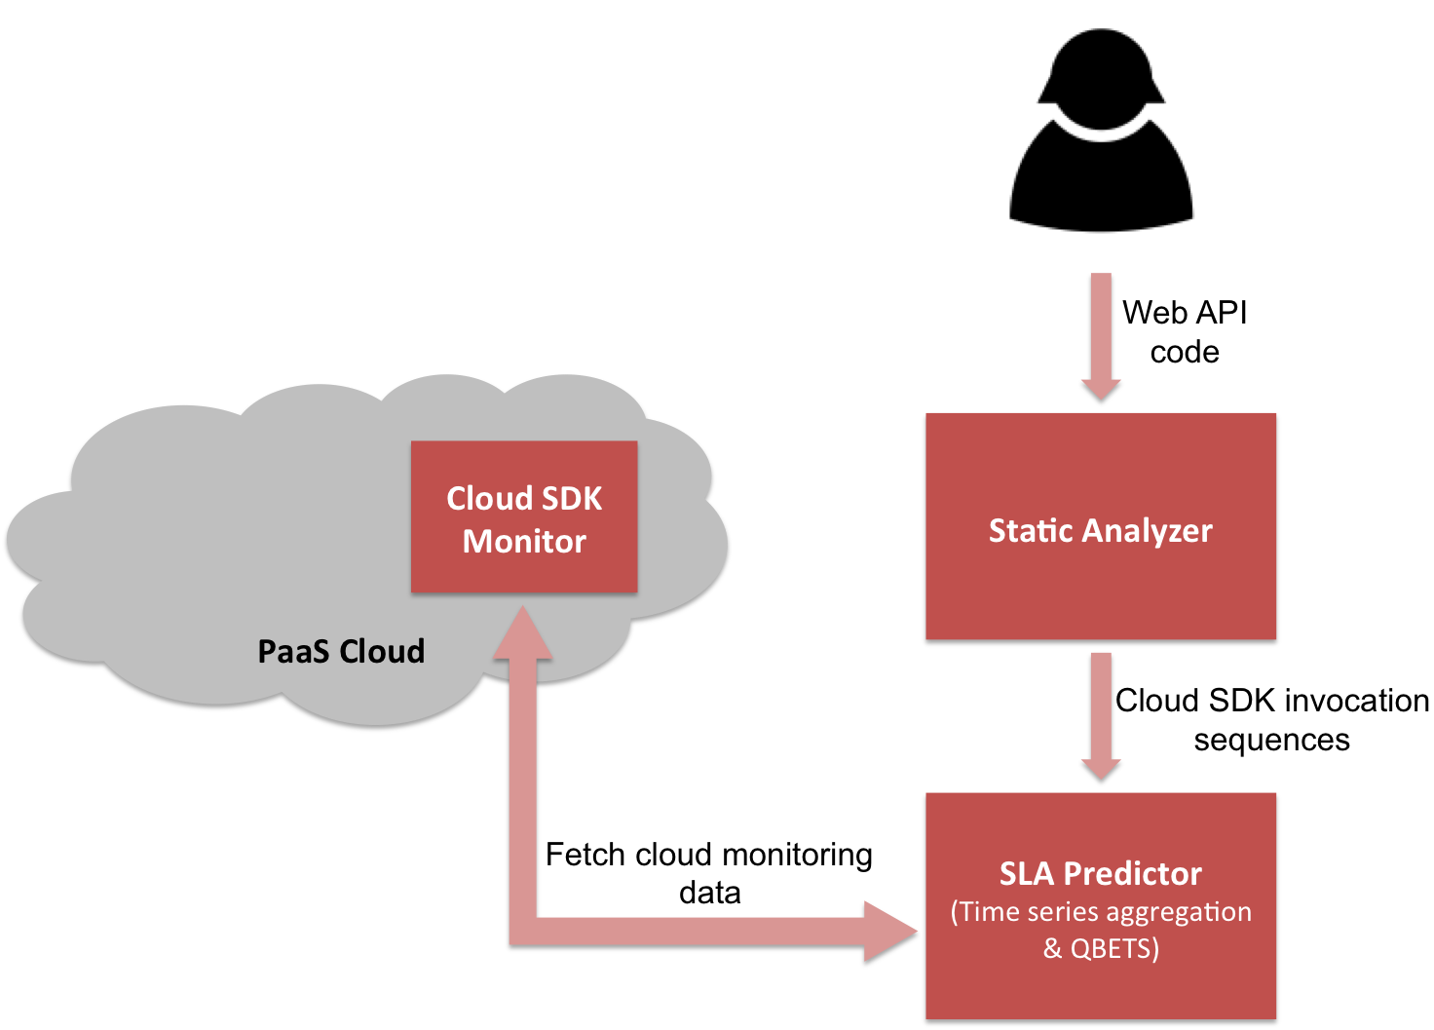
Cerebro Architecture

Slide 10
QBETS: Queue Bounds Estimation from Time Series
Analyzes the first n entries in a time series
Predicts an upper bound for the (n+1)^{th} entry
QBETS([x₁,x₂,…x_{n}], p) = Q where p ∈ (0,1)
P(x_{n+1} ≤ Q) ≥ p
Cerebro uses QBETS to predict response time SLAs of the form:
Operation O responds under T milliseconds (100p)% of the time

Slide 11
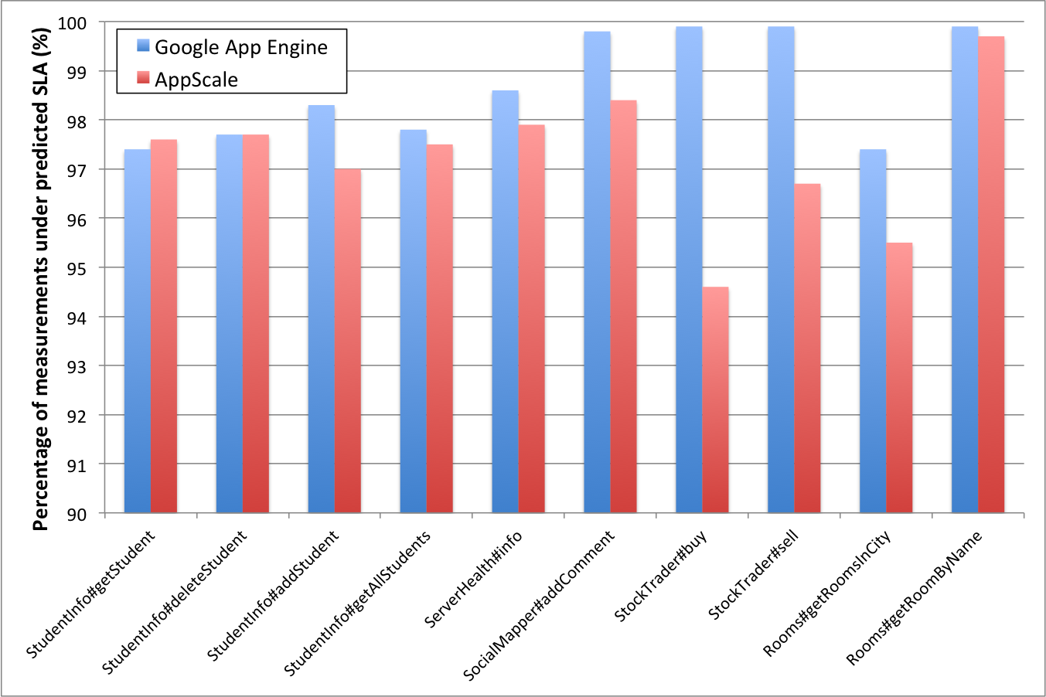
Evaluation: Prediction Correctness

Slide 12
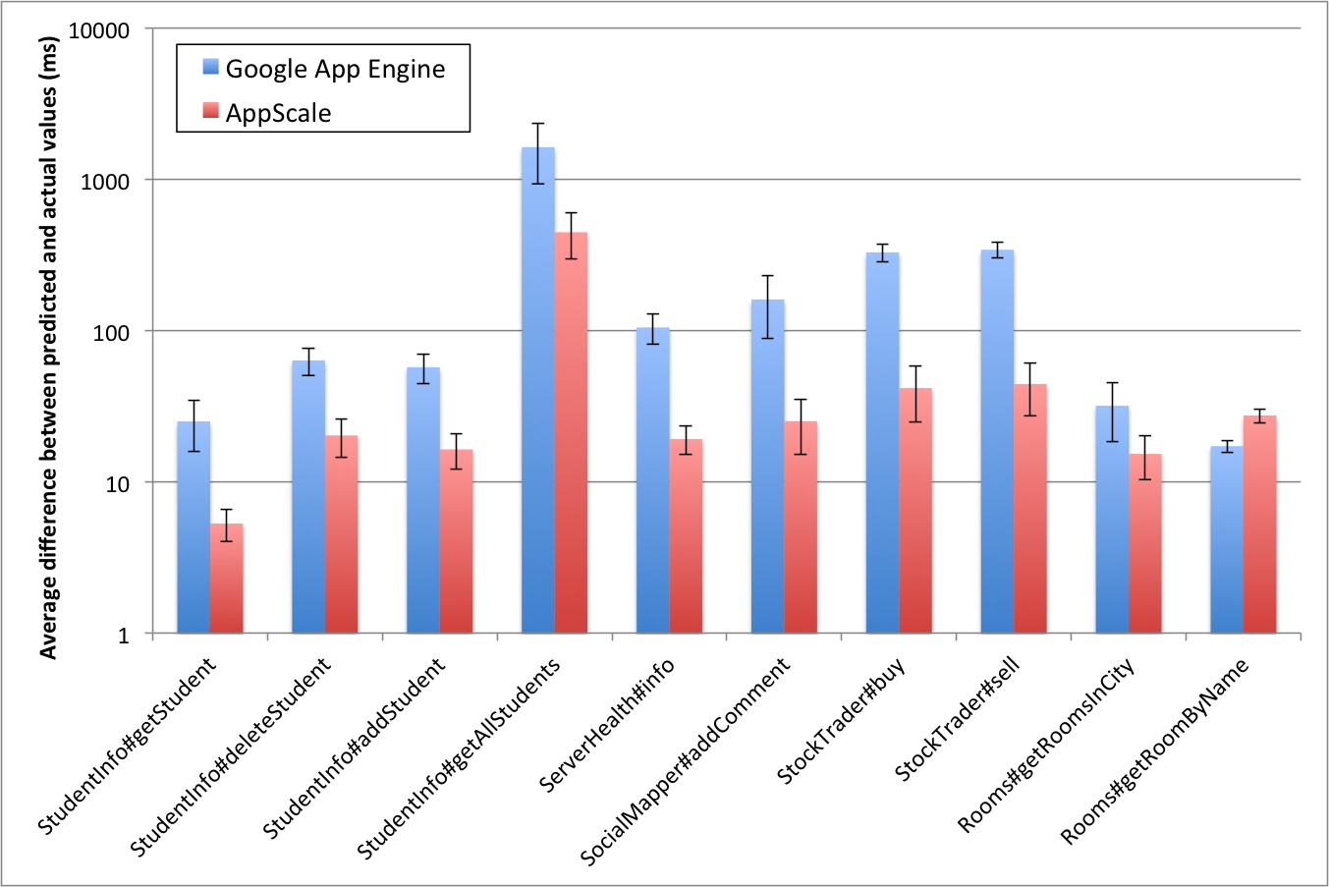
Evaluation: Prediction Tightness

Slide 13
Conclusions and Future Work
Cerebro predictions are correct and moderately tight
Necessary conditions for use in an SLA
SLA durability period analysis
GAE: 26.8 hours
AppScale: 33.7 hours
SLA-related policy enforcement at deployment time with EAGER

Slide 14
Thank You! Questions?
Hiranya Jayathilaka (hiranya@cs.ucsb.edu)
The UCSB Lab for Research on Adaptive Computing Environments (RACELab)
http://www.cs.ucsb.edu/~ckrintz/racelab.html

Slide 15
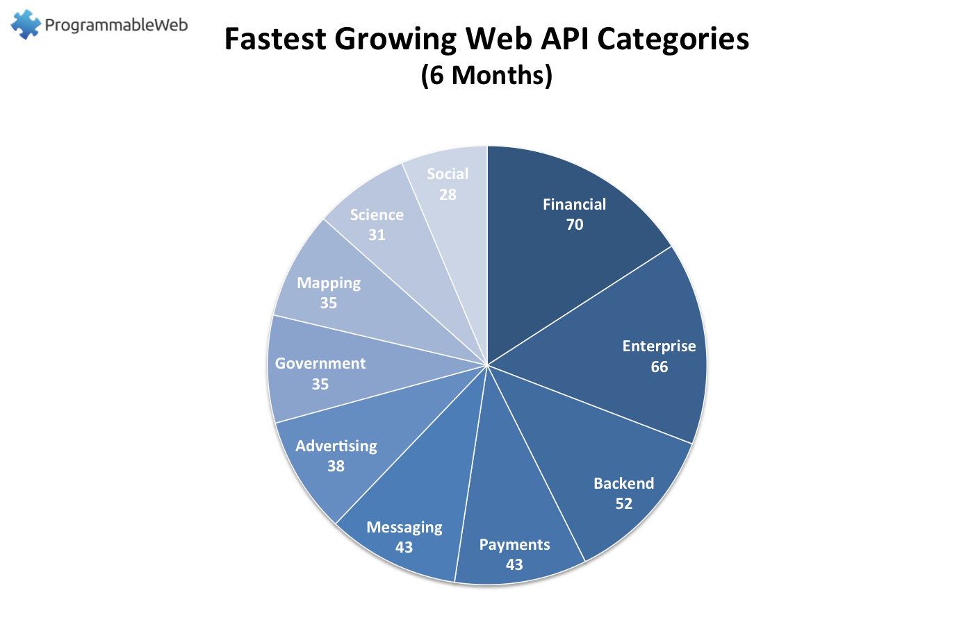
Non-commercial entities are joining the API party too…
White House API Program: https://www.whitehouse.gov/digitalgov/apis
IEEE APIs: http://ieeexplore.ieee.org/gateway/
UC Berkeley APIs: https://api-central.berkeley.edu/

Slide 16
Prototype and Experiments
SDK monitor: App Engine Java app
Tests conducted on Google App Engine public cloud, and AppScale private cloud (running on a 4-node Eucalyptus cluster)
Network delay between client and Google is included but not modeled or predicted explicitly

