Slide 1
SnapValet ARB Prototype I
Global Trojan Solutions – Team 03

Slide 2
Outline
SnapValet Intro
Basalmiq Mockups
Google Places API

Slide 3
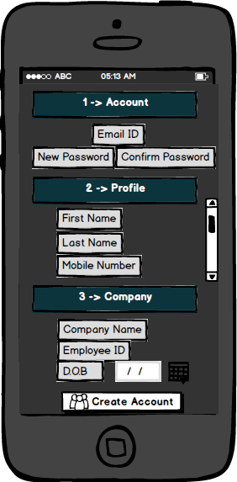
Registration
Valet employees will have a login autogenerated when employers add them via a web application
Employees will use this login to register by providing the login along with the additional requested information.

Slide 4
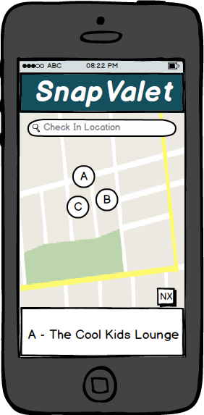
Geolocation Check-in
Both customers and valet employees will check in to locations using geolocation
Locations will be suggested using the Google Places API
Locations will be filtered based on a radial proximity and place type

Slide 5
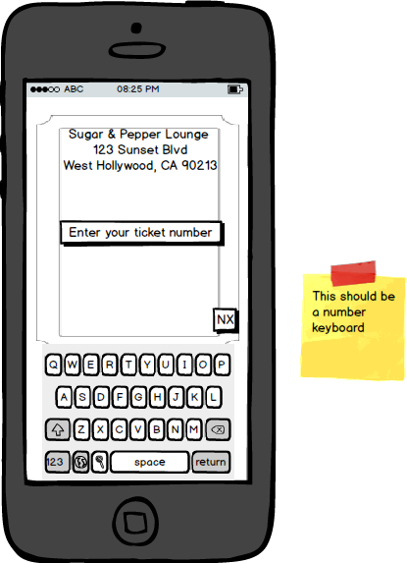
Vehicle Request
Following check-in, customers can request their vehicle by entering the number on the ticket that was given to them by the valet.
This will generate a request that will be displayed in the valet queue following a prompt for payment

Slide 6
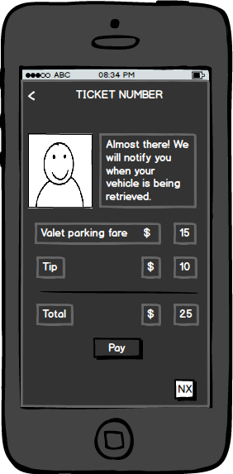
Payment
Customers will have the option of paying cash or mobile.
Payment will be verified before release of the vehicle

Slide 7
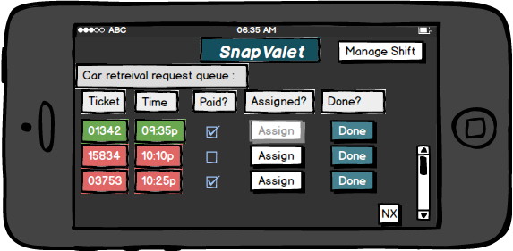
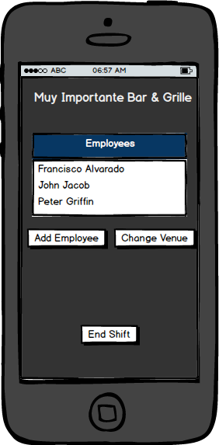
Valet Interface
Request Queue
Shift Management

Slide 8
Google Places API
http://greenbay.usc.edu/csci577/fall2014/projects/team03/Valuation/PRO/geolocation_prototype.html
Lat/Long plugged in for demonstrative purposes
Venues limited to restaurants, nightclubs, shopping malls, movie theaters, lodging
Radial/nearby parameters varied

