Slide 1
AstroBuddy
By David A Gereau

Slide 2
What is AstroBuddy?
Solar System Model
Key Features
Model-View-Controller Architecture
Factory Pattern building of Celestial Bodies
API Call to Web Service with Multiple Date Support
File I/O

Slide 3
UML Diagrams
Goal: To model The System and ensure all components work with one another in the MVC format.

Slide 4
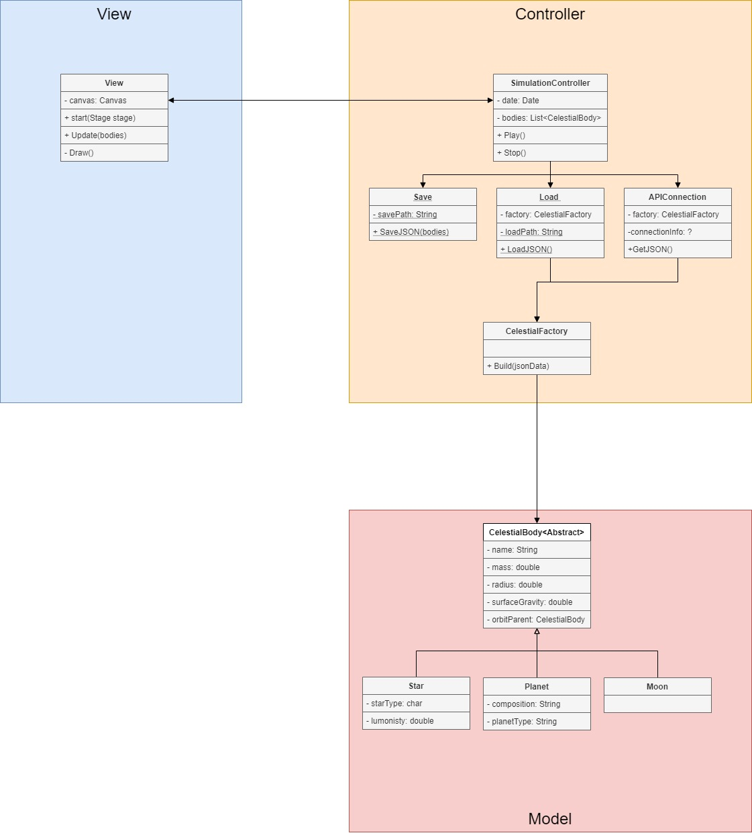
(First Draft)

Slide 5
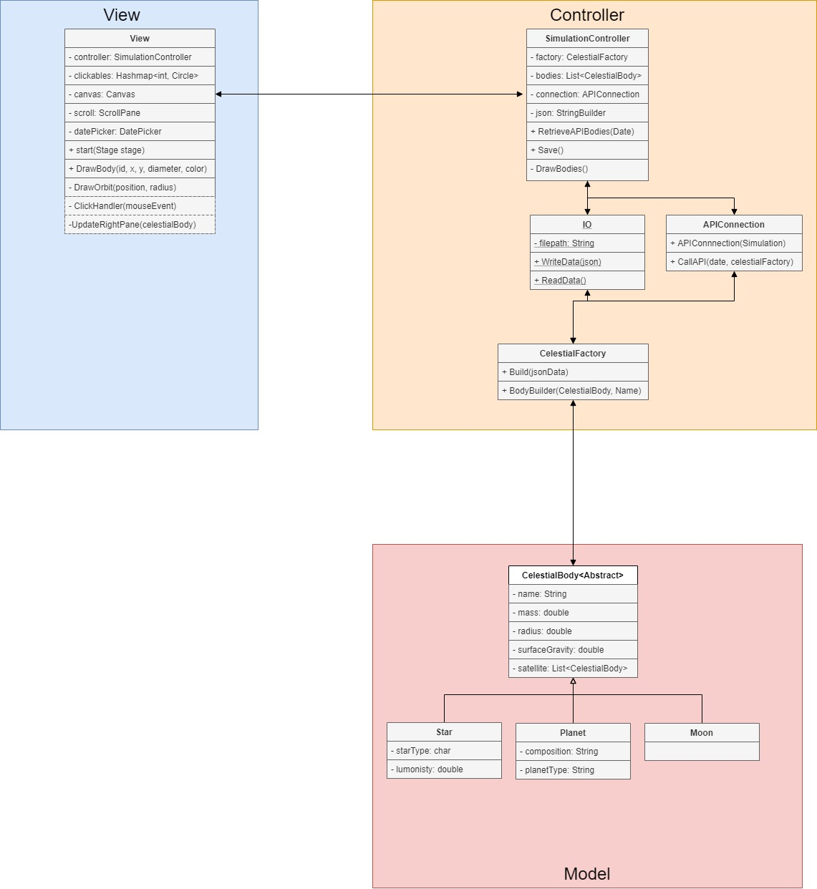
(Final Code)

Slide 6
Implementation

