Slide 1


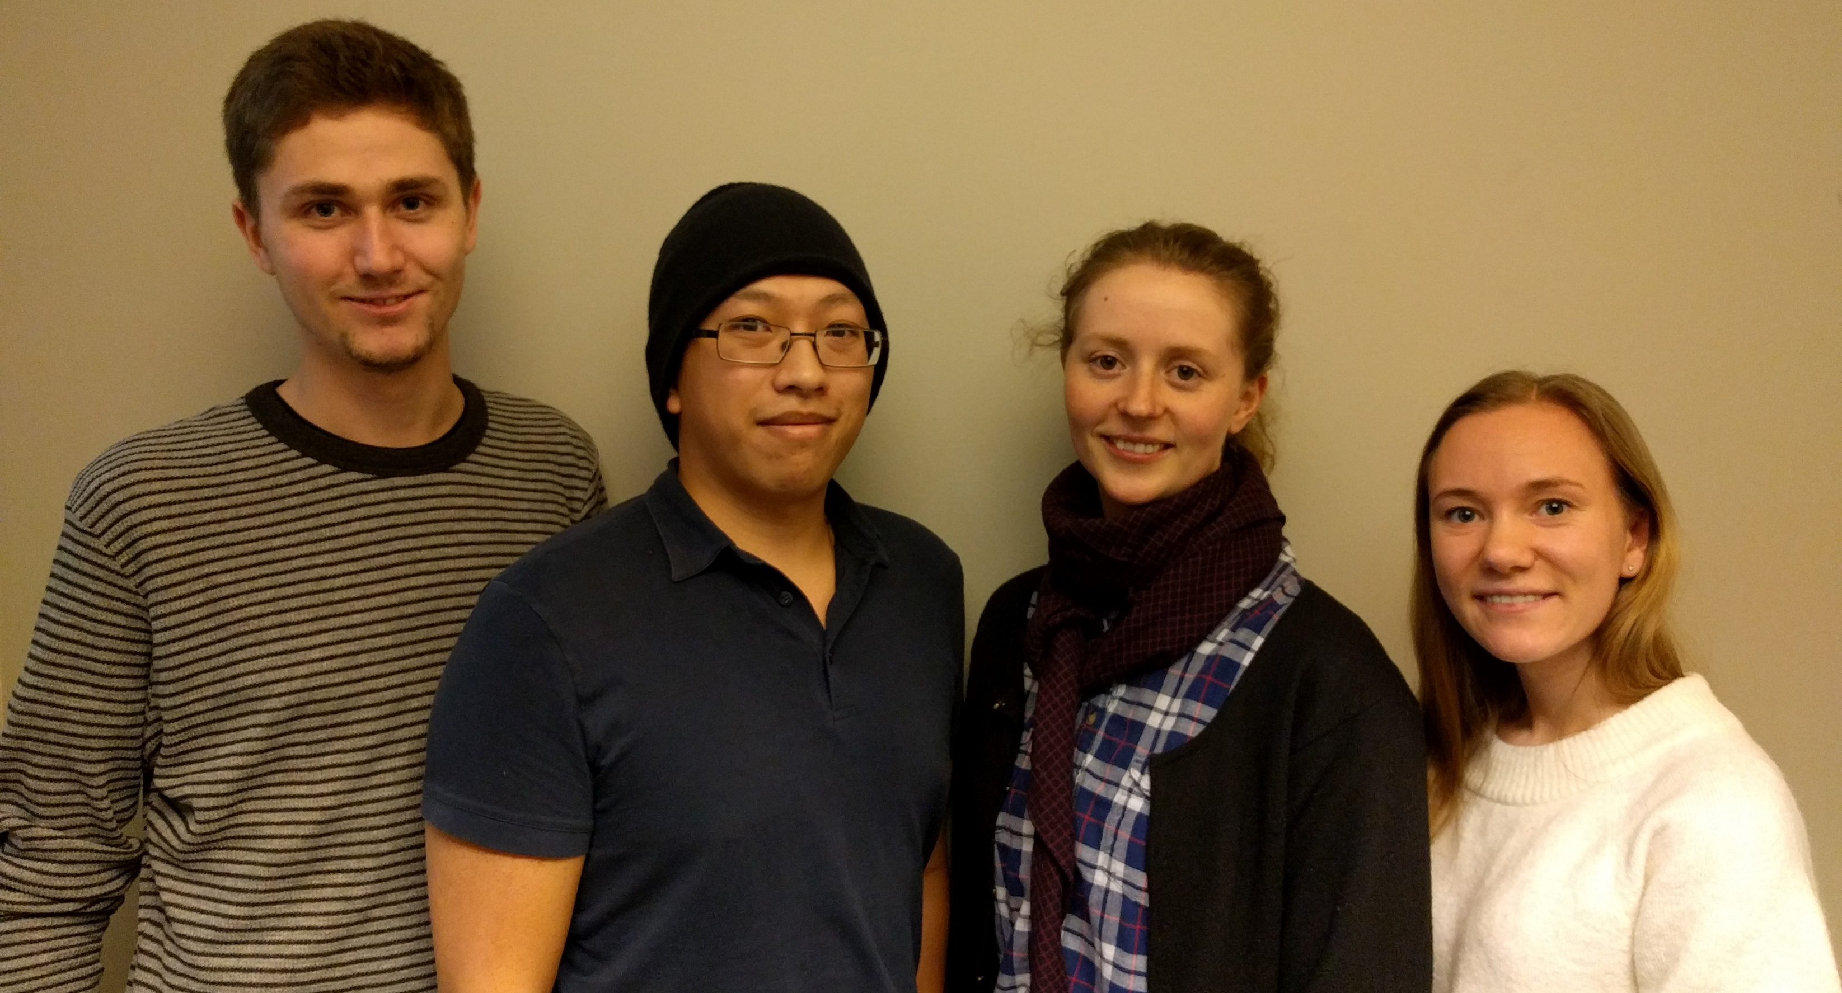




Your personal study coach
Group 8:
Simon Nymo (tv):
Software responsible
Truong Tran:
Project team leader
Ditte Heebøll Callesen:
Product owner
Maria Soleim:
Scrum master
All members of the group has the role as software developer
“Students do not work steadily throughout the semester, but more in periods”
Prof. at NTNU
Einstein will help you develop as a student and improve the communication between the student and the teacher.
Gain motivation through your phone.
  The students wants:
  Guidance and motivation
  Quick feedback on assignments
  To know their learning progress
  The teacher wants:
  Better communication with students
User stories:
Trine is a professor at a big university, she sometimes encounter problems regarding that the students works mostly in periods and do not ask questions during lectures.
Sofie studies to become an engineer. She feels it is difficult to have the motivation to work steadily throughout a semester. She also wants help with keeping track over assignments, deadlines, and her development.
Page 20
9
TDT4140 Software Engineering course, Spring 2017
Concept poster
Lecturer: Pekka Abrahamsson, Anh Nguyen Duc
Coaches: Henry Sjøen, Kari Eline Strandjord, Audun Liberg, Evelyn Saxegaard, Hung Quang Thieu, Jie Li, Håvard Estensen
Software Processes
Agile Software Development
Project Management and Planning
Architectural Design
Software Design
System Modeling and Unified Modeling Language
Software Process Improvement
Configuration Management
Software Testing
Concepting
Security
Software Reuse
Software Evolution
Service Oriented Architecture
Software Quality Improvement

Slide 2
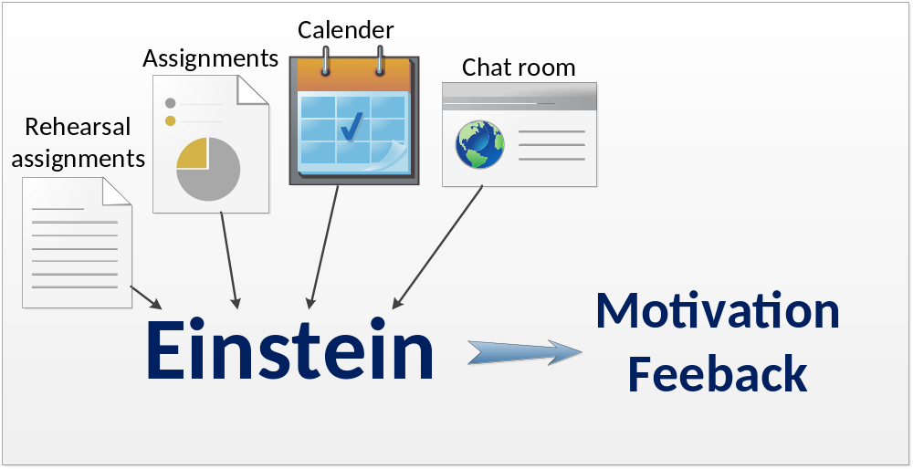
-
Einstein
31.01.2017
by Simon Nymo, Maria Soleim, Truong Tran, Ditte Heebøll Callesen
1. As a student, I want a personal coach
2. As a student, I would love to get quick feedback on my work
3. As a student, I want my work to be appreciated
4. As a student, I would like to get rated on my work
5. As a student, I want to be told what to do on a daily basis
Einstein will:
Give quick feedback on uploaded assignments.
Provide chat room where students can ask questions.
Improve communication between teacher and students.
Guide the student trough the semester.
Einstein will be your personal coach and motivator.
It will improve the relation between teacher and the students.
Einstein will answer questions, and keep track of the students’ learning development.
Einstein will be an android app.
It will use SQL for a database and other supporting systems for their functionalities.
Page 21
TDT4140 Software Engineering course, Spring 2017
Concept poster
Lecturer: Pekka Abrahamsson, Anh Nguyen Duc
Coaches: Henry Sjøen, Kari Eline Strandjord, Audun Liberg, Evelyn Saxegaard, Hung Quang Thieu, Jie Li, Håvard Estensen
9
Software Processes
Agile Software Development
Project Management and Planning
Architectural Design
Software Design
System Modeling and Unified Modeling Language
Software Process Improvement
Configuration Management
Software Testing
Concepting
Security
Software Reuse
Software Evolution
Service Oriented Architecture
Software Quality Improvement

