Slide 1
Cardiac surgery prediction modelling
Chaoqun Zheng, MD, PhD studerende
Theis Itenov, MD, PhD
Lars Grønlykke, MD, PhD

Slide 2
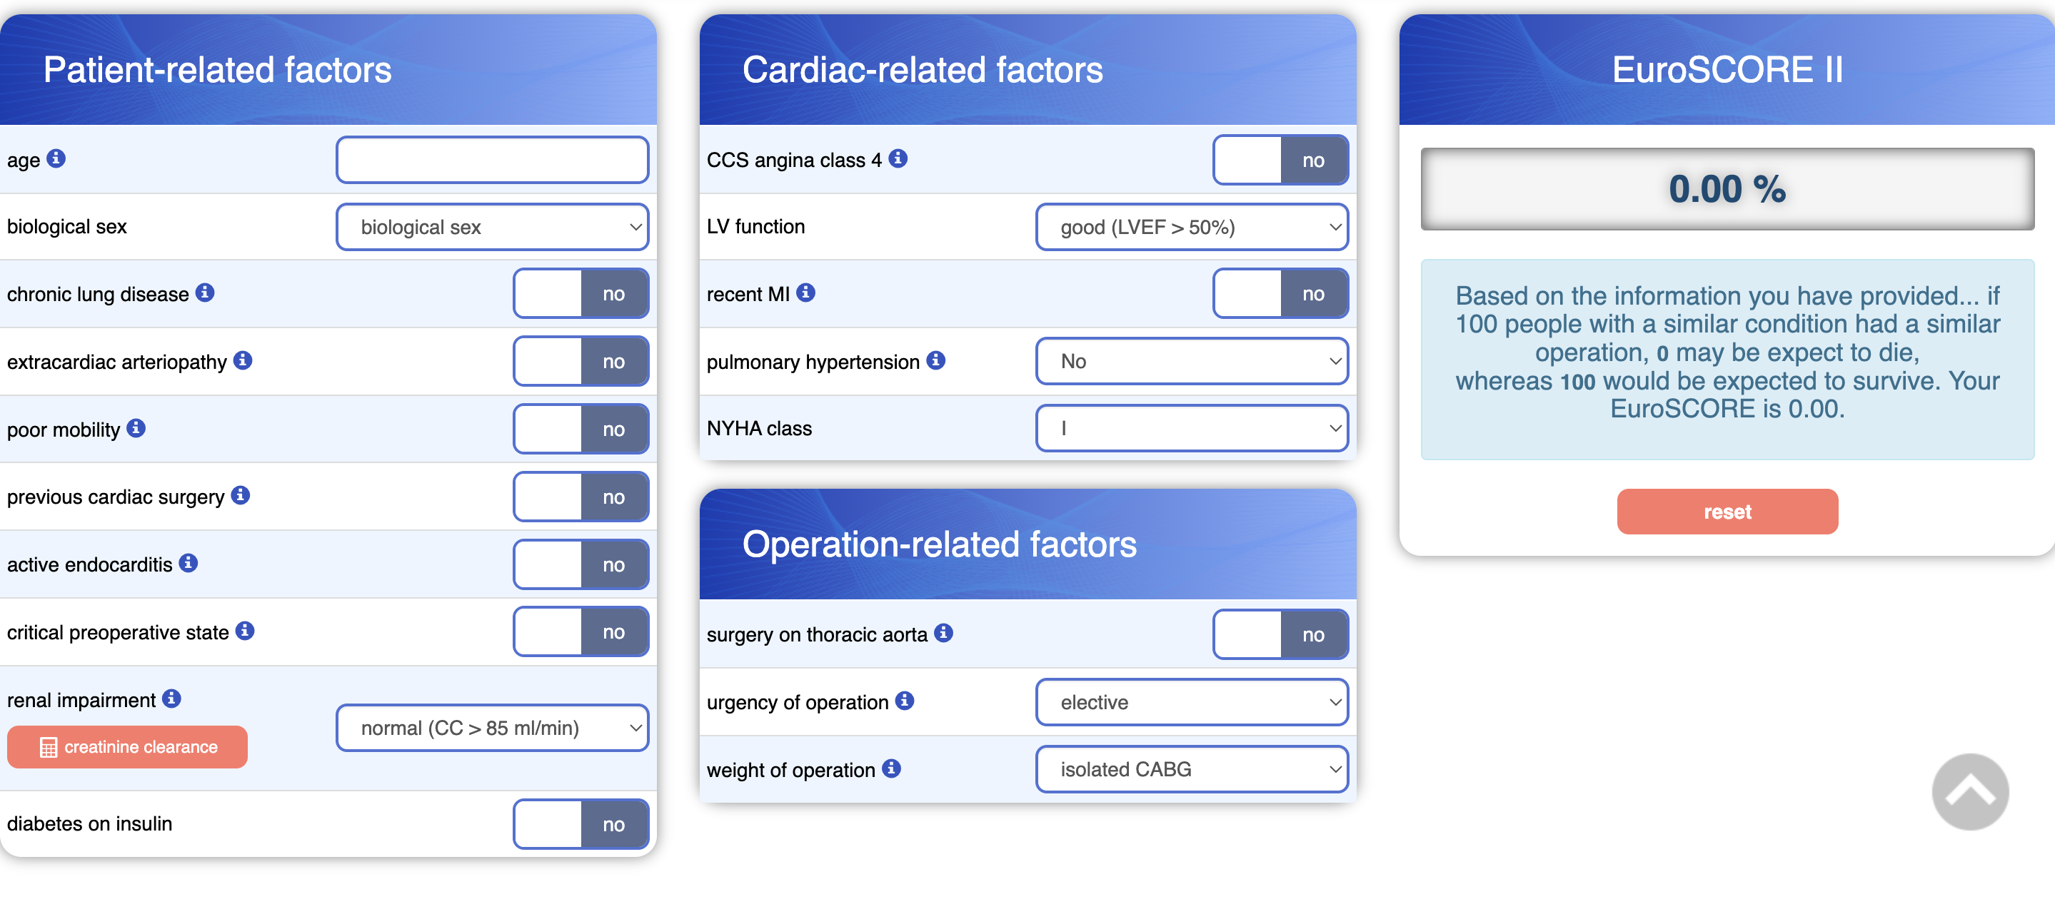
EuroSCORE 2

Slide 3





Cardiac patient data journey
Preoperative
Perioperative
ICU
Ward
Outcome
Outcome
Demographics:
Age
Sex
Medical history
Surgical history
Medication
Echocardiography
Coronary angiography
Pulmonary function
ECG
Lab work
Blood pressure
Heart rate
Central venous pressure
Pulmonary artery pressure
Temperature
Ventilator settings
Extracorporal circulation
Lab work
Medication
Blood pressure
Heart rate
Central venous pressure
Pulmonary artery pressure
Temperature
Ventilator settings
Extracorporal circulation
Lab work
Medication
Dialysis
Blood pressure
Heart rate
Medication
Mortality 30 d Mortality 90 d
Mortality 365 d
Readmission
ICU length of stay
Hospital length of stay
Patient reported outcome measures
a

Slide 4
Sampling rate
Surgery (T=0)
Patient timeline
Preoperative
Perioperative
ICU
Last follow up
Medical history
Surgical history
Echocardiography
Pulmonary function test
Coronary angiography
Monitors
Charts
Medication
Biochemistry
Ventilator settings
Extracorporal circulation
Age

Slide 5
Outcomes
Death
Organ failure
Dialysis
Persistent hypotension/need for inotropi/vasopressor
Ventilatortime
Admission time
Organizational – Time at Rigshospitalet. Time in the healthcare system
Readmission
Sequential measurements – medicine, hemodynamics, ventilatorsettings
Time-true modelling – example: hypotensions, but for how long and how easy is it to fix it with medication
Do we see model saturation from a few parameters (for example time)

Slide 6
Practicalities
Contract
Access to data
Laptop

Slide 7
DTU project

