Slide 1
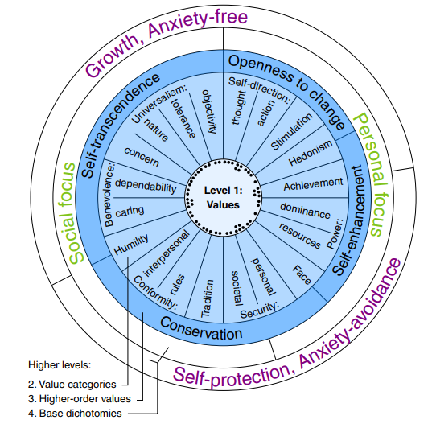
SemEval 2023 Task 4. ValueEval: Identification of Human Values behind Arguments
Andrea Alfonsi , Gianluca Di Tuccio, Lorenzo Orsini
NLP Project + Project Work

Slide 2
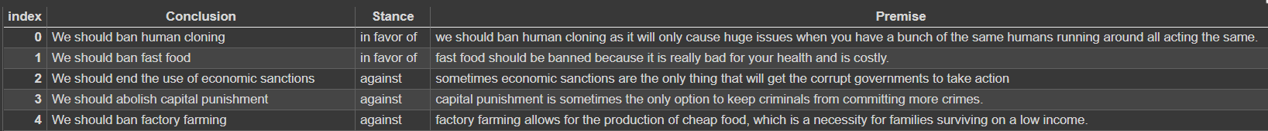
The Dataset
output
5393 training samples;
1896 validation split;
No test split

Slide 3
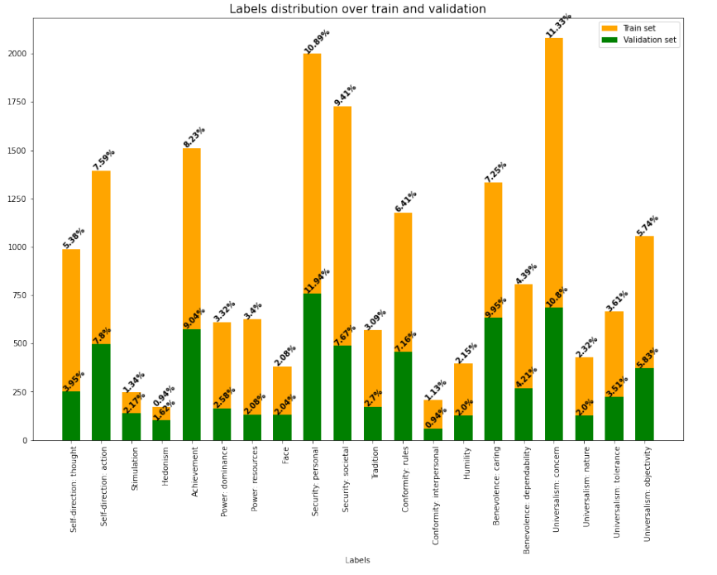
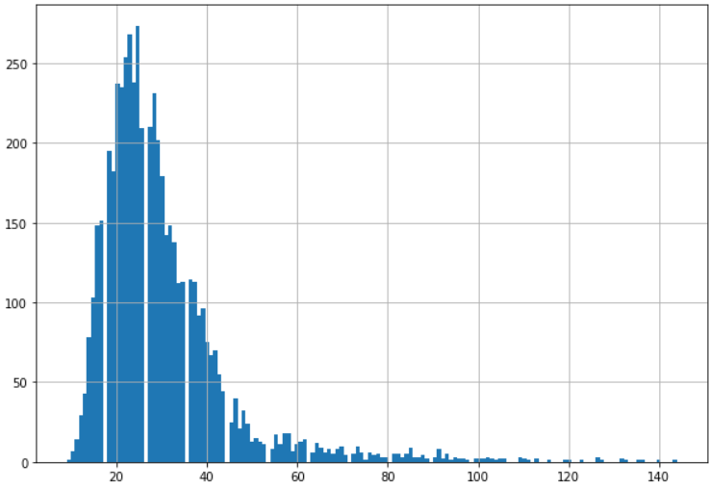
Statistics
Input length distribution
95 percentile = 58

Slide 4
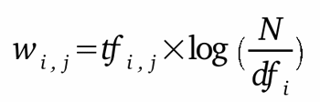
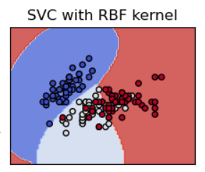
SVM
Removing special chars & numbers
Removing stopwords
Lowering of the text
Lemmatization
PCA to 2250
components
Took the 5k most frequent words
tf-idf
Unigram-bigram
One vs Rest
Kernel: RBF
C: 10
Gamma: 0.01
Max iter: 500
20 labels F1-score = 0.30

Slide 5
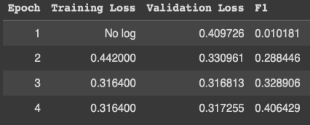
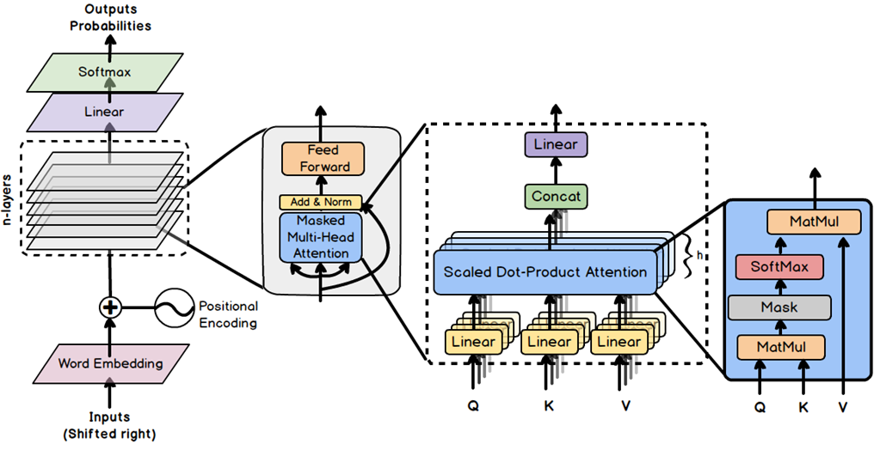
XLNet-large
Lowering of the text
Add dot at the end
of the sentence
Tokenizer: Conclusion <SEP> Stance + Premise
Threshold tuning → 0.25
20 labels task F1-score = 0.49
Fine tuning with the techinque of Zhang et. al
Changed classification head dropout rate to 0.3

Slide 6
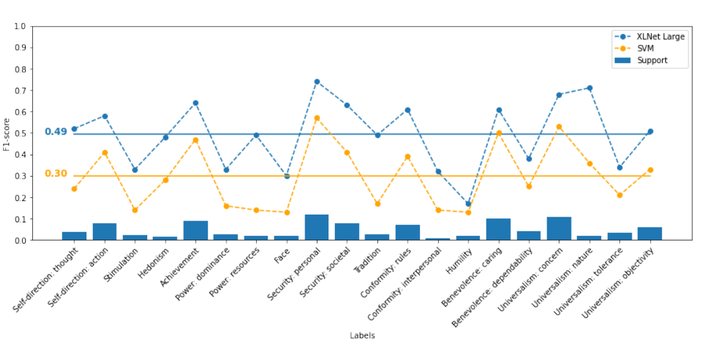
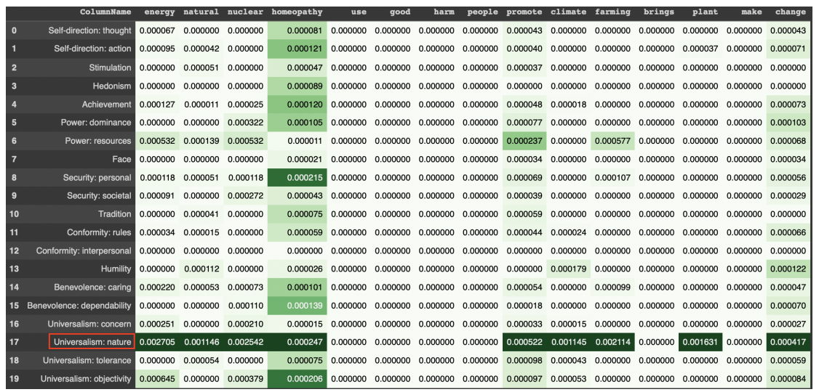
20-labels task results
XLNet-large consistently performs better than SVM for each class;
Better performances for high supported classes;
One exception : "Universalism: nature"
- "Universalism: nature" presents high TF-IDF values → these terms are mainly used in sentences of this class;
- "Power: resources” has the largest difference in performance (0.35); high tf-idf (anomaly for SVM, maybe for the incomplete fine-tuning)

Slide 7
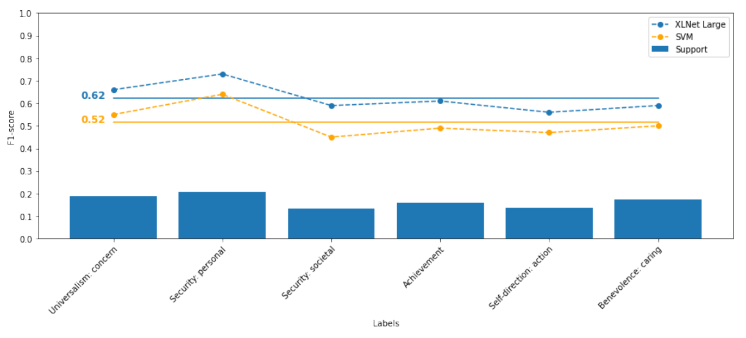
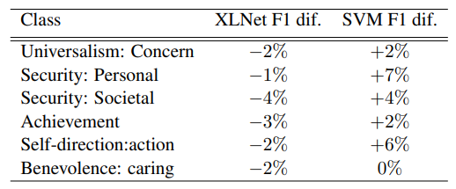
6-labels task results
Reducing the classes
More homogeneous performances between the classes: increase for both SVM (22%) and XLNet-large (13%).
For SVM XLNet-large
Here no dependance by tf-idf;
Conclusion:
Both models depends by number of classes and support;
Room for improvement → adding more samples and making the distribution more homogeneous.

Slide 8
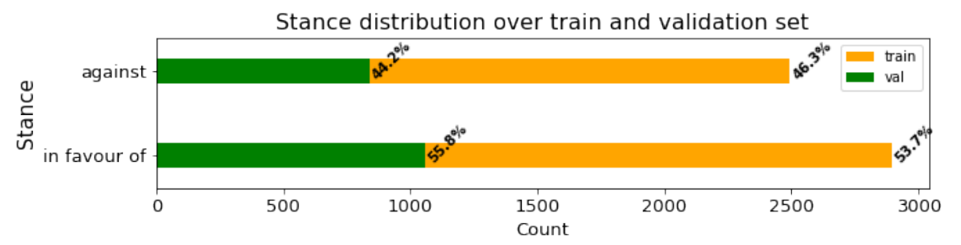
Natural Language Inference
Premise: "the security of children
and teachers is essential for all."
output
Input
‘In favour of’
Conclusion: "we should adopt a zero- tolerance policy in schools."
«in favour of» is always the most frequent stance, while there is almost the same distribution for the two splits (difference by 2%)

Slide 9
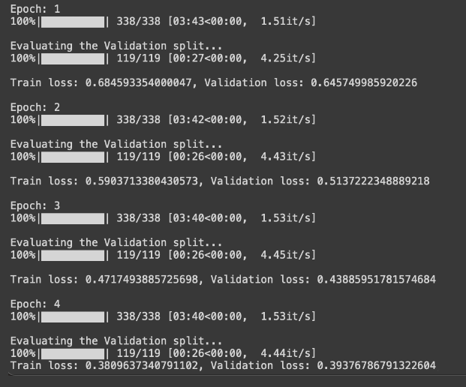
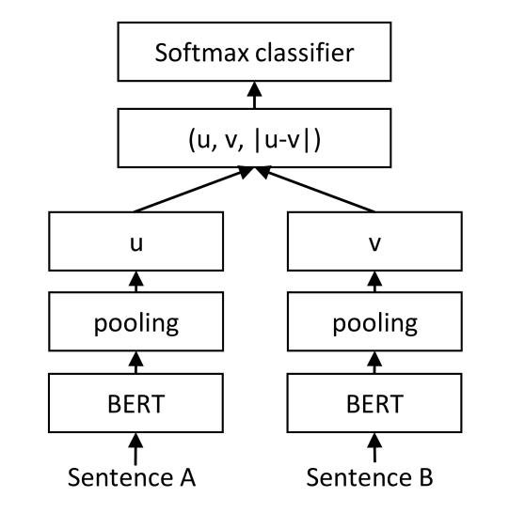
Models
- XLNet-large
- Bert-large
- Siamese Bert (SBERT)
Same fine-tuning of HVD
Premise
Conclusion

Slide 10
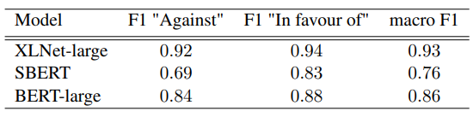
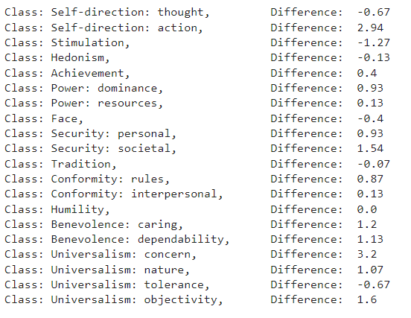
Results
XLNet is always the best, SBERT the worst;
‘against’ is always the the worst stance, and in particular SBERT has a strong difference
Not caused by the classes distribution between wrong and correct predictions

Slide 11
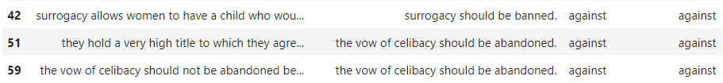
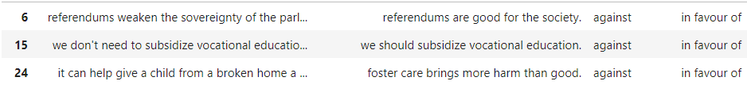
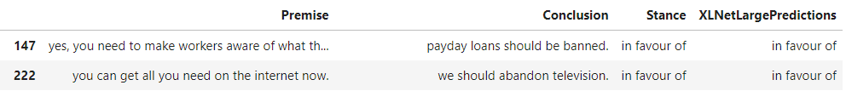
Errors analysis
SBERT correct predictions:
stance
prediction
Good performance for terms opposed to the premise;
Bad performance for context-dependent words.
SBERT wrong predictions
XLnet-large and BERT-large:
No recurrent pattern in the wrong predictions;
Only noticed a high pre-existing knowledge required

