Slide 1
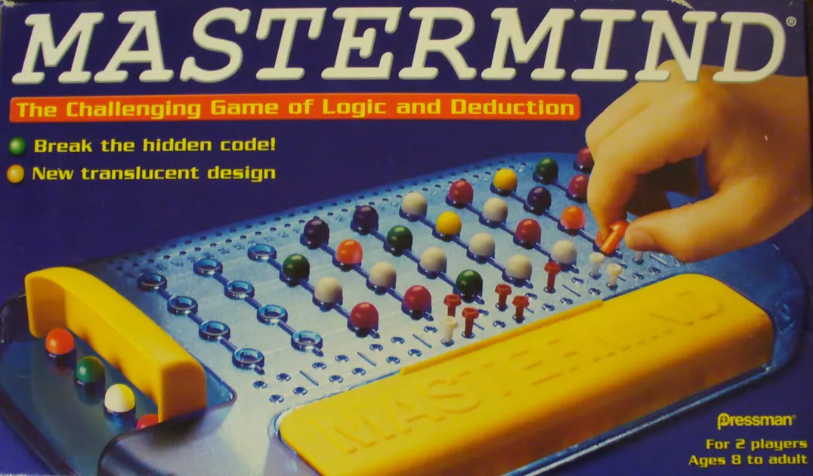

Modified Mastermind
Lorenzo Orsini, Gianluca Di Tuccio

Slide 2
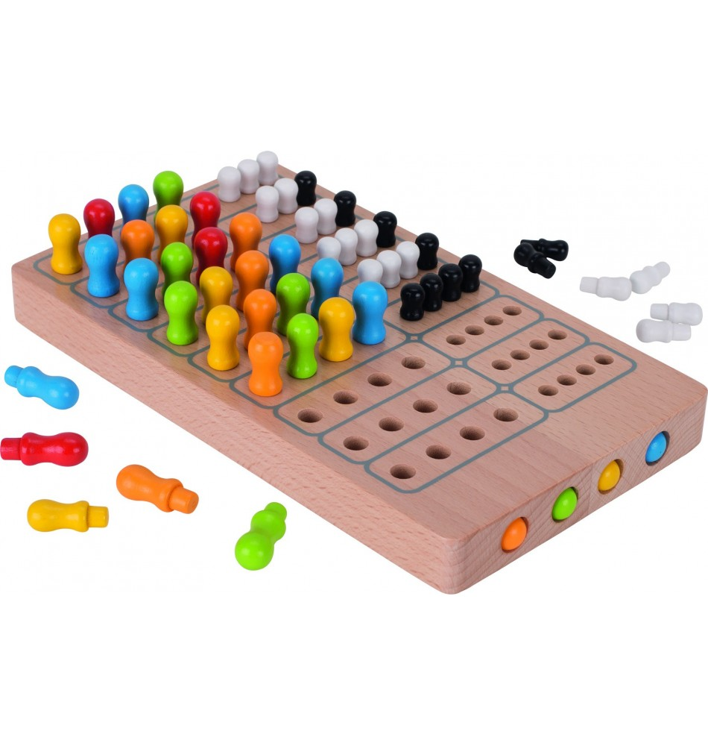
MASTERMIND

Slide 3
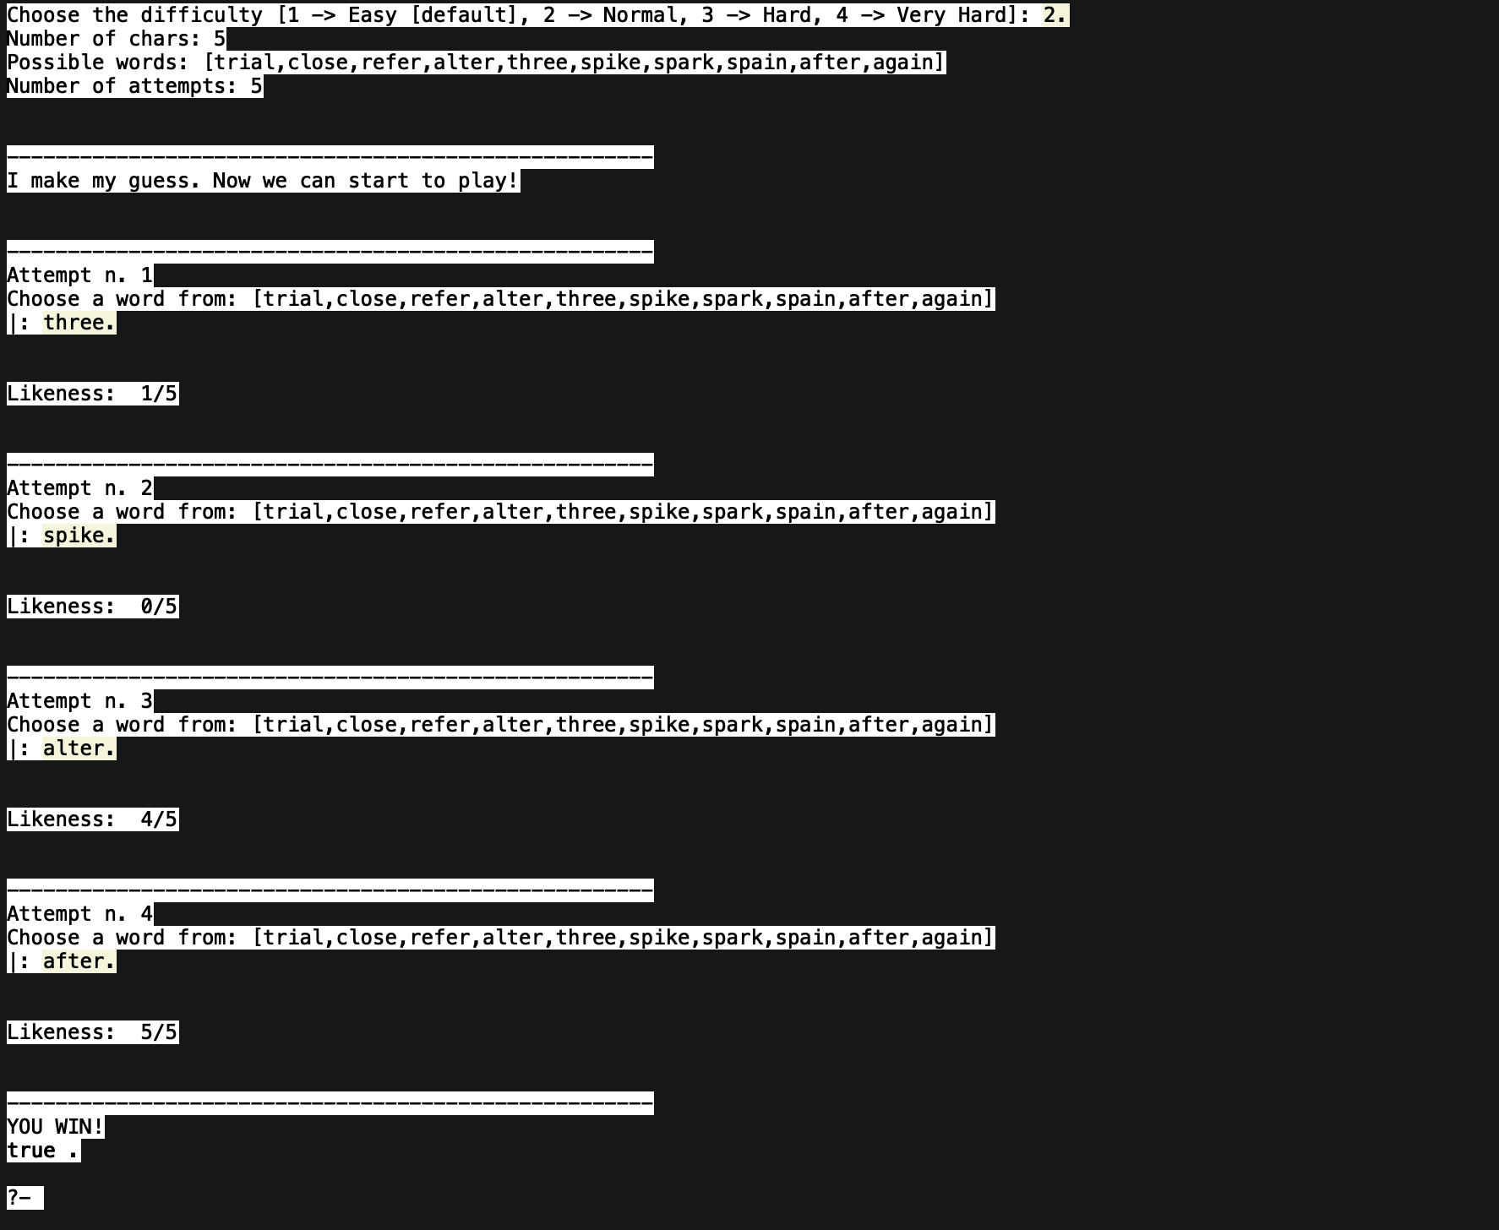
THE GAME

Slide 4
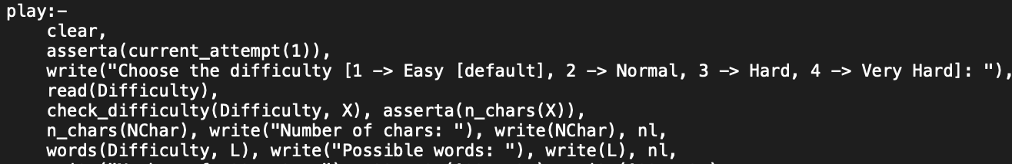
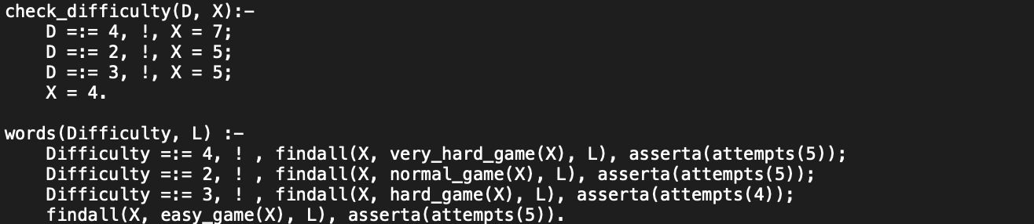
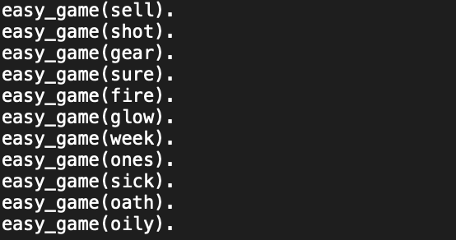
PROLOG IMPLEMENTATION

Slide 5
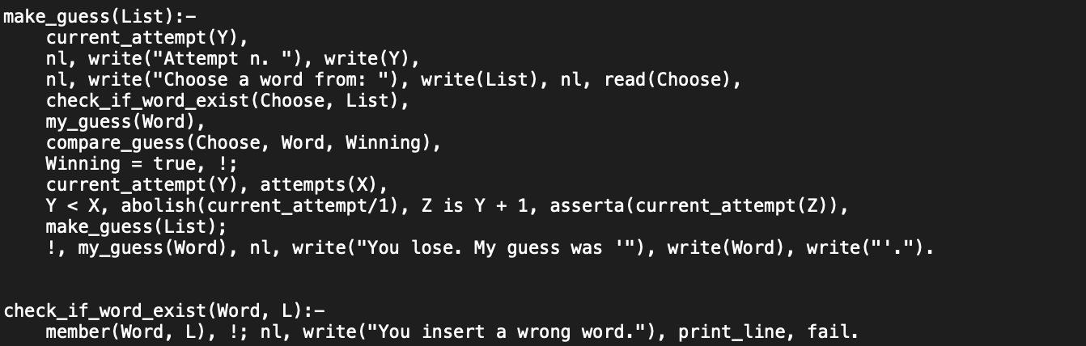
PROLOG IMPLEMENTATION

Slide 6
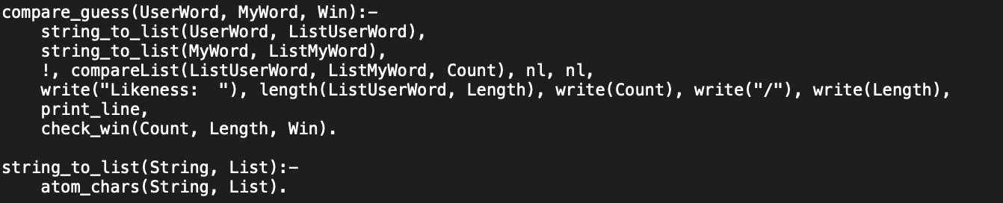
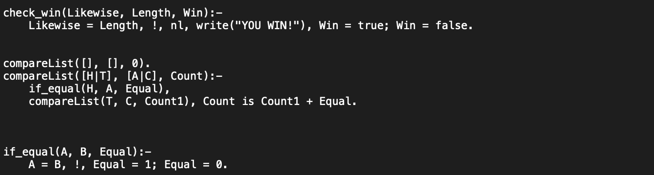
PROLOG IMPLEMENTATION

Slide 7
PROLOG IMPLEMENTATION

