Slide 1

Conducting Marketing Research
Chapter 4

Slide 2
What constitutes good marketing research

Slide 3
Marketing Research System
Market Research
Insight
Notes:
Managers use market research to help them better understand the customers and markets. These insights are the how’s and why’s certain things happen in the market.
The text gives an example of how Gillette conducted market research on the woman’s shaver market and how this research led the company to develop the Venus razor, which now has more than 50% of the global market.

Slide 4
Marketing Research
Defined
The systematic design, collection, analysis, and reporting of data and findings relevant to a specific marketing situation facing the company.
Notes:
Over $28 billion was spent on marketing research in 2007.

Slide 5

Creative Research Means
Rivals
Internet sources
Marketing partners

Slide 6
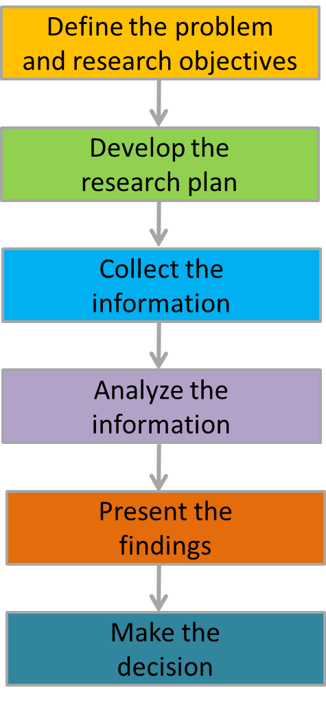
Marketing Research Process
Figure 4.1
Notes:
Example: American Airlines wanted to determine how many first-class passengers would be interested in having limited, Internet access during flights and how much extra they would be willing to pay for this service. AA would have to invest $90,000 per plane.

Slide 8
American Airlines is constantly looking for new ways to serve its passengers. One manager came up with the idea of offering phone service. The other managers got excited about this idea. The marketing manager volunteered to do some preliminary research. He contacted a major telecommunications company to find out the cost of providing this service on B747 coast-to-coast flights. The telecommunications company said that the equipment would cost the airline about $1,000 a flight. The
airline could break even if it charged $25 a phone call and at least 40 passengers made calls during the flight. The marketing manager then asked the company’s marketing research manager to find out how air travelers would respond to this new service.

Slide 9
The Top line of Maggi is receding in Karnataka for Nestle and is a significant cause of concern for the Regional Team. A management team is set up to address the issue and device a plan of action. What would be your take.

Slide 10
Identify
a) research problem
b) research objectives
c) Methodology for conducting research

Slide 11
Step 1: Define the Problem

Slide 12



Step 2: Develop the Research Plan
Research Approaches
Observation
Focus groups
Surveys
Behavioral data
Experiments
Data Sources
Secondary data
Primary data
Research instrument
Questionnaires
Qualitative measures
Technological devices
Sampling plan
Contact method

Slide 13
Step 3: Collect the Information
Online surveys
Telephone surveys
Interviews
In-home surveys
Notes:
Most expensive step
Most prone to errors

Slide 14


Step 4: Analyze the Information
Notes:
Develop summary measures
Compute averages
Statistical analysis / decision models

Slide 15

Step 5: Present the Findings
Notes:
Transform raw data into insight
Present information in clear and compelling fashion

Slide 16

Step 6: Make the Decision
Research
Decisions
Notes:
Research should guide decisions, not be used to support decisions already made.

Slide 17

Characteristics of Good Marketing Research
1. Scientific method
2. Research creativity
3. Multiple methods
4. Interdependence of models and data
5. Value and cost of information
6. Healthy skepticism
7. Ethical marketing

Slide 18

Former marketing research executive for General Foods concluded that Star Wars would fail at the box office. The film grossed $4.3 billion in box office receipts.
Notes:
Market research must be used properly and must be designed for the specific questions, to a specific audience, using specific tools. Using traditional marketing research techniques, a successful marketing research executive left General Foods in hopes of bringing market research to Hollywood. A film studio gave him the task of determining if a potential science fiction movie would be a success or failure. He concluded it would be a failure. His reasoning, American were looking for realism and authenticity (due to Watergate). Furthermore, he stated that citizens were suffering from a post-Vietnam hangover and would not welcome any movie that had the word “war” in its title.

Slide 19
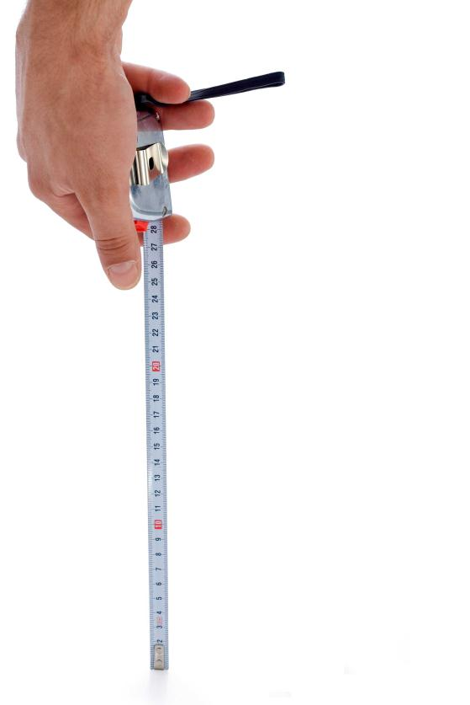
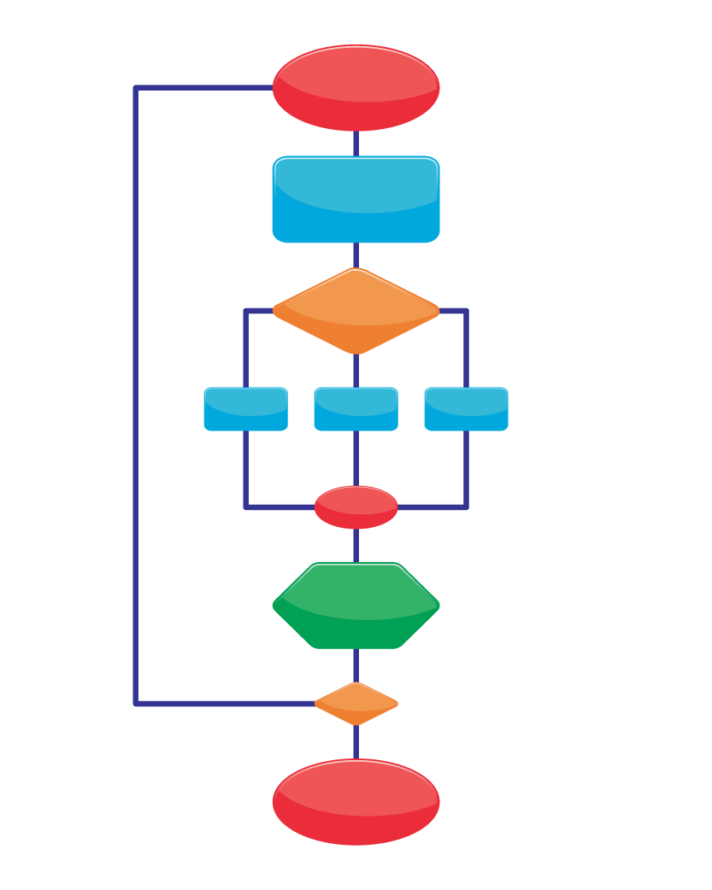

Measuring Marketing Productivity
Marketing-mix modeling
Marketing metrics
Notes:
A survey of CMO’s found that 80% were dissatisfied with their ability to benchmark their marketing programs business impact and value.

Slide 20
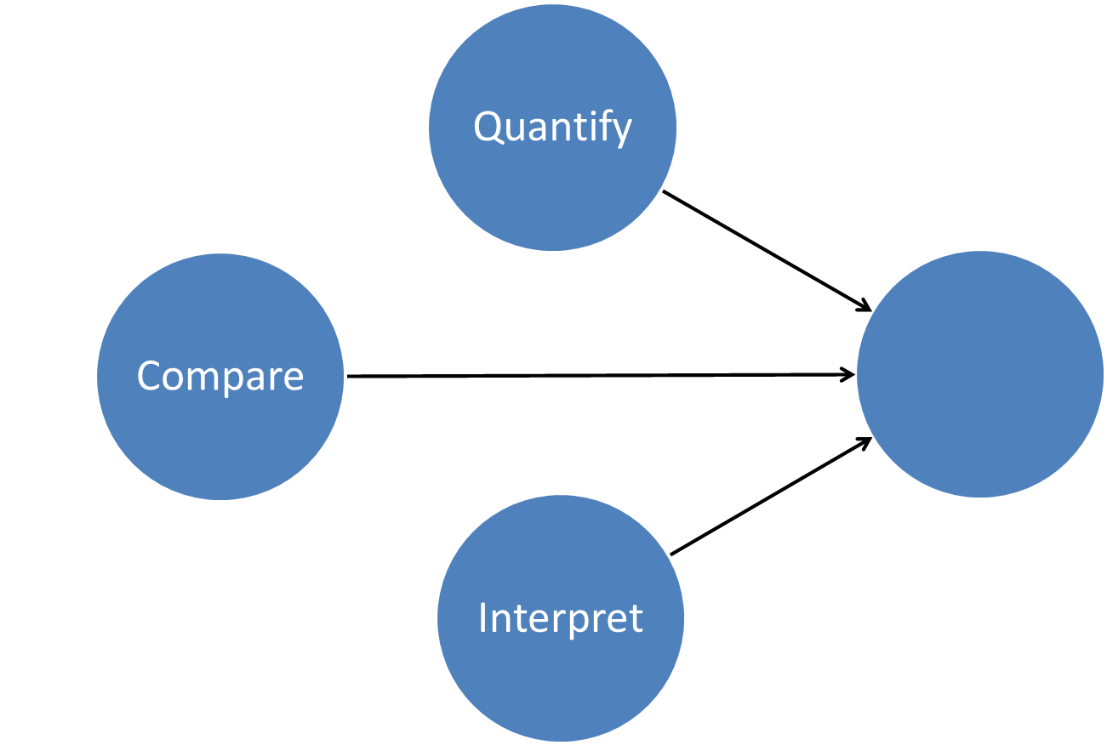
Marketing Metrics
Marketing Performance
Notes:
Marketers are facing pressure to provide clear, quantifiable evidence as to how marketing expenditures (ads, promo, etc) are helping their firms be more profitable. Marketing metrics are measures that helps marketers quantify, compare, and interpret marketing performance.

Slide 21

Marketing Metrics
External
  Awareness
  Market share
  Relative price
  Number of complaints
  Consumer satisfaction
  Total number of customers
  Perceived quality/esteem
  Loyalty/retention
  Relative perceived quality
Notes:
Marketing metrics can being either external, such as those shown here, or internal. Internal metrics can include employees awareness of goals; resource adequacy or autonomy.

Slide 22
Marketing-Mix Modeling
Awareness
Expenditure
Notes:
The results of marketing-mix modeling helps guide allocation on marketing budgets. With the right models, marketers can determine how each marketing element (sales promotions, advertising, trade promotions, etc) impact product revenue.
Marketing mix modeling has three shortcomings, as outlined by Dave Reibstein:
Focus on incremental growth rather than on long-term sales
Integrating multiple metrics (such as satisfaction, awareness, and brand equity) is limited
These models fail to incorporate metrics related to competitors, the trade, or the sales force.

Slide 23
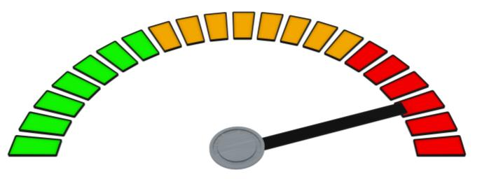
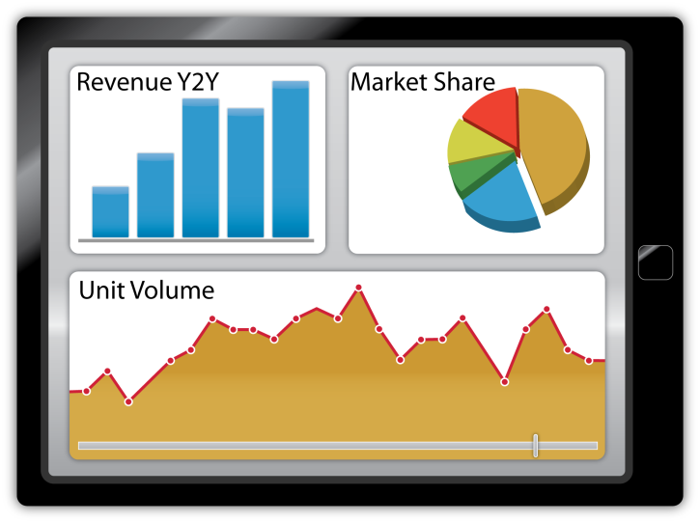
Marketing Dashboards
Notes:
Dashboards are similar to the instrument panel of an airplane. They can be designed to provide information in real-time that managers can use to better understand the market.

Slide 24
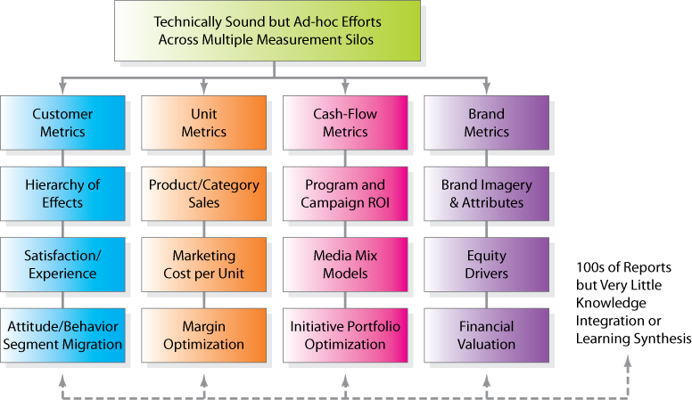
Marketing Measurement Pathway
Figure 4.2

Slide 25
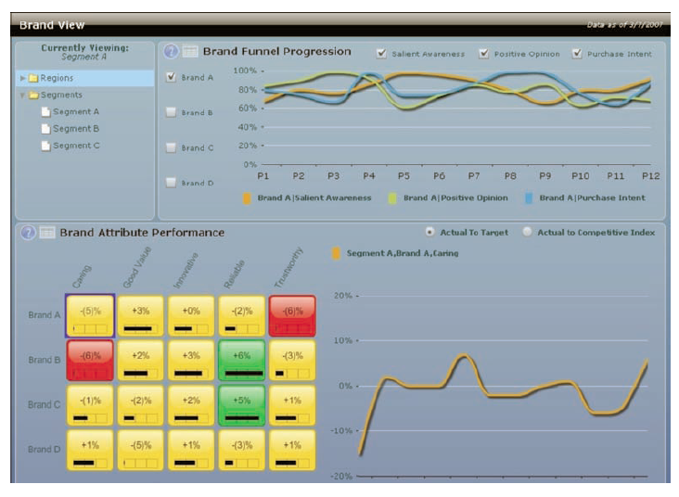
Figure 4.3
Marketing Dashboard Example

