Slide 1
Consumer Behavior

Slide 2
Points to Ponder
Pay for 3 pieces of ‘Liril’ and get the 4th free !!!
Buy one ‘Harpic’ and get an ‘Odonil’ free !!!
Exchange your Maruti Alto for a Maruti Swift at a Rs 40,000/= discount !!!
Buy ‘Fast Track’ watches and get 5 different colored wrist-bands free !!!
New LG Television with unique ‘Child Lock’ feature !!!
Why are such offers given to consumers??

Slide 3
Some more examples…..
‘Dar ke aage jeet hai’ ….. Mountain Dew
‘We also make steel’ …… Tata Steel
‘Filmi sitaron ka saundarya sabun’ …….. Lux
‘Jaago India Jaago’ …….. Tata Tea
‘Desh ki Dhadkan’ ……… Hero Honda
‘An Idea can change your life’ ……. Idea
How do such slogans impact consumers??

Slide 4
Consumer Behaviour……..what is it?
All such activities done by a consumer, while obtaining , consuming and disposing of products and services. This includes the decision making processes that precede and follow such actions.

Slide 5
Why study Consumer Behavior?
Consumers ‘evolve’ with time, learning, exposure and experience. They cannot be taken for granted.
e.g. People booked their railway tickets from the station counters, now they prefer online purchase thru website.
As a consequence, a sound understanding of consumer behavior is a pre-requisite for sustained success of any marketing program

Slide 6
The study of Consumer Behaviour includes:
1. Consumers in the Market Place.
2. Consumers as individuals.
3. Consumers as decision makers.
4. Consumers and cultures.
5. Consumers and subcultures.

Slide 7
Marketing decisions
Market Segmentation: Process of dividing the market into distinct subsets of consumers with common needs and characteristics and selecting one or more segments to target with distinct marketing mix. E.g. Bathing soap, detergents, shampoos etc.
Segment Marketing: Serving needs of a particular group; different marketing mix for different segments. e.g. Vegetarian recipes by Haldiram.
Niche Marketing: Marketing to a single group, tailoring the mix to their specific needs and attract them, allowing the firm to engage in relationship marketing. e.g. Nutralite bread spread, Diet Coke, Sugar – free etc.
Differentiated Marketing: organizations sell multiple versions of a product; each appealing to different market segment. Differentiated strategy can produce greater sales. e.g. Pepsi in 300ml as well as 2 litres.
Individual Marketing: tailoring market mix to suit individual customers and create value for each individual. e.g. Designer clothes by Ritu Kumar, Manish Malhotra.

Slide 8
Segmentation
Means by which marketers differentiate among consumers and market segments.
Type | Examples
Demographic | Age, Life cycle, Gender, Education, Income, Occupation
Psychographic | Interests, Opinions, Values, Lifestyle
Psychological Influence | Motivation, Perception, Learning, Personality, Self-image, Risk involvement, Attitude, Beliefs
Cultural and Social Influence | Culture, Subculture, Social class, Reference group, household
Marketplace behavior | Recognizing needs, response to marketing & communication, price and product acceptance
Consumption behaviour | Situation, usage rate, satisfaction, loyalty

Slide 9
Demographic Factors
Age: Johnson’s Baby Soap is targeted at kids between 0-5 years. NIIT ads target young adults in age group of 17-22 years.
Gender: Obvious for products which are gender specific. e.g. Shaving Creams, Fairness Creams etc. However, changing roles are seen in other ads like detergents etc. (Ariel, Fair & Handsome etc)
Marital Status: impact on consumption. Investments after marriage. e.g. Elle-18 depicts freedom as a spinster.
Household type: Type and size of household matters. Kelloggs shows young household (couple with small kids)
Education: Rational ads to educated, more emotional appeal to others.
Income: Nescafe depicts sophistication, style (higher income), Bru a middle class household. Ability to pay.
Occupation: employment data to design product positioning. Surf excel for field jobs (journalist ad)

Slide 10
Geographic Segmentation
Clues on likely purchase behavior. Identifies segments based on geographical boundaries. People in a same area share similar needs. Regional differences are accounted for by climate, culture, religion, concentration etc. e.g. Coastal cities with heavy rainfall for Umbrellas,
Difference in needs among rural, urban and suburban areas. e.g. Eveready Torch for rural areas, emergency lights for sub-urban areas, CFL for Urban metros.
Indian zones- viz. North, South, East and West greatly differs in their culture, food habits, TV viewing patterns, social customs etc; hence affecting their purchasing patterns. e.g. Regional TV Channels with regional programmes.
Feasible for marketer to concentrate efforts and resources and fully utilize the available services.

Slide 11
Psychographic/ Psychological Segmentation
Refers to inner/ intrinsic qualities of an individual.
Motivation: Understand ‘why’ of consumer’s buying pattern. e.g. Why did ready to eat food items fail in India?
Desired Benefits: need and benefits various segments seek from the product.
Attitude: attitude towards brands give rise to distinct segments. (negatives, functionalists, fun lovers etc. e.g. the ‘my can’ pack of Pepsi, Mountain Dew etc.
Lifestyle: predict buyer behavior on the basis of attitude, interests and opinions (VALS 2)… Colgate for trust and traditions.
Personality: one’s personality determines the kind of product and the image thus associated. UCB- young and easy attitude, Reid & Tailor- corporate image.
Brand Loyalty: measure of customer attachment to a particular brand. They prefer a particular product irrespective of thick and thin.
Behavior: emotional and cognitive process going on inside a consumer’s head, lead to many problems. Segmenting the market based on specific behavior patterns and product use. E.g. while travelling in a train most people buy magazines who otherwise do not buy.

Slide 12
Socio-Cultural Segmentation
Family Life Cycle: All families pass through phases of formation, growth and dissolution. At each stage, requirements vary and hence becomes an important segment to be captured. (Maruti 800 ads in year 2000-01)
Social Class: relative status and social standing is important to consumers. It is a function of income, education and occupation. Knowledge of buying patterns, behavior etc. is important to appeal to different segments. (Raymond)
Culture, Cross Culture & Sub culture: segmenting the domestic and international markets on the basis of cultural heritage as members of the same culture share same values, beliefs and customs. Within the larger culture distinct subgroups and subcultures are united by certain experiences, values or beliefs and make effective segments. Culturally different segments. (Health conscious Indian urban upper middle class-LG)

Slide 13
Purchase Segmentation
Usage rate: segmenting based on the rate of product usage. Division of market into heavy, moderate and light users and planning the marketing mix differently for each. e.g. ‘Frequent Flyer’ scheme of airlines
Loyalty status: consistency with which consumers continue to buy same brand of a particular product and show their commitment. e.g. ‘Loyalty Cards’ offered by retail stores.
User status: whether consumers have used the product in past, use it currently or are likely to use the same in future. Different mix could be needed for each category. e.g. Upgrade your Godrej Refrigerator, return the old one and buy a frost-free one.

Slide 14
Stimulus – Response Theory
Pavlov’s Classical Conditioning Theory:
Whenever you hear the ‘Intel’ jingle, you recall ‘Intel’
Whenever you see the name ‘McDonald’, you are reminded of Burgers.
Whenever you see the Amul ‘Butter Girl’ you are reminded of ‘Amul Butter’.

Slide 15


Marketing and
Other Stimuli
Model of Consumer Behavior
Product
Price
Place
Promotion
Economic
Technological
Political
Cultural
Buyer’s Black Box
Characteristics affecting consumer behavior
Buyer’s Decision Process
Buyer’s Response
Purchase Timing
Purchase Amount
Product Choice
Brand Choice
Dealer Choice

Slide 16
Few findings which motivated study of Consumer Behavior
Of all the products launched every year, only 55% survive five years later.
e.g. FIAT launched Uno, Palio, Sienna etc but could not survive profitably.
Of the various new product concepts offered by over 100 leading companies, only 8% reached the market and out of this 8% only 17% achieved the marketing objectives.
e.g. HUL launched pre-cooked ready-to-eat rice, in line with Nestle’s Maggi, but failed miserably. ( discuss)

Slide 17
Satisfying the consumer’s need is more important than the expectations of the management.
For survival, there is not option before the companies but to understand and adapt to consumer motivation and behavior.

Slide 18
Effective Marketing can positively influence the consumer, provided the product/service offered satisfies his/her needs and expectations
The right marketing program can activate a latent demand and lead to successful sales.

Slide 19
Consumer Research: The Dominant Forces:
Economy moving from – ‘production/product-centric’ to ‘market/customer-centric’.
e.g. Hindustan Motors (Ambassador) followed product centric approach and lost its market share to Maruti which followed the customer centric approach.
Better understanding of human behavior through improved tools of psychology and other behavioral sciences.

Slide 20
The Marketing Challenge: Environmental factors
Extent of gap between the supply and demand of the valid products/services. e.g. LPG cylinders are often sold at a ‘premium’ due to demand-supply gap.
Speed and accuracy of communication with/from customers. e.g. Most PSU Banks lost their market share to Private Banks because of speed & accuracy of communication.
Efficient and multiple distribution channels. e.g. sales of telephone connections increased after mobile service providers started appointing dealers, contrary to MTNL & BSNL.
Marketers power to influence and induce channel partners to comply with overall marketing strategy. e.g. certain Dish Antenna companies offer certain channels free.
National & Global Economic growth.

Slide 21
What is Motivational Research?
Study to explore the factors that motivate consumers in making choices. The techniques delve into the conscious, subconscious and the unconscious state of the consumer.
‘Bata sells lovely feet, and not foot-ware’.
‘Women don’t buy Ponds, they buy hope.’
‘While buying a Rolex, people don’t buy a time-keeping machine, rather style’.

Slide 22
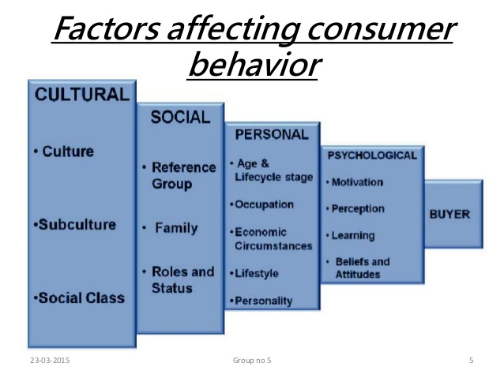
Notes:
Social class – eight categories from A1 , A2, B1, B2, C, D , E1 and E2

Slide 23
Factors Affecting Consumer Behavior: Culture
Values – Honesty e.g. Tata is an ‘honest brand’
Perceptions – e.g. ‘fair & lovely’ will make you fairer.
Subculture - Groups of people with shared value systems based on common life experiences.
Example: Hispanic Consumers, African American Consumers, Asian American Consumers, Mature Consumers
Social Class - People within a social class tend to exhibit similar buying behavior.
Example: Occupation, Income, Education, Wealth

Slide 24

Emotion

Slide 25
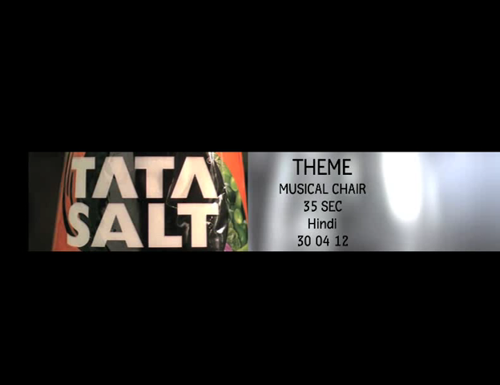
Honesty- Values

Slide 26

All age groups

Slide 27

Income/ Life style

Slide 28
Groups
Membership
Reference
Factors Affecting Consumer Behavior: Social
Family
Husband, wife, kids
Influencer, buyer, user
Social Factors
Roles and Status

Slide 29
Factors Affecting Consumer Behavior:
Personal
Personal Influences
Age and Family Life Cycle Stage
Occupation
Economic Situation
Personality & Self-Concept
Lifestyle Identification
Activities
Interests
Opinions

Slide 30
Lifestyle Dimension
Activities | Interests | Opinions | Demographics
Work | Family | Themselves | Age
Hobbies | Home | Social issues | Education
Social events | Job | Politics | Income
Vacation | Community | Business | Occupation
Entertainment | Recreation | Economics | Family size
Club membership | Fashion | Education | Dwelling
Community | Food | Products | Geography
Shopping | Media | Future | City size
sports | Achievements | Culture | Stages in life cycle
Joseph T. Plummer, “The concept and application of lifestyle segmentation, “Journal of Marketing, 38)

Slide 31
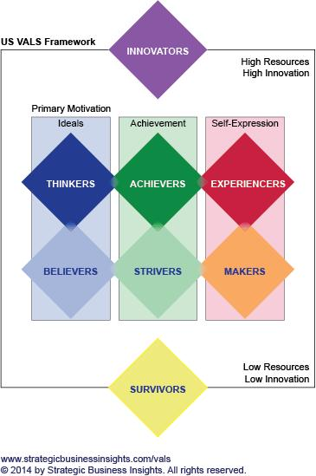

Slide 32
VALS Segmentation
Innovator. These consumers are on the leading edge of change, have the highest incomes, and such high self-esteem and abundant resources that they can indulge in any or all self-orientations. They are located above the rectangle. Image is important to them as an expression of taste, independence, and character. Their consumer choices are directed toward the "finer things in life."
Thinkers. These consumers are the high-resource group of those who are motivated by ideals. They are mature, responsible, well-educated professionals. Their leisure activities center on their homes, but they are well informed about what goes on in the world and are open to new ideas and social change. They have high incomes but are practical consumers and rational decision makers.
Believers. These consumers are the low-resource group of those who are motivated by ideals. They are conservative and predictable consumers who favor local products and established brands. Their lives are centered on family, community, and the nation. They have modest incomes.
Achievers. These consumers are the high-resource group of those who are motivated by achievement. They are successful work-oriented people who get their satisfaction from their jobs and families. They are politically conservative and respect authority and the status quo. They favor established products and services that show off their success to their peers.

Slide 33
Strivers. These consumers are the low-resource group of those who are motivated by achievements. They have values very similar to achievers but have fewer economic, social, and psychological resources. Style is extremely important to them as they strive to emulate people they admire.
Experiencers. These consumers are the high-resource group of those who are motivated by self-expression. They are the youngest of all the segments, with a median age of 25. They have a lot of energy, which they pour into physical exercise and social activities. They are avid consumers, spending heavily on clothing, fast-foods, music, and other youthful favorites, with particular emphasis on new products and services.
Makers. These consumers are the low-resource group of those who are motivated by self-expression. They are practical people who value self-sufficiency. They are focused on the familiar - family, work, and physical recreation - and have little interest in the broader world. As consumers, they appreciate practical and functional products.
Survivors. These consumers have the lowest incomes. They have too few resources to be included in any consumer self-orientation and are thus located below the rectangle. They are the oldest of all the segments, with a median age of 61. Within their limited means, they tend to be brand-loyal consumers.

Slide 34
Notes:
Social class – eight categories from A1 , A2, B1, B2, C, D , E1 and E2

Slide 35



Factors Affecting Consumer Behavior:
Psychological
Motivation
Beliefs and
Attitudes
Psychological
Factors
Perception
Learning

Slide 36
What is Motivation?
Motivation refers to an activated state within a person that leads to goal-directed behavior.
  It consists of the drives, urges, wishes, or desires that initiate the sequence of events leading to a behavior.
  e.g. A banner announcing “50% off” on Lewis Jeans – leading to youth discussing plans to visit the store.
  A combo pack of “Harpic & Odonil” - leading housewives shifting their favorite store.

Slide 37
Motivation begins a stimulus that leads to the recognition of a need. E.g. the free Odonil with Harpic was a stimulus for the housewife.
Need recognition occurs when a perceived discrepancy exists between an actual and a desired state of being
  Needs can be either innate or learned.
  Needs are never fully satisfied.
  Feelings and emotions accompany needs
Expressive needs involve desires by consumers to fulfill social and/or aesthetic requirements. E.g. buying of a M F Hussain Painting
Utilitarian needs involve desires by consumers to solve basic problems . E.g. filling a car’s gas tank.

Slide 38
The Types of Emotions
The Ten Emotions People Experience:
  Disgust Interest
  Joy Surprise
  Sadness Anger
  Fear Contempt
  Shame Guilt

Slide 39
Theory of Motivation
Maslow’s Need Hierarchy

Slide 40
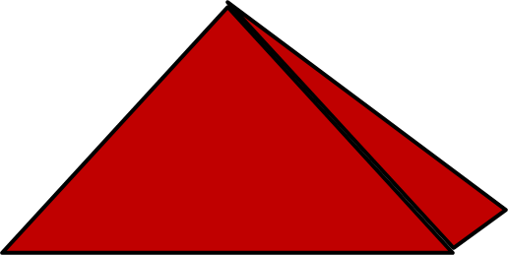




Maslow’s Hierarchy of Needs
Self
Actualization
(Self-development)
Esteem Needs
(self-esteem, status)
Social Needs
(sense of belonging, love)
Safety Needs
(security, protection)
Physiological Needs
(hunger, thirst)

Slide 41
Learning in consumer behaviour
Kotler’s Definition : Learning involves changes in an individual’s behavior arising out of experience. Most of the human behavior is learned over time out of experience.
Schiffman and Kanuk’s Definition : Learning is a process by which individuals acquire the purchase and consumption knowledge and experience that they apply to future related behaviour.
Loudon and Della Bitta’s Definition : Learning can be viewed as a relatively permanent change in behaviour occurring as a result of experience.
Why Learning? Learning is defined as a change of behavior following an interaction between a person and their environment. Most behaviors, attitudes, preferences, values, feelings, and symbolic meanings are acquired through learning. We learn through the processes of attention and understanding
Attention: The consumer's attention is gained through processing the stimulus
Understanding: The consumer interprets the information and acts upon it

Slide 42
The salient features of Learning :
Consumer learning is a process, and thus it continuously changes and evolves as a result of newly acquired knowledge.
This knowledge can be obtained from reading, discussing, observing, thinking, etc. Or from actual experience.
Both the newly acquired knowledge and personal experience serve as a feedback.
This also serve as a future behaviour in similar situations.
Not all learning is deliberate. Learning can be :
  Intentional : acquired as a result of careful search for information with effort.
  Incidental : acquired as a result of accident or by the way, without much effort.
The term “Learning” generally covers all ranges of learning from simple reflexive responses to abstract concepts or complex problem solving capability.

Slide 43
ELEMENTS OF LEARNING
Motives, motivation or drive is very important for learning. E.g. showing ads for winter goods just before winter and summer products just before summer.
Cues - Motives stimulate learning, whereas “Cues” are the stimuli that give direction to these motives. E.g. in the market place, price, styling, packaging, store display all serve as cues to help consumer to decide a particular product from a group.
Response - Response is how the consumers react to the motives or a cue, and how they behave. Response can be overt (open, physical or visible) or covert (hidden or mental).
Reinforcement - Reinforcement is an important element which increases the probability (tendency or likelihood) of a particular response to occur in future as a result of a given set of motives and cues.

Slide 44
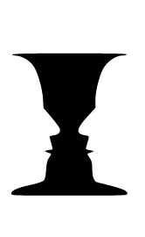
Perception
Selecting, organizing and interpreting information in a way to produce a meaningful experience of the world is called perception.

Slide 45
Marketing and
Other Stimuli
Model of Consumer Behavior
Product
Price
Place
Promotion
Economic
Technological
Political
Cultural
Buyer’s Black Box
Characteristics affecting consumer behavior
Buyer’s Decision Process
Buyer’s Response
Purchase Timing
Purchase Amount
Product Choice
Brand Choice
Dealer Choice

Slide 46
MARCH 4
210907444 tejash
1, 2 ,
12, 13, 15, 16, 18,
23, 28,30.
36, 40
69, 71 72

Slide 48
Three different perceptual processes
Selective
Exposure
Consumer pays attention to certain stimuli and ignores others
Selective
Comprehension
Consumer interprets info so that is is consistent with his beliefs
Selective
Retention
Average consumer only remembers
30% of information heard

Slide 49
Perceived risk
  Perceived risk represents the anxieties felt because the consumer cannot anticipate the outcomes of a purchase but believes that there may be negative consequences.
  Perceived risk is a consumer’s perception of the overall negativity of a course of action based upon as assessment of the possible negative outcomes and of the likelihood that these outcomes will occur.
  Perceived risk consists of two major concepts - the negative outcomes of a decision and the probability these outcomes will occur.

Slide 50
7 Types of Consumer Risks.
Financial/Economic
Performance
Physical/Personal
Psychological
Social
Time & Opportunity Loss

Slide 51
Six risk-reduction strategies
  Be brand loyal and consistently purchase the same brand.
  Buy through brand image and purchase a quality national brand.
  Buy through store image from a retailer that you trust.
  Seek out information in order to make a well informed decision.
  Buy the most expensive brand, which is likely to have high quality.
  Buy the least expensive brand in order to reduce financial risk.

Slide 52
Beliefs & Attitudes
Belief
A descriptive thought about a brand or service
May be based on real knowledge, opinion or faith
Attitude
Describes a person’s evaluations, feelings and tendencies towards an object or idea
They are difficult to change

Slide 53
Types of Buying Decisions
Complex
Buying
Behavior
Variety-
Seeking
Behavior
High
Involvement
Low
Involvement
Significant
Differences
between brands
Dissonance-
Reducing Buying
Behavior
Habitual
Buying
Behavior
Few differences
Between brands

Slide 54
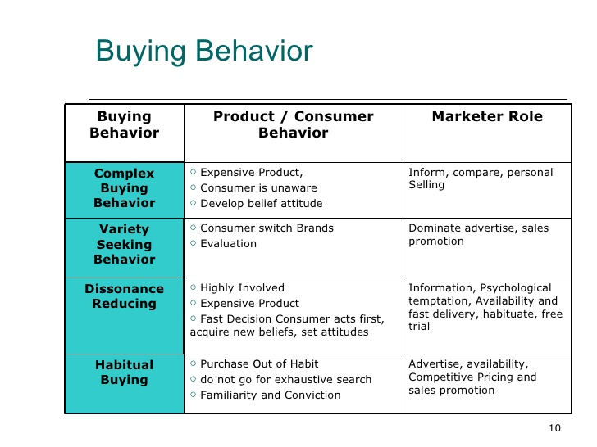

Slide 55
Age of Head of Household
 | Under 35 yrs | 35-64 yrs | Over 64 yrs
One adult in household | Bachelor I | Bachelor II | Bachelor III
Two adults in household | Young couple | Childless couple | Older couple
Two adults plus children in household | Full nest I* Full nest II* | Delayed full nest* Full nest III*
Full Nest I: youngest child is younger than 6 yrs
Full Nest II: youngest child is older than 6 yrs
Full Nest III: youngest child is older than 6 yrs and the parents are middle aged
Delayed Full Nest: parents are middle-aged but the youngest child is younger than 6 yrs

Slide 56
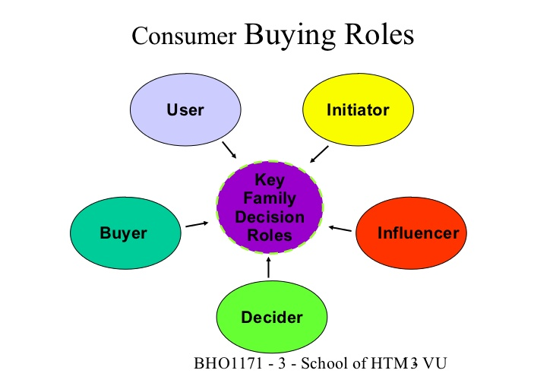

Slide 57
Consumer Decision-Making Process
Need Recognition
Cultural, Social,
Individual and
Psychological
Factors
affect
all steps
Information Search
Evaluation
of Alternatives
Purchase
Postpurchase
Behavior

Slide 58
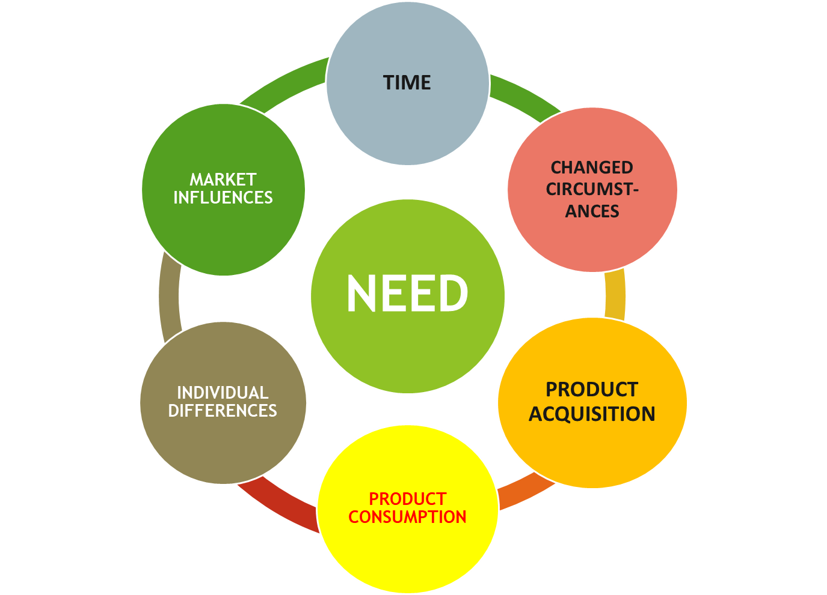


Slide 59

When the current product/service is not satisfying the need
When the consumer is running out of an product/service
When another product/service seems superior to the one currently being used

Slide 60
DESIRED
STATE
ACTUAL
STATE
DEGREE OF
DISCREPANCY
BELOW
THRESHOLD
AT OR ABOVE
THRESHOLD
NO NEED
RECOGNITION
NEED
RECOGNITION

Slide 61

Internal search involves the scanning of one's memory to recall previous experiences or knowledge concerning solutions to the problem/satisfying need.
Generally done for frequently purchased products/low involvement products/services .
External search may be necessary when past experience or knowledge is insufficient, the risk of making a wrong purchase decision is high, and/or the cost of gathering information is low.
Generally done for high involvement products

Slide 62

Personal Sources
Commercial Sources
Family, friends, neighbors
Most influential source of
information
Public Sources
Advertising, salespeople
Receives most information
from these sources
Experiential Sources
Mass Media
Consumer-rating groups
Handling the product
Examining the product
Using the product

Slide 63
Product Attributes
Evaluation of Quality, Price, & Features
Degree of Importance
Which attributes matter most to me?
Brand Beliefs
What do I believe about each available brand?
Total Product Satisfaction
Based on what I’m looking for, how satisfied
would I be with each product?
Evaluation Procedures
Choosing a product (and brand) based on one
or more attributes.

Slide 64
Purchase Intention
Desire to buy the most preferred brand
Attitudes of others
Unexpected situational factors
Purchase Decision

Slide 65
Consumer’s Expectations of
Product’s Performance
Product’s Perceived
Performance
Satisfied
Customer!
Dissatisfied Customer
Cognitive Dissonance
Cognitive dissonance is when the customer experiences feelings of post-purchase psychological tension or anxiety. Some companies like to engage their consumers with post-purchase communications in an effort to influence their feelings about their purchase and future purchases

Slide 66
Complete model of consumer behavior
Need recognition
Internal
search
Search
Influences
culture
social class
family
situation
Exposure
Memory
Stimuli (marketer dominated, other)
Attention
Alternative evaluation
Comprehension
Individual
differences
resources
motivation &
involvement
knowledge
attitudes
personality,
values, lifestyle
Acceptance
Purchase
Retention
Outcomes
External search
Dissatisfaction
Satisfaction

Slide 67
3
4
9
12
14
17
24
26
27
30 36 37 ,
41, 48 , 59, 63, 69, 7172

Slide 68
What is a Business Market?
The Business Market - all the organizations that buy goods and services to use in the production of other products and services that are sold, rented, or supplied to others.
Business markets involve many more dollars and items than consumer markets.

Slide 69
Characteristics of Business Markets
Market Structure and Demand
Fewer, larger buyers
Geographically concentrated
Demand derived from consumers
Inelastic demand
Fluctuating demand
Nature of the Buying Unit
More buyers
More professional purchasing
effort
Types of Decisions & the
Decision Process
More complex decisions
Process is more formalized
Buyer and seller are more
dependent on each other
Build close long-term relationships
with customers
Notes:
Characteristics of Organizational Markets
Market Structure and Demand. Business markets have far fewer buyers than consumer markets. Business markets are much more geographically concentrated. Business demand is derived demand coming from the demand for the consumer goods the organization produces. Demand is more inelastic and more fluctuating.
Nature of the Buying Unit. Business markets have more buyers and more professional purchasing procedures. Purchasing agents may be career professionals highly trained in how to buy better. As purchases become more complex, more people are likely to become involved in the purchase decision.
Types of Decisions. Business buying decisions may be more complex due to the large amounts of money involved, technical specification considerations, and the interaction and coordination of more people in the buying process.
Decision Process. Beyond the complexity of the decision business buying is more formalized, often with written procedures. Also, business buying decisions feature buyer-seller relationships that are more dependent upon each other than consumer buying situations. Both buyer and seller have fewer options to do business elsewhere than do consumer buyer and sellers.
Other Characteristics
Direct Purchasing. Business buyers usually buy direct from producers.
Reciprocity. Business buyers often practice reciprocity, selecting suppliers who also buy from them.
Leasing. Many businesses lease rather than buy equipment. Leasing gains a number of advantages over buying such as having more capital, having newer products, and tax incentives.
Characteristics of Business Markets
This CTR corresponds to Table 6-1 on p. 171 and relates to the material on pp. 170-172.

Slide 70


Marketing and
Other Stimuli
Model of Business Buyer Behavior
Product
Price
Place
Promotion
Economic
Technological
Political
Cultural
The Buying Organization
Organizational Influences
Interpersonal and Individual Influences
The Buying Center
Buying Decision
Process
Buyer’s Response
Product or Service Choice
Supplier Choice
Order Quantities
Delivery Terms and Times
Service Terms
Payment
Notes:
A Model of Business Buyer Behavior
This CTR corresponds to Figure 6-1 on p. 173 and the material on pp. 172-173.
A Model of Business Buyer Behavior
The Environment. The business buyer operates in a competitive environment consisting of two categories:
Marketing Stimuli. Marketer controlled stimuli consist of the product, place, price, and promotion.
Other Stimuli. As with consumer markets, other stimuli consist of the forces in the economic, technological, political, cultural, and competitive environments. However, group membership in the business organization and participation in the business buying process affects how these environmental forces influence decision making.
The Buying Organization. The buying organization is influenced by the overall organization -- its corporate culture and values, traditions, and procedures and regulations. The buying center and the business buying decision process also differs from consumer buying influences and is discussed on a following CTR.
Buyer Responses. Buyer responses in business buying situations often consist of more alternatives than those available to consumers. Supplier choice, order quantities, delivery terms, service options, and payment terms are often more negotiable than they are to the consumer.

Slide 71
Participants in the Business Buying
Process: The Buying Center
Initiators
Gatekeepers
Users
Buying
Center
Approvers
Buyers
Deciders
Influencers
Notes:
Buying Centers
This CTR relates to the material on pp. 175-177.
Participants in Business Buying Centers
Users. These are members of the organization who will use the product or service. Users often initiate the buying proposal and help define product specifications.
Influencers. These are people who affect the buying decision. They often help define specifications and provide information for evaluating alternatives. Technical personnel are particularly important influencers.
Buyers. These are the people with the formal authority to select the supplier and arrange terms of purchase. Buyers may influence product specifications, but their major role is in selecting vendors and negotiating.
Deciders. These are the people who have the formal or informal power to select or approve the final suppliers.
Gatekeepers. Gatekeepers are those people who control the flow of information to others. Gatekeepers are extremely important to anyone trying to gain the cooperation of buying center members, especially in widely-dispersed organizations.

Slide 72
1. Initiators:
Usually the need for a product/item and in turn a supplier arises from the users. But there can be occasions when the top management, maintenance or the engineering department or any such recognise or feel the need. These people who “initiate” or start the buying process are called initiators.
2. Users:
Under this category come users of various products. If they are technically sound like the R&D, engineering who can also communicate well. They play a vital role in the buying process. They also act as initiators.
3. Buyers:
They are people who have formal authority to select the supplier and arrange the purchase terms. They play a very important role in selecting vendors and negotiating and sometimes help to shape the product specifications.

Slide 73
4. Influencers:
Technical personnel, experts and consultants and qualified engineers play the role of influencers by drawing specifications of products. They are, simply put, people in the organisation who influence the buying decision. It can also be the top management when the cost involved is high and benefits long term. Influencers provide information for strategically evaluating alternatives.
5. Deciders:
Among the members, the marketing person must be aware of the deciders in the organisation and try to reach them and maintain contacts with them. The organisational formal structure might be deceptive and the decision might not even be taken in the purchasing department.
Generally, for routine purchases, the purchase executive may be the decider. But for high value and technically complex products, senior executives are the deciders. People who decide on product requirements/specifications and the suppliers are deciders.
6. Approvers:
People who authorise the proposed actions of deciders or buyers are approvers. They could also be personnel from top management or finance department or the users.
7. Gate Keepers:
A gatekeeper is like a filter of information. He is the one the marketer has to pass through before he reaches the decision makers.

Slide 74





Major Influences on
Business Buying
Environmental
Economic, Technological, Political, Competitive & Cultural
Organizational
Objectives, Policies, Procedures,
Structure, & Systems
Interpersonal
Authority, Status, Empathy &
Persuasiveness
Individual
Age, Education, Job Position, Personality &
Risk Attitudes
Buyers
Notes:
Major Influences on Business Buying
This CTR corresponds to Figure 6-2 on p. 178 and the material on pp. 177-179.
Major Influences on Business Buying
Environmental Factors. Industrial Buyers are heavily influenced by the economic environment especially the level of primary demand, economic outlook, and the cost of money. Materials shortages are also increasing in importance.
Organizational Factors. These factors stem from each organization's objectives, policies, procedures, and ways of doing business. Marketers must identify how each of these elements are manifest in a particular company.
Interpersonal Factors. Interpersonal influences center on group dynamics and the interplay of personalities and organizational roles. Buyer roles within the buying unit may differ not only from organizational factors but from the interpersonal interaction of the individuals involved as well.
Individual Factors. A person's age, status, education, professional specialty, and overall personality and attitudes affect how they participate in organizational buying decisions. It may be difficult for the marketer to identify individual factors directly.

Slide 75

Stages in the Business
Buying Process
Problem Recognition
General Need Description
Product Specification
Supplier Search
Proposal Solicitation
Supplier Selection
Order Routine Specification
Performance Review
Notes:
Stages in Business Buying Process
This CTR corresponds to Table 6-2 on p. 179 and relates to the material on pp. 179-184.
Stages in Business Buying
Problem Recognition. Problem recognition can result from internal or external stimuli. They may emerge from an identified shortage or ideas for improvements recognized by buyers.
General Need Description. The buyer describes the overall characteristics and quantities of the needed item. For complex items, this step may require coordinating the efforts of many specialists.
Product Specification. A developmental team must translate general needs into product specifications. An engineering value analysis team may look at alternative designs to reduce production costs.
Supplier Search. The buyer conducts a search for the best vendors for the product specifications.
Proposal Solicitation. The buyer invites qualified suppliers to submit proposals covering the terms of supply and support. Selected proposals may be asked to make formal presentations.
Supplier Selection. The buyer selects suppliers based upon a combination of technical competence and service record and reputation. Negotiation of specific terms may occur before final selection, especially on price.
Order Routine Specification. The buyer specifies the details of the supplier's contract listing technical specifications, delivery terms, policies for return and warranties, and quantities needed. Sellers will seek blanket contracts binding them closer to the buyer.
Performance Review. The buyer will review how the supplier contract is working for the company and may continue, amend, or drop the seller.

