Slide 1

Developing Marketing Strategies and Plans
Chapter 2

Slide 2

Discussion Questions
How does marketing affect customer value?
How is strategic planning carried out at different levels of the organization?
What does a marketing plan include?

Slide 3
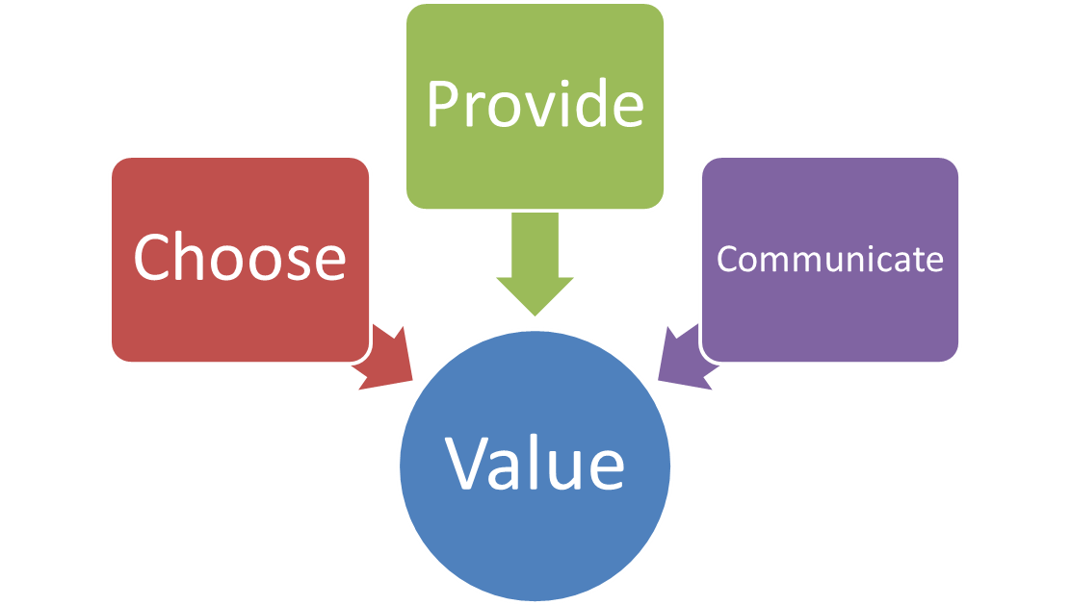
The Value Delivery Approach
Successful marketers must focus on delivering value to customers
Notes:
Successful marketers must focus on delivering value to customers. This is accomplished by:
Choosing the value – Here marketers do their homework to segment the market, select the appropriate target, and develop the offerings value proposition.
Providing the value – Entails selecting specific product features, prices, and distribution.
Communicate the value – The third phase, communicating the value, is accomplished through the use of the sales force, the Internet, advertising, and other communication methods to announce and promote the product.

Slide 4
The Value Chain (Porter Model)
Primary Activities
Inbound Logistics
Outbound Logistics
Operations
Marketing
Service
Margin
Procurement
Support Activities
Human Resource management
Technological Development
Infrastructure
Notes:
One way that managers can identify ways to create more value is through The Value Chain, developed by Harvard’s Michael Porter. According to this model, a company is a collection of activities that are performed to design, produce, market, deliver and support its products. The Value Chain identifies nine – five primary and 4 support – activities that create value and cost in a business.

Slide 5



Core Business Processes
Customer relationship management
Fulfillment management
Customer acquisition
New-offering realization
Market-sensing
Notes:
A firms success depends in part on how well each department performs its role. However, firms must also coordinate departmental activities to conduct these core business processes.
Market-sensing – Activities involved in gathering and acting upon information about the market.
New-offering realization – Research, development, and launch of new high-quality product offerings quickly and within budgets.
Customer acquisition – All the activities in defining target markets and prospecting for new customers.
Customer-relationship management – Activities involved in in building deeper understanding, relationships, and offerings to individual customers.
Fulfillment management process – The activities that related to receiving and approving orders, shipping the goods on time, and collecting payments.

Slide 6
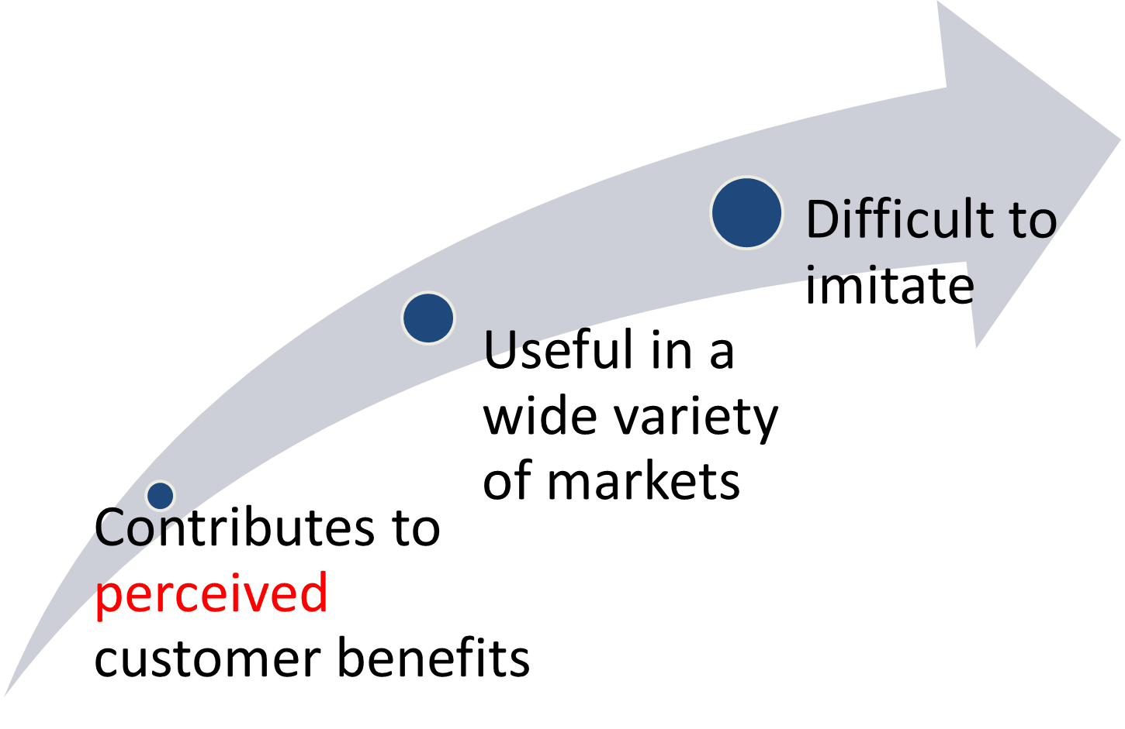
Core Competencies / Value
Notes:
Firms must focus on what they do well; things that are the essence of the business. A core competency must hold the above characteristics.
Competitive advantage helps in excelling in three distinctive capabilities: Market sensing, customer linking and channel bonding

Slide 7
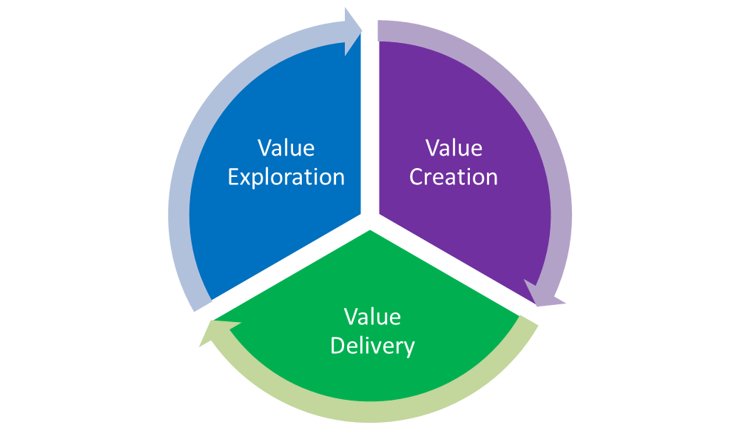
Holistic Marketing Orientation and Customer Value
Value Exploration – How the firm identifies new value opportunities.
Value Creation – How efficiently a company creates more promising new value offerings
Value Delivery – How a company uses its capabilities and infrastructure to deliver the new value offering more efficiently.
Notes:
Holistic marketers addresses three key management questions:
Value Exploration – How the firm identifies new value opportunities.
Value Creation – How efficiently a company creates more promising new value offerings
Value Delivery – How a company uses its capabilities and infrastructure to deliver the new value offering more efficiently.

Slide 8

Strategic Planning
Businesses as investment portfolio
Assessing each business’s strength
Establish a strategy
Notes:
Strategic planning must focus on three key areas: 1) managing a company’s businesses as an investment portfolio, 2) assessing each business’s strength by considering the market’s growth rate and the company’s position and fit in that market, and 3) establishing a strategy.

Slide 9
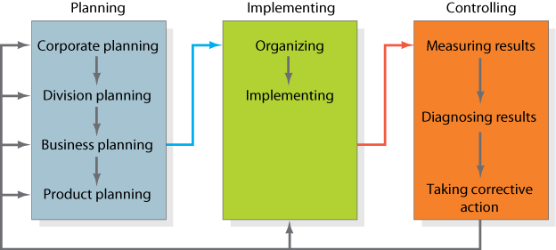
Strategic Planning, Implementation, and Control Processes
Notes:
Figure 2.1 presents the complete planning, implementation, and control cycle of strategic planning.

Slide 10

Marketing Plan
Directs and coordinates the marketing effort
Product Line or Brand Level
Strategic and Tactical levels
Notes:
A marketing plan is used to direct and coordinate the marketing effort and is created at the strategic and tactical level.

Slide 11
Levels of a Marketing Plan
Strategic
  Analysis of marketing opportunities
  Target marketing decisions
  Value proposition
Tactical
  Product features
  Promotion
  Merchandising
  Pricing
  Sales channels
  Service
Notes:
Strategic marketing plans begin with an analysis of market opportunities and based on what’s learned leads to an identification of target markets and the firm’s value propositions. Tactical marketing plans focus on specific tactics such as product features, promotion, merchandising, pricing, sales channels, and service.

Slide 12
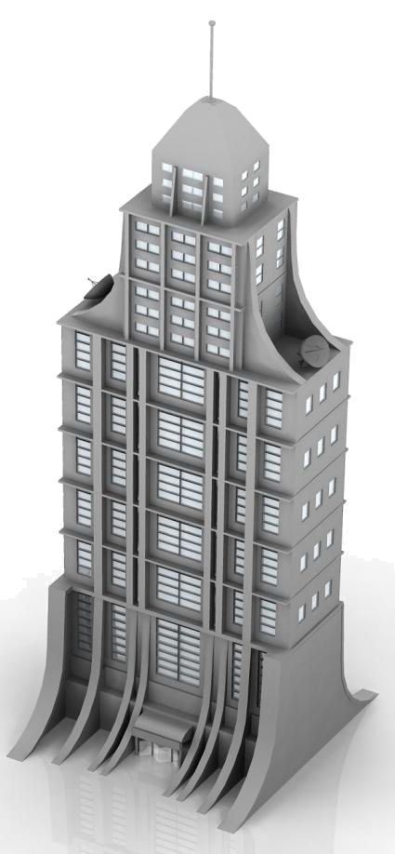
Corporate Strategic Planning
1
Define corporate mission
2
Establish SBU’s
3
Assign resources to SBU’s
4
Assess growth opportunities
Notes:
Corporate strategy focuses on these four elements.

Slide 13
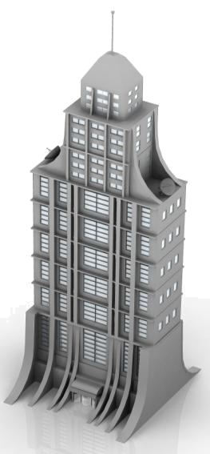
Defining the Corporate Mission
Who is the customer?
What is of value to the customer?
What is our business?
1. What is your mission?
2. Who is your customer?
3. What does your customer value?
4. What results do you seek?
5. What is your plan?
What should our business be?
What will our business be?
Notes:
In defining the corporate mission, organizations should start by answering Peter Drucker’s classic questions… from these answers the organization can develop a good mission statement.

Slide 14
Criteria for Evaluating a Mission Statement
Is our mission statement focused on satisfying customer needs rather than being focused on the product?
Does our mission statement tell who our customers are?
Does our mission statement explain what customer needs our company is trying to satisfy?
Does our mission statement explain how our company will serve its customers?
Does our mission statement fit the current market environment?
Is our mission statement based on our core competencies? (A core competency is a company strength.)
Is our mission statement motivating and does it inspire employee commitment?
Is our mission statement realistic?
Is our mission statement specific, short, sharply focused and memorable.
Is our mission statement clear and easily understood?
Does our mission statement say what we want to be remembered for?

Slide 15
Mission Statements
Characteristics of good mission statements:
Focus on a limited number of goals
Stress major policies and values
Define major competitive spheres
Take a long-term view
Short, memorable, meaningful
Notes:
Good mission statements have five major characteristics:

Slide 16
Vague Mission Statement
To build total brand value by innovating to deliver customer value and customer leadership faster, better, and more completely than our competition
Notes:
Vaguely written mission statement and philosophy

Slide 17
GOOGLE’S Mission Statement
To organize the world’s information and make it universally accessible and useful.

Slide 18
Vague Philosophy
We build brands and make the world a little happier by bringing our best to you.
Notes:
Vaguely written mission statement and philosophy

Slide 19
GOOGLE’s Philosophy
  Focus on the user and all else will follow.
  It’s best to do one thing really, really well.
  Fast is better than slow.
  Democracy on the web works.
  You don’t need to be at your desk to need an answer.
  You can make money without doing evil.
  There is always more information out there.
  The need for information crosses all borders.
  You can be serious without a suit.
  Great just isn’t good enough.

Slide 20



Defining Strategic Business Units
Customer groups
Customer needs
Technology
Notes:
Companies often define themselves in terms of the products it produces. This view often limits a company. A market definition on the other hand describe the business as a customer-satisfying process. For example, if Xerox defined itself from only a product perspective (We make copying equipment) it would limit its ability to market products and services other than copiers.
SBUs can be defined by: 1) Customer needs; Customer groups; and 3) Technology

Slide 21
Strategic Business Units
Company | Product Definition | Market Definition
Union Pacific | We run a railroad. | We are a people-and-goods mover.
Xerox | We make copying equipment. | We help improve office productivity.
Hess Corporation | We sell gasoline. | We supply energy.
Paramount Pictures | We make movies. | We market entertainment.
Encyclopaedia Britannica | We sell encyclopedias | We distribute information.
Carrier | We make air conditioners and furnaces. | We provide climate control in the home.
Notes:
Table 2.3 shows how companies define themselves based on whether they use a product or market definition. Market definitions allow for additional growth opportunities.

Slide 22
Strategic Business Units (SBU)

Slide 23


Strategic Business Units (SBU)
Three Characteristics of an SBU:
Unique competitors
A single business or collection of related businesses
Leader responsible for planning and profitability
Notes:
A strategic business unit has three characteristics: 1) It is a single business, or a collection of related businesses, that plan separately from the rest of the company; 2) It has its own set of competitors; and 3) It has a manager responsible for strategic planning and profit performance.

Slide 24
Category Attractiveness
  Dimensions ???
Market growth rate
Market share
Profitability

Slide 25
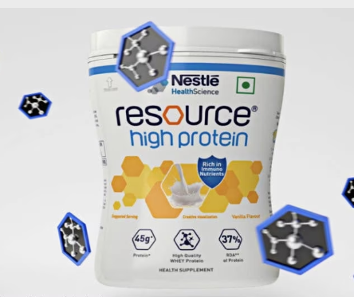
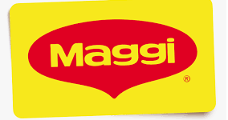


BCG Matrix
Nestle

Slide 26
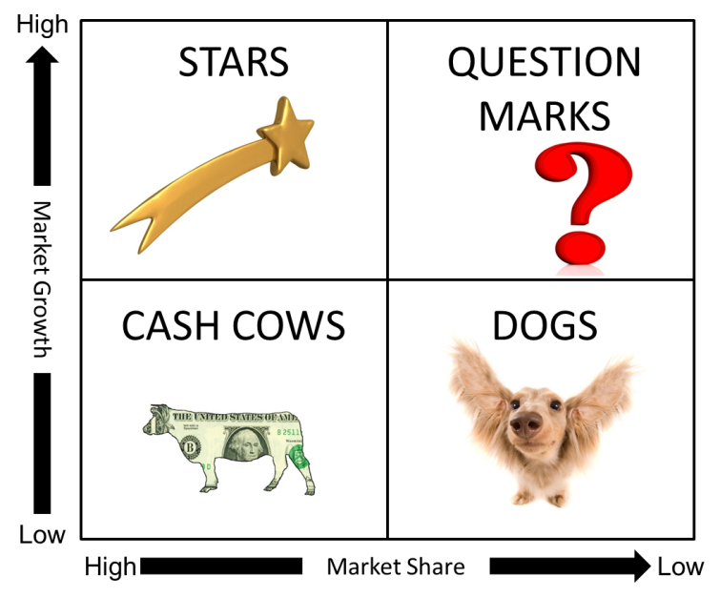

Boston Consulting Group Matrix

Slide 27
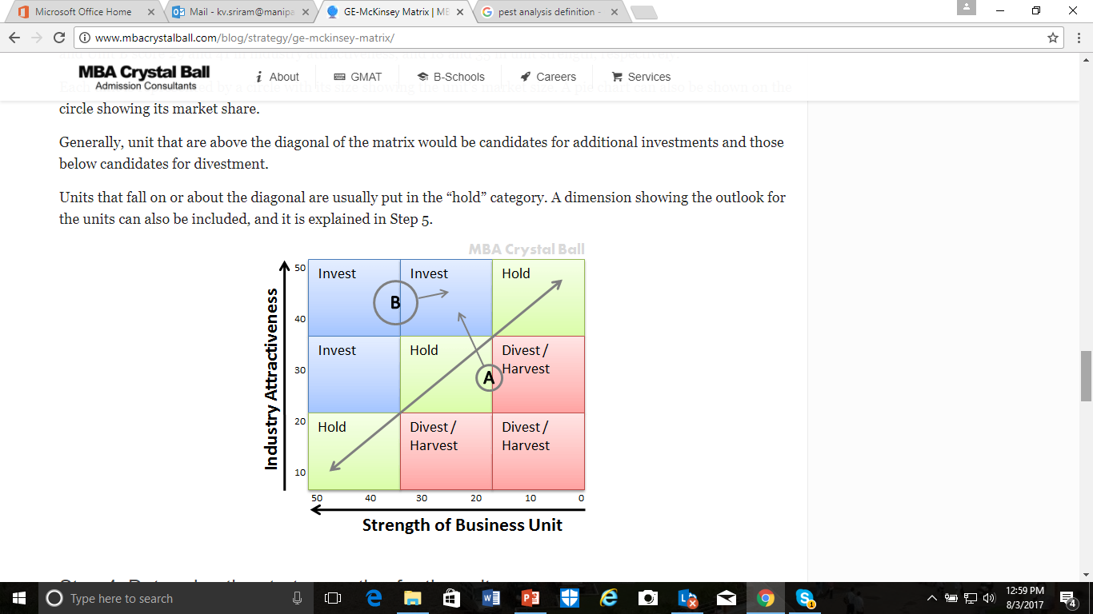
Assigning Resources
GE Mckinsey Model
Industry attractiveness: industry growth rate, market size, industry profitability, low competition, and PEST factors
Market share, growth rate, profitability, brand reputation, and customer service.
Notes:
Portfolio-planning models such as the GE/McKinsey Matrix and the BCG Matrix were used in the past to assist managers in making resource allocation decisions. But they have been replaced with newer models that consider shareholder value analysis. The newer models consider growth from global expansion, repositioning, retargeting, and strategic outsourcing.

Slide 28
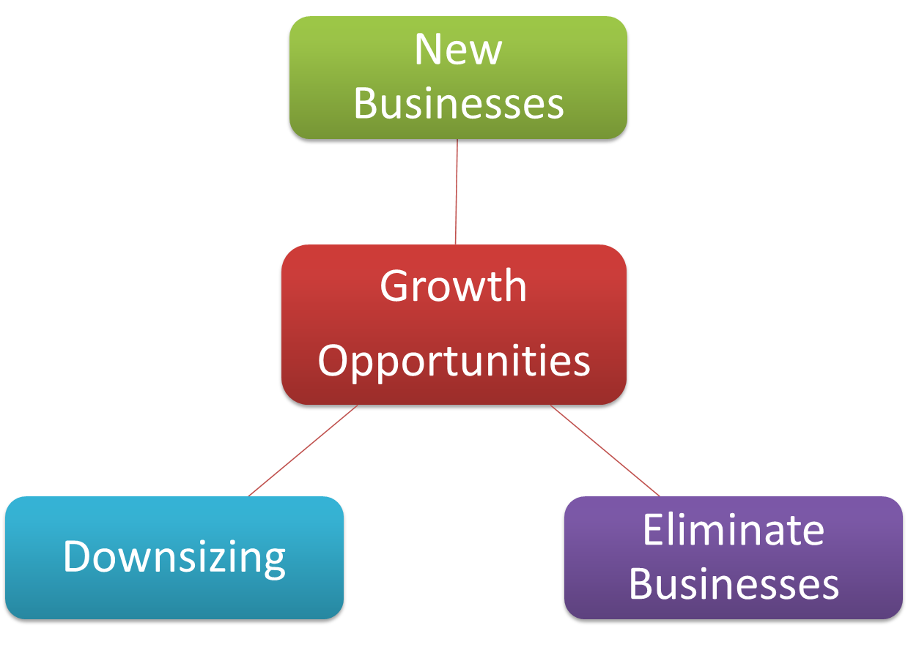
To achieve Growth
Notes:
To achieve growth, firms’ can look toward new business, downsize, or the elimination of older businesses.

Slide 29
Mech
    2,3,6,14,16, 17,21, 23, 24, 25, 26, 28, 31, 36, 40
    42, 43, 48,
  Ip : 4, 10, 16, 19

Slide 30
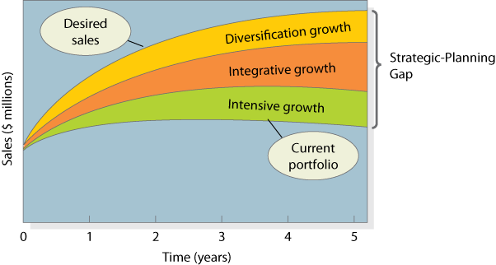
The Strategic-Planning Gap
Notes:
Figure 2.1 is based on a manufacturer (Musicale) of blank compact discs.
The lowest curve projects expected sales over the next five years from the company’s current business portfolio. The top curve is the desired sales over this period. As the company wishes to grow faster than its current businesses will allow, the company must seek new opportunities.
The firm can take three approaches toward achieving growth: Intensive; Integrative, or Diversification. Each of these will be discussed in detail in the following slides.

Slide 31
Intensive Growth- Within Current businesses
Product-Market Expansion Grid
New
Market Development
Diversification
Markets
Current
Market Penetration
Product Development
Current
New
Products
Notes:
Intensive growth looks for opportunities within current businesses. The product-market expansion grid looks at growth possibilities from the perspective of current and new products and markets.
Market Penetration – gaining market share with current products and current customers. The company can achieve growth by having current customers purchase more, attract competitors customers, or bring non-buyers into the market.
Market Development – Finding new markets for existing products. The firm can find new buyer groups (business customers rather than consumers), new distribution channels (online), or expand distribution to other regions or countries.
Product Development – Develop new products to the current market. As the firm already has a relationship with current customers, they can develop new products to meet other, related needs of it’s customers.
Diversification – Developing new products for new markets.

Slide 32
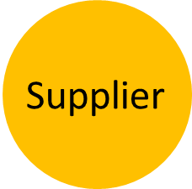
Integrative Growth
Business
Wholesaler
Competitor
Notes:
A business can achieve growth through backward (buy supplier), forward (buy wholesaler), or horizontal (competitor) integration.

Slide 33
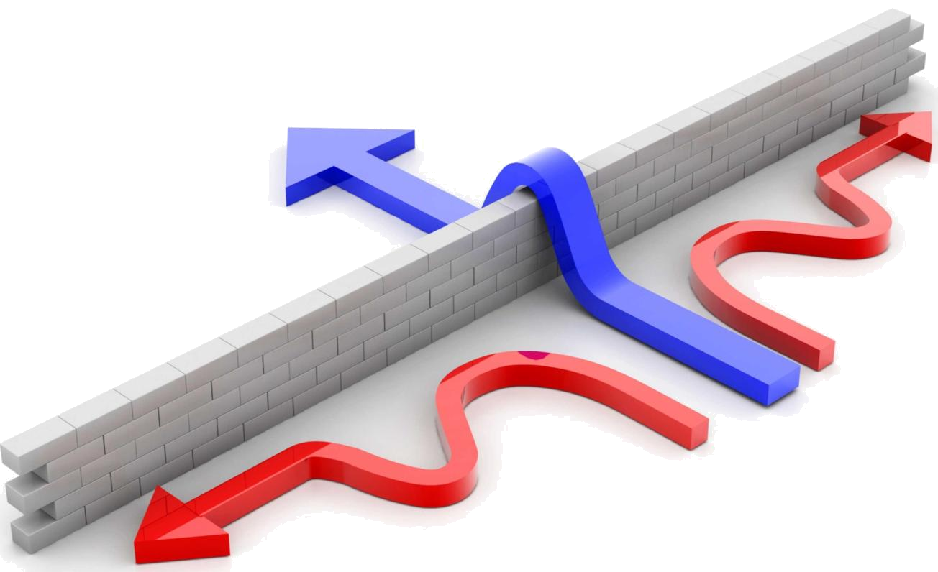
Diversification Growth
New Opportunity
Notes:
Firms can often discover opportunities outside its present business. However, the new industry should be highly attractive (grow potential) and the company should have (or acquire) the right capabilities to succeed.

Slide 34
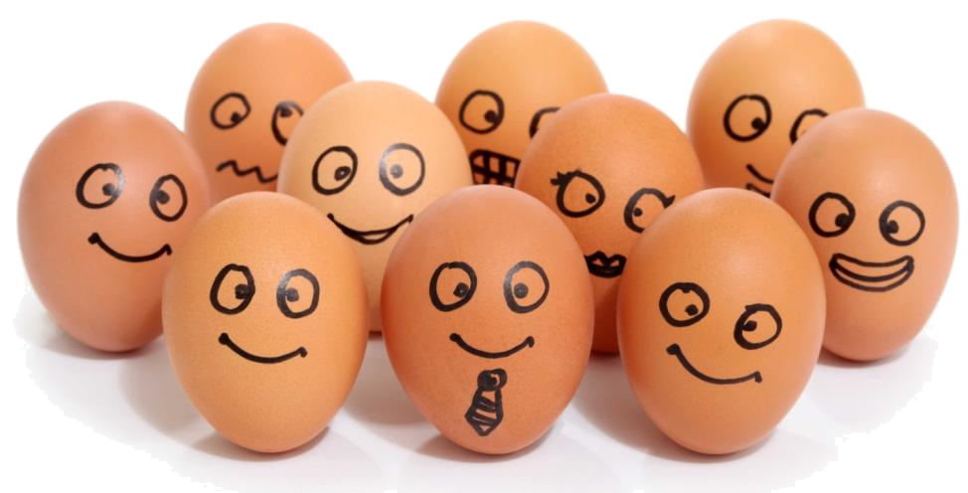
Corporate Culture
… is the shared experiences, stories, beliefs, and norms that characterize an organization.
Notes:
Corporate culture is defined as “the shared experiences, stories, beliefs, and norms that characterize an organization.”

Slide 35


Marketing Innovation
Identify and encourage new ideas
Scenario Analysis
Notes:
Companies looking for innovative marketing ideas should look to three underrepresented employee groups such as: employees with youthful or diverse perspectives, employees far away from corporate headquarters, and employees new to the industry.
Scenario analysis looks at future possibilities by asking “What if…” questions about customers, competitors, markets.

Slide 36
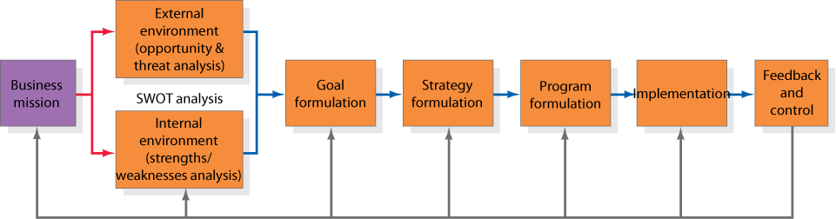
Business Unit Strategic Planning
Notes:
Figure 2.3 outlines strategic planning at the SBU level.
Each business unit must develop a specific mission that fits within the broader company mission. For example, the specific mission for YouTube must fit within the overall mission of Google.

Slide 37
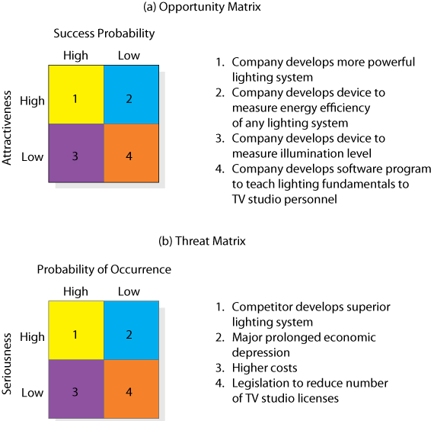
Opportunity and Threat Matrices
Notes:
Figure 2.4 outlines the opportunity and threat matrix.
In this example, the best marketing opportunity facing the TV-lighting equipment company appear in the upper-left cell (#1). The opportunities in the lower-right cell (#4) are too minor. Cells 2 and 3 are opportunities worth monitoring.
For threat assessment, Cell #1 must be monitored because there is a high probability and can seriously harm the company.

Slide 38
SWOT Analysis
S
W
Internal
Strength
Weakness
O
T
External
Opportunity
Threat
Notes:
Strategic planning requires managers to understand the external and internal environments. A SWOT analysis allows for these environments to be monitored.
Business units must monitor key macro-environment forces as well as micro-environment factors. Monitoring the external environment can allow firms to identify growth opportunities and potential threats to its existing businesses.
To take advantage of opportunities the firm must be aware of its own internal strengths and weaknesses.

Slide 39

Goal Formulation
Ranked
Consistent
Quantified
Realistic
Notes:
After completing a SWOT analysis the firm can proceed to goal formulation whereby it develops specific goals for the planning period. Goals are objectives that are specific with respect to magnitude and time. Managing these objectives effectively requires these four criteria to be met.

Slide 40
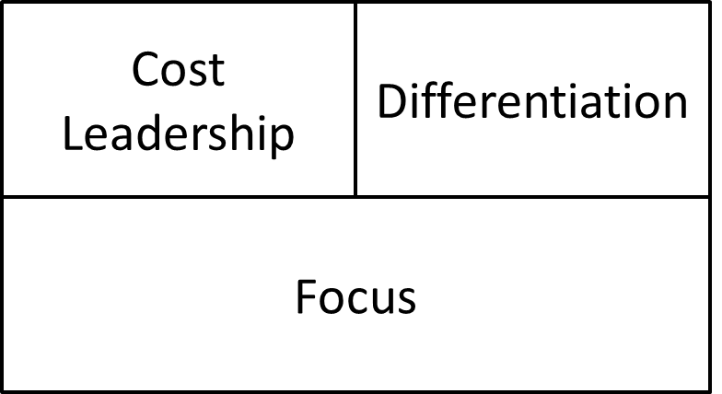

Strategy Formulation
Porter’s Generic Strategies
BCG Matrix
Stars
Question marks
Dogs
Cows
Strategic Alliances
Notes:
Porter outlines three generic strategies that businesses can follow. They can focus on Cost Leadership, where they are seeking to achieve the lowest production and distribution costs to underprice competitors and gain market share; the can select a Differentiation strategy, where they focus on achieving better performance on a important customer benefit (such as quality or speed); or third, businesses can take a Focus approach where they concentrate on a narrow market segment, gaining as much insight about the segment as possible, and then pursue either a cost leadership or differentiation strategy.
Oftentimes, companies cannot achieve objectives without the use of partners. Strategic Alliances can be used to compliment or leverage current capabilities and resources to the benefit of both parties. Alliances fall into four categories:
Product or service alliance.
Promotional alliances
Logistic alliances
Pricing collaborations.

Slide 41

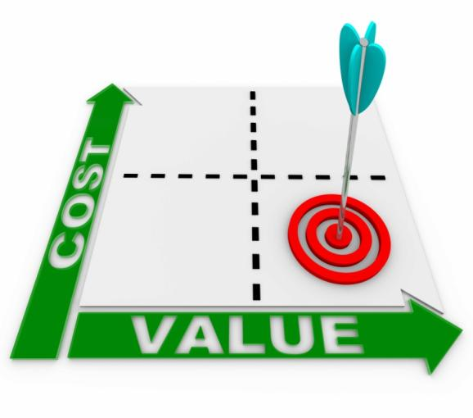
Program Formulation and Implementation
Notes:
Great strategies can lead to failure unless they are implemented properly. Proper formulation ensures that all the pieces fit together. But firms must also examine the cost of the marketing programs to ensure that the expense is justified.

Slide 42


Feedback and Control
Strong leadership
Notes:
Changes in the market are inevitable. Companies must be aware of pending changes and also have the will to change course.

Slide 43
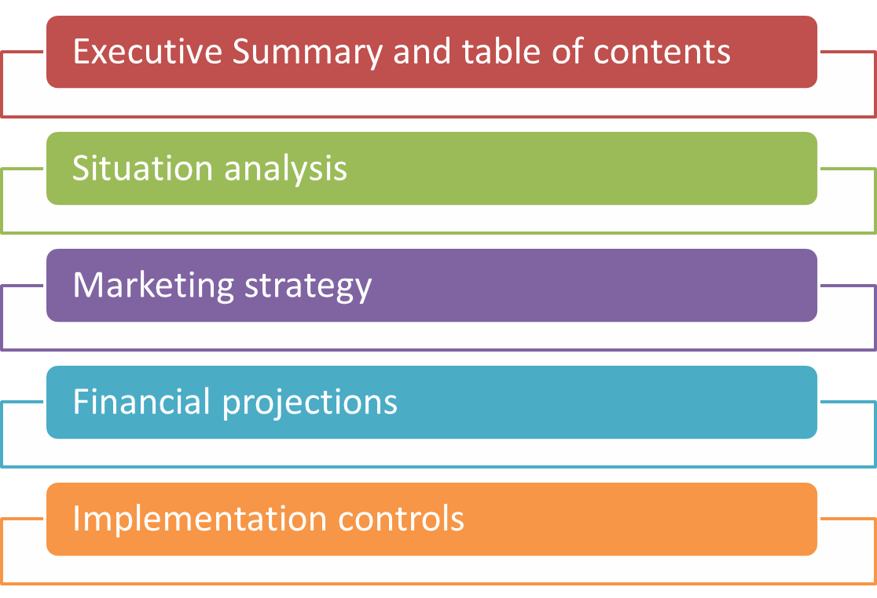
Product Planning
Marketing Plans
Notes:
At the product level, planning centers around the marketing plan, which can be based on each product, channel, or customer group. The five major sections of a marketing plan are presented here.

