Slide 1
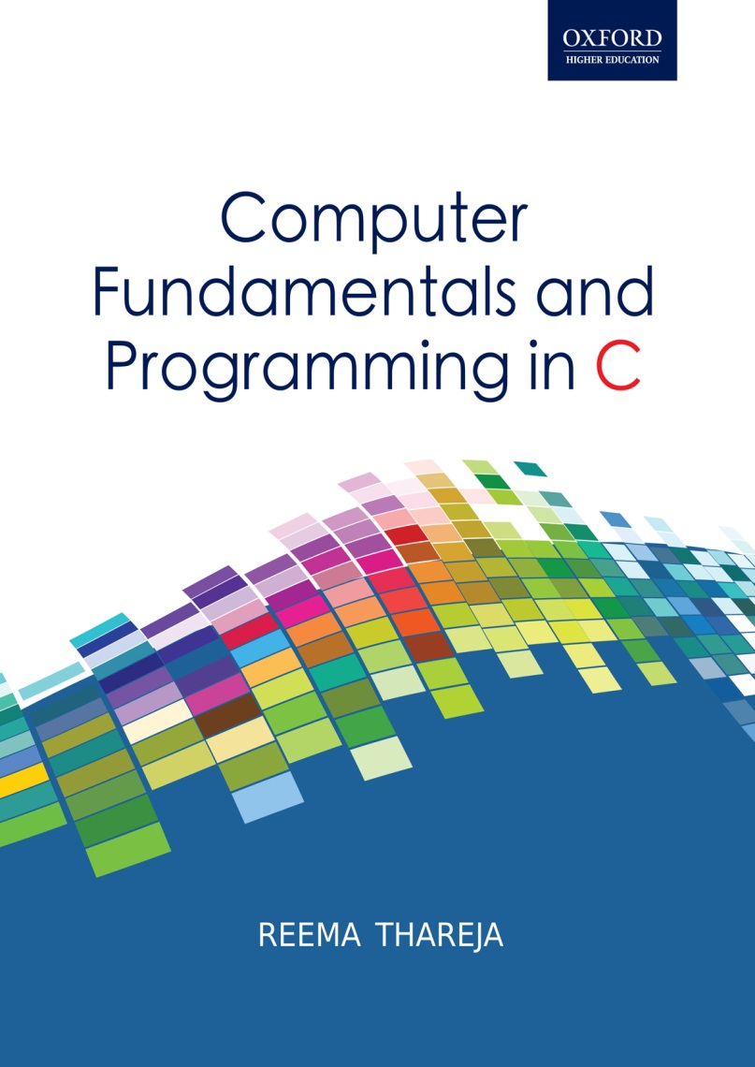
Computer Fundamentals and Programming in C
Reema Thareja, Assistant Professor, Institute of Information Technology and Management

Slide 2
CHAPTER 16
THE PREPROCESSOR DIRECTIVE

Slide 3
INTRODUCTION
The preprocessor is a program that processes the source code before it passes through the compiler. It operates under the control of preprocessor directive which is placed in the source program before the main().
Before the source code is passed through the compiler, it is examined by the preprocessor for any preprocessor directives. In case, the program has some preprocessor directives, appropriate actions are taken (and the source program is handed over to the compiler.
The preprocessor directives are always preceded by a hash sign (#).
The preprocessor is executed before the actual compilation of program code begins. Therefore, the preprocessor expands all the directives and take the corresponding actions before any code is generated by the program statements.
No semicolon (;) can be placed at the end of a preprocessor directive.
The advantages of using preprocessor directives in a C program include:
Program becomes readable and easy to understand
Program can be easily modified or updated
Program becomes portable as preprocessor directives makes it easy to compile the program in different execution environments
Due to the aforesaid reason the program also becomes more efficient to use.

Slide 4
TYPES OF PREPROCESSOR DIRECTIVES
Preprocessor Directive
Unconditional
Conditional
define
line
undef
include
error
pragma
if
else
elif
ifdef
ifndef
endif
#define
To define preprocessor macros we use #define. The #define statement is also known as macro definition or simply a macro. There are two types of macros- object like macro and function like macro.
Object like macro
An object-like macro is a simple identifier which will be replaced by a code fragment. They are usually used to give symbolic names to numeric constants. Object like macros do not take ant argument. It is the same what we have been using to declare constants using #define directive. The general syntax of defining a macro can be given as:
#define identifier string
The preprocessor replaces every occurrence of the identifier in the source code by a string.
#define PI 3.14

Slide 5
Function-like macros
They are used to stimulate functions.
When a function is stimulated using a macro, the macro definition replaces the function definition.
The name of the macro serves as the header and the macro body serves as the function body. The name of the macro will then be used to replace the function call.
The function-like macro includes a list of parameters.
References to such macros look like function calls. However, when a macro is referenced, source code is inserted into the program at compile time. The parameters are replaced by the corresponding arguments, and the text is inserted into the program stream. Therefore, macros are considered to be much more efficient than functions as they avoid the overhead involved in calling a function.
The syntax of defining a function like macro can be given as
# define identifier(arg1,arg2,...argn) string
The following line defines the macro MUL as having two parameters a and b and the replacement string (a * b):
#define MUL(a,b) (a*b)
Look how the preprocessor changes the following statement provided it appears after the macro definition.
int a=2, b=3,c;
c = MUL(a,b);

Slide 6
OPERATORS RELATED TO MACROS
# Operator to Convert to String Literals
The # preprocessor operator which can be used only in a function like macro definition is used to convert the argument that follows it to a string literal. For example:
#include<stdio.h>
#define PRINT(num) printf( #num " = %d", num)
main()
{
PRINT(20);
} The macro call expands to
printf( “num" “ = %d", num)
Finally, the preprocessor will automatically concatenate two string literals into one string. So the above statement will become
printf( “num = %d", num)
Merge Operator (##)
At times you need macros to generate new tokens. Using the merge operator you can concatenate two tokens into a third valid token. For example,
#include<stdio.h>
#define JOIN(A,B) A##B
main()
{
int i;
for(i=1;i<=5;i++)
printf("\n HI JOIN(USER, i) : ");
}
The above program would print
HI USER1
HI USER2
HI USER3
HI USER4
HI USER5

Slide 7
#include
An external file containing function, variables or macro definitions can be included as a part of our program. This avoids the effort to re-write the code that is already written.
The #include directive is used to inform the preprocessor to treat the contents of a specified file as if those contents had appeared in the source program at the point where the directive appears.
The #include directive can be used in two forms. Both forms makes the preprocessor insert the entire contents of the specified file into the source code of our program. However, the difference between the two is the way in which they search for the specified.
#include <filename>
This variant is used for system header files. When we include a file using angular brackets, a search is made for the file named filename in a standard list of system directories.
#include "filename"
This variant is used for header files of your own program. When we include a file using double quotes, the preprocessor searches the file named filename first in the directory containing the current file, then in the quote directories and then the same directories used for <filename>.
#undef
As the name suggests, the #undef directive undefines or removes a macro name previously created with #define. Undefining a macro means to cancel its definition. This is done by writing #undef followed by the macro name that has to be undefined.

Slide 8
#line
Compile the following C program.
#include<stdio.h>
main()
{ int a=10:
printf("%d", a);
}
The above program has a compile time error because instead of a semi-colon there is a colon that ends line int a = 10. So when you compile this program an error is generated during the compiling process and the compiler will show an error message with references to the name of the file where the error happened and a line number. This makes it easy to detect the erroneous code and rectify it.
The #line directive enables the users to control the line numbers within the code files as well as the file name that we want that appears when an error takes place. The syntax of #line directive is:
#line line_number filename
Here, line_number is the new line number that will be assigned to the next code line. The line numbers of successive lines will be increased one by one from this point on.
Filename is an optional parameter that redefines the file name that will appear in case an error occurs. The filename must be enclosed within double quotes. If no filename is specified then the compiler will show the original file name. For example:
#include<stdio.h>
main()
{ #line 10 "Error.C"
int a=10:
#line 20
printf("%d, a);
}

Slide 9
PRAGMA DIRECTIVES
The #pragma directive is used to control the actions of the compiler in a particular portion of a program without affecting the program as a whole.
The effect of pragma will be applied from the point where it is included to the end of the compilation unit or until another pragma changes its status.
A #pragma directive is an instruction to the compiler and is usually ignored during preprocessing. The syntax of using a pragma directive can be given as:
#pragma string
INSTRUCTION | DESCRIPTION
COPYRIGHT | To specify a copyright string
COPYRIGHT_DATE | To specify a copyright date for the copyright string
HP_SHLIB_VERSION | To create versions of a shared library routine
LOCALITY | To name a code subspace
OPTIMIZE | To turn the optimization feature on or off
OPT_LEVEL | To set the level of optimization
VERSIONID | To specify a version string

Slide 10
CONDITIONAL DIRECTIVES
A conditional directive is used instruct the preprocessor to select whether or not to include a chunk of code in the final token stream passed to the compiler. The preprocessor conditional directives can test arithmetic expressions, or whether a name is defined as a macro, etc.
Conditional preprocessor directives can be used in the following situations:
A program may need to use different code depending on the machine or operating system it is to run on.
The conditional preprocessor directive is very useful when you want to compile the same source file into two different programs. While one program might make frequent time-consuming consistency checks on its intermediate data, or print the values of those data for debugging, the other program, on the other hand can avoid such checks.
The conditional preprocessor directives can be used to exclude code from the program whose condition is always false but is needed to keep it as a sort of comment for future reference.
#ifdef
#ifdef is the simplest sort of conditional preprocessor directive and is used to check for the existence of macro definitions. Its syntax can be given as:
#ifdef MACRO
controlled text
#endif
#ifdef MAX
int STACK[MAX];
#endif

Slide 11
#ifndef
The #ifndef directive is the opposite of #ifdef directive. It checks whether the MACRO has not been defined or if its definition has been removed with #undef.
#ifndef is successful and returns a non-zero value if the MACRO has not been defined. Otherwise in case of failure, that is when the MACRO has already been defined, #ifndef returns false (0).
The general format to use #ifndef is the same as for #ifdef:
#ifndef MACRO
controlled text
#endif
The #if Directive
The #if directive is used to control the compilation of portions of a source file. If the specified condition (after the #if) has a nonzero value, the controlled text immediately following the #if directive is retained in the translation unit.
The #if directive in its simplest form consists of
#if condition
  controlled text
  #endif
While using #if directive, make sure that each #if directive must be matched by a closing #endif directive. Any number of #elif directives can appear between the #if and #endif directives, but at most one #else directive is allowed. However, the #else directive (if present) must be the last directive before #endif.

Slide 12
The #else Directive
The #else directive can be used within the controlled text of an #if directive to provide alternative text to be used if the condition is false. The general format of #else directive can be given as:
#if condition
Controlled text1
#else
Controlled text2
#endif
The #elif Directive
The #elif directive is used when there are more than two possible alternatives. The #elif directive like the #else directive is embedded within the #if directive and has the following syntax:
#if condition
  Controlled text1
  #elif new_condition
  Controlled text2
  #else
  Controlled text3
  #endif
  THE #endif DIRECTIVE
  The general syntax of #endif preprocessor directive which is used to end the conditional compilation directive can be given as:
  #endif
  The #endif directive ends the scope of the #if , #ifdef , #ifndef , #else , or #elif directives.

Slide 13
THE defined OPERATOR
We have seen that we can check the existence of a macro by using #ifdef directive. However, the alternative to #ifdef directive is to use the defined unary operator. The defined operator has one of the following forms:
defined MACROdefined (MACRO)
The above expression evaluates to 1 if MACRO is defined and to 0 if it is not. The defined operator helps you to check for macro definitions in one concise line without having to use many #ifdef or #ifndef directives. For example,
#if defined (MACRO1) && defined (MACRO2)
Controlled text1
#else
  printf(“\n MACROS not defined”);
  #endif
#error DIRECTIVE
The #error directive is used to produce compiler-time error messages. The syntax of this directive is:
#error string
The error messages include the argument string. The #error directive is usually used to detect programmer inconsistencies and violation of constraints during preprocessing.
When #error directive is encountered, the compilation process terminates and the message specified in string is printed to stderr. For example,
#ifndef SQUARE
#error MACRO not defined.
#endif
#ifndef VERSION
#error Version number is not specified.
#endif

