Slide 1
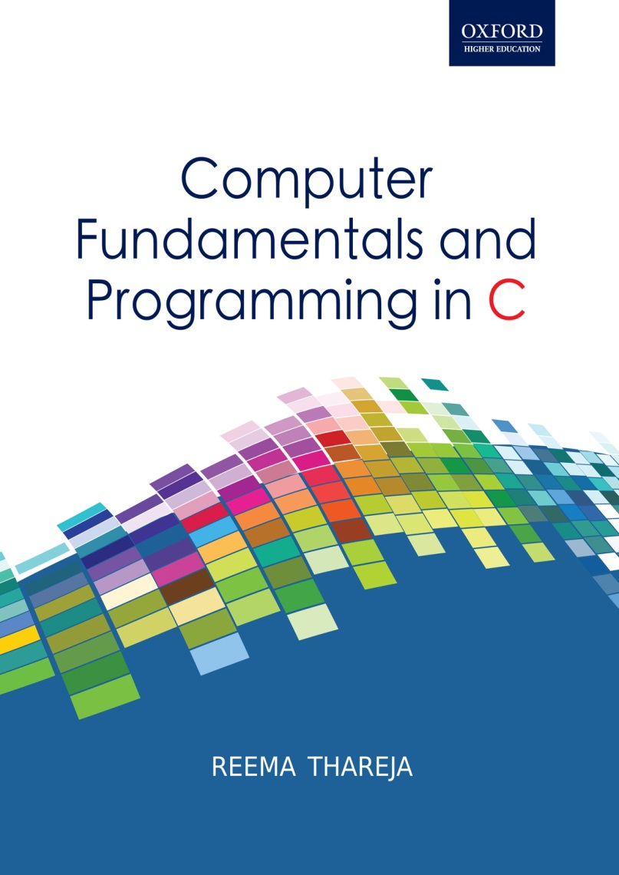
Computer Fundamentals and Programming in C
Reema Thareja, Assistant Professor, Institute of Information Technology and Management

Slide 2
CHAPTER 12
STRINGS

Slide 3
INTRODUCTION
A string is a null-terminated character array. This means that after the last character, a null character (‘\0’) is stored to signify the end of the character array.
The general form of declaring a string is
char str[size];
For example if we write,
char str[] = “HELLO”;
We are declaring a character array with 5 characters namely, H, E, L, L and O. Besides, a null character (‘\0’) is stored at the end of the string. So, the internal representation of the string becomes- HELLO’\0’. Note that to store a string of length 5, we need 5 + 1 locations (1 extra for the null character).
The name of the character array (or the string) is a pointer to the beginning of the string.
str[0] 1000
str[1] 1001
str[2] 1002
str[3] 1003
str[4] 1004
str[5] 1005
H
E
L
L
O
\0

Slide 4
READING STRINGS
If we declare a string by writing
char str[100];
Then str can be read from the user by using three ways
use scanf function
using gets() function
using getchar()function repeatedly
The string can be read using scanf() by writing
scanf(“%s”, str);
The string can be read by writing
gets(str);
gets() takes the starting address of the string which will hold the input. The string inputted using gets() is automatically terminated with a null character.
The string can also be read by calling the getchar() repeatedly to read a sequence of single characters (unless a terminating character is entered) and simultaneously storing it in a character array.
i=0;
getchar(ch);
while(ch != '*’)
{ str[i] = ch;
i++;
getchar(ch);
} str[i] = '\0';

Slide 5
WRITING STRINGS
The string can be displayed on screen using three ways
use printf() function
using puts() function
using putchar()function repeatedly
The string can be displayed using printf() by writing
printf(“%s”, str);
The string can be displayed by writing
puts(str);
The string can also be written by calling the putchar() repeatedly to print a sequence of single characters
i=0;
while(str[i] != '\0*)
{ putchar(str[i]);
i++;
}

Slide 6
SUPPRESSING INPUT
scanf() can be used to read a field without assigning it to any variable. This is done by preceding that field's format code with a *. For example, given:
scanf("%d*c%d", &hr, &min);
The time can be read as 9:05 as a pair. Here the colon would be read but not assigned to anything.
Using a Scanset
The ANSI standard added the new scanset feature to the C language. A scanset is used to define a set of characters which may be read and assigned to the corresponding string. A scanset is defined by placing the characters inside square brackets prefixed with a %
int main()
{
char str[10];
printf("\n Enter string: " );
scanf("%[aeiou]", str );
printf( "The string is : %s", str);
return 0;
}
The code will stop accepting character as soon as the user will enter a character that is not a vowel.
However, if the first character in the set is a ^ (caret symbol), then scanf() will accept any character that is not defined by the scanset. For example, if you write
scanf("%[^aeiou]", str );

Slide 7
LENGTH
The number of characters in the string constitutes the length of the string.
For example, LENGTH(“C PROGRAMMING IS FUN”) will return 20. Note that even blank spaces are counted as characters in the string.
LENGTH(‘0’) = 0 and LENGTH(‘’) = 0 because both the strings does not contain any character.
ALGORITHM TO CALCULATE THE LENGTH OF A STRING
Step 1: [INITIALIZE] SET I = 0
Step 2: Repeat Step 3 while STR[I] != '\0'
Step 3: SET I = I + 1
[END OF LOOP]
Step 4: SET LENGTH = I
Step 5: END
CONVERTING CHARACTERS OF A STRING INTO UPPER CASE
In memory the ASCII code of a character is stored instead of its real value. The ASCII code for A-Z varies from 65 to 91 and the ASCII code for a-z ranges from 97 to 123. So if we have to convert a lower case character into upper case, then we just need to subtract 32 from the ASCII value of the character.

Slide 8
CONCATENATING TWO STRINGS TO FORM A NEW STRING
ALGORITHM TO CONVERT THE CHARACTERS OF STRING INTO UPPER CASE
Step1: [Initialize] SET I=0
Step 2: Repeat Step 3 while STR[I] != ‘\0’
Step 3: IF STR[1] > ‘a’ AND STR[I] < ‘z’
SET Upperstr[I] = STR[I] - 32
ELSE
SET Upperstr[I] = STR[I]
[END OF IF]
[END OF LOOP]
Step 4: SET Upperstr[I] = ‘\0’
Step 5: EXIT
IF S1 and S2 are two strings, then concatenation operation produces a string which contains characters of S1 followed by the characters of S2.
ALGORITHM TO CONCATENATE TWO STRINGS
1. Initialize I =0 and J=0
2. Repeat step 3 to 4 while I <= LENGTH(str1)
SET new_str[J] = str1[I]
Set I =I+1 and J=J+1
  [END of step2]
  5. SET I=0
Repeat step 6 to 7 while I <= LENGTH(str2)
SET new_str[J] = str1[I]
Set I =I+1 and J=J+1
  [END of step5]
  9. SET new_str[J] = ‘\0’
  10. EXIT

Slide 9
APPENDING
Appending one string to another string involves copying the contents of the source string at the end of the destination string. For example, if S1 and S2 are two strings, then appending S1 to S2 means we have to add the contents of S1 to S2. so S1 is the source string and S2 is the destination string. The appending operation would leave the source string S1 unchanged and destination string S2 = S2+S1.
ALGORITHM TO APPEND A STRING TO ANOTHER STRING
  Step 1: [Initialize] SET I =0 and J=0
  Step 2: Repeat Step 3 while Dest_Str[I] != ‘\0’
  Step 3: SET I + I + 1
  [END OF LOOP]
  Step 4: Repeat Step 5 to 7 while Source_Str[J] != ‘\0’
  Step 5: Dest_Str[I] = Source_Str[J]
  Step 6: SET I = I + 1
  Step 7: SET J = J + 1
  [END OF LOOP]
  Step 8: SET Dest_Str[J] = ‘\0’
  Step 9: EXIT

Slide 10
COMPARING TWO STRINGS
If S1 and S2 are two strings then comparing two strings will give either of these results-
S1 and S2 are equal
S1>S2, when in dictionary order S1 will come after S2
S1<S2, when in dictionary order S1 precedes S2
Step1: [Initialize] SET I=0, SAME =0
Step 2: SET Len1 = Length(STR1), Len2 = Length(STR2)
Step 3: IF len1 != len2, then
Write “Strings Are Not Equal”
ELSE
Repeat while I<Len1
IF STR1[I] == STR2[I]
SET I = I + 1
ELSE
Go to Step
[END OF IF]
[END OF LOOP]
IF I = Len1, then
SET SAME =1
Write “Strings are equal”
[END OF IF]
Step 4: IF SAME = 0, then
IF STR1[I] > STR2[I], then
Write “String1 is greater than String2”
  ELSE IF STR1[I] < STR2[I], then
Write “String2 is greater than String1”
[END OF IF]
[END OF IF]
Step 5: EXIT

Slide 11
REVERSING A STRING
If S1= “HELLO”, then reverse of S1 = “OLLEH”. To reverse a string we just need to swap the first character with the last, second character with the second last character, so on and so forth.
ALGORITHM TO REVERSE A STRING
Step1: [Initialize] SET I=0, J= Length(STR)
Step 2: Repeat Step 3 and 4 while I< Length(STR)
Step 3: SWAP( STR(I), STR(J))
Step 4: SET I = I + 1, J = J – 1
[END OF LOOP]
Step 5: EXIT
EXTRACTING A SUBSTRING FROM LEFT
In order to extract a substring from the main string we need to copy the content of the string starting from the first position to the nth position where n is the number of characters to be extracted.
For example, if S1 = “Hello World”, then Substr_Left(S1, 7) = Hello W
ALGORITHM TO EXTRACT N CHARCTERS FROM RIGHT OF A STRING
Step 1: [Initialize] SET I=0, J = Length(STR) – N + 1
Step 2: Repeat Step 3 while STR[J] != ‘\0’
Step 3: SET Substr[I] = STR[J]
Step 4: SET I = I + 1, J = J + 1
[END OF LOOP]
Step 5: SET Substr[I] =’\0’
Step 6: EXIT

Slide 12
EXTRACTING A SUBSTRING FROM RIGHT OF THE STRING
In order to extract a substring from the right side of the main string we need to first calculate the position. For example, if S1 = “Hello World” and we have to copy 7 characters starting from the right, then we have to actually start extracting characters from the 5th position. This is calculated by, total number of characters – n + 1.
For example, if S1 = “Hello World”, then Substr_Right(S1, 7) = o World
ALGORITHM TO EXTRACT N CHARCTERS FROM RIGHT OF A STRING
Step 1: [Initialize] SET I=0, J = Length(STR) – N + 1
Step 2: Repeat Step 3 while STR[J] != ‘\0’
Step 3: SET Substr[I] = STR[J]
Step 4: SET I = I + 1, J = J + 1
[END OF LOOP]
Step 5: SET Substr[I] =’\0’
Step 6: EXIT

Slide 13
EXTRACTING A SUBSTRING FROM THE MIDDLE OF A STRING
To extract a substring from a given string requires information about three things
the main string
the position of the first character of the substring in the given string
maximum number of characters/length of the substring
For example, if we have a string-
str[] = “Welcome to the world of programming”; then,
SUBSTRING(str, 15, 5) = world
Algorithm to extract substring from a given text
  Step 1: [INITIALIZE] Set I=M, J = 0
  Step 2: Repeat steps 3 to 6 while str[I] != ‘0’ and N>=0
  Step 3: SET substr[J] = str[I]
  Step 4: SET I = I + 1
  Step 5: SET J = J + 1
  Step 6: SET N = N – 1
  [END of loop]
  Step 7: SET substr[J] = ‘\0’
  Step 8: EXIT

Slide 14
INSERTION
The insertion operation inserts a string S in the main text, T at the kth position. The general syntax of this operation is: INSERT(text, position, string). For ex, INSERT(“XYZXYZ”, 3, “AAA”) = “XYZAAAXYZ”
Algorithm to insert a string in the main text
  Step 1: [INITIALIZE] SET I=0, J=0 and K=0
  Step 2: Repeat steps 3 to 4 while text[I] != ‘0’
  Step 3: IF I = pos, then
    Repeat while str[K] != ‘\0’
    new_str[j] = str[k]
    SET J=J+1
    SET K = K+1
    [END OF INNER LOOP]
ELSE
    new_str[[J] = text[I]
    SET J = J+1
  Step 4: SET I = I+1
  [END OF OUTER LOOP]
  Step 5: SET new_str[J] = ‘\0’
  Step 6: EXIT

Slide 15
INDEXING
Index operation returns the position in the string where the string pattern first occurs. For example,
INDEX(“Welcome to the world of programming”, “world”) = 15
However, if the pattern does not exist in the string, the INDEX function returns 0.
Algorithm to find the index of the first occurrence of a string within a given text
  Step 1: [Initialize] SET I=0 and MAX = LENGTH(text) – LENGTH(str) +1
  Step 2: Repeat Steps 3 to 6 while I <= MAX
Step 3: Repeat step 4 for K = 0 To Length(str)
  Step 4: IF str[K] != text[I + K], then GOTO step 6
  [END of inner loop]
  Step 5: SET INDEX = I. Goto step 8
  Step 6: SET I = I+1
  [END OF OUTER LOOP]
  Step 7: SET INDEX = -1
  Step 8: EXIT

Slide 16
DELETION
The deletion operation deletes a substring from a given text. We write it as, DELETE(text, position, length)
For example, DELETE(“ABCDXXXABCD”, 5, 3) = “ABCDABCD”
Algorithm to delete a substring from a text
  Step 1: [INITIALIZE] SET I=0 and J=0
  Step 2: Repeat steps 3 to 6 while text[I] !=’\0’
  Step 3: IF I=M, then
    Repeat Step 4 while N>=0
  SET I = I+1
    SET N = N – 1
    [END of inner loop]
    [END OF IF]
  Step 4: SET new_str[J] = text[I]
  Step 5: SET J= J + 1
  Step 6: SET I = I + 1
  [ END of outer loop]
  Step 7: SET new_str[J] = ‘\0’
  Step 8: EXIT

Slide 17
REPLACEMENT
Replacement operation is used to replace the pattern P1 by another pattern P2. This is done by writing, REPLACE(text, pattern1, pattern2)
For example, (“AAABBBCCC”, “BBB”, “X”) = AAAXCCC
(“AAABBBCCC”, “X”, “YYY”)= AAABBBCC
Note in the second example there is no change as ‘X’ does not appear in the text.
Algorithm to replace a pattern P₁ with another pattern P₂ in the given text TEXT
  Step 1: [INITIALIZE] SET Pos = INDEX(TEXT, P₁)
  Step 2: SET TEXT = DELETE(TEXT, Pos, LENGTH(P₁))
  Step 3: INSERT(TEXT, Pos, P₂)
  Step 4: EXIT

Slide 18
ARRAY OF STRINGS
Now suppose that there are 20 students in a class and we need a string that stores names of all the 20 students. How can this be done? Here, we need a string of strings or an array of strings. Such an array of strings would store 20 individual strings. An array of string is declared as,
char names[20][30];
Here, the first index will specify how many strings are needed and the second index specifies the length of every individual string. So here, we allocate space for 20 names where each name can be maximum 30 characters long.
Let us see the memory representation of an array of strings. If we have an array declared as,
char name[5][10] = {“Ram”, “Mohan”, “Shyam”, “Hari”, “Gopal”};
Name[0]
Name[1]
Name[2]
Name[3]
Name[4]
R | A | M | ‘\0’
M | O | H | A | N | ‘\0’
S | H | Y | A | M | ‘\0’
H | A | R | I | ‘\0’
G | O | P | A | L | ‘\0’

Slide 19
WRITE A PROGRAM TO READ AND PRINT THE NAMES OF N STUDENTS OF A CLASS
#include<stdio.h>
#include<conio.h>
main()
{
char names[5][10];
int i, n;
clrscr();
printf(“\n Enter the number of students : “);
scanf(“%d”, &n);
for(i=0;i<n;i++)
{
printf(“\n Enter the name of %dth student : “, i+1);
gets(names[i]);
}
printf(“\n Names of the students are : \n”);
for(i=0;i<n;i++)
puts(names[i]);
getch();
return 0;
}

