Slide 1
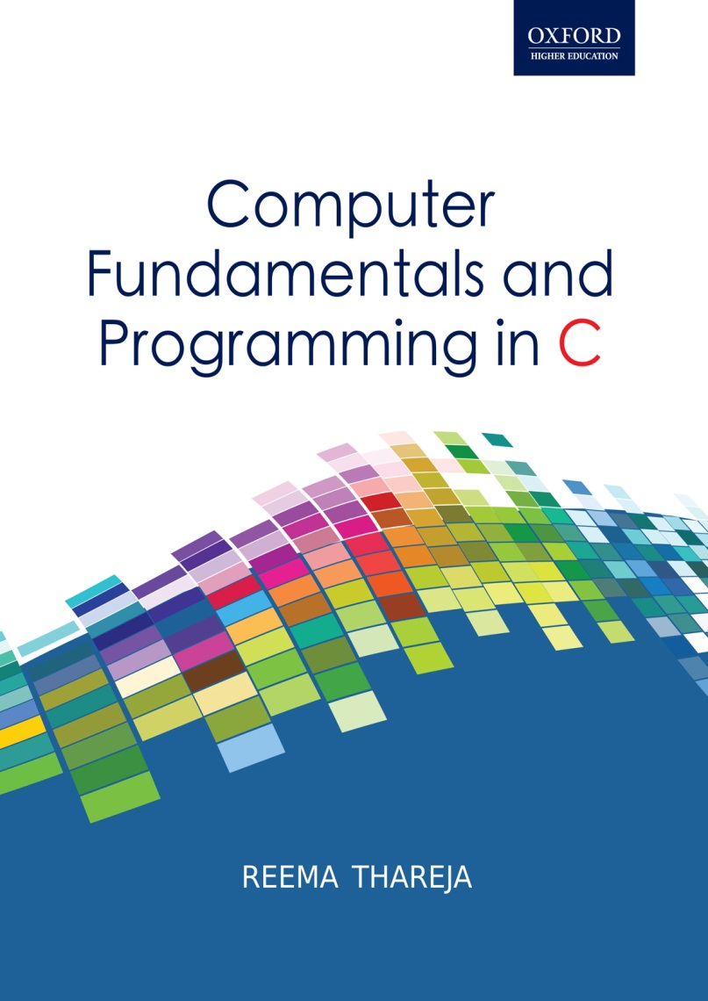
Computer Fundamentals and Programming in C
Reema Thareja, Assistant Professor, Institute of Information Technology and Management

Slide 2
CHAPTER 14
STRUCTURES

Slide 3
INTRODUCTION
It stores related information about an entity.
Structure is basically a user defined data type that can store related information (even of different data types) together.
A structure is declared using the keyword struct followed by a structure name. All the variables of the structures are declared within the structure. A structure type is defined by using the given syntax.
struct struct-name
{ data_type var-name;
data_type var-name;
...
};
struct student
{ int r_no;
char name[20];
char course[20];
float fees;
};
The structure definition does not allocates any memory. It just gives a template that conveys to the C compiler how the structure is laid out in memory and gives details of the member names. Memory is allocated for the structure when we declare a variable of the structure. For ex, we can define a variable of student by writing
struct student stud1;

Slide 4
TYPEDEF DECLARATIONS
When we precede a struct name with typedef keyword, then the struct becomes a new type. It is used to make the construct shorter with more meaningful names for types already defined by C or for types that you have declared. With a typedef declaration, becomes a synonym for the type.
For example, writing
typedef struct student
{
int r_no;
char name[20];
char course[20];
float fees;
};
Now that you have preceded the structure’s name with the keyword typedef, the student becomes a new data type. Therefore, now you can straight away declare variables of this new data type as you declare variables of type int, float, char, double, etc. to declare a variable of structure student you will just write,
student stud1;

Slide 5
INITIALIZATION OF STRUCTURES
Initializing a structure means assigning some constants to the members of the structure.
When the user does not explicitly initializes the structure then C automatically does that. For int and float members, the values are initialized to zero and char and string members are initialized to the ‘\0’ by default.
The initializers are enclosed in braces and are separated by commas. Note that initializers match their corresponding types in the structure definition.
The general syntax to initialize a structure variable is given as follows.
struct struct_name
{ data_type member_name1;
data_type member_name2;
data_type member_name3;
.......................................
}struct_var = {constant1, constant2, constant 3,...};
OR
struct struct_name
{ data_type member_name1;
data_type member_name2;
data_type member_name3;
.......................................
};
struct struct_name struct_var = {constant1, constant2, ….};
struct student stud1 = {01, “Rahul”, “BCA”, 45000};

Slide 6
ACCESSING THE MEMBERS OF A STRUCTURE
Each member of a structure can be used just like a normal variable, but its name will be a bit longer. A structure member variable is generally accessed using a ‘.’ (dot operator).
The syntax of accessing a structure a member of a structure is:
struct_var.member_name
For ex, to assign value to the individual data members of the structure variable Rahul, we may write,
stud1.r_no = 01;
strcpy(stud1.name, “Rahul”);
stud1.course = “BCA”;
stud1.fees = 45000;
We can assign a structure to another structure of the same type. For ex, if we have two structure variables stu1 and stud2 of type struct student given as
struct student stud1 = {01, "Rahul", "BCA", 45000};
struct student stud2;
Then to assign one structure variable to another we will write,
stud2 = stud1;

Slide 7
Write a program using structures to read and display the information about a student
#include<stdio.h>
int main()
{ struct student
{ int roll_no;
char name[80];
float fees;
char DOB[80];
};
struct student stud1;
printf(“\n Enter the roll number : “);
scanf(“%d”, &stud1.roll_no);
printf(“\n Enter the name : “);
scanf(“%s”, stud1.name);
printf(“\n Enter the fees : “);
scanf(“%f”, &stud1.fees);
printf(“\n Enter the DOB : “);
scanf(“%s”, stud1.DOB);
printf(“\n ********STUDENT’S DETAILS *******”);
printf(“\n ROLL No. = %d”, stud1.roll_no);
printf(“\n NAME. = %s”, stud1.name);
printf(“\n ROLL No. = %f”, stud1.fees);
printf(“\n ROLL No. = %s”, stud1.DOB);
}

Slide 8
NESTED STRUCTURES
A structure can be placed within another structure. That is, a structure may contain another structure as its member. Such a structure that contains another structure as its member is called a nested structure.
typedef struct
{ char first_name[20];
char mid_name[20];
  char last_name[20];
  }NAME;
  typedef struct
  { int dd;
  int mm;
  int yy;
  }DATE;
  struct student stud1;
stud1.name.first_name = “Janak”;
  stud1.name.mid_name = “Raj”;
stud1.name.last_name = “Thareja”;
stud1.course = “BCA”;
stud1.DOB.dd = 15;
stud1.DOB.mm = 09;
stud1.DOB.yy = 1990;
stud1.fees = 45000;

Slide 9
Write a program to read and display information of a student using structure within a structure
#include<stdio.h>
int main()
{ struct DOB
{
int day;
int month;
int year;
};
struct student
{ int roll_no;
char name[100];
float fees;
struct DOB date;
};
struct student stud1;
printf(“\n Enter the roll number : “);
scanf(“%d”, &stud1.roll_no);
printf(“\n Enter the name : “);
scanf(“%s”, stud1.name);
printf(“\n Enter the fees : “);
scanf(“%f”, &stud1.fees);
printf(“\n Enter the DOB : “);
scanf(“%d %d %d”, &stud1.date.day, &stud1.date.month, &stud1.date.year);
printf(“\n ********STUDENT’S DETAILS *******”);
printf(“\n ROLL No. = %d”, stud1.roll_no);
printf(“\n NAME. = %s”, stud1.name);
printf(“\n FEES. = %f”, stud1.fees);
printf(“\n DOB = %d - %d - %d”, stud1.date.day, stud1.date.month, stud1.date.year);
}

Slide 10
ARRAYS OF STRUCTURES
The general syntax for declaring an array of structure can be given as,
struct struct_name struct_var[index];
struct student stud[30];
Now, to assign values to the i^{th} student of the class, we will write,
stud[i].r_no = 09;
stud[i].name = “RASHI”;
stud[i].course = “MCA”;
stud[i].fees = 60000;

Slide 11
Write a program to read and display information of all the students in the class.
#include<stdio.h>
int main()
{ struct student
{
int roll_no;
char name[80];
float fees;
char DOB[80];
};
struct student stud[50];
int n, i;
printf(“\n Enter the number of students : “);
scanf(“%d”, &n);
for(i=0;i<n;i++)
{ printf(“\n Enter the roll number : “);
scanf(“%d”, &stud[i].roll_no);
printf(“\n Enter the name : “);
scanf(“%s”, stud[i].name);
printf(“\n Enter the fees : “);
scanf(“%f”, stud[i].fees);
printf(“\n Enter the DOB : “);
scanf(“%s”, stud[i].DOB);
}
for(i=0;i<n;i++)
{ printf(“\n ********DETAILS OF %dth STUDENT*******”, i+1);
printf(“\n ROLL No. = %d”, stud[i].roll_no);
printf(“\n NAME. = %s”, stud[i].name);
printf(“\n ROLL No. = %f”, stud[i].fees);
printf(“\n ROLL No. = %s”, stud[i].DOB);
}
}

Slide 12
Passing Individual Structure Members to a Function
To pass any individual member of the structure to a function we must use the direct selection operator to refer to the individual members for the actual parameters. The called program does not know if the two variables are ordinary variables or structure members.
#include<stdio.h>
typedef struct
{
int x;
int y;
}POINT;
void display(int, int);
main()
{
POINT p1 = {2, 3};
display(p1.x, p1.y);
return 0;
}
void display( int a, int b)
{
printf("%d %d", a, b);
}

Slide 13
PASSING A STRUCTURE TO A FUNCTION
When a structure is passed as an argument, it is passed using call by value method. That is a copy of each member of the structure is made. No doubt, this is a very inefficient method especially when the structure is very big or the function is called frequently. Therefore, in such a situation passing and working with pointers may be more efficient.
The general syntax for passing a structure to a function and returning a structure can be given as, struct struct_name func_name(struct struct_name struct_var);
The code given below passes a structure to the function using call-by-value method.
#include<stdio.h>
typedef struct
{
int x;
int y;
}POINT;
void display(POINT);
main()
{
POINT p1 = {2, 3};
display(p1);
return 0;
}
void display( POINT p)
{
printf("%d %d", p.x, p.y);
}

Slide 14
PASSING STRUCTURES THROUGH POINTERS
C allows to crerate a pointer to a structure. Like in other cases, a pointer to a structure is never itself a structure, but merely a variable that holds the address of a structure. The syntax to declare a pointer to a structure can be given as
struct struct_name
{
data_type member_name1;
data_type member_name2;
.....................................
}*ptr;
OR
struct struct_name *ptr;
For our student structure we can declare a pointer variable by writing
struct student *ptr_stud, stud;
The next step is to assign the address of stud to the pointer using the address operator (&). So to assign the address, we will write
ptr_stud = &stud;
To access the members of the structure, one way is to write
/* get the structure, then select a member */
(*ptr_stud).roll_no;
An alternative to the above statement can be used by using ‘pointing-to’ operator (->) as shown below.
/* the roll_no in the structure ptr_stud points to */
ptr_stud->roll_no = 01;

Slide 15
Write a program using pointer to structure to initialize the members in the structure.
#include<stdio.h>
struct student
{
int r_no;
char name[20];
char course[20];
float fees;
};
main()
{ struct student stud1, *ptr_stud1;
ptr_stud1 = &stud1;
ptr_stud1->r_no = 01;
strcpy(ptr_stud1->name, "Rahul");
strcpy(ptr_stud1->course, "BCA");
ptr_stud1->fees = 45000;
printf("\n DETAILS OF STUDENT");
printf("\n ---------------------------------------------");
printf("\n ROLL NUMBER = %d", ptr_stud1->r_no);
printf("\n NAME = ", puts(ptr_stud1->name));
printf("\n COURSE = ", puts(ptr_stud1->course));
printf("\n FEES = %f", ptr_stud1->fees);
}

Slide 16
SELF REFERENTIAL STRUCTURES
Self referential structures are those structures that contain a reference to data of its same type. That is, a self referential structure in addition to other data contains a pointer to a data that is of the same type as that of the structure. For example, consider the structure node given below.
struct node
{
int val;
struct node *next;
};
Here the structure node will contain two types of data- an integer val and next that is a pointer to a node. You must be wondering why do we need such a structure? Actually, self-referential structure is the foundation of other data structures.

Slide 17
UNION
Like structure, a union is a collection of variables of different data types. The only difference between a structure and a union is that in case of unions, you can only store information in one field at any one time.
To better understand union, think of it as a chunk of memory that is used to store variables of different types. When a new value is assigned to a field, the existing data is replaced with the new data.
Thus unions are used to save memory. They are useful for applications that involve multiple members, where values need not be assigned to all the members at any one time.
DECLARING A UNION
The syntax for declaring a union is same as that of declaring a structure.
union union-name
{ data_type var-name;
data_type var-name;
  ...
  };
  Again, the typedef keyword can be used to simplify the declaration of union variables.
The most important thing to remember about a union is that the size of an union is the size of its largest field. This is because a sufficient number of bytes must be reserved to store the largest sized field.

Slide 18
ACCESSING A MEMBER OF A UNION
A member of a union can be accessed using the same syntax as that of a structure. To access the fields of a union, use the dot operator(.). That is the union variable name followed by the dot operator followed by the member name.
INITIALIZING UNIONS
It is an error to initialize any other union member except the first member
A striking difference between a structure and a union is that in case of a union, the field fields share the same memory space, so fresh data replaces any existing data. Look at the code given below and observe the difference between a structure and union when their fields are to be initialized.
#include<stdio.h>
typedef struct POINT1
{ int x, y;
};
typedef union POINT2
{
int x;
int y;
};
main()
{ POINT1 P1 = {2,3};
// POINT2 P2 ={4,5}; Illegeal with union
POINT2 P2;
P2. x = 4;
P2.y = 5;
printf("\n The co-ordinates of P1 are %d and %d", P1.x, P1.y);
printf("\n The co-ordinates of P2 are %d and %d", P2.x, P2.y);
return 0;
}
OUTPUT
The co-ordinates of P1 are 2 and 3
The co-ordinates of P2 are 5 and 5

Slide 19
ARRAYS OF UNION VARIABLES
Like structures we can also have array of union variables. However, because of the problem of new data overwriting existing data in the other fields, the program may not display the accurate results.
#include <stdio.h>
union POINT
{ int x, y;
};
main()
{ int i;
    union POINT points[3];
    points[0].x = 2; points[0].y = 3;
    points[1].x = 4; points[1].y = 5;
    points[2].x = 6; points[2].y = 7;
    for(i=0;i<3;i++)
    printf("\n Co-ordinates of Points[%d] are %d and %d", i, points[i].x, points[i].y);
    return 0;
    }
    OUTPUT
Co-ordinates of Points[0] are 3 and 3
Co-ordinates of Points[1] are 5 and 5
Co-ordinates of Points[2] are 7 and 7

Slide 20
UNIONS INSIDE STRUCTURES
union can be very useful when declared inside a structure. Consider an example in which you want a field of a structure to contain a string or an integer, depending on what the user specifies. The following code illustrates such a scenario.
struct student
{ union
{ char name[20];
int roll_no;
};
int marks;
};
main()
{ struct student stud;
char choice;
printf("\n You can enter the name or roll number of the student");
printf("\n Do you want to enter the name? (Yes or No) : ");
gets(choice);
if(choice=='y' || choice=='Y')
{ printf("\n Enter the name : ");
    gets(stud.name);
}
else
{ printf("\n Enter the roll number : ");
    scanf("%d", &stud.roll_no);
}
printf("\n Enter the marks : ");
scanf("%d", &stud.marks);
if(choice=='y' || choice=='Y')
  printf("\n Name : %s ", stud.name);
else
    printf("\n Roll Number : %d ", stud.roll_no);
printf("\n Marks : %d", stud.marks);
}

Slide 21
ENUMERATED DATA TYPES
The enumerated data type is a user defined type based on the standard integer type.
An enumeration consists of a set of named integer constants. That is, in an enumerated type, each integer value is assigned an identifier. This identifier (also known as an enumeration constant) can be used as symbolic names to make the program more readable.
To define enumerated data types, enum keyword is used.
Enumerations create new data types to contain values that are not limited to the values fundamental data types may take. The syntax of creating an enumerated data type can be given as below.
enum enumeration_name { identifier1, identifier2, …..., identifiern };
Consider the example given below which creates a new type of variable called COLORS to store colors constants.
enum COLORS {RED, BLUE, BLACK, GREEN, YELLOW, PURPLE, WHITE};
In case you do not assign any value to a constant, the default value for the first one in the list - RED (in our case), has the value of 0. The rest of the undefined constants have a value 1 more than its previous one. So in our example,
RED = 0, BLUE = 1, BLACK = 2, GREEN = 3, YELLOW = 4, PURPLE = 5, WHITE =6
If you want to explicitly assign values to these integer constants then you should specifically mention those values as shown below.
enum COLORS {RED = 2, BLUE, BLACK = 5, GREEN = 7, YELLOW, PURPLE , WHITE = 15};
As a result of the above statement, now
RED = 2, BLUE = 3, BLACK = 5, GREEN = 7, YELLOW = 8, PURPLE = 9, WHITE = 15

Slide 22
ENUM VARIABLES
The syntax for declaring a variable of an enumerated data type can be given as,
enumeration_name variable_name;
So to create a variable of COLORS, we may write:
enum COLORS bg_color;
Another way to declare a variable can be as illustrated in the statement below.
enum COLORS {RED, BLUE, BLACK, GREEN, YELLOW, PURPLE, WHITE}bg_color, fore_color;
USING THE TYPEDEF KEYWORD
C permits to use typedef keyword for enumerated data types. For ex, if we write
typedef enum COLORS color;
Then, we can straight-away declare variables by writing
color forecolor = RED;
ASSIGNING VALUES TO ENUMERATED VARIABLES
Once the enumerated variable has been declared, values can be stored in it. However, an enumerated variable can hold only declared values for the type. For example, to assign the color black to the back ground color, we will write,
bg_color = BLACK;
Once an enumerated variable has been assigned a value, we can store its value in another variable of the same type as shown below.
enum COLORS bg_color, border_color;
bg_color = BLACK;
border_color = bg_color;

Slide 23
ENUMERATION TYPE CONVERSION
Enumerated types can be implicitly or explicitly cast. For ex, the compiler can implicitly cast an enumerated type to an integer when required.
However, when we implicitly cast an integer to an enumerated type, the compiler will either generate an error or warning message.
To understand this, answer one question. If we write:
enum COLORS{RED, BLUE, BLACK, GREEN, YELLOW, PURPLE, WHITE};
enum COLORS c;c = BLACK + WHITE;
Here, c is an enumerate data type variable. If we write, c = BLACK + WHITE, then logically, it should be 2 + 6 = 8; which is basically a value of type int. However, the left hand side of the assignment operator is of the type enum COLORS. SO the statement would complain an error.
To remove the error, you can do either of two things. First, declare c to be an int.
Second, cast the right hand side in the following manner. :
c = enum COLORS(BLACK + WHITE);

Slide 24
COMPARING ENUMERATED TYPES
C also allows using comparison operators on enumerated data type. Look at the following statements which illustrate this concept.
bg_color = (enum COLORS)6;
if(bg_color == WHITE)
fore_color = BLUE;
fore_color = BLUE;
if(bg_color == fore_color)
printf("\n NOT VISIBLE");
Since enumerated types are derived from integer type, they can be used in a switch-case statement.
enum {RED, BLUE, BLACK, GREEN, YELLOW, PURPLE, WHITE}bg_color;
switch(bg_color)
{
case RED:
case BLUE:
case GREEN:
printf("\n It is a primary color");
break;
case default:
printf("\n It is not a primary color");
break;
}
INPUT/OUTPUT OPERATIONS ON ENUMERATED TYPES
Since enumerated types are derived types, they cannot be read or written using formatted I/O functions available in C. When we read or write an enumerated type, we read/write it as an integer. The compiler would implicitly do the type conversion as discussed earlier.
enum COLORS(RED, BLUE, BLACK, GREEN, YELLOW, PURPLE, WHITE};
enum COLORS c;
scanf("%d", &c);
printf("\n Color = %d", c);

