Slide 1
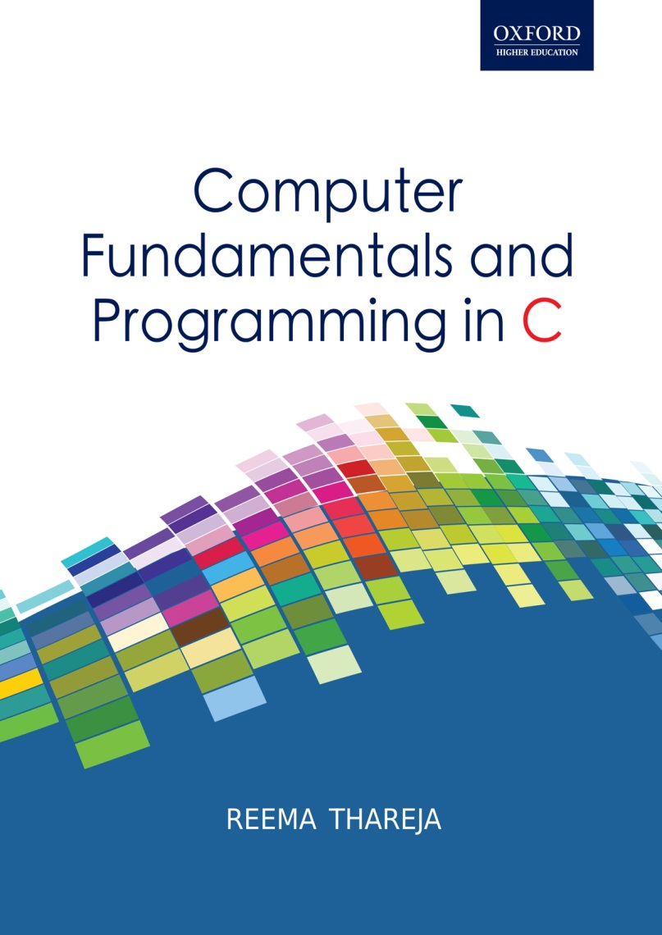
Computer Fundamentals and Programming in C
Reema Thareja, Assistant Professor, Institute of Information Technology and Management

Slide 2
CHAPTER 3
BINARY NUMBER SYSTEM

Slide 3
BINARY NUMBER SYSTEM
Computers are electronic machines which operate using binary logic.
These devices use two different values to represent the two voltage levels (0V for logic 0 and +5V for logic 1). The two values 0 and 1 therefore, correspond to the two digits used by the binary number system.
Some important terms in binary number system include:
Bit: Bit is a short form of binary digit. It is the smallest possible unit of data. In computerized data a bit can either be 0 or 1.
Nibble: Nibble is a group of four binary digits.

Slide 4
Byte: Byte is a group of eight bits. A nibble is a half byte. Bits 0 through 3 are called the low order nibble, and bits 4 through 7 form the high order nibble.
Word: A group of two bytes is called a word. Bits 0 through 7 form the low order byte and bits 8 through 15 form the high order byte. However, computers today have redefined word as a group of 4 bytes (32 bits).
Term | Size (bits) | Example
Bit | 1 | 0
Nibble | 4 | 1010
Byte | 8 | 0101 1100
Word | 16 | 0101 1100 0101 1100

Slide 5
Convert a binary number into a decimal number
With binary number, all the columns are powers of 2.
Note that in the table, all the columns are specified in powers of 2. So in order to convert a binary number into its decimal equivalent, multiply that place holder amount (power of 2) by the digit, and then add them all up.
For example, let us convert 1101 into decimal
Decimal number = 1*2³ + 1*2² + 0*2¹ + 1*2⁰
= 1*8 + 1*4 + 0*2 + 1*1
= 8 + 4 + 0 + 1
= 13
Number of digits- 2 Data values that can be represented = 2² = 4
0 | 00
1 | 01
2 | 10
3 | 11
Number of digits- 3 Data values that can be represented = 2³ = 8
0 | 000
1 | 001
2 | 010
3 | 011
4 | 100
5 | 101
6 | 110
7 | 111
Sixteen’s Column | Eight’s column | Fours column | Twos column | Ones column (LSB)
2⁴ | 2³ | 2² | 2¹ | 2⁰

Slide 6
Convert a Decimal number into a binary number
To convert decimal number into its binary equivalent, simply divide the decimal number by 2 and then write down the remainder, repeat this process until you cannot divide by 2 anymore.
Let us convert decimal 13 or (13)₁₀ into its binary equivalent
2 | 13 | R
2 | 6 | 1
2 | 3 | 0
2 | 1 | 1
2 | 0 | 1
Now write the result starting from the last remainder obtained. Therefore, (13)₁₀ = (1101)₂

Slide 7
Adding two binary numbers
Adding binary numbers is not only simple but also similar to the addition of decimal numbers. While performing binary addition, start by adding the bits (digits) in one column, or place weight, at a time, from right to left as we do in case of adding decimal numbers. However, to perform binary addition you must memorize the rules of addition.
Rules of Binary Addition
0 + 0 = 0
0 + 1 = 1
1 + 0 = 1
1 + 1 = 0, and carry 1 to the next more significant bit
0001010 + 0100100 0101110 | 1010101 + 0101010 1111111 | 11 - CARRY 1011 + 0001 1100 | 11111 1010101 + 0101110 10000011

Slide 8
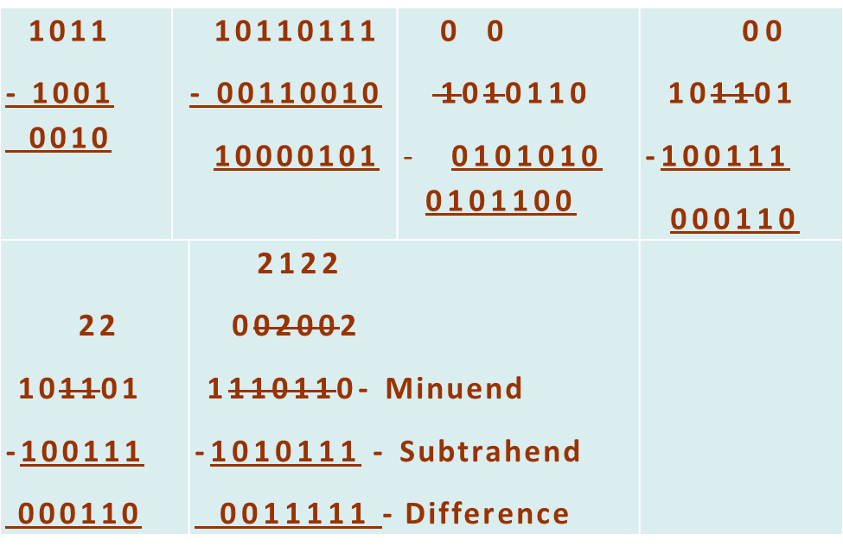
Subtracting Two Binary Numbers
Now that you have learnt to perform addition on two binary numbers, subtraction will also be an easy task to perform. Like binary addition, there are certain rules to be followed for binary subtraction. These rules can be summarized as:
0 - 0 = 0
1 - 0 = 1
1 - 1 = 0
0 - 1 = 1, and borrow 1 from the next more significant bit

Slide 9
SUBTRACTING TWO BINARY NUMBERS USING 2’s COMPLEMENT
STEP 1: Find the two’s complement of the number to be subtracted (subtrahend). Two’s complement is calculated in two steps.
Complement each digit of the number. That is, change 1 for 0 and 0 for 1. The resultant number is said to be in one’s complement form.
Add 1 to the result number in one’s complement form to get the corresponding two’s complement
STEP 2: Add the minuend and subtrahend (which is now in two’s complement form). Take care of the carries in each column and discard any carry bit that extends beyond the number of bit of the original or two's complement.
1011 – 1001
Step 1: Subtrahend = 1001
One’s complement of subtrahend = 0110
Two’s complement of subtrahend = 0110 + 1 = 0111
Step 2: Add minuend and two’s complement of subtrahend
1011
+ 0111
1 0010 Now discard the carry from the last bit, the result = 0010

Slide 10
MULTIPLYING TWO BINARY NUMBERS
Two numbers A and B are multiplied using partial products. For each digit in B, the product of that digit in A is calculated and written on a new line (shifted leftward). The partial products are added together to get the final result.
The rules of multiplications of binary numbers are same as that of decimal numbers, that is
0 x 0 = 0
0 x 1 = 0
1 x 0 = 0
1 x 1 = 1
* 11 = 11110 1010 *11 1010 10100 11110 | 111010 * 101 = 100100010 111010 *101 111010 0000000 11101000 100100010 | 1011 * 1001 = 1100011 1011 *1001 1011 00000 000000 1011000 1100011

Slide 11
Division of Two Binary Numbers
Binary division is again similar to dividing two decimal numbers. According to the long division method, the divisor is multiplied with quotient and the result is then subtracted from the dividend.
0011 11 ) 1001( 0 10 0 100 11 11 11 0 | 011101 10 ) 111011( 0 11 10 11 10 10 10 01 0 11 10 1 | 00101111 101 )11101110( 0 11 0 111 101 100 0 1001 101 1001 101 1001 101 1000 101 11

Slide 12
OCTAL NUMBER SYSTEM
The octal numeral system, is the base-8 number system, and uses the digits 0 to 7. This number system was used extensively in early mainframe computer systems, but has become less popular when compared with binary and hexadecimal number systems.
In order to convert an octal number into its decimal equivalent, multiply that place holder amount (power of 8) by the digit, and then add them all up.
For example, let us convert (123)₈ into decimal
Now, use the above table to form the decimal number.
Decimal number = 1*8² + 2*8¹ + 3*8⁰
= 1*64 + 2*8 + 3*1
= 64 + 16 + 3
= 83

Slide 13
Convert a Decimal Number into an Octal Number
To convert decimal number into its octal equivalent, simply divide the decimal number by 8 and then write down the remainder, repeat this process until you cannot divide by 2 anymore.
Let us convert decimal 786 or (786)₁₀ into its binary equivalent
8 | 786 | R
8 | 98 | 2
8 | 12 | 2
8 | 1 | 4
8 | 0 | 1
Now write the result starting from the last remainder obtained. Therefore, (786)₁₀ = (1422)₈

Slide 14
HEXADECIMALNUMBER SYSTEM
The hexadecimal numeral system is the base-16 number system.
It uses sixteen distinct symbols- the symbols 0–9 to represent values zero to nine, and A, B, C, D, E, F (or a to f) to represent values ten to fifteen.
The main problem with binary numbers is that for larger values, binary numbers quickly become too unwieldy. The hexadecimal (base 16) number system overcomes this problem as hex numbers are very compact.
It is very easy to convert from hex to binary and binary to hexadecimal.
In hexadecimal, just like in the binary, octal and decimal number systems, we start counting in the first column which represents the smallest unit, ones. Then, working from right to left, we move to a 16s column; a 256s column; a 4096s column; a 65,536s column; and so forth.
Dec | 0 | 1 | 2 | 3 | 4 | 5 | 6 | 7 | 8 | 9 | 10 | 11 | 12 | 13 | 14 | 15
Bin | 0000 | 0001 | 0010 | 0011 | 0100 | 0101 | 0110 | 0111 | 1000 | 1001 | 1010 | 1011 | 1100 | 1101 | 1110 | 1111
Hex | 0 | 1 | 2 | 3 | 4 | 5 | 6 | 7 | 8 | 9 | A | B | C | D | E | F

Slide 15
Convert Hexadecimal Number into Binary
Break the binary number into 4-bit groups beginning with the LSB and substitute the corresponding four bits in binary for each hexadecimal digit in the number.
For example, convert OxABCD into its binary equivalent.
(ABCD)₁₆ = (1010 1011 1100 1101)₂
Convert Hexadecimal Number into Binary
To convert a hexadecimal number into binary, first pad the binary number with leading zeroes (if necessary) so that the binary number contains multiples of four bits.
For example, let us convert the binary number 01101110010110 into hexadecimal.
Note that the given binary number contains 14 bits. Pad the number with two zeroes on the left so that the number has 16 bits (multiple of 4 bits).
Now, the binary number = 0001 1011 1001 0110
The next step is to substitute the appropriate hexadecimal digits. The equivalent hex number = 1B96

Slide 16
Convert Hex to Decimal Number
Multiply the value in each position by its hex weight and add each value. For example, let us convert 0x312B into its equivalent decimal value.
Decimal number = 3*16³ + 1*16² + 2*16¹ + B*16⁰
= 3*4096 + 1*256 + 2*16 + B*1
= 12288 + 256 + 32 + 11
= 12587
Converting a Decimal Number to Hexadecimal
Divide the decimal number by 16 and then write down the remainder, repeat this process until you cannot divide by 16 anymore.
Let us convert decimal 1239 into its hex equivalent
16 | 1239 | R
16 | 77 | 7
16 | 4 | D
16 | 0 | 4
Now write the result starting from the last remainder obtained. Therefore, (1239)₁₀ = (4D7)₈

Slide 17
SIGNED NUMBER REPRESENTATION IN BINARY
Signed number representation is required to encode negative numbers in binary number systems. Negative numbers in any base system are written by preceding the number with a – sign. However, in computers, negative numbers are represented in binary only. The binary language which the computer understands does not support the minus sign to write negative numbers.
Sign-and-magnitude
Sign-and-magnitude is the simplest technique in which the MSB is set to 0 for a positive number or zero, and set to 1 for a negative number. The other bits denote the value or the magnitude of the number.

Slide 18
SIGNED NUMBER REPRESENTATION IN BINARY (Contd.)
Ones' complement
The ones'-complement representation of a negative number is obtained by taking the complement of its positive counterpart (in binary).
So, +45 in binary is 0010 1101
Now negate each bit to obtain the binary representation of -45.
Hence, -45 in binary = 1101 0010

Slide 19
Two's complement
In ones'-complement, +0 is represented as 00000000 and -0 is represented as 11111111. In sign-and-magnitude method, -0 is represented as 10000000. These different representations sometimes become problematic.
To avoid such a situation, the two's-complement representation is the one generally used. The two's-complement representation is obtained in two steps:
Complement or negate the bits in binary representation of the positive number
Add 1 to the result of the first step.
In two’s complement -54 can be given as:
Binary representation of 54 is: 0011 0110
Complement each bit: 1100 1001
Add 1 to the above result. Therefore,
1100 1001
+1
1100 1010 (-54 in two’s complement)

Slide 20
BINARY CODED DECIMAL (BCD) CODE
BCD is a technique of encoding decimal numbers in which, each digit is represented by its own binary sequence. The main advantage of using BCD code is that it allows easy conversion to decimal digits for printing or display, and allows faster decimal calculations. For example,
Decimal 7 = 0111 (in BCD)
There are two types of BCD numbers—packed BCD and unpacked BCD.
In Unpacked BCD representation, only one decimal digit is represented per byte. The digit is stored in the lower nibble and the higher nibble is not relevant to the value of the represented number. For example,
Decimal 17 = 0000 0001 0000 0111 (in BCD)
In Packed BCD representation, two decimal digits are stored into a single byte.
Decimal 17 = 0001 0111 (in BCD)
To convert a number from BCD to Decimal, just reverse the process. That is, start with least significant byte and group the binary digits into a group of 4, if it a packed BCD number, otherwise in group of 8 bits

Slide 21
American Standard Code for Information Interchange (ASCII) Codes
It is a 7-bit character code used by personal and workstation computers in US
ASCII digits are unpacked BCD. Values in ASCII codes are represented as its 4-bit binary equivalent stored in the lower nibble, while the upper nibble contains 011 and has no bearing on the value of the represented number. ASCII is the most common format for text files in computers and on the Internet. It can define 128 different characters because it is a 7 bit code, and can support 2⁷ combinations.
Extended Binary Coded Decimal Interchange Code (EBCDIC)
is an 8-bit character encoding technique used on IBM mainframes. EBCDIC supports a wider range of control characters than ASCII because it supports 8-bit character codes which can encode 2⁸ or 256 characters. EBCDIC is easier to use on punched cards. It is still used to allow continued use of software written many years ago. In EBCDIC, the lower nibble contains the 4-bit binary equivalent (as in ASCII), the upper nibble on the other hand is padded with 1111 instead of 011.

Slide 22
Excess-3 (XS3)
In excess-3 coding technique, each decimal digit is the 4-bit binary equivalent with 3 (0011) added.
In excess-3 coding technique, each decimal digit is the 4-bit binary equivalent with 3 (0011) added.
In excess-3 coding technique, each decimal digit is the 4-bit binary equivalent with 3 (0011) added.
In excess-3 coding technique, each decimal digit is the 4-bit binary equivalent with 3 (0011) added.
Weighted binary codes are those in which each position of the number represents a specific weight. For ex, we have 8421, 2421, 5211, and 4221 codes.
In 8421 BCD code, the code is a straight assignment of the binary equivalent. Every position in the BCD is assigned a weight of 8,4,2,1. For ex, the bit assignment in 1010 represent decimal 10 because 1*8 + 0*4 + 1*2 + 0*1 = 10
In 4221 coding, each digit is represented as a 4-bit group and each bit represents 4, 2, 2, and 1 instead of 8, 4, 2 and 1. For ex, 7 in 4241 can be written as, 1101 because 1*4 + 1*2 + 0*2 + 1*1 = 7

Slide 23
In 2421 code, the weights are 2, 4, 2 and 1. And in 5211, the codes are 5, 2, 1 and 1.
The gray code is minimum change code, in which only one bit in the code changes from one code to the next. It is a non-weighted code. Gray code of a number is obtained from its binary code. To derive the Gray code of a number,
Copy the MSB of the binary code as the MSB of the Gray code
Repetitively add MSB and the bit next to the MSB to get the corresponding bit for the Gray code

Slide 24
LOGIC GATES
Boolean expressions can be represented using gates in digital electronics.
AND Gate: The AND gate i accepts two inputs and gives an output. The o/p will be ‘1’ if and only if both the inputs are ‘1’ and a zero otherwise.
OR Gate: The OR gate accepts two inputs and gives an output. The output will be ‘1’ if any of the two is a ‘1’.
NOT Gate: The NOT gate accepts just one input. The output produced by a NOT gate is just the opposite of the input.
NAND Gate: The NAND gate the opposite of the AND gate. It accepts two inputs and returns 1 of any one of the input is a 1 but not both.

Slide 25
LOGIC GATES (Contd.)
NOR Gate: The NOR gate the opposite of the OR gate. The NOR gate accepts two inputs and returns 1 only of both the inputs are low (zero).
XOR Gate: The X in the XOR gate stands for "exclusive." This means that the output from this gate will be a 1 if only one of the inputs is a 1 and not both.
XNOR Gate: The XNOR gate is the opposite of the XOR gate. It accepts two inputs and returns 1 only if both the inputs are same and a 0 otherwise.

