Slide 1
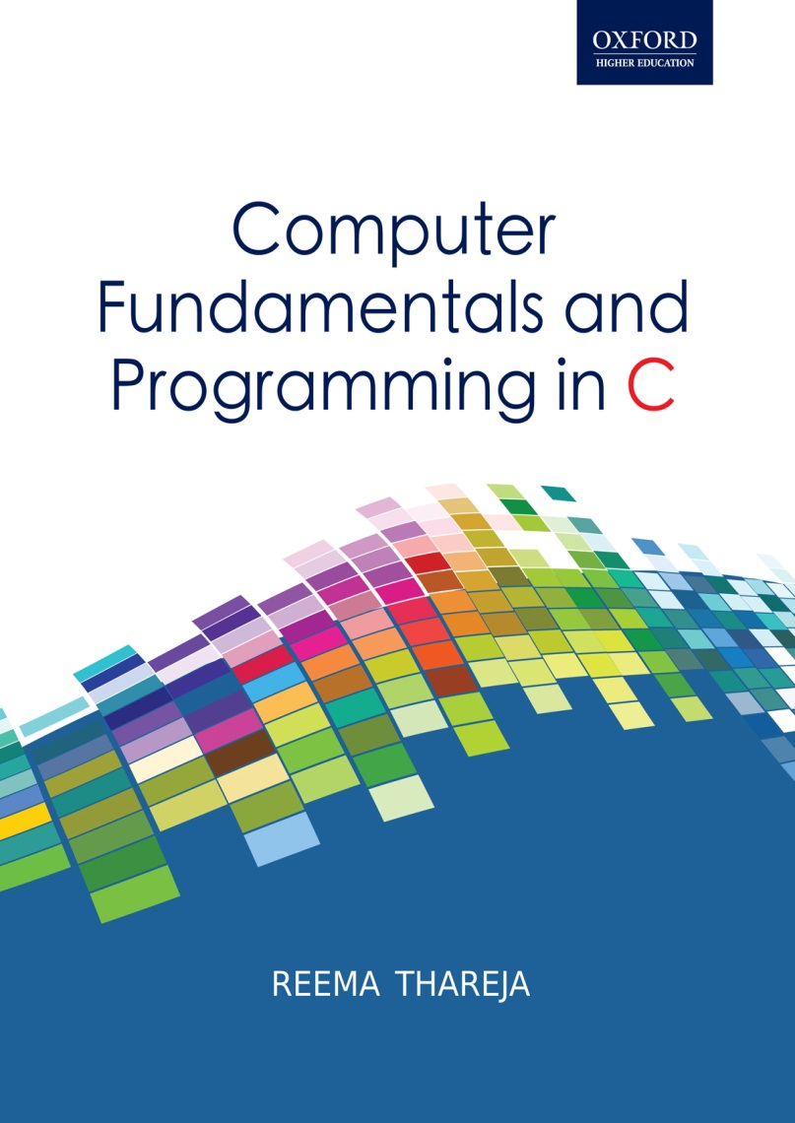
Computer Fundamentals and Programming in C
Reema Thareja, Assistant Professor, Institute of Information Technology and Management

Slide 2
CHAPTER 4
COMPUTER MEMORY

Slide 3
INTRODUCTION
Computer memory is an internal storage area used to store data and programs
It can be divided into two groups: primary memory and secondary memory.
While the main memory holds instructions and data when a program is executing, the auxiliary or the secondary memory holds data and programs not currently in use and provides long-term storage.
The primary memory is volatile, so the data can be retained in it, only when the power is on. Moreover, it is very expensive and therefore limited in capacity.

Slide 4
INTRODUCTION (Contd.)
On the contrary, the secondary memory stores data or instructions permanently, even when the power is turned off. It is cheap and can store large volumes of data. Moreover, data stored in auxiliary memory is highly portable, as the users can easily move it from one computer to the other.
The only drawback of secondary memory is that data can be accessed from it at a very slow speed as and when compared with the data access speed of primary memory.

Slide 5
MEMORY HIERARCHY
In contemporary usage, memory usually refers to random-access memory, typically DRAM (Dynamic-RAM) but memory can also refer to other forms of data storage.
In computer’s terminology, the term storage refers to storage devices that are not directly accessible by the CPU (secondary or tertiary storage).
Examples of secondary storage include hard disk drives, optical disc drives, and other devices that are slower than RAM but are used to store data permanently.
These days, computers use different types of memory which can be organized in a hierarchy around the CPU, as a trade-off between performance and cost.
The memory at a higher level in the storage hierarchy has less capacity to store data, is more expensive and is fastest to access.
CPU Registers
Level 1 Cache
Level 2 Cache
Level 3 Cache
Primary Memory
Hard Disk
Optical Disk
Magnetic Tape

Slide 6
PROCESSOR REGISTERS
Processor registers are located inside the processor and are therefore directly accessed by the CPU. Each register stores a word of data (which is either 32 or 64 bits). CPU instructions instruct the arithmetic and logic unit to perform various calculations or other operations on this data. Registers are the fastest of all forms of computer data storage.
CACHE MEMORY
Cache memory is an intermediate form of storage between ultra-fast registers and the RAM. The CPU uses cache memory to store instructions and data that are repeatedly required to execute programs thereby improving the overall system speed and increase the performance of the computer.
Cache memory is basically a portion of memory made of high-speed static RAM (SRAM) instead of the slower and cheaper dynamic RAM (DRAM) which is used for main memory.

Slide 7
TYPES OF RAMS
SRAM (Static RAM) and DRAM (Dynamic RAM): This is a type of RAM that holds data without an external refresh as long as it is powered. This is in striking contrast with the DRAM which must be refreshed multiple times in a second to hold its data contents.
SRAM is made of D flip flops in which the memory cells flip-flop between 0 and 1 without the use of capacitors. Therefore, there is need for an external refresh process to be carried out.
SRAM occupies more space and is expensive as compared to DRAM. While each transistor on a DRAM chip can store one bit of information, the SRAM chip, on the other hand requires four to six transistors to store a bit.
However, SRAM is faster and more reliable than DRAM. SRAM is often used as cache memory. Static RAM chips are also used in cars, household appliances and handheld electronic devices.

Slide 8
READ ONLY MEMORY (ROM)
ROM refers to computer memory chips containing permanent or semi-permanent data. Unlike RAM, ROM is non-volatile.
Most computers contain a small amount of ROM that stores critical programs such as BIOS which is used to boot the computer when it is turned on.
Rewritable ROM chips include PROMs, EPROMs and EEPROMs.
Programmable read-only memory (PROM) can be written to or programmed using a special device called a PROM programmer. The PROM programmer uses high voltages to permanently destroy or create internal links within the chip. The working of a PROM is similar to that of CD-ROM recorder which enables the users to "burn" programs onto blanks once.

Slide 9
READ ONLY MEMORY (ROM) contd.
Erasable programmable read-only memory (EPROM) can be erased and re-programmed by exposing the chip to strong ultraviolet light for 10 minutes or longer and then rewritten with a process that again needs higher than usual voltage applied. The EPROM is much more useful than PROM and can be compared with a reusable CD-RW.
Electrically erasable programmable read-only memory (EEPROM) is based on a similar semiconductor structure to EPROM, but allows its entire or selected contents to be electrically erased, then rewritten electrically, so that they need not be removed from the computer (or camera, MP3 player, etc.). The process of writing an EEPROM is also known as flashing.

Slide 10
READ ONLY MEMORY (ROM) contd.
The flash memory is also a type of EEPROM in which the contents can be erased under software control. This is the most flexible type of ROM, and is widely used to store BIOS programs. It is primarily used in memory cards, USB flash drives, MP3 players, PDAs (personal digital assistants), laptop computers, digital audio players, digital cameras, and mobile phones. The EEPROM blurs the difference between what "read-only" really means. However, the EEPROM is rewritten only once a year or so, compared to real read-write memory (RAM) where rewriting is done often many times per second.

Slide 11
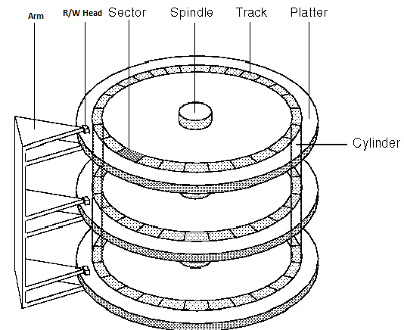
HARD DISK
A hard disk is a set of disks stacked together like phonograph records, that has data recorded electromagnetically in concentric circles also known as tracks.
A single hard disk includes several platters (or disks) that are covered with a magnetic recording medium.
Each platter requires two read/write heads, one for each side.
Data is actually stored on the surface of a platter in sectors and tracks. While tracks are concentric circles, sectors on the other hand are pie-shaped wedges on a track.

Slide 12
HARD DISK (Contd.)
A track is divided into a number of segments (also called sectors) that can store a fixed number of bytes- for example, 256 or 512.
The performance of a hard disk depends on its access time where access time is the time required to read or write on the disk. Access time is actually a combination of three components:
Seek time
Rotational delay
Transfer time

Slide 13
HARD DISK contd.
Seek time: The time taken to position the R/W head over the appropriate cylinder (usually around 8 msec on average). Seek time varies depending on the position of the access arm when the R/W command is received. Seek time will be maximum when the access arm is positioned over the innermost track while the data that has to be accessed is stored on the outermost track. Similarly, seek time will be zero if the access arm is already positioned over the desired track. On an average, the seek time varies from 10-100 milli-seconds.
Rotational delay: The time taken to bring the target sector to rotate under the R/W head. Assuming that the hard disk has 7,200 rotations per minute, or 120 rotations per second, a single rotation is done in approximately 8 msec. The average rotational delay is around 4 msec.

Slide 14
HARD DISK (contd.)
Transfer time: The time to transfer data or the time taken to read/write to a disk is called transfer rate.
Thus, the overall time required to access data = seek time + rotational delay + transfer time.
To access data from the hard disk, a disk address has to be specified. The disk address consist of Sector number, Track number and Surface number (when data is recorded on both the sides of the disk)
Storage capacity of a disk with multiple recording surfaces can be calculated as:
Storage capacity = no. of recording surfaces * no. of tracks per surface * no. of sectors per track * no. of bytes per sector

Slide 15
HARD DISK (contd.)
Advantages:
Enable random access of data
Can be often used as a shared device in a multi-user environment
Preferred both for online and offline storage of data
Can store large amounts of data
The cost of data storage is very low.
Disadvantages:
Must be stored in a dust free environment
Magnetic disks are larger in size and heavy in weight

Slide 16
OPTICAL DRIVE
Optical storage refers to storing data on an optically readable medium by making marks in a pattern that can be read using a beam of laser light precisely focused on a spinning disc.
An optical storage media consists of a flat, round, portable metal disc, which is usually 0.75 inches in diameter and less than one-twentieth of an inch thick.
The disc is coated with a thin metal or plastic or other material that is highly reflective.

Slide 17
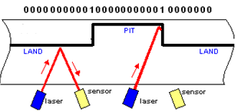
The optical disk stores information in the form of pits and lands. The pits are the tiny reflective bumps created with laser beam and lands are flat areas separating the pits. While a land reflects the laser light and is read as binary digit 1, a pit on the other hand absorbs the light and is read as binary digit 0.
Like magnetic disk, the optical disk also has tracks which are divided into sectors but shape of these sectors is different than that of magnetic disk.

Slide 18
Compact Disc Read-Only-Memory (CD-ROM)
It is a type of optical disc that uses laser technology to read and write data on the disc. The information stored on CDROM becomes permanent and cannot be altered. This means that the stored information can only be read for processing.
Digital Video Disk or Digital Versatile Disc (DVD-ROM)
It is an extremely high capacity optical disc with storage capacity from 4.7 GB to 17 GB. DVDs are widely used to store large databases, movies, music, complex software etc.
Most of the DVD-ROMs are double sided discs as they can store data on both the sides of the disc.

Slide 19
DVDROMs have a multi-layer storage technique and smaller sized pits and tracks. When data is recorded on a DVD, the laser starts on the inside of the disk and moves outward. The laser beam has a smaller wavelength and can be focused on two different layers on the disk.
Compact Disc Rewritable (CD-RW) is an erasable optical disk. The user can write and over-write data on the CD-RW disc multiple times.

Slide 20
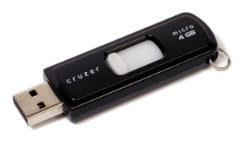
USB FLASH DRIVES
USB flash drives are removable, rewritable, and physically much smaller drives weighing even less than 30 g.
A flash drive consists of a small printed circuit board carrying the circuit elements and a USB connector, insulated electrically and protected inside a plastic, metal, or rubberized case which can be carried in a pocket or on a key chain.
Advantages
Data stored on flash drives is impervious to scratches and dust
Mechanically very robust
Easily portable
Have higher data capacity than any other removable media.
Compared to hard drives, flash drives use little power
Flash drives are small and light-weight devices
Flash drives can be used without installing device drivers.

Slide 21
FLASH DRIVES contd.
Disadvantages
Can sustain only a limited number of write and erase cycles before the drive fails.
Most flash drives do not have a write-protect mechanism
Flash drives are very small devices that can easily be misplaced, left behind, or otherwise lost.
The cost per unit of storage in a flash drive is higher than that of hard disks
Uses of flash drives
Personal data transport
System administration
Booting operating systems
Music storage and marketing
Brand and product promotion
Backup

Slide 22
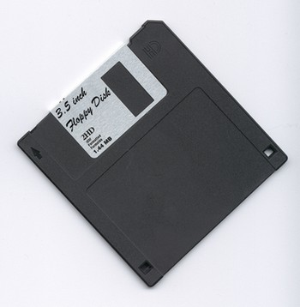
FLOPPY DISK
Floppy disks are data storage devices that consist of a thin magnetic storage medium encased in a square plastic shell lined with fabric.
The mechanism of a floppy disk has two motors. One motor in the drive rotates the diskette at a regulated speed, the second motor moves the magnetic RW head,
along the surface of the disk. To read/write data on the disk media, there must be a physical contact between the read–write head and the disk media.

Slide 23
Reading/Writing data on the disk
To write data on the floppy disk, current is passed through a coil in the head. The magnetic field of the coil magnetizes spots on the disk as it rotates. The change in magnetization encodes the digital data.
Similarly, to read data from the floppy disk, a small amount of current is induced in the head coil to detect the magnetization on the disk. The floppy drive controller separates the data from the stream of pulses coming from the floppy drive, decodes the data, tests for errors, and sends the data on to the host computer system.

Slide 24
MAGNETIC TAPE
Magnetic tape is a thin strip of plastic coated with magnetic recording material. These storage devices are used as sequential access secondary storage device.
Storage capacity of magnetic tape = data recording density * length of the tape
Data is recorded in the form of tiny non-magnetized and magnetized spots, where the presence of a spot represents 1 and its absence represents 0. This means that data is stored in the form of zeroes and ones.

Slide 25
Advantages of Magnetic Tape:
Compact in size, light in weight and can store large amounts of data.
Easily portable
Economical
Consume less power
Can be used for long term data storage and retrieval
Disadvantages of Magnetic Tape:
Data stored on the tape can be accessed only sequentially
Data on a tape is accessed at a very slow speed
A special hw is required to read the data stored on tapes
Susceptible to degradation due to heat, humidity, dust, mishandling, electromagnetic surfaces and ordinary wear

Slide 26
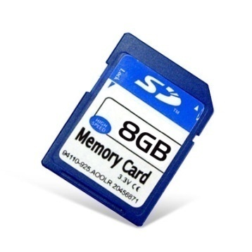
MEMORY CARD
A small device that can store a wide range of files. They are easily portable from one place to another
It implements flash memory to add/delete files multiple times.
Most of these cards have constantly powered nonvolatile memory
Memory cards have no moving parts therefore they are unlikely to suffer from mechanical difficulties.
Since newer memory cards are smaller, require less power, have higher storage capacity, are completely silent, less prone to mechanical failures, allow immediate access to data and are portable among a greater number of devices, they are being widely used in the production of an increasing number of small, lightweight and low-power devices.
Although memory cards are far better than hard disks, they still could not replace them because a memory card is quite expensive.

